Slide 1
Interim Eligibility Guidance:
Life Sciences Example
Workshop I
Notes:
Instructor Note:
For this workshop the Examiner will be provided with:
Workshop Handout that includes:
Examples 29 and 30 (background and pertinent claims),
A link to blank Worksheets, and
A link to the July 2015 Quick Reference Sheet (QRS);
PDF document of the Slides
The Instructor will have available completed Worksheets for each claim, including a sample rejection where appropriate.
Examiners are encouraged to fill out the worksheets for each claim as they progress through the training.
During Webex presentations the examiners should each open the slide set and follow the links to the necessary documents.
Prior to taking the workshop, examiners should be familiar with the July 2015 Update and the published examples, especially Life Sciences examples 29 and 30. As a prerequisite, training should have been completed on the 2014 Interim Guidance on Patent Subject Matter Eligibility, along with the Spring 2015 training entitled “Analyzing Nature-Based Products”. Refresher training is also available on 35 U.S.C. 101: Statutory Requirements and Four Categories of Invention (Step 1). All training is available at: http://www.uspto.gov/patent/laws-and-regulations/examination-policy/examination-guidance-and-training-materials

Slide 2
Overview
This workshop training will demonstrate the application of several key aspects of the Interim Eligibility Guidance including:
  Understanding how the broadest reasonable interpretation affects the eligibility analysis
  Identifying judicial exceptions in Step 2A:
    Abstract ideas and their identification by correspondence to court-identified exceptions
    Products of nature exceptions and the markedly different characteristics analysis
  Evaluating additional elements in Step 2B, particularly in combination
  How to write a rejection that satisfies your burden to make a prima facie case of ineligibility
Notes:
<Examiners should have the July 2015 Quick Reference Sheet (QRS) and blank copies of the Subject Matter Eligibility Worksheets at hand during this training session. Examiners are encouraged to fill out the worksheets for each claim as they progress through the training.>

Slide 3
Examples
In this workshop, you will analyze examples that are taken from the Life Sciences Examples issued in May 2016:
  Example 29: Diagnosing and Treating Julitis
  Example 30: Dietary Sweeteners
Each example should be analyzed under the 2014 Interim Guidance on Patent Subject Matter Eligibility (IEG) and the July 2015 Update
As the examples are intended to be illustrative only, they should be interpreted based on the fact patterns set forth in the workshop materials. Other fact patterns may have different eligibility outcomes.
Notes:
<Examiners should have the July 2015 Quick Reference Sheet (QRS) and blank copies of the generic Subject Matter Eligibility Worksheets at hand during this training session. Examiners are encouraged to fill out the worksheets for each claim as they progress through the training.>
Some workgroups will also analyze Example 28: Vaccines, but that will be done via worksheets and group discussion. The slides will only track Examples 29 and 30.

Slide 4
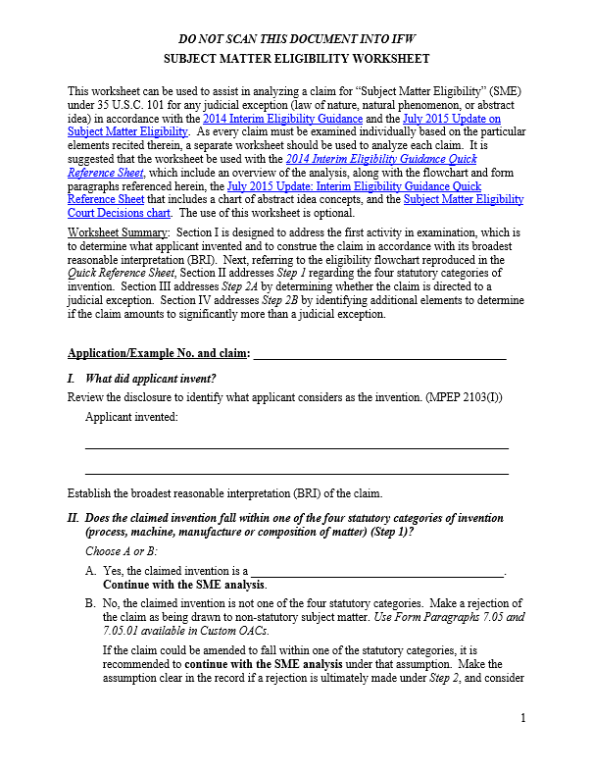
Worksheets
Each example will step through the analysis using a worksheet and the same set of questions:
  What did applicant invent?
  Does the claimed invention fall within a statutory category (Step 1)?
  Is the claim directed to a judicial exception (Step 2A)?
  Does the claim as a whole amount to significantly more than the exception (Step 2B)?
Notes:
<Examiners should have the July 2015 Quick Reference Sheet (QRS) and blank copies of the Subject Matter Eligibility Worksheets at hand during this training session. Examiners are encouraged to fill out the worksheets for each claim as they progress through the training.>

Slide 5
Life Sciences Example 29:
Diagnosing & Treating Julitis
The following slides address three claims from Example 29:
  Claim 2 (original)
  Claim 3 (an amended version of claim 2)
  Claim 6 (a different amended version of claim 2)
Examiners should use the “generic” worksheet with this example
Go to page __ of the Workshop Handout for Example 29 to evaluate claim 2
Notes:
Instructor Notes:
Provide a handout for the selected example that includes an abbreviated specification and a set of claims. Participants should take time now to read through the background and claims for Example 29.
Links are provided in the Handout to a blank worksheet and the QRS.
Proceed through slides [*Insert slide #s], pausing on the question slides to get feedback from the examiners and then proceed to the answer slides.

Slide 6

Background of Example 29
“Julitis” is an autoimmune disease that causes chronic inflammation and an itchy and extremely painful rash on the face, hands, and feet.
Conventionally, julitis is diagnosed by a physical examination of the characteristic rash. However, because the rash caused by julitis looks similar to rashes caused by rosacea, doctors often misdiagnosed people as having rosacea when they actually had julitis.
Notes:
The next few slides provide an overview of the invention.

Slide 7
Background (cont.)
Applicant discovered that the presence of the “JUL-1” protein in a person’s plasma is indicative that the person has julitis.
Applicant discloses detecting JUL-1 in plasma by routine and conventional methods, such as immunoassays in which a plasma sample is contacted with an antibody, and then binding between the antibody and the protein is detected using a laboratory technique such as fluoroscopy.
Applicant’s immunoassays use human or porcine anti-JUL-1 antibodies. Prior to applicant’s invention, and at the time the application was filed, the use of porcine antibodies in veterinary therapeutics was known to most scientists in the field, but these antibodies were not routinely or conventionally used to detect human proteins such as JUL-1.

Slide 8
Background (cont.)
Prior to applicant’s invention, and at the time the application was filed, julitis was conventionally treated with anti-tumor necrosis factor (TNF) antibodies. When julitis patients were misdiagnosed as having rosacea, however, the patients would be given rosacea treatments such as antibiotics. These rosacea treatments were not effective to treat julitis.
Applicant’s diagnostic methods have improved patient outcomes, by ensuring that patients who have julitis will be accurately diagnosed (due to the detection of JUL-1 in their plasma), and then properly treated with anti-TNF antibodies, as opposed to being misdiagnosed as having rosacea as was previously commonplace.

Slide 9
Claim 2
2. A method of diagnosing julitis in a patient, said method comprising:
obtaining a plasma sample from a human patient;
detecting whether JUL-1 is present in the plasma sample by contacting the plasma sample with an anti-JUL-1 antibody and detecting binding between JUL-1 and the antibody; and
diagnosing the patient with julitis when the presence of JUL-1 in the plasma sample is detected.

Slide 10
Worksheet Section I:
What Has Applicant Invented?
Before analyzing for eligibility or any other patentability requirement:
  Review the detailed disclosure and specific embodiments to understand what the applicant has invented
  Determine the broadest reasonable interpretation (BRI) of the claims
    Identify the boundaries of protection sought by applicant
    Understand how the claims relate to and define what applicant has indicated as the invention
    Examiners should fill out Section I of the blank worksheet
Notes:
Before analyzing claims for patent eligibility or any other patentability requirement, USPTO personnel must review the detailed disclosure and specific embodiments to understand what the applicant has invented. USPTO personnel are to give claims their broadest reasonable interpretation in light of the supporting disclosure. The goal of performing this claim analysis is to identify the boundaries of protection sought by applicant and to understand how the claims relate to and define what applicant has indicated as the invention. MPEP 2103 provides additional information on determining what applicant has invented and is seeking to patent.
<Examiner should fill out Section I entitled “What did applicant invent?” of the blank worksheet.>

Slide 11
Applicant’s Invention
Applicant invented a method of diagnosing julitis, that uses anti-JUL-1 antibodies in an immunoassay to detect JUL-1 protein in a plasma sample from a human patient. The antibodies can be human or porcine.
The method is based on applicant’s discovery that the presence of JUL-1 protein in a person’s plasma is indicative that the person has julitis.

Slide 12
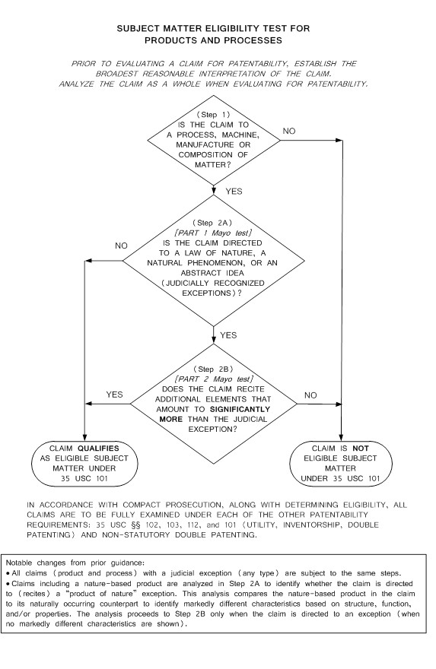
Worksheet Section II:
Does The Claimed Invention Fall Within
A Statutory Category (Step 1)?
Claimed inventions that do not fall within the statutory categories are not eligible for patenting
Identification of one particular category is not necessary for eligibility
A claim may satisfy the requirements of more than one category
Notes:
Step 1 of the analysis asks “Is the claim directed to a process, machine, manufacture, or composition of matter”, i.e., to one of the four patent-eligible subject matter categories. This step of the analysis is discussed in MPEP 2106(I).
Under the 2014 Interim Eligibility Guidance, the claim must fall within at least one of the categories to be eligible. To be eligible, a claim may satisfy the requirements of more than one category. For example, a claim to a bicycle may satisfy both machine and manufacture categories. Precise identification of a category is not necessary for eligibility. Claims outside the four categories must be treated under 101 as being drawn to subject matter not within one of the four categories of invention.

Slide 13

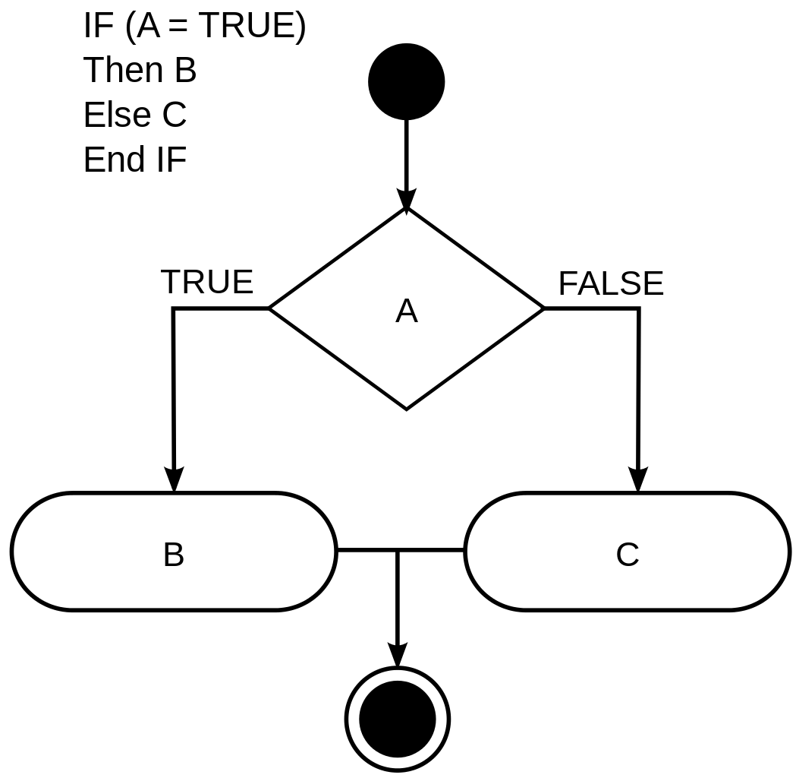


The Statutory Categories
Process Machine Manufacture Composition of Matter
    Examiners should fill out Section II of the blank worksheet
Notes:
<Examiner should fill out Section II entitled “Does the claimed invention fall within one of the four statutory categories of invention?” of the blank worksheet.>
<Pause for audience consideration and feedback, then advance slide>

Slide 14
The Claimed Invention Falls Within
A Statutory Category (Step 1: YES)
The claim recites a series of steps or acts, including detecting the presence of JUL-1 in a plasma sample. Thus, the claim is directed to a process, which is one of the statutory categories of invention.
Notes:
<Pause for audience consideration and feedback, then advance slide>

Slide 15
Worksheet Section III:
Is The Claim Directed To
A Judicial Exception (Step 2A)?
“Directed to” means the exception is recited in the claim, i.e., the claim sets forth or describes the exception
Process claims are not directed to products recited therein, except in limited situations (e.g., providing a pomelo fruit)
Notes:
Step 2A of the analysis determines whether the claim is directed to a judicial exception, i.e., a law of nature, natural phenomenon, or abstract idea. For a discussion of the judicial exceptions, which are commonly called “laws of nature, natural phenomena, and abstract ideas,” see MPEP 2106(II). This step is also known as Part 1 of the Mayo test.
A claim is directed to a judicial exception when a law of nature, a natural phenomenon, or an abstract idea is recited in the claim. A judicial exception is recited when the claim sets forth or describes the exception. Under the 2014 Interim Eligibility Guidance, if the claimed invention is merely based on or involves a judicial exception, but the exception is not set forth or described in the claim, the claim is not directed to an exception and is eligible.
Note that process claims are not “directed to” a product of nature simply because one is recited therein, except in the limited situation where a process claim is drafted in such a way that there is no difference in substance from a product claim. For example, “a method of providing an apple”, which under the broadest reasonable interpretation is focused on the apple fruit itself, which is a product of nature. Other nuances of the Step 2A analysis with respect to products of nature are discussed below with respect to Example 30, and were also explained in the Spring 2015 training entitled “Analyzing Nature-Based Products”.

Slide 16
Examples of Laws of Nature & Natural Phenomena
The chemical principle underlying the union between fatty elements and water – Tilghman
Electromagnetism to transmit signals – Morse
A correlation that is the consequence of natural processes, e.g., how a certain compound is metabolized by the body – Mayo
An isolated DNA – Myriad
A sheep that “does not possess markedly different characteristics from any farm animals found in nature” – Roslin
Primers having naturally occurring genetic sequence – Ambry Genetics
Notes:
<Pause for audience consideration and feedback, then advance slide>

Slide 17
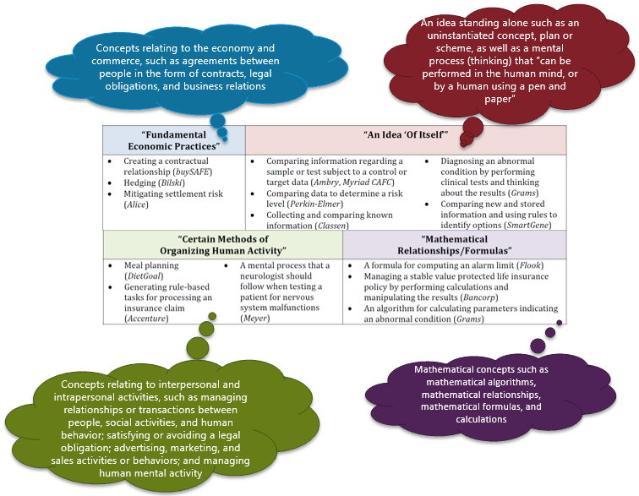
Abstract Ideas
An abstract idea can be identified by comparison to similar concepts found abstract by the courts.
The July 2015 Update Quick Reference Sheet (page 2) contains a categorized list of some court-identified abstract ideas.
Notes:
<Pause for audience consideration and feedback, then advance slide>

Slide 18
Which Limitation Is A Judicial Exception?
2. A method of diagnosing julitis in a patient, said method comprising:
obtaining a plasma sample from a human patient;
detecting whether JUL-1 is present in the plasma sample by contacting the plasma sample with an anti-JUL-1 antibody and detecting binding between JUL-1 and the antibody; and
diagnosing the patient with julitis when the presence of JUL-1 in the plasma sample is detected.
Examiners should fill out Section III of the blank worksheet
by indicating which limitation of the claim
sets forth or describes a judicial exception
Notes:
Determine if the claim is directed to an exception. Do any of the claim limitations set forth or describe a judicial exception?
<Pause for audience consideration and feedback, then advance slide>

Slide 19
Step (c) Recites A Judicial Exception…But Why?
Court-Identified Exceptions
A correlation that is the consequence of natural processes, e.g., how a certain compound is metabolized by the body (Mayo)
Mental processes or basic critical thinking that can be performed in the human mind, such as:
  comparing information regarding a sample or test subject to a control or target data (Ambry)
  diagnosing an abnormal condition by performing clinical tests and thinking about the results (Grams)
2. A method of diagnosing julitis in a patient, said method comprising:
obtaining a plasma sample from a human patient;
detecting whether JUL-1 is present in the plasma sample by contacting the plasma sample with an anti-JUL-1 antibody and detecting binding between JUL-1 and the antibody; and
diagnosing the patient with julitis when the presence of JUL-1 in the plasma sample is detected.
Examiners should fill out Section III of the blank worksheet
by indicating the reasons why step (c) is considered a judicial exception
Notes:
Why does step (c) recite a judicial exception? What type of exception is it? The box on the right lists some concepts the courts have identified as laws of nature or abstract ideas. Other concepts not listed here can be found in the Update materials. Does step (c) set forth or describe a law of nature, or any idea similar to an idea previously identified by a court as an abstract idea?
<Pause for audience consideration and feedback, then advance slide>

Slide 20
The Claim Is Directed To A
Judicial Exception (Step 2A: YES)
Step c recites diagnosing the patient with julitis when the presence of JUL-1 in the plasma sample is detected, which describes a naturally occurring correlation or relationship between the presence of JUL-1 in a patient’s plasma and the presence of julitis in the patient.
This type of correlation is a judicial exception, which may be termed a law of nature, an abstract idea, or both:
  The correlation is a consequence of natural processes, similar to the naturally occurring correlation found to be a law of nature by the Supreme Court in Mayo.
  The diagnosing of step c could be performed by a human using mental steps or basic critical thinking, which are types of activities that have been found by the courts to represent abstract ideas (e.g., the mental comparison in Ambry Genetics, or the diagnosing an abnormal condition by performing clinical tests and thinking about the results in Grams).
Notes:
Note that although the claim recites several nature-based product limitations (e.g., the plasma sample and JUL-1), the claim as a whole is focused on a process of detecting whether JUL-1 is present in a plasma sample, and is not focused on the products per se. Thus, there is no need to perform the markedly different characteristics analysis on the recited nature-based product limitations.
<Pause for audience consideration and feedback, then advance slide>

Slide 21
Worksheet Section IV:
Does The Claim As A Whole Amount To Significantly More Than The Exception (Step 2B)?
Claim is analyzed as a whole
Consider the additional elements claimed with the exception, both individually and as a combination, to ensure that the claim describes a product or process that applies the exception in a meaningful way
Notes:
Step 2B of the flowchart, which is also known as Part 2 of the Mayo test, is to determine whether any element, or combination of elements, in the claim is sufficient to ensure that the claim amounts to significantly more than the judicial exception. It is important to analyze each claim as a whole. USPTO personnel should consider the additional elements claimed with the exception, both individually and as a combination, to ensure that the claim describes a product or process that applies the exception in a meaningful way.

Slide 22
Significantly More Considerations
Considerations that assist in determining whether additional elements provide significantly more than a judicial exception:
May provide “significantly more”
Improvements to another technology or technical field
Improvements to the functioning of the computer itself
Applying the judicial exception with, or by use of, a particular machine
Effecting a transformation or reduction of a particular article to a different state or thing
Adding a specific limitation other than what is well-understood, routine and conventional in the field
Adding unconventional steps that confine the claim to a particular useful application
Other meaningful limitations beyond generally linking the use of the judicial exception to a particular technological environment
May not provide
  Generic computer performing generic computer function
  Words equivalent to “apply the exception”
  Mere instructions to implement a judicial exception on a computer
  Insignificant extra-solution activity, such as mere data gathering
  Generally linking the use of the judicial exception to a particular technological environment or field of use
  Merely appending well understood, routine, conventional activities previously known to the industry, specified at a high level of generality

Slide 23
Identify The Additional Elements
2. A method of diagnosing julitis in a patient, said method comprising:
obtaining a plasma sample from a human patient;
detecting whether JUL-1 is present in the plasma sample by contacting the plasma sample with an anti-JUL-1 antibody and detecting binding between JUL-1 and the antibody; and
diagnosing the patient with julitis when the presence of JUL-1 in the plasma sample is detected.
Examiners should fill out Section IV.A of the blank worksheet
by identifying any additional elements (features/limitations/steps)
recited in the claim beyond the exception
Notes:
Determine if the claim recites any additional elements beyond the exception.
<Examiner should fill out Section IV.A entitled “Are there any additional elements recited in the claim beyond the abstract idea identified above?” of the blank worksheet.>
<Pause for audience consideration and feedback, then advance slide>

Slide 24
The Claim Recites Additional Elements
There are two additional elements besides the law of nature:
  Obtaining a plasma sample from a human patient (step a)
  Detecting whether JUL-1 is present in the plasma sample by contacting the plasma sample with an anti-JUL-1 antibody and detecting resultant binding between JUL-1 and the antibody (step b)
Notes:
<Pause for audience consideration and feedback, then advance slide>

Slide 25
Do The Additional Elements Amount To Significantly More?
It is vital that the additional elements be considered both individually and as a combination when determining whether the claim as a whole recites eligible subject matter
When evaluating whether an element represents well-understood, routine, conventional activity previously engaged in by those in the field, keep the following points in mind:
  Finding the element in the prior art does not necessarily show that it is well-understood, routine or conventional
  Such an element must have been widely prevalent in the field at the time the invention was made and the application was filed
Examiners should fill out Section IV.B of the blank worksheet
Notes:
It is vital that the additional elements be considered both individually and as a combination when determining whether the claim as a whole recites eligible subject matter. As the Supreme Court has made clear, for example in Diamond v. Diehr, even if an element does not amount to significantly more on its own, it can still amount to significantly more when considered in combination with the other elements of the claim.

Slide 26
The Additional Elements Individually
Step a: obtaining a sample in order to perform tests is well-understood, routine, conventional activity previously engaged in by scientists in the field of diagnostics, and this step is recited at a high level of generality such that it amounts to insignificant presolution activity, e.g., obtaining samples is a necessary precursor to gather data for using the correlation.
Step b: detecting whether JUL-1 is present in the plasma sample merely instructs a scientist to use any detection technique with any generic anti-JUL-1 antibody. When recited at this high level of generality, there is no meaningful limitation in this step that distinguishes it from well-understood, routine, conventional data gathering activity previously engaged in by scientists in the field prior to applicant’s invention, and at the time the application was filed.
Notes:
<Pause for audience consideration and feedback, then advance slide>

Slide 27
The Additional Elements In Combination
Consideration of the additional elements as a combination adds no other meaningful limitations not already present when the elements are considered separately.
Unlike the eligible claim in Diehr in which the elements limiting the exception are individually conventional, but taken together act in concert to improve a technical field, the claim here does not invoke any of the considerations that courts have identified as providing significantly more than an exception. Even when viewed as a combination, the additional elements fail to transform the exception into a patent-eligible application of that exception.
Notes:
<Pause for audience consideration and feedback, then advance slide>

Slide 28
What Should The Rejection Include?
Prima facie case of ineligibility requires clear articulation of the reason(s) why the claimed invention is not eligible:
  Identify judicial exception, and explain why it is an exception
  Identify additional elements (if any), and explain why they do not amount to significantly more
Sample rejections satisfying this burden are in prior training:
  Phase I Training slides 37 (Mayo claim 1) and 41-42 (Alice Corp. claim 26)
  Abstract Idea Workshop Materials: worksheets for examples 5-8, 21 and 23 (posted on the web)
Examiners should fill out the rejection portion of the blank worksheet
Notes:
<Examiner should fill out the sample rejection portion of the blank worksheet>

Slide 29
Sample Rejection Summary
A rejection of claim 2 should identify step c as an exception by pointing to it in the claim and explaining why it is an exception, e.g., that the recited correlation is a law of nature because it is a consequence of a natural process in the body, and/or that the critical thinking step is an abstract idea similar to those found by the courts to be an exception.
The rejection should also identify the additional elements in the claim and explain why they do not amount to significantly more, in this case, because they merely add data gathering and well-understood, routine and conventional activities that do not impose meaningful limits on the law of nature.
Notes:
<Pause for audience consideration and feedback, then advance slide>

Slide 30
Can The Claim Be Amended To Achieve Eligibility?
Are there elements in the disclosure that could be added to the claim that may amount to significantly more (i.e., provide an inventive concept) and make it eligible?
To answer this question, it will be helpful to review the background of the example while keeping the significantly more considerations in mind
Examiners should fill out the suggestion portion of the blank worksheet
Notes:
<Examiner should fill out the suggestion portion of the blank worksheet, which is located just above the rejection portion on the last page>

Slide 31
Claim Amendments
The following slides walk through two different ways in which claim 2 could be amended in response to the rejection under § 101
  For purposes of consistency, the following claims are numbered the same as in the published examples
  Differences in language between the following claims and rejected claim 2 are shown as if the claims had been amended
Examiners should use a new “generic” worksheet with each claim
Notes:
Proceed through slides [*Insert slide #s], pausing on the question slides to get feedback from the examiners and then proceed to the answer slides.

Slide 32
Claim 3
3. A method of diagnosing julitis in a patient, said method comprising:
obtaining a plasma sample from a human patient;
detecting whether JUL-1 is present in the plasma sample by contacting the plasma sample with [[an]] a porcine anti-JUL-1 antibody and detecting binding between JUL-1 and the porcine antibody; and
diagnosing the patient with julitis when the presence of JUL-1 in the plasma sample is detected.
Note: Claim 3 is marked-up as if it were an
amended version of claim 2.
Notes:
<Examiners should review claim 3, which has been marked up as if it were an amended version of claim 2. Examiners should pay close attention to the “amended” language.>
<Examiners are encouraged to fill out a new worksheet for claim 3 as they progress through the training. Part I of the worksheet for claim 3 will be similar to Part I of the worksheet for claim 2>

Slide 33
Worksheet Sections I and II
Review the claim “amendments”, and perform the following analysis:
  Determine whether the amended claim has the same or a different broadest reasonable interpretation (BRI) as original claim 2
  Determine whether the amended claim still falls within the same statutory category as original claim 2 (Step 1)
    Examiners should fill out Sections I & II of the blank worksheet
Notes:
<Examiner should fill out Section I entitled “What did applicant invent?”, and Section II entitled “Does the claimed invention fall within one of the four statutory categories of invention?” of the blank worksheet.>

Slide 34
Applicant’s Invention Is Still Claimed Within A Statutory Category (Step 1: YES)
The amended claim is still to a method of diagnosing julitis using anti-JUL-1 antibodies, however the claim is now limited to using porcine antibodies in the immunoassay.
The amended claim is still to a process.
Notes:
<Pause for audience consideration and feedback, then advance slide>

Slide 35
Worksheet Section III
Review the claim amendments, and evaluate whether the amendments have affected the Step 2A analysis
  Does the amended claim recite the same judicial exception as original claim 2?
  Does the amended claim recite additional judicial exceptions that were not in original claim 2?
Examiners should fill out Section III of the blank worksheet
by indicating which limitation of the claim sets forth or describes a judicial exception, and why that limitation is considered a judicial exception
Notes:
Evaluate whether the amended claim is still directed to an exception. Determine if the claim is directed to an exception. Do any of the claim limitations set forth or describe a judicial exception?

Slide 36
The Amended Claim Is Directed To A
Judicial Exception (Step 2A: YES)
The amended claim recites the same correlation and critical thinking step (step c) as claim 2, which as explained above is a law of nature and/or an abstract idea.
Thus, the amended claim is still directed to a judicial exception.
Notes:
<Pause for audience consideration and feedback, then advance slide>

Slide 37
Worksheet Section IV:
Identify The Additional Elements
3. A method of diagnosing julitis in a patient, said method comprising:
obtaining a plasma sample from a human patient;
detecting whether JUL-1 is present in the plasma sample by contacting the plasma sample with [[an]] a porcine anti-JUL-1 antibody and detecting binding between JUL-1 and the porcine antibody; and
diagnosing the patient with julitis when the presence of JUL-1 in the plasma sample is detected.
Examiners should fill out Section IV.A of the blank worksheet
by identifying any additional elements (features/limitations/steps)
recited in the claim beyond the exception
Notes:
Determine if the claim recites any additional elements beyond the exception.
<Examiner should fill out Section IV.A entitled “Are there any additional elements recited in the claim beyond the abstract idea identified above?” of the blank worksheet.>
<Pause for audience consideration and feedback, then advance slide>

Slide 38
Do The Additional Elements Amount To Significantly More?
The amended claim recites two additional elements:
  obtaining a plasma sample from a human patient (step a)
  detecting whether JUL-1 is present in the plasma sample by contacting the plasma sample with a porcine anti-JUL-1 antibody and detecting resultant binding between JUL-1 and the porcine antibody (step b)
Do the additional elements in the amended claim amount to significantly more, either individually or in combination?
Examiners should fill out Section IV.B of the blank worksheet
Notes:
<Pause for audience consideration and feedback, then advance slide>
<Examiner should fill out Section IV.B entitled “Evaluate the significance of the additional elements” of the blank worksheet>

Slide 39
The Amended Claim As A Whole Amounts To Significantly More (Step 2B: YES)
Step a does not add significantly more, for the reasons discussed above for claim 2.
Step b, however, requires detecting using a porcine anti-JUL-1 antibody.
  Prior to applicant’s invention, and at the time the application was filed, porcine antibodies were not routinely or conventionally used to detect human proteins such as JUL-1. Thus, detecting JUL-1 using a porcine antibody is an unconventional step that is more than a mere instruction to “apply” the correlation and critical thinking step (the exception) using well-understood, routine, conventional activity previously engaged in by scientists in the field.
  Whether taken alone or in combination with step a, step b yields a claim as a whole that amounts to significantly more than the exception itself.
Notes:
<Pause for audience consideration and feedback, then advance slide>

Slide 40
Claim 6
6. A method of diagnosing and treating julitis in a patient, said method comprising:
obtaining a plasma sample from a human patient;
detecting whether JUL-1 is present in the plasma sample by contacting the plasma sample with an anti-JUL-1 antibody and detecting binding between JUL-1 and the antibody; and
diagnosing the patient with julitis when the presence of JUL-1 in the plasma sample is detected; and
administering an effective amount of anti-tumor necrosis factor (TNF) antibodies to the diagnosed patient.
Note: Claim 6 is marked-up as if it were an
amended version of claim 2.
Notes:
<Examiners should review claim 6, which has been marked up as if it were an amended version of claim 2. Examiners should pay close attention to the “amended” language.>
<Examiners are encouraged to fill out a new worksheet for claim 6 as they progress through the training. Part I of the worksheet for claim 6 will be similar to Part I of the worksheet for claim 2>

Slide 41
Worksheet Sections I and II
Review the claim “amendments”, and perform the following analysis:
  Determine whether the amended claim has the same or a different broadest reasonable interpretation (BRI) as original claim 2
  Determine whether the amended claim still falls within the same statutory category as original claim 2 (Step 1)
    Examiners should fill out Sections I & II of the blank worksheet
Notes:
<Examiner should fill out Section I entitled “What did applicant invent?”, and Section II entitled “Does the claimed invention fall within one of the four statutory categories of invention?” of the blank worksheet.>

Slide 42
Applicant’s Invention Is Still Claimed Within A Statutory Category (Step 1: YES)
The amended claim is still to a method of diagnosing julitis based on the detection of JUL-1, but now has an altered BRI:
  the BRI is no longer limited to detection methods using anti-JUL-1 antibodies (step b); and
  the BRI now encompasses a step of administering an effective amount of anti-TNF antibodies to the diagnosed patient (step d).
The amended claim is still to a process.
Notes:
<Pause for audience consideration and feedback, then advance slide>

Slide 43
Worksheet Section III
Review the claim amendments, and evaluate whether the amendments have affected the Step 2A analysis
  Does the amended claim recite the same judicial exception as original claim 2?
  Does the amended claim recite additional judicial exceptions that were not in original claim 2?
Examiners should fill out Section III of the blank worksheet
by indicating which limitation of the claim sets forth or describes a judicial exception, and why that limitation is considered a judicial exception
Notes:
Evaluate whether the amended claim is still directed to an exception. Determine if the claim is directed to an exception. Do any of the claim limitations set forth or describe a judicial exception?

Slide 44
The Amended Claim Is Directed To A
Judicial Exception (Step 2A: YES)
The amended claim recites the same correlation and critical thinking step (step c) as claim 2, which as explained above is a law of nature and/or an abstract idea.
Thus, the amended claim is still directed to a judicial exception.
Notes:
<Pause for audience consideration and feedback, then advance slide>

Slide 45
Worksheet Section IV:
Identify The Additional Elements
6. A method of diagnosing and treating julitis in a patient, said method comprising:
obtaining a plasma sample from a human patient;
detecting whether JUL-1 is present in the plasma sample by contacting the plasma sample with an anti-JUL-1 antibody and detecting binding between JUL-1 and the antibody; and
diagnosing the patient with julitis when the presence of JUL-1 in the plasma sample is detected; and
administering an effective amount of anti-tumor necrosis factor (TNF) antibodies to the diagnosed patient.
Examiners should fill out Section IV.A of the blank worksheet
by identifying any additional elements (features/limitations/steps)
recited in the claim beyond the exception
Notes:
Determine if the claim recites any additional elements beyond the exception.
<Examiner should fill out Section IV.A entitled “Are there any additional elements recited in the claim beyond the abstract idea identified above?” of the blank worksheet.>
<Pause for audience consideration and feedback, then advance slide>

Slide 46
Do The Additional Elements Amount To Significantly More?
The amended claim recites three additional elements:
  obtaining a plasma sample from a human patient (step a)
  detecting whether JUL-1 is present in the plasma sample (step b)
  administering an effective amount of anti-TNF antibodies to the diagnosed patient (step d)
Do the additional elements in the amended claim amount to significantly more, either individually or in combination?
Examiners should fill out Section IV.B of the blank worksheet
Notes:
<Pause for audience consideration and feedback, then advance slide>
<Examiner should fill out Section IV.B entitled “Evaluate the significance of the additional elements” of the blank worksheet>

Slide 47
The Additional Elements Individually
Step a does not add significantly more, for the reasons discussed above for claim 2.
Step b does not add significantly more, for the reasons discussed above for claim 2. E.g., step b in this claim is recited at an even higher level of generality than in claim 2, because it encompasses any protein detection method, whether or not it uses antibodies.
Step d does not add significantly more, because administering these antibodies to treat a patient diagnosed with julitis was well-understood, routine, conventional activity previously engaged in by doctors in the field prior to applicant’s invention, and at the time the application was filed.
Notes:
<Pause for audience consideration and feedback, then advance slide>

Slide 48
The Additional Elements In Combination Amount To Significantly More (Step 2B: YES)
The combination of the additional elements (steps a, b and d) adds meaningful limits on the use of the exception (the correlation and critical thinking step) and thus amounts to significantly more than the exception itself.
In combination, the steps add meaningful limits because:
  Treatment step d is integrated into the claim as a whole (which ensures that patients with julitis will be accurately diagnosed and properly treated with anti-TNF antibodies, as opposed to being misdiagnosed as having rosacea and given the wrong treatment as was previously commonplace) and thus is more than insignificant post-solution activity;
  The claimed steps and particularly recitation of a particular treatment (administration of an effective amount of anti-TNF antibodies) in step d amounts to more than merely diagnosing a patient with julitis and instructing a doctor to generically “treat it”; and
  The combination of additional elements was not well-understood, routine, conventional activity previously engaged in by those in the field.
Notes:
<Pause for audience consideration and feedback, then advance slide>

Slide 49
Summary of Example 29
The claim “amendments” demonstrate two different ways to make a claim directed to a judicial exception eligible
  Claim 3 demonstrates how an unconventional reagent (the porcine antibodies) can provide eligibility
  Claim 6 demonstrates how a combination of additional elements including a particular treatment can provide eligibility
For more information about the eligibility analysis of these claims, consult the published example set
A sample rejection of claim 2 is presented in the worksheet answer key

Slide 50
Life Sciences Example 30:
Dietary Sweeteners
The following slides address three claims from Example 30:
  Claim 2 (original)
  Claim 3 (an amended version of claim 2)
  Claim 6 (a different amended version of claim 2)
Examiners should use the “nature-based products” worksheet with this example
Go to page __ of the Workshop Handout for Example 30 to evaluate claim 2
Notes:
Instructor Notes:
Here the examiners should open the Workshop Handout to Example 30.
Links are provided in the Handout to a blank nature-based product worksheet. This worksheet contains all of the information of the “generic” worksheet, plus additional information applicable to claims that recite nature-based products including products of nature.
Proceed through slides [*Insert slide #s], pausing on the question slides to get feedback from the examiners and then proceed to the answer slides.

Slide 51

Background of Example 30
The “Texas mint” plant has a thin liquid sap containing about 10% texiol (a newly discovered glycoside), water, and other nutrients. Texiol is lower in calories and tastes sweeter than table sugar, but it has a bitter aftertaste.
Applicant discloses a dietary sweetener comprising texiol mixed with other components such as water to form a heterogeneous or homogenous mixture. Applicant discloses that trained sensory panels reviewed formulations having varying concentrations of texiol in water, and preferred a dietary sweetener comprising 1-5% texiol and at least 90% water. This preferred sweetener retains the naturally occurring texiol’s sweetness and bitter aftertaste.
Notes:
The next few slides provide an overview of the invention.

Slide 52
Background (cont.)
Applicant also discloses a dietary sweetener comprising texiol mixed with water and Compound N (a natural flavor excreted from mushrooms and having a mild umami taste). When combined with texiol in particular amounts, Compound N neutralizes the bitter aftertaste of texiol, even though it does not chemically react with texiol.
The same sensory panel tasted mixtures having various concentrations of Compound N and texiol, and found that a formulation comprising 1-5% texiol, 1-2% Compound N, and the balance water produced the most palatable results for a dietary sweetener with no bitter aftertaste. When Compound N is added in the specified amount, the changed taste perception occurs whether or not the texiol is fully dissolved, e.g., even when large crystals of texiol are used.

Slide 53
Background (cont.)
Applicant discloses that the same sensory panel, upon tasting naturally occurring texiol, reported perceiving an immediate burst of sweetness that rapidly dissipated. Because prolonged sweetening is desirable for some sweetened products such as chewing gum, applicant discloses dietary sweeteners comprising texiol in a controlled release formulation.
Applicant’s formulations achieve controlled release (e.g., release of specific amounts of texiol from the formulation at specific time intervals, or over a prolonged period of time) by mixing the texiol with other substances such as polymers and/or changing the form of the texiol so that a controlled perception of sweetness is achieved. For example, in one such formulation, texiol particles are encapsulated in a polymer-emulsifier mixture that delays release of the texiol as compared to unencapsulated (e.g., naturally occurring) texiol particles. These controlled release formulations alter the time over which texiol’s sweetness is perceived.

Slide 54
Claim 2
2. A dietary sweetener comprising:
  1-5 percent texiol; and
  at least 90 percent water.

Slide 55
Worksheet Section I:
What Is Applicant’s Invention & The BRI?
Before analyzing for eligibility or any other patentability requirement:
  Understand what applicant has invented
  Establish the BRI of the claim
BRI is particularly crucial for claims reciting nature-based products, because it assists in identifying appropriate naturally occurring counterparts
    Examiners should fill out Section I of the blank worksheet
Notes:
Before analyzing claims for patent eligibility or any other patentability requirement, USPTO personnel must review the detailed disclosure and specific embodiments to understand what the applicant has invented. USPTO personnel are to give claims their broadest reasonable interpretation in light of the supporting disclosure. The goal of performing this claim analysis is to identify the boundaries of protection sought by applicant and to understand how the claims relate to and define what applicant has indicated as the invention. MPEP 2103 provides additional information on determining what applicant has invented and is seeking to patent.
<Examiner should fill out Section I entitled “What did applicant invent?” of the blank worksheet.>

Slide 56
Applicant’s Invention & The BRI
Applicant invented a dietary sweetener comprising texiol mixed with water.
Based on the specification’s definition of “dietary sweetener”, the BRI of the claim is a mixture of texiol and water in the specified amounts (1-5% texiol and at least 90% water).
The BRI does not encompass the naturally occurring sap of the Texas mint plant, which contains a different amount of texiol (10%).

Slide 57
Worksheet Section II:
Does The Claimed Invention Fall Within
A Statutory Category (Step 1)?
Process Machine Manufacture Composition of Matter
    Examiners should fill out Section II of the blank worksheet
Notes:
<Examiner should fill out Section II entitled “Does the claimed invention fall within one of the four statutory categories of invention?” of the blank worksheet.>
<Pause for audience consideration and feedback, then advance slide>

Slide 58
The Claimed Invention Falls Within
A Statutory Category (Step 1: YES)
Because texiol and water are composed of matter, the claim is directed to a statutory category, e.g., a composition of matter.
Notes:
<Pause for audience consideration and feedback, then advance slide>

Slide 59
Worksheet Section III:
Is The Claim Directed To
A Judicial Exception (Step 2A)?
“Directed to” means the exception is recited in the claim, i.e., the claim sets forth or describes the exception
The Markedly Different Characteristics (MDC) analysis is used to determine if a nature-based product is a product of nature exception
Notes:
Step 2A of the analysis determines whether the claim is directed to a judicial exception. A claim is directed to a judicial exception when a law of nature, a natural phenomenon, or an abstract idea is recited in the claim, that is, the claims sets forth or describes the exception. The courts have held that products of nature fall under the laws of nature or natural phenomena exceptions.
Under the 2014 Interim Eligibility Guidance, the Markedly Different Characteristics (MDC) analysis is used in Step 2A to determine if a nature-based product is a product of nature exception. As explained in the guidance and in the Spring 2015 training entitled “Analyzing Nature-Based Products”, examiners should take care not to overly extend the markedly different characteristics analysis. The prior training and the December 2014 example set provide several examples of situations in which the markedly different characteristics analysis is not needed, such as when a product viewed as whole is not nature-based (e.g., the firework claim in Nature-Based Product Example 1), when the claim qualifies for the streamlined analysis (e.g., a plastic chair with wooden trim), or a process claim that is not focused on the products recited therein.

Slide 60
Products of Nature
Nature-based products that are naturally occurring
  “a new mineral discovered in the earth or a new plant found in the wild” - Chakrabarty
  “naturally occurring things” – Myriad
  “any existing organism” - Roslin
Nature-based products that are not naturally occurring but do not have markedly different characteristics from any naturally occurring counterpart
  An isolated DNA – Myriad
  A cloned sheep that “does not possess markedly different characteristics from any farm animals found in nature” – Roslin
  Primers having naturally occurring genetic sequence – Ambry Genetics
Notes:
<Pause for audience consideration and feedback, then advance slide>

Slide 61
How To Perform The MDC Analysis
Using the “product of nature” worksheet, you will walk through the three parts of the MDC analysis
  Identify the nature-based product limitation in the claim;
  Identify the appropriate naturally occurring counterpart to the nature-based product limitation; and
  Compare the nature-based product limitation to its counterpart, to determine whether it exhibits MDC
The MDC analysis is laid out in Section III.C of the “product of nature” worksheet
Notes:
<Pause for audience consideration and feedback, then advance slide>

Slide 62
MDC Analysis Part One:
Which Limitation Is A Nature-Based Product?
2. A dietary sweetener comprising:
  1-5 percent texiol; and
  at least 90 percent water.
Examiners should fill out Section III.C of the blank worksheet
by indicating in part 1(a) which limitation of the claim
sets forth or describes a nature-based product
Notes:
Determine if the claim recites a nature-based product limitation. Do any of the claim limitations or the claim as a whole set forth or describe a nature-based product?
HINT: This claim does recite a nature-based product limitation.
<Pause for audience consideration and feedback, then advance slide>

Slide 63
The Nature-Based Product
The claimed mixture of texiol and water is a nature-based product. This mixture must be analyzed for MDC, in order to determine if it is a product of nature exception.
Notes:
<Pause for audience consideration and feedback, then advance slide>

Slide 64
MDC Analysis Part Two:
What Is The Naturally Occurring Counterpart?
Consider what the courts have used as counterparts
  Case Nature-Based Product Counterpart
  Funk Brothers Mixture of bacterial species Each naturally occurring species by itself
  Chakrabarty Genetically modified Unmodified Pseudomonas
  Pseudomonas bacterium bacterium
  Myriad Isolated DNA segment Same DNA segment
  as part of chromosome
  Roslin Cloned sheep Parent sheep; naturally occurring sheep
Examiners should fill out Section III.C of the blank worksheet
by indicating in part 1(b) an appropriate naturally occurring counterpart

Slide 65
The Naturally Occurring Counterpart
The closest naturally occurring counterpart in its natural state to the claimed nature-based product limitation is the naturally occurring texiol-water mixture in the sap of the Texas mint plant.
Notes:
<Pause for audience consideration and feedback, then advance slide>

Slide 66
MDC Analysis Part Three:
Are There Markedly Different Characteristics?
Compare the nature-based product limitation to its counterpart, to determine whether it exhibits MDC
  Consider whether any of the following characteristics were changed:
    biological and pharmacological functions or activities
    structure or form
    phenotype
    chemical or physical properties
  To show a marked difference, the characteristic(s) must be changed as compared to nature, and the change must be “marked” (significant)
Examiners should fill out Section III.C of the blank worksheet
by indicating the results of the comparison in part 1(c)
Notes:
<Pause for audience consideration and feedback, then advance slide>

Slide 67
The Claim Is Directed To A
Product of Nature (Step 2A: YES)
Although the combination as claimed is novel and does not occur in nature, there is no indication that mixing 1-5 percent texiol with at least 90 percent water changes the structure, function, or other properties of the texiol or water in any marked way.
The texiol in the claimed mixture retains its naturally occurring structure and properties (e.g., its sweetness and bitter aftertaste), and is merely located in water, which also retains its naturally occurring structure and properties (e.g., its liquid form at room temperature).
These characteristics are also the same as the naturally occurring texiol and water in the sap, which is also a sweet liquid at room temperature. Thus, the claimed mixture as a whole does not display markedly different characteristics compared to the closest naturally occurring counterpart.
There are no other exceptions in the claim.
Notes:
<Pause for audience consideration and feedback, then advance slide>

Slide 68
Worksheet Section IV:
Does The Claim As A Whole Amount To Significantly More Than The Exception (Step 2B)?
Claim is analyzed as a whole
Consider the additional elements claimed with the exception, both individually and as a combination, to ensure that the claim describes a product or process that applies the exception in a meaningful way
Notes:
Step 2B of the flowchart, which is also known as Part 2 of the Mayo test, is to determine whether any element, or combination of elements, in the claim is sufficient to ensure that the claim amounts to significantly more than the judicial exception. It is important to analyze each claim as a whole. USPTO personnel should consider the additional elements claimed with the exception, both individually and as a combination, to ensure that the claim describes a product or process that applies the exception in a meaningful way.

Slide 69
Significantly More Considerations
Considerations that assist in determining whether additional elements provide significantly more than a judicial exception:
May provide “significantly more”
Improvements to another technology or technical field
Improvements to the functioning of the computer itself
Applying the judicial exception with, or by use of, a particular machine
Effecting a transformation or reduction of a particular article to a different state or thing
Adding a specific limitation other than what is well-understood, routine and conventional in the field
Adding unconventional steps that confine the claim to a particular useful application
Other meaningful limitations beyond generally linking the use of the judicial exception to a particular technological environment
May not provide
  Generic computer performing generic computer function
  Words equivalent to “apply the exception”
  Mere instructions to implement a judicial exception on a computer
  Insignificant extra-solution activity, such as mere data gathering
  Generally linking the use of the judicial exception to a particular technological environment or field of use
  Merely appending well understood, routine, conventional activities previously known to the industry, specified at a high level of generality

Slide 70
Do The Additional Elements Amount To Significantly More?
Unique treatment of “additional elements” is available for combination products of nature like the texiol-water mixture here
  Because the component elements (texiol and water) do not occur together in nature as claimed (i.e., in the recited amounts), each component element is considered as an additional element to the other components
  This unique treatment provides an opportunity to explore whether the combination of products of nature results in significantly more
Examiners should fill out Section IV.B of the blank worksheet, indicating whether the texiol and water, individually or in a combination, amount to significantly more than the products of nature
Notes:
It is vital that the additional elements be considered both individually and as a combination when determining whether the claim as a whole recites eligible subject matter. As the Supreme Court has made clear, for example in Diamond v. Diehr, even if an element does not amount to significantly more on its own, it can still amount to significantly more when considered in combination with the other elements of the claim.
As explained in the guidance and examples, in order to provide an additional pathway to eligibility for many claims directed to “product of nature” exceptions, a claimed combination of “product of nature” exceptions is treated in Step 2B as if each “product of nature” is an additional element to the other exceptions. Thus, in Example 17 (NBP-9: cells) claim 5, the claim was to a combination of naturally occurring cells and a naturally occurring biocompatible scaffold, each of which was a “product of nature” exception, and yet the cells and scaffold were treated as additional elements to each other in Step 2B. This treatment, which is unique to claims reciting combinations of “product of nature” exceptions, permitted claim 5 to be eligible, because the combination of the cells and scaffold amounted to significantly more than the cells and scaffold by themselves.

Slide 71
The Claim As A Whole Does Not Amount To Significantly More (Step 2B: NO)
On their own, each component continues to have the same properties in the mixture as it had alone.
Mixing sweeteners with water was well-understood, routine, conventional activity engaged in by those in the field prior to applicant’s invention and at the time of filing the application. The widespread prevalence of such mixtures is evidenced by, e.g., the ubiquity of simple syrup and stevia-based liquid sweeteners.
Mixing specific amounts of sweeteners with water (or vice-versa) was also well-understood, routine, conventional activity at the time, e.g., to achieve commercially acceptable sweetness levels and provide sweeteners for different purposes.
Thus, the mixing of texiol and water, when recited at this high level of generality, does not meaningfully limit the claim, and the claim as a whole does not amount to significantly more than each “product of nature” by itself.
Notes:
<Pause for audience consideration and feedback, then advance slide>

Slide 72
What Should The Rejection Include?
Prima facie case of ineligibility requires clear articulation of the reason(s) why the claimed invention is not eligible:
  Identify judicial exception, and explain why it is an exception
  Identify additional elements (if any), and explain why they do not amount to significantly more
Sample rejections satisfying this burden are in prior training:
  Phase I Training slides 37 (Mayo claim 1) and 41-42 (Alice Corp. claim 26)
  Abstract Idea Workshop Materials: worksheets for examples 5-8, 21 and 23 (posted on the web)
Examiners should fill out the rejection portion of the blank worksheet
Notes:
<Examiner should fill out the sample rejection portion of the blank worksheet>

Slide 73
Sample Rejection Summary
A rejection of claim 2 should identify the exceptions by pointing to the nature-based product limitations in the claim (texiol and water) and explaining why they lack markedly different characteristics from their naturally occurring counterparts, e.g., because there are no marked changes in structure, function or other characteristics.
The rejection also should explain that mixing texiol and water does not amount to significantly more than the exceptions, because mixtures of sweeteners and water are well-understood, routine and conventional in the field.
Notes:
<Pause for audience consideration and feedback, then advance slide>
If the examiner believes that it would be helpful to cite an analogous court decision, the rejection could include an explanation of how the claimed mixture is like the novel bacterial mixture of Funk Brothers, which was held ineligible because each species of bacteria in the mixture (like each component in the texiol mixture) continued to have “the same effect it always had”, i.e., it lacked markedly different characteristics. Funk Brothers Seed Co. v. Kalo Inoculant Co., 333 U.S. 127, 131 (1948), discussed in Myriad Genetics, 133 S. Ct. at 2117 (explaining that the bacterial mixture of Funk Brothers “was not patent eligible because the patent holder did not alter the bacteria in any way”). While not discussed in the opinion, it is noted that several of the claims held ineligible in Funk Brothers recited specific amounts of the bacterial species in the mixture, e.g., claims 6, 7 and 13. Funk Brothers, 333 U.S. at 128 n.1.

Slide 74
Can The Claim Be Amended To Achieve Eligibility?
Are there elements in the disclosure that could be added to the claim that may make it eligible? Note for products of nature, amending the claim may:
  Result in MDC, e.g., because an added limitation affects the characteristics of the claimed product
  Amount to significantly more, e.g., because an added limitation adds an inventive concept to the claimed product
To answer this question, it will be helpful to review the background of the example
Examiners should fill out the suggestion portion of the blank worksheet
Notes:
<Examiner should fill out the suggestion portion of the blank worksheet, which is located just above the rejection portion on the last page>

Slide 75
Claim Amendments
The following slides walk through two different ways in which claim 2 could be amended in response to the rejection under § 101
  For purposes of consistency, the following claims are numbered the same as in the published examples
  Differences in language between the following claims and rejected claim 2 are shown as if the claims had been amended
Examiners should use a new “product of nature” worksheet with each claim
Notes:
Proceed through slides [*Insert slide #s], pausing on the question slides to get feedback from the examiners and then proceed to the answer slides.

Slide 76
Claim 3
3. A dietary sweetener comprising:
  1-5 percent texiol; and
  at least 90 percent water; and
  1-2 percent Compound N.
Note: Claim 3 is marked-up as if it were an
amended version of claim 2.
Notes:
<Examiners should review claim 3, which has been marked up as if it were an amended version of claim 2. Examiners should pay close attention to the “amended” language.>
<Examiners are encouraged to fill out a new worksheet for claim 3 as they progress through the training. >

Slide 77
Worksheet Sections I and II
Review the claim “amendments”, and perform the following analysis:
  Determine whether the amended claim has the same or a different broadest reasonable interpretation (BRI) as original claim 2
  Determine whether the amended claim still falls within the same statutory category as original claim 2 (Step 1)
    Examiners should fill out Sections I & II of the blank worksheet
Notes:
<Examiner should fill out Section I entitled “What did applicant invent?”, and Section II entitled “Does the claimed invention fall within one of the four statutory categories of invention?” of the blank worksheet.>

Slide 78
The Amended Claim Has An Altered BRI, But Still
Falls Within A Statutory Category (Step 1: YES)
The amended claim is still to a dietary sweetener, but the BRI is now limited to a mixture of texiol, water and Compound N in the specified amounts (1-5% texiol, 1-2% Compound N and at least 90% water).
The amended claim is still to a composition of matter.
Notes:
<Pause for audience consideration and feedback, then advance slide>

Slide 79
Worksheet Section III
Review the claim amendments, and evaluate whether the amendments have affected the Step 2A analysis
  Does the amended claim recite the same nature-based product as original claim 2?
  Does the amended nature-based product have the same naturally occurring counterpart as original claim 2?
  Does the amended nature-based product exhibit MDC when compared to its counterpart?
Examiners should fill out Section III.C of the blank worksheet
to reflect their MDC analysis of the amended claim
Notes:
Evaluate whether the amended claim is still directed to an exception. Determine if the claim is directed to an exception. Do any of the claim limitations set forth or describe a judicial exception?

Slide 80
The Amended Claim Is Not Directed To A
Judicial Exception (Step 2A: NO)
When the claimed mixture is compared to its counterparts (the texiol-water mixture in the sap, and Compound N), there are no chemical or structural changes. However, the mixture has a changed organoleptic property (e.g., taste), because its flavor profile (sweet and lacking bitterness) is different than the mere sum of the flavors of the individual components, e.g., texiol’s sweetness and bitter aftertaste, and Compound N’s mild umami flavor.
This altered property is a marked difference in characteristics, because it results in the claimed mixture being distinct from its natural counterparts in a way that is relevant to the nature of the invention as a dietary sweetener, e.g., because the taster no longer perceives the bitter aftertaste of naturally occurring texiol. Thus, the claimed dietary sweetener has markedly different characteristics as compared to its natural counterparts, and is not a “product of nature” exception.
There are no other judicial exceptions in the claim.
Notes:
<Pause for audience consideration and feedback, then advance slide>

Slide 81
Claim 6
6. A dietary sweetener comprising:
  1-5 percent texiol; and
  at least 90 percent water in a controlled release formulation.
Note: Claim 6 is marked-up as if it were an
amended version of claim 2.
Notes:
<Examiners should review claim 6, which has been marked up as if it were an amended version of claim 2. Examiners should pay close attention to the “amended” language.>
<Examiners are encouraged to fill out a new worksheet for claim 6 as they progress through the training.>

Slide 82
Worksheet Sections I and II
Review the claim “amendments”, and perform the following analysis:
  Determine whether the amended claim has the same or a different broadest reasonable interpretation (BRI) as original claim 2
  Determine whether the amended claim still falls within the same statutory category as original claim 2 (Step 1)
    Examiners should fill out Sections I & II of the blank worksheet
Notes:
<Examiner should fill out Section I entitled “What did applicant invent?”, and Section II entitled “Does the claimed invention fall within one of the four statutory categories of invention?” of the blank worksheet.>

Slide 83
The Amended Claim Has An Altered BRI, But Still
Falls Within A Statutory Category (Step 1: YES)
The amended claim is still to a dietary sweetener, but the BRI has changed. The BRI of the amended claim encompasses a texiol formulation that has altered time release properties so that its sweetness is now released in a controlled manner over time due to (a) a change in form or structure or (b) being mixed with other substances (e.g., by being encapsulated in a polymer-emulsifier mixture).
The amended claim is still to a composition of matter.
Notes:
<Pause for audience consideration and feedback, then advance slide>

Slide 84
Worksheet Section III
Review the claim amendments, and evaluate whether the amendments have affected the Step 2A analysis
  Does the amended claim recite the same nature-based product as original claim 2?
  Does the amended nature-based product have the same naturally occurring counterpart as original claim 2?
  Does the amended nature-based product exhibit MDC when compared to its counterpart?
Examiners should fill out Section III.C of the blank worksheet
to reflect their MDC analysis of the amended claim
Notes:
Evaluate whether the amended claim is still directed to an exception. Determine if the claim is directed to an exception. Do any of the claim limitations set forth or describe a judicial exception?

Slide 85
The Amended Claim Is Not Directed To A
Judicial Exception (Step 2A: NO)
When the claimed formulation is compared to its counterpart (naturally occurring texiol in its natural state), the formulation has altered time release properties, in that it releases the sweetness of texiol in a controlled manner over time, as opposed to the naturally occurring texiol, which releases all of its sweetness at one point in time.
These altered time release properties are a marked difference in characteristics, because they result in the claimed formulation being distinct from its natural counterpart in a way (release of sweetness over time) that is relevant to the nature of the invention as a dietary sweetener. E.g., the claimed dietary sweetener prolongs enjoyment of a texiol-sweetened product such as chewing gum, by altering the time over which texiol’s sweetness is perceived.
Because it has markedly different characteristics as compared to its natural counterpart, the claimed formulation is not a “product of nature” exception.
There are no other judicial exceptions in the claim.
Notes:
<Pause for audience consideration and feedback, then advance slide>

Slide 86
Summary of Example 30
The claim “amendments” demonstrate how to make a claim reciting a nature-based product eligible
  Claim 3 demonstrates how altering the organoleptic characteristics of the product can provide eligibility
  Claim 6 demonstrates how altering the time release characteristics of the product can provide eligibility
For more information about the eligibility analysis of these claims, consult the published example set
A sample rejection of claim 2 is presented in the worksheet answer key

Slide 87
Questions and Comments?
Please see your SPE for questions or comments. Your SPE can direct you to TC subject matter eligibility points of contact (POCs) if needed.
Training Time Code:

