Slide 2
Madrid Protocol USPTO as Office of origin
Presenters:
Moderator:
Date:
Images used in this presentation are for educational purposes only

Slide 3
Topics covered
Overview of the Madrid system
Filing and review of the international application
How to avoid a denial of certification
Petition to the director
Notice of irregularity
After the international registration issues

Slide 4
Overview of Madrid Protocol
Filing treaty only.
Cost-effective and efficient for trademark holders to seek protection in multiple countries:
One application with a single office; one language; one set of fees
No local agent is needed to file
When international registration issues:
Each Contracting Party designated for protection determines whether or not protection can be granted.
Once the trademark office in a designated country grants protection, the mark is protected in that country just as if that office had registered a directly filed application.
Simplifies the subsequent management of the mark
Changes in ownership; name or address of the holder; renewal; adding designations
Administered by the International Bureau (IB) in Geneva, Switzerland.
Current members: 106 covering 122 countries.

Slide 5
General procedure of Madrid system
Basic mark
International application
Certifies that the particulars in the prerequisite national or regional basic application or basic registration are the same as those in the international application.
Forwards the international application to IB in a timely manner, as required.
Office of
origin
Examines formalities, not substantive issues.
Records in the International Register.
Publishes in WIPO Gazette of International Marks.
Issues a registration certificate.
Notifies Contracting Parties designated in international registration; has effect as a national or regional application.
International Bureau
Substantive examination:
Refusals must be made within set time limits from publication of international registration.
Office of designated Contracting Party
No refusal: effect as a national or regional registration
Refusal: national or regional procedure followed; final result reported to IB

Slide 6
Filing overview
“Basic mark”
Designated Contracting Parties (DCPs)
Request for extension of protection
“Basic” TM application
WIPO
International application
International registration
Request for extension of protection
and/or
“Basic” TM registration
Certified by Office of origin as matching scope of basic mark(s)
Request for extension of protection
WIPO formalities review
Scope of the international registration is dependent on the scope of the basic mark for five years. If basic mark is canceled or limited, so is the international registration and the DCPs.
Renewal and maintenance of extensions of protection is centralized by maintaining international registration at WIPO.

Slide 7
Noteworthy items of the Madrid system
An international application may be based on one or more applications and/or registrations that cover the same mark.
Fees include:
Basic fee (due to WIPO)
Designated Contracting Party fees
Scope of protection determined by designated Contracting Party.
Right of refusal
Right of invalidation
Period for refusal is limited in time.
12 months or 18 months
Beyond 18 months in cases of opposition
Five-year period of dependency on basic mark — transformation option.
Possibility of subsequent designation:
Geographic expansion
Re-designation after initial refusal
Designation of goods/services not previously extended

Slide 8
Noteworthy items of the Madrid system
Rights in the international registration may not exceed those present in the basic mark.
Representation and description of mark
Listing of goods and/or services
Type of mark (three dimensional, certification, collective, sound)
Color claims
Standard characters

Slide 9
Madrid system administered at WIPO
Operations of the IB:
Four teams
Centralized knowledge and service according to member states
Streamlined communication
Processing applications, decisions from national offices, requests regarding maintenance of rights, corrections, restrictions, etc.
Customer service to users for information and guidance
Outreach

Slide 10
Madrid Protocol implementation in U.S.
Madrid Protocol was made effective in U.S. as of November 2, 2003.
Madrid Protocol Implementation Act of 2002 amended the U.S. Trademark Act to provide:
Owner of a U.S. national application and/or registration may seek protection of its mark in any of the countries or intergovernmental organizations party to the Madrid Protocol by submitting a single international application to the International Bureau of WIPO through the USPTO; and
Holder of an international registration may request an extension of protection of the international registration to the U.S.
A notice of final rulemaking amending the USPTO Trademark Rules of Practice was published at 68 Fed. Reg. 55748 (September 26, 2003).
The U.S. is a big user of the Madrid system.
Top-three user as Office of origin and as a designated Contracting Party
8-10% of applications as designated Contracting Party

Slide 11
USPTO implementation
18-month refusal period
If IB not notified of a refusal — automatic grant of protection
Declaration of Use requirement
MM18
Individual fee (same fee as TEAS in CFH)
Incorporated the designations into U.S. trademark national filing system
Established a separate unit to process Madrid transactions (MPU)

Slide 12
Madrid system is a two-way process
Outgoing — international applications
U.S. applicants seeking protection in other countries (USPTO is Office of origin)
TMEP §§1900–1903 applies to outgoing international applications
Incoming — requests for extension of protection
Foreign applicants seeking protection in U.S. (USPTO is a designated Contracting Party)
TMEP §§1904–1904.15 apply to incoming §66(a) applications, i.e., requests for extension of protection to the U.S.

Slide 13
Madrid Processing Unit
Madrid Processing Unit (MPU)
One supervisor
One administrative assistant
One lead specialist
Six specialists
MPU specialists are responsible for international applications (Office of origin):
Examination of international applications
Review responses to irregularity notices
Ceasing of effect notices to the IB

Slide 14
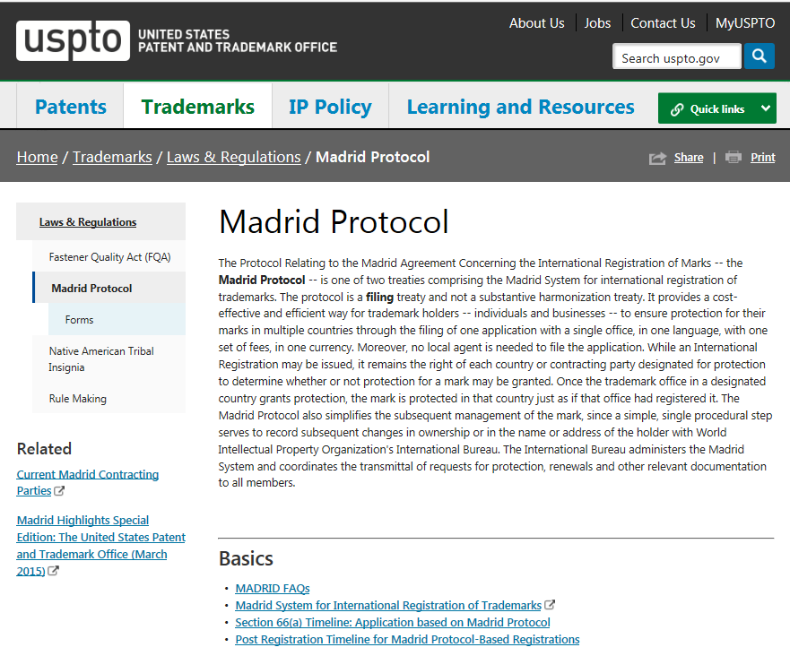
USPTO webpage for Madrid
www.uspto.gov/trademark/ laws-regulations/ madrid-protocol

Slide 15
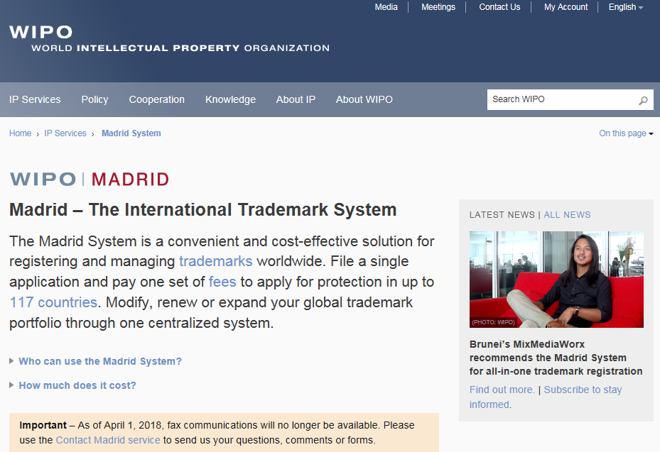
WIPO website
www.wipo.int/madrid/en/

Slide 16
Filing options
Electronic filing system is available.
The filing language is English only.
Certification fees:
US$100 per class if based on one basic application or registration
US$150 per class if based on more than one basic application or registration
Official WIPO and country fees can be paid through the USPTO or to WIPO directly via a WIPO account.
The USPTO sends transactions to the IB every day in a batch file (not individually).
The USPTO sends fees to the IB once a week.

Slide 17
USPTO TEASi forms
The USPTO accepts two types of filings:
Electronic applications:
Pre-populated form — only one base mark
No modifications — no review
Free-text form — more than one base mark
Paper applications: must be submitted to the USPTO on IB’s MM2 form, available from WIPO via petition as appropriate*
Mandatory electronic filing
U.S. counsel

Slide 18
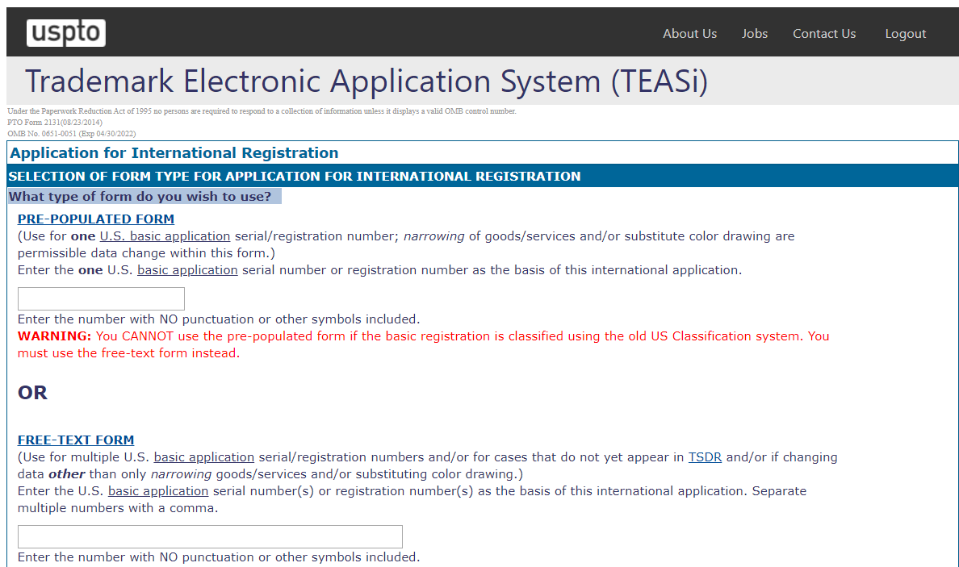
Electronic filing options
Electronic applications filed via TEASi TEASi forms on the USPTO website allow filing an international application in two ways:
1. Pre-populated form
2. Free-text form

Slide 19
TEASi pre-populated form advantages
Only one U.S. basic application or registration is used as the basis for filing an international application.
The form automatically displays the exact information from the USPTO database for one U.S. basic application serial number or registration number.
If no changes are made, the USPTO automatically certifies the international application and transmits it directly to the IB, without independent review of this data. There is no specialist review of the data.
If any changes are made to the data fields, independent review will occur by MPU before the application will be certified and forwarded to IB.

Slide 20
Electronic filing options disadvantages
Mistakes in basic ➔ mistakes in international application and international registration
These cannot be corrected.
Examples include hyphens, punctuation, and wrong type of mark.
This may affect protection in designated countries.
A color image but no color claim in the U.S. will generate a black and white mark image.
Assignment of change of ownership did not automatically upload.
Check assignment record

Slide 21
Examination for certification
MPU examines the international application and compares the information with each basic application/registration.
MPU will either certify or deny the international application:
MPU certifies and forwards the international application to the IB for further examination (either electronically or via upload to MOP).
Or
MPU denies certification of the international application and sends the applicant a letter setting forth the reasons for the denial, if filing requirements are not met.
Refund of fees

Slide 22
Key elements of review for certification
Ownership
Owner must be identical in the international application and in all basic applications/registrations.
Reproduction of mark
Must be the same as in basic application/registration.
Standard character claim
Standard character claim must be present in all basic applications/registrations.
Description of the mark
Must be the same as the description of the mark in the basic application/registration.

Slide 23
Key elements of review for certification
Special type/category of marks
If basic mark is one of the following, international application must indicate the same by checking the appropriate box:
Three-dimensional mark
Checking this box indicates the mark is trade dress (i.e., product design, product packaging, interior/exterior of buildings).
Sound mark
Collective mark or certification mark

Slide 24
Key elements of review for certification
Identification of goods/services
It must be same as or less than the goods and services in the U.S. basic application/registration.
The listing of goods and services in the international application must be within scope of the basic application/registration on the day it is reviewed.
Caution: If identification is amended in the basic application/registration before review of the international application, it may be denied.
May include a limitation:
List the specific goods and services that apply to each designated Contracting Party.
Limited goods and services must be within scope of goods and services in the basic application/registration.

Slide 25
Not a certification requirement
Classification
MPU does not certify classification stated in international application.
TMEP §1902.02(g)
IB determines proper classification based on Nice Agreement.
Current edition of Nice Agreement in effect as of filing date of international application.

Slide 26
International registration date
If IB receives international application within two months of the date of receipt by the USPTO, the international registration date is the date of receipt at the USPTO.
If priority is claimed in an international application and the international application is certified within two months, IB will honor the priority claim.
Example: If the international application is filed with the USPTO on the last day of the priority period, the USPTO will have two months to forward the international application to the IB.

Slide 27
How to avoid a denial of certification

Slide 28
Before filing international application
Review information in each basic application/registration to ensure it is correct.
Mistakes and inaccuracies should be fixed before international application is filed.
When filling out international application, use basic record data shown in the Trademark Status and Document Retrieval (TSDR) system, not the Trademark Electronic Search System (TESS).

Slide 29
Before filing international application
Fixing inconsistencies:
Amend basic application
If assigned to examining attorney ➔ contact examining attorney to request necessary amendment(s)
If not assigned to examining attorney ➔ may file voluntary amendment
Amend basic registration
File §7 amendment with USPTO Post Registration Unit. 37 C.F.R. §2.173; TMEP §1609.01
Filing assignment in basic application/registration
May file assignment with USPTO Assignment Recordation Branch using the USPTO Electronic Trademark Assignment System (ETAS). See TMEP Chapter 500

Slide 30
Before filing international application
Owner name, entity, and citizenship
Must be same in international application and in each basic record
Fixing ownership issues in basic application/registration:
Amend basic record or file assignment.
If assignment filed within days of filing international application ➔ wait until Assignment Recordation Branch has recorded and correct owner name appears in USPTO records before filing international application.
Mistake in owner name or legal entity may or may not be correctible. See TMEP §1201.02(c)

Slide 31
Denial of certification of international application
If international application does not meet filing requirements ➔ MPU denies certification.
MPU sends letter to applicant informing of reasons for denial.
MPU decision to deny certification is final.
Applicant cannot respond to MPU’s denial — no back and forth.
Applicant cannot amend electronically filed international application.

Slide 32
Petition to review denial of certification
A petition is a request to the Director of the USPTO to review the MPU decision or exercise authority to permit applicant to correct minor mistakes in the international application.
If you have any questions, please contact the USPTO Petitions Office at 571-272-8950 for guidance before filing IA and before filing a petition.

Slide 33
Petition to review denial of certification
Petitions regarding denials of international applications are expedited due to two month window.
If electronically filed international application is incorrect (base application/registration is correct), then a substitute MM2 must be submitted with the petition.
If the international application is not certified within two months of the date of receipt of the international application in the USPTO, the date of international registration will be affected.

Slide 34
Other considerations for international application
Pending U.S. applications or registrations issued by the USPTO on the Supplemental Register.
Additional information may be provided in international application that is not in base (e.g., disclaimer or translation).
Subsequent designations are covered on the next slide.

Slide 35
Other considerations — subsequent designations
Protection of subsequent designation expires on same date as international registration.
Example: International registration expires on May 1, 2012. Subsequent designation is filed and meets filing requirements such that its effective date is February 1, 2012. Subsequent designation expires on May 1, 2012.
You may only subsequently designate certain Contracting Parties if international registration date is after accession date (date those countries joined Madrid Protocol), e.g.,:
Brazil — October 2, 2019
India — July 8, 2013
Philippines — July 25, 2012
Namibia — June 30, 2004
Estonia — November 17, 1998

Slide 36
Notices of irregularity

Slide 37
Notice of irregularity issued by IB
IB may issue one or more irregularities if there are deficiencies in international application upon examination.
Irregularities may be issued for several reasons:
Classification of goods/services
Identification of goods/services
Fees

Slide 38
Response to notice of irregularity
Must be remedied by USPTO e.g., omission of drawing or USPTO signature
Remedied by applicant directly with IB e.g., fees
Remedied by applicant through USPTO and forwarded to IB e.g., amending goods/services
Classification of goods/services not proper. USPTO will not advise applicant regarding reclassification. Common Regs., Rule 12
Identification of goods/services is too vague for purposes of classification, incomprehensible, or linguistically incorrect. Common Regs., Rule 13

Slide 39
Response to notice of irregularity
Applicant’s response deadline is generally three months from the date of notice.
Suggest filing response with the USPTO at least one month before deadline to allow MPU to review response.
MPU will not process response received after IB’s response deadline.

Slide 40
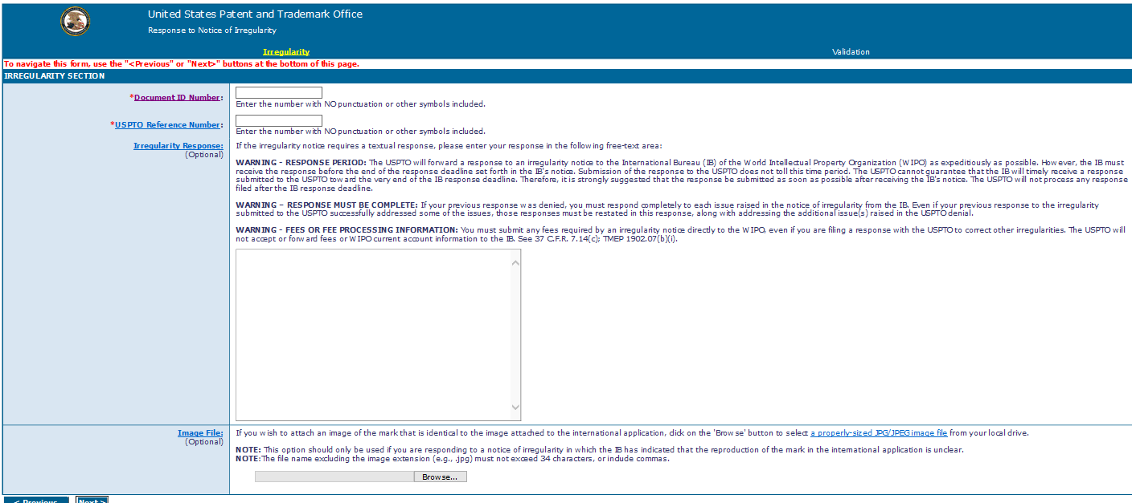
Electronic form available

Slide 41
Applicant’s response to notice of irregularity
MPU will review goods/services in response to ensure they are within scope of basic goods/services at time response is reviewed.
If basic goods/services were amended since the date international application was filed, goods/services in response must be within scope of amended goods/services.
If goods/services in response exceed scope of basic goods/services as amended, MPU will not forward response to IB and will notify applicant that proposed amendment does not conform to basic goods/services.
If response deadline not expired ➔ applicant may submit new response and, if acceptable, MPU will forward to IB.

Slide 42
Applicant’s response to notice of irregularity
Goods/services
If goods/services are not amended to remedy the irregularity within response deadline and all other international application requirements are met, IB will:
If class provided in the international application: Include the unacceptable wording/terms in goods/services in IR with indication that IB considers such wording/terms to be too vague for purposes of classification.
If class not provided in the international application: Delete the unacceptable wording/terms and notify both the USPTO and applicant.

Slide 43
After international registration issues
Dependency — ceasing of effect
Maintaining international registration
Changes to international registration

Slide 44
Dependency — ceasing of effect
International registration is dependent on basic application/registration for five years.
Any protection extended to a mark in a designated country is also dependent on basic application/registration for five years.
Within five-year period ➔ the USPTO must notify IB to restrict or cancel international registration, either totally or partially if:
Basic application abandons, registers, or is divided; or
Basic registration cancels or is divided

Slide 45
Dependency — ceasing of effect
“Ceasing of effect” — The USPTO informs IB of which goods/services are protected in U.S.; extends only to:
Registration of basic application — all or some goods/services protected in U.S.
Abandonment of basic application — no goods/services protected in U.S.
Cancelation of the basic registration — goods/services no longer protected in U.S.
IB will restrict or cancel international registration accordingly and notify all designated countries.
End of five years ➔ international registration and every extension of protection becomes independent of basic application/registration

Slide 46
Caution: dependency — ceasing of effect
Changes in basic record to drawing, description, translation, owner, and address ➔ not notified to IB.
Changes in basic record to goods/services ➔ are notified to IB (i.e., ceasing of effect).
International registration updated with final basic goods/services
Negative consequences to international registration may arise due to changes in basic record during prosecution or after registration.

Slide 47
Other considerations — caution about dependency
Applicants encouraged to wait until at least the USPTO issues first office action.
Note: Priority may be claimed if international application is filed within six months of filing date of U.S. basic application.

Slide 48
Caution: dependency – ceasing of effect
Different/inconsistent protection may result:
Mark may be different by the time basic application registers.
Example: Basic mark filed as RIGHT-ON. International application mark registers as RIGHT-ON. Basic mark registers as RIGHT ON (no hyphen). No provision in Madrid rules to change mark in international registration to RIGHT ON.
Goods/services may be different by the time basic application registers.
Example: In response to USPTO refusal, “headgear” in Class 25 is amended to “motorcycle helmets” in Class 9. USPTO will notify IB of the ceasing that the USPTO registered “motorcycle helmets” in Class 25. The ceasing will be recorded in the international registration by the IB and notified to all the affected designated Contracting Parties.

Slide 49
Maintaining an international registration
International registration is valid for 10 years (10-year renewal periods from date of international registration).
Must be renewed directly with IB.
E-renewal form or form MM11 can be found on WIPO’s website.
The USPTO will not process or forward request for renewal of international registration to IB.
If not renewed ➔ international registration will be canceled, and IB will notify all designated countries.

Slide 50
Changes to an international registration
Changes to international registration must be filed directly with IB.
Change in owner/holder name, entity, citizenship, and address (MM5)
Change in owner/holder representative name and/or address (MM9)
Limitation of goods/services (MM6)
Renunciation of a designated Contracting Party (MM7)
Cancelation of international registration, in whole or in part (MM8)
All official forms for filing these changes can be found on WIPO website —www.wipo.int/madrid/en/forms/.

Slide 51
Changes to an international registration
Change in owner name, entity, citizenship, and address
Change in ownership: To record a change due to transfer of property from one legal entity to another, or a change in the nature of legal entity ➔ use WIPO MM5 form.
IB does not require evidence of change in ownership, so supporting documents should not be sent to IB (e.g., copies of deed of assignment or other contract).
Change in name, address, or legal nature: To record a change in name and/or address only (including address for correspondence) ➔ use WIPO MM9 form.

Slide 52
Change of holder (MM5) — when USPTO signs and sends to IB
File directly with the IB.
All requests must be signed by holder.
What happens if holder no longer exists or new owner cannot obtain signature of the holder?
Trademark Rule 7.23
Electronic petition form is available.

Slide 53
Important trademark contact information
Assignments Recordation Branch 571-272-3350 Monday-Friday, 8:30 a.m. to 5 p.m. ET
Madrid Processing Unit (MPU) 571-272-8910 MPU@uspto.gov Monday-Friday, 8:30 a.m. to 5 p.m. ET
Petitions Office 571-272-8950 Monday-Friday 9 a.m. to 5 p.m. ET
TEAS and TEASi online forms technical difficulties TEAS@uspto.gov Monday-Friday 8 a.m. to 8 p.m. ET
Trademark Assistance Center (TAC) 800-786-9199 TrademarkAssistanceCenter@uspto.gov Monday-Friday 8:30 a.m. to 8 p.m. ET

