Slide 1
Trademarks management report
David Gooder
Commissioner for Trademarks

Slide 2
Trademarks management report agenda
FY22 YTD business operations update
  Filing performance and staffing
Financial update (OCFO)
Management updates
  Policy, Admin/IT, & Operations

Slide 3
Trademark filing performance

Slide 4
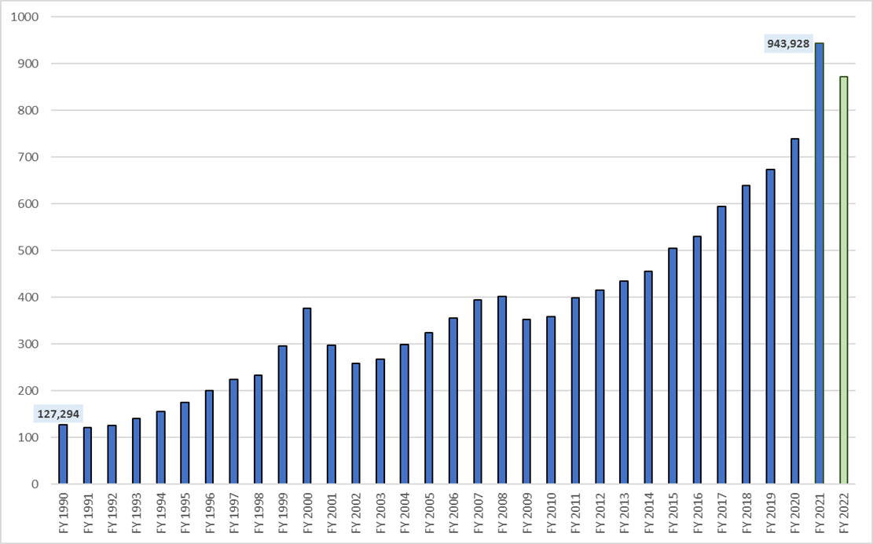

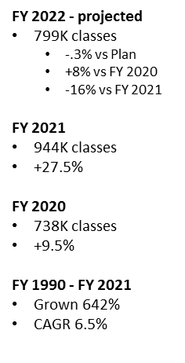
Trademark application filing levels

Slide 5
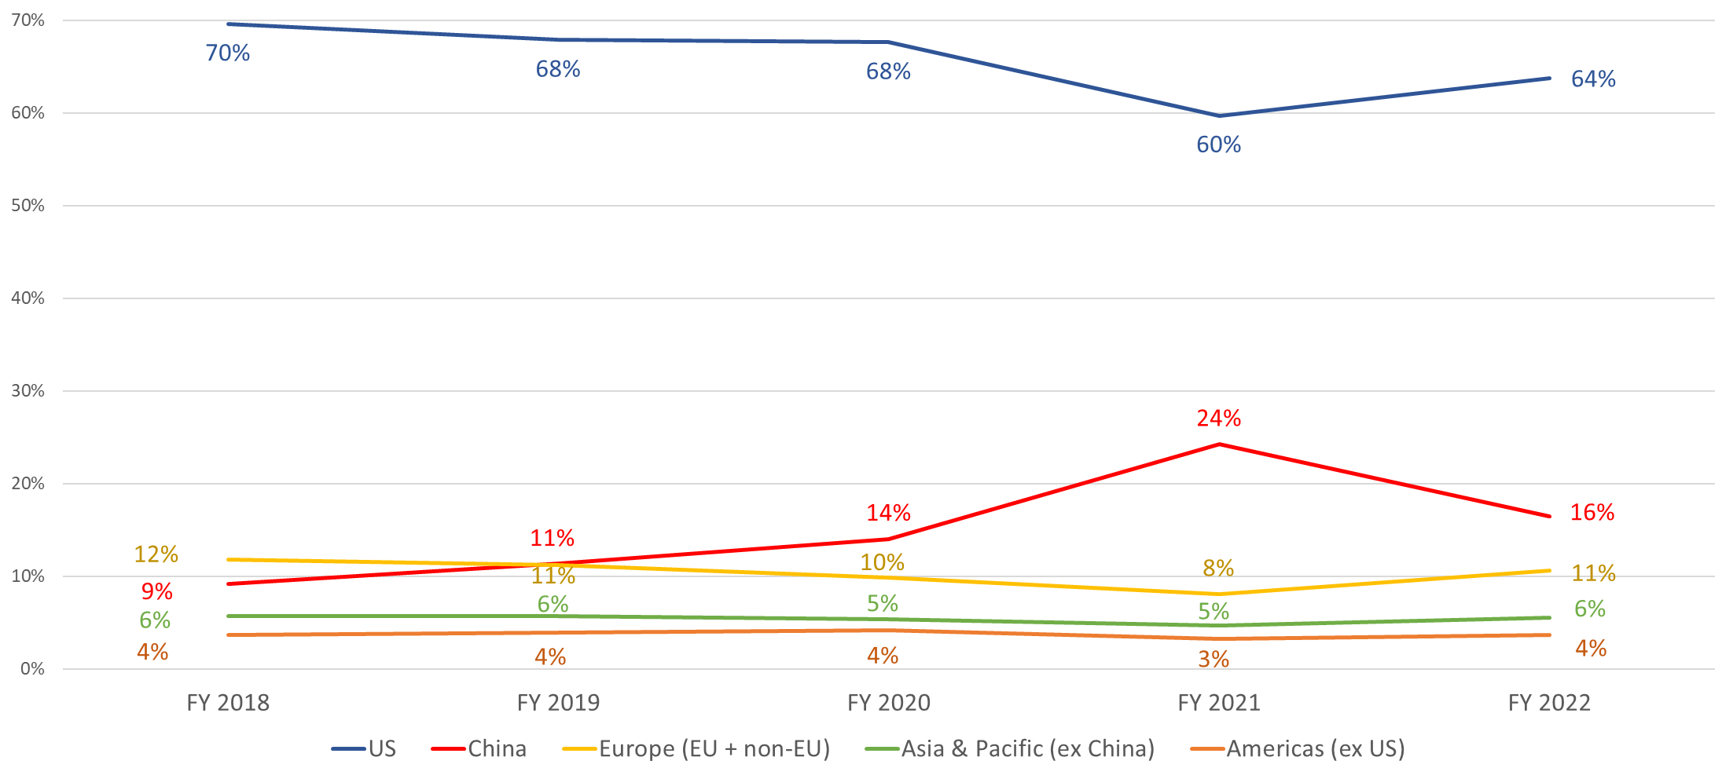
Share of application classes filed by applicant's domicile (FY 2018 - FY 2022)
Notes:
7/19/22 TV

Slide 6
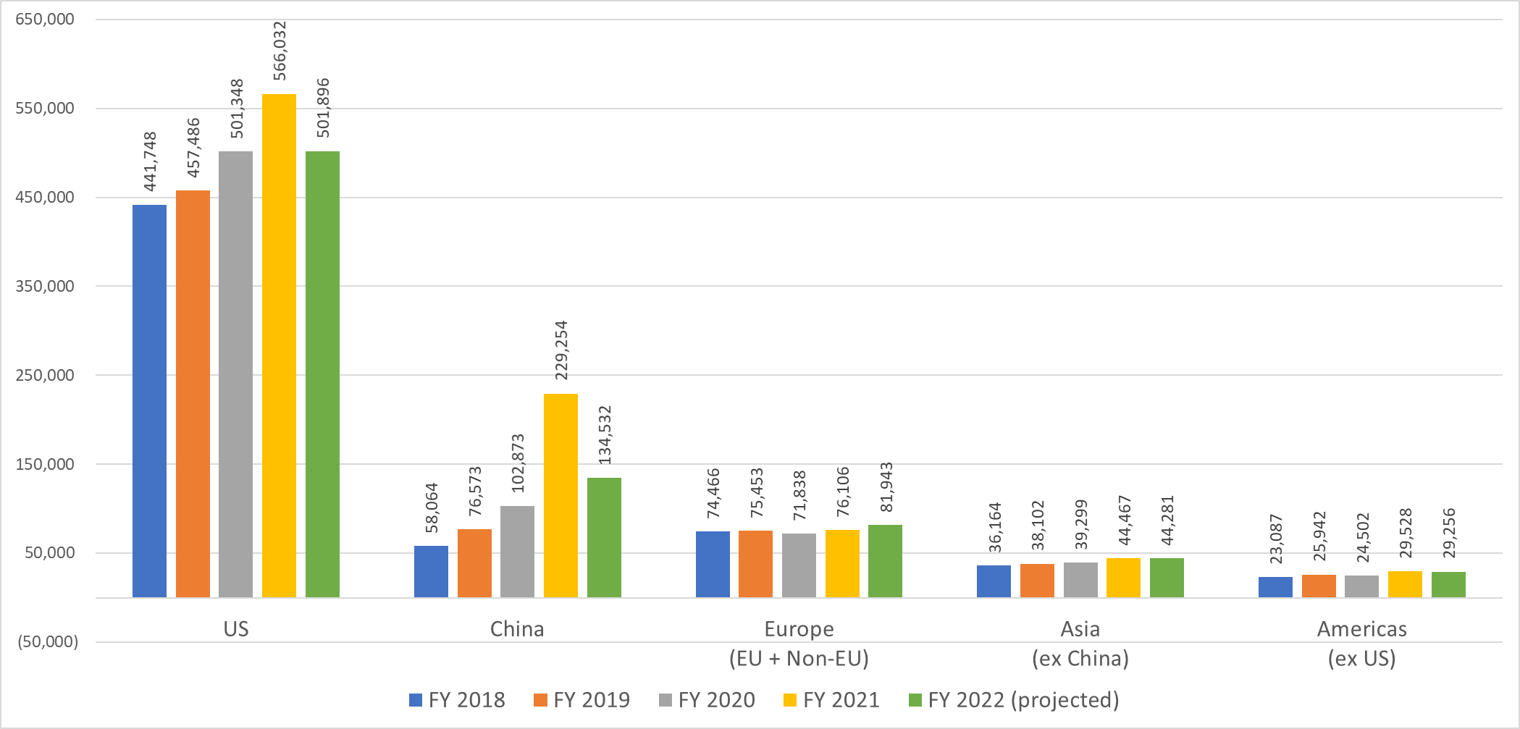
Regional filings FY 2018 - FY 2022 (projected)
Notes:
7/19/22 TV

Slide 7
Trademarks staffing
1,058 employees (7.5% of USPTO)
716 examining attorneys (68% of Trademarks)
  32 hires onboarded in March 2022
  Currently recruiting
1%
68%
5%
13%
1%
4%
1%
7%
Notes:
Updated
•Number total TM employees, EAs, and percentages
Unchanged:
•USPTO/Trademarks still in state of “Maximum telework
Slide updated 07/18/2022, Trademark Analytics

Slide 8
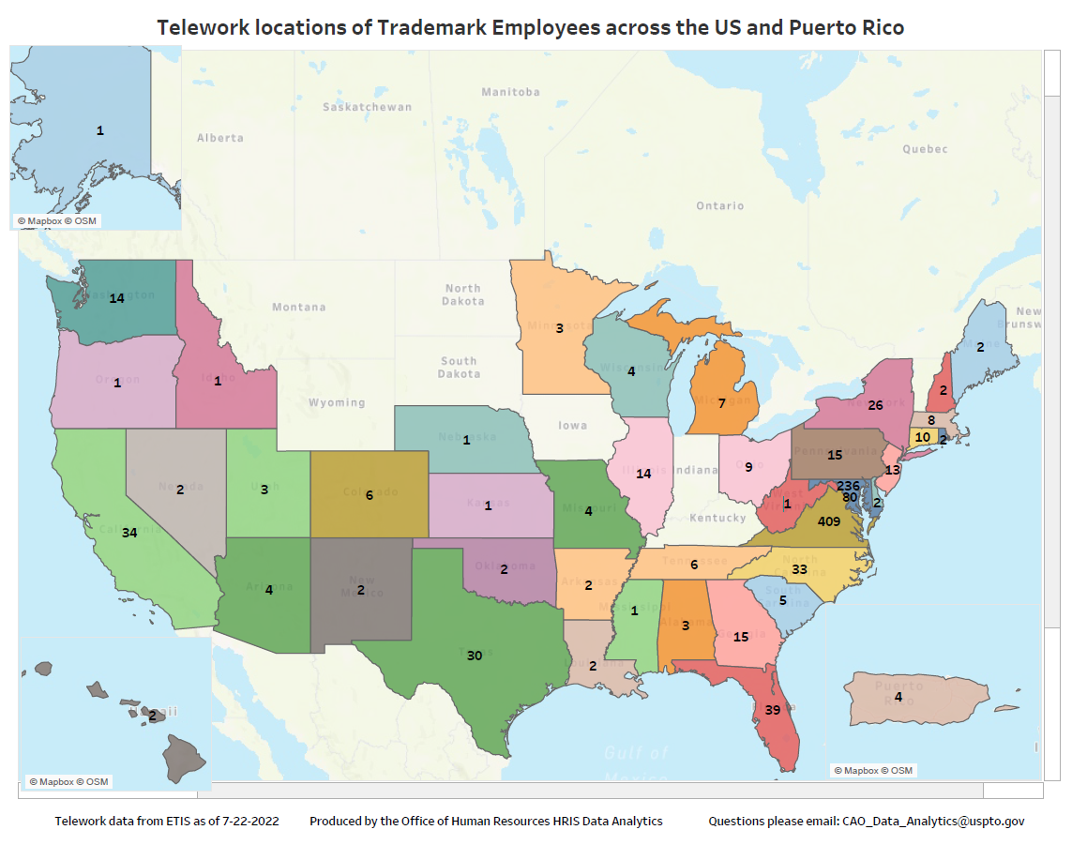
Where are we today…literally!
A total of 1,077 professionals
  935 TEAP or Remote 50
    87.5%
  28 Hotelers
    2.7%
  103 Routine
    9.85%
  5 Situational
    0.5%
  6 no telework
    0.6%

Slide 9
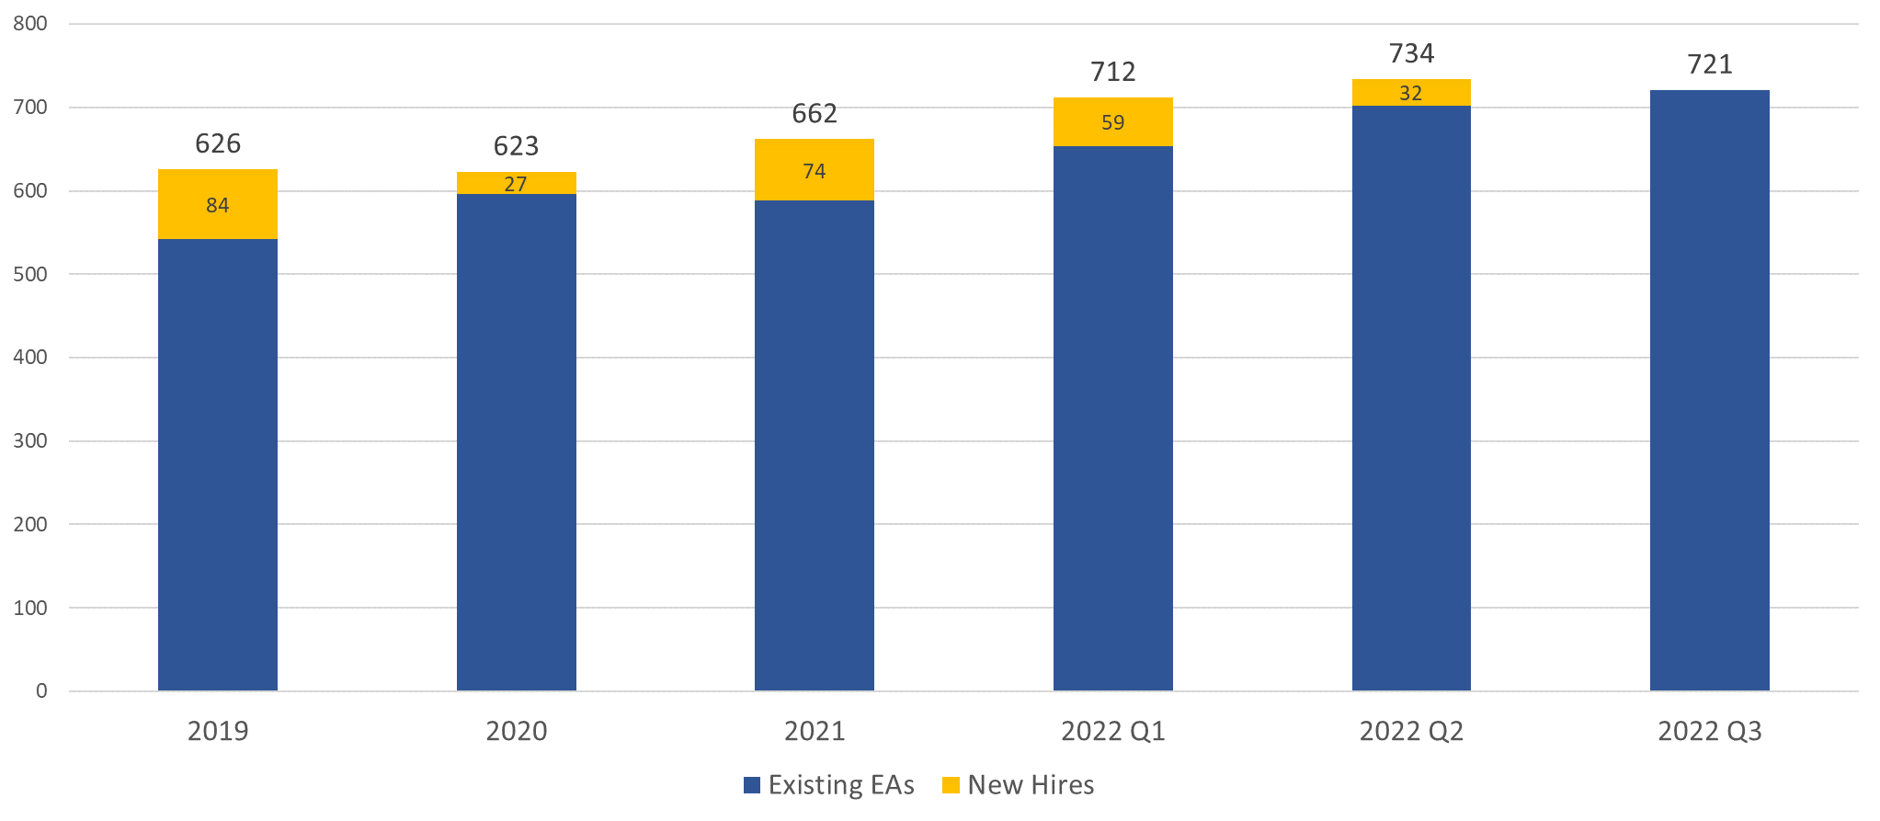
USPTO trademark examining attorneys
FY 2019 to FY 2022
Notes:
7/19/22 TV

