Slide 2
Path to a Patent Series, Part III: Patent Searching U.S. Patent and Trademark Office

Slide 3
Workshop objectives
Participants will understand:
Benefits of searching
Keyword search vs. classification search
What is Cooperative Patent Classification (CPC)?
The six-step search process
Building a search strategy using keywords and classification scheme

Slide 4
Disclaimer
References to particular patents, designs, trademarks, service marks, products, services, companies, copyrights, and/or organizations appearing in this presentation are for illustrative and educational purposes only and do not constitute or imply endorsement by the U.S. government, the U.S. Department of Commerce, the U.S. Patent and Trademark Office, or any other federal agency.

Slide 5
Patents
A U.S. patent is
A property right granted by the United States government to an inventor
To exclude others from making, using, offering for sale, or selling the invention throughout the United States or importing the invention into the United States
For a limited time
In exchange for public disclosure of the invention

Slide 6
Why search?
Patentability
– Inventions that are new, useful, non-obvious, and accompanied by a written description disclosing how to make and use the invention may be patented.
But how do you know if an invention is new and non-obvious?

Slide 7
Patent process overview
1.
Determine the type of IP
protection
you need
2.
Determine if your
invention is patentable
3.
Determine what kind
of patent you need
4.
Get ready to apply
5.
Prepare and submit
your initial application
6.
Work with your examiner
7.
Receive your approval
8.
Maintain your patent

Slide 8
U.S. patent prior art search
Ensure that your invention is indeed novel and non-obvious; conduct a prior art search before filing a U.S. patent application
– Many searchers start with a preliminary prior art search of
U.S. patents and published patent applications
Conduct a keyword search; however, note that there are pitfalls from relying only on a keyword search
To be as thorough as possible, a supplemental prior art search ideally includes a classification search of granted U.S. patents and published U.S. patent applications, conducted to determine patentability of an invention

Slide 9
Prior art
Any document that contains a discussion or description relevant to an invention for which a patent is currently being sought or enforced, may be a prior art reference.
It is an applicant's duty to submit to the USPTO information which is “material to patentability of the invention claimed in a non-provisional application.”
A patent examiner may reject one or more claims in a patent application on the grounds that they are “anticipated by” or “obvious in view of” the prior art.

Slide 10
Prior art
Prior art consists of information disclosed to the public, including:
U.S. patents and published patent applications
Foreign patents and published patent applications
Journal and magazine articles
Books, manuals, and catalogs
Websites
Conference proceedings
Scientific papers

Slide 11
Challenges with relying on keyword searching
Vague or inconsistent terminology
“Toy and Process of Use” (Patent 2,415,012)
Obsolete names and terms
“LP” … “hi-fi” … “laser disc” … “water closet”
Different meanings in different fields
“mouse” the animal v. computer “mouse”
Synonyms
Rodent Extermination Device (Patent 5,185,953)

Slide 12
Challenges with relying on keyword searching (continued)
Some text may have British spellings
Colour v. color
Tyre v. tire
Spelling errors and variations
Repellant v. repellent
Three wheeled v. tri-wheeled
Acronyms and abbreviations
LED, light emitting diode
PDA, personal digital assistant

Slide 13
Biggest challenge of keyword searching
Text patent databases limit keyword searching to no earlier than:
Google Patents: 1880’s
USPTO Patent Public Search 1830’s
Searching by classification allows access to all U.S. patents.

Slide 14
What is classification?
In general, a classification system is a system of hierarchical categories used to organize like “things” by their characteristics and relationships.
Classification systems are very useful for sorting and searching large collections of information, including inventions.

Slide 15
Worldwide classification systems
Replaced by CPC in 1/2015 for U.S. utility patents
Replaced by CPC in 2013
 | USPC | IPC | ECLA | FI | CPC
Documents classified into system by | USPTO | IPC union members (61) | EPO, member states | Japan Patent Office | USPTO/EPO
Relationship to IPC | None | None | ECLA is an extension of IPC | FI is an extension of IPC | CPC is an extension of IPC
Classification | 2 standards for classification | Invention information | Invention information | Invention information | Invention information
Rules for classification | U.S. classification guidelines | IPC guide | IPC guide + art specific rules | IPC guide + deep indexing with F-terms | IPC guide + art specific rules
Number of subdivisions | 150,000 | 69,000 | 145,000 | 180,000 | 200,000

Slide 16
What is CPC?
Joint partnership with the European Patent Office (EPO)
Harmonization of the USPC and ECLA
The CPC is divided into eight main areas, A-H:
A: Human Necessities
B: Performing Operations; Transporting
C: Chemistry and Metallurgy
D: Textiles and Paper
E: Fixed Construction
F: Mechanical Engineering; Lighting; Heating; Weapons; Blasting; Engines or Pumps
G: Physics
H: Electricity

Slide 17
Six-step U.S. patent search strategy
The six-step U.S. patent search strategy is a strategy for searching
U.S. patents and published patent applications to locate and evaluate relevant prior art; any previous publication that discloses an invention and would preclude issuance.
A more comprehensive prior art search would also include foreign patent publications and non-patent literature.
Careful recording of the search process (databases used, date and time of search, classes searched, and patents/published patent applications retrieved) is important.

Slide 18
Search example
We have invented an umbrella with a new rib design to eliminate the umbrella collapsing or inverting due to winds.

Slide 19
Step 1 – Brainstorm terms describing the invention
What is the purpose of the invention? Is it a utilitarian device or an ornamental design?
Is the invention a process – a way of making something or performing a function – or is it a product?
What is the invention made of? What is the structure of the invention?
How is the invention used?
What are keywords and technical terms that describe the nature of the invention?
Note: Consult a technical dictionary or thesaurus to help find the appropriate terms.

Slide 20
Step 1 – Brainstorm terms describing the invention (continued)
Purpose: Umbrella has a new rib design to eliminate an umbrella collapsing or inverting due to high winds
Invention: An improvement in umbrellas to eliminate need for frequent replacement of umbrellas
Invention components: Framework with ribs, stretchers, a main frame, securing rings, mounting brackets, joint connectors, fabric connectors, and fabric linkage bar
How used: As needed in protection from the elements
Other terms (in addition to above): parasol, sunshade, support assembly or apparatus, windproof, wind-resistant

Slide 21
Step 2 – Keyword search
Use Boolean operators:
Use “OR” to group together synonyms.
Use “AND” to find the intersection of two sets of information.
Include wildcard symbols (*) to obtain versions of words.
Incorporate quotes to group search phrases where words are adjacent.
Filter by selected fields, e.g., inventor name.

Slide 22
Keyword search strategy
((umbrella* OR parasol* OR sunshade*) AND (windproof or “wind resistant”))

Slide 23
Step 3 - Conduct in-depth review of patents you selected based on front page information
Review each U.S. patent you selected in-depth for similarity to your own invention.
Look at other sections of the patent - additional drawings pages, the specification, and especially the claims.
References cited by the applicant and/or patent examiner may lead you to additional relevant patents.
Save the most relevant U.S. patents you find.
Refine and repeat searches.

Slide 24
U.S. patent image after 2015
Review the front page of each patent as well as other pages.
Record the patent number of those patents similar to your invention that will merit later closer review.
Note the classification value(s).

Slide 25
U.S. patent image prior to 2015
Review the front page of each patent as well as other pages.
Record the patent number of those patents similar to your invention that will merit later closer review.
Note: Only U.S. Classification, no CPC value(s).

Slide 26
Corresponding U.S. patent text version
In text view, U.S. patents issued before 2015 will have contain both U.S. and CPC values.
CPC values have been retrofitted to all U.S. patents.
Since January 1, 2015,
U.S. patent images contain and display CPC values.

Slide 27
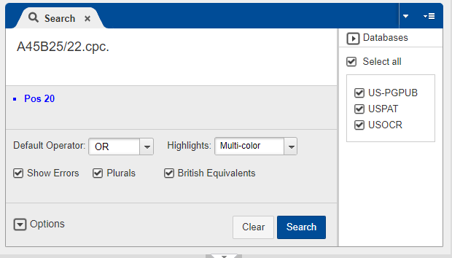
Step 4 - Retrieve and review published patent applications using CPC values

Slide 28
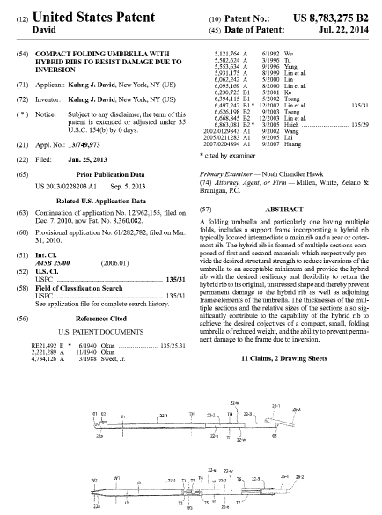
Step 5 Cited references
Conduct a search of cited U.S. patents and patent applications.

Slide 29
Step 6 – Broadening your search
Extend your search to foreign patents and published patent applications using CPC classification, and re-run your search using Espacenet at http://worldwide.espacenet.com.
Search non-patent print and electronic publications,
e.g., books, journals, websites, technical catalogs, and conference proceedings.
Consider hiring a registered patent attorney or patent agent to review your search and conduct a follow-up search of his/her own.

Slide 30
Access CPC schema
Go to the USPTO home page at www.uspto.gov.
Search for CPC classification schema using the search box on the home page or the search box in the top right-hand corner.
Use specific language for your search terms:
– CPC scheme umbrella
From the search results page, click an entry for a Class- Subclass Scheme page.
If you are not satisfied with your results, rerun your search using synonyms that you identified in Step 1.

Slide 31
I’m looking for…

Slide 32
Results

Slide 33
A45B 25/22
A45B 25/22: Devices for increasing the resistance of umbrellas to wind

Slide 34
Access classification definition
If the selected classification has a “D” to the left of it, it is hyperlinked to a CPC definition.
CPC definitions are helpful in establishing the scope of the relevant classification. A45B 25/22 definition relies on images (below), however, most CPC definitions use text.

Slide 35
Search resources
USPTO resources:
Search for patents: www.uspto.gov/patents/process/search
External resources:
Google Patents: https://patents.google.com/advanced
Espacenet: https://worldwide.espacenet.com/
Patentscope: https://patentscope.wipo.int
Free Patents Online: http://www.freepatentsonline.com/
CPC general website: www.CPCinfo.org

Slide 36
Patent and Trademark Resource Centers (PTRC)
Nationwide network of public, state, and academic libraries that are designated by the USPTO to disseminate patent and trademark information and to support intellectual property needs of the public.
Patent and Trademark Resource Centers
www.uspto.gov/ptrc

Slide 37
Resources for submitting your patent application
1.
Determine the type of IP
protection
you need
2.
Determine if your
invention is patentable
3.
Determine what kind
of patent you need
4.
Get ready to apply
5.
Prepare and submit
your initial application
6.
Work with your examiner
7.
Receive your approval
8.
Maintain your patent

Slide 38
Inventors Assistance Center (IAC)
The IAC provides patent information and services to the public. It is staffed by former supervisory patent examiners and experienced former primary examiners who answer general questions concerning patent examining policy and procedure.
Contact Info
Hours: Monday – Friday, 8:30
a.m. to 8 p.m. ET, except federal holidays
Telephone numbers:
800-PTO-9199 (800-786-9199)
571-272-1000
TTY customers can dial
800-877-8339 for customer assistance

Slide 39
Electronic Business Center (EBC)
The EBC can assist with:
Submitting your patent application via EFS-Web
Viewing application information in Private PAIR
Digital certificate, customer number issues, and assistance
Java and web browser problems
Technical problems or errors with your patent application
PDX/DAS registration inquires and issues
Technical problems with biotech tools
Contact Info
Hours: Monday – Friday, 6 a.m. to midnight ET, except federal holidays
Telephone numbers:
Toll-Free: 866-217-9197
Local: 571-272-4100
Email: ebc@uspto.gov

Slide 40
USPTO resources
Path to a Patent at: https://www.uspto.gov/about-us/events/path-patent

Slide 41
Access Patent Public Search

Slide 42
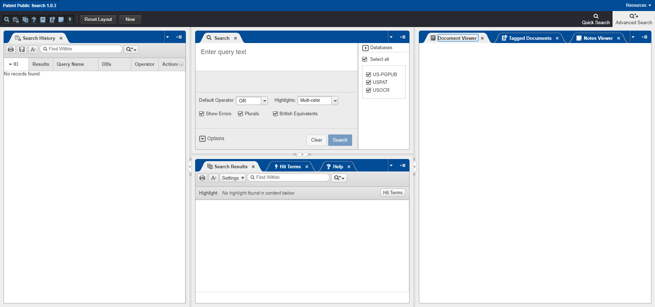
Patent Public Search

Slide 43
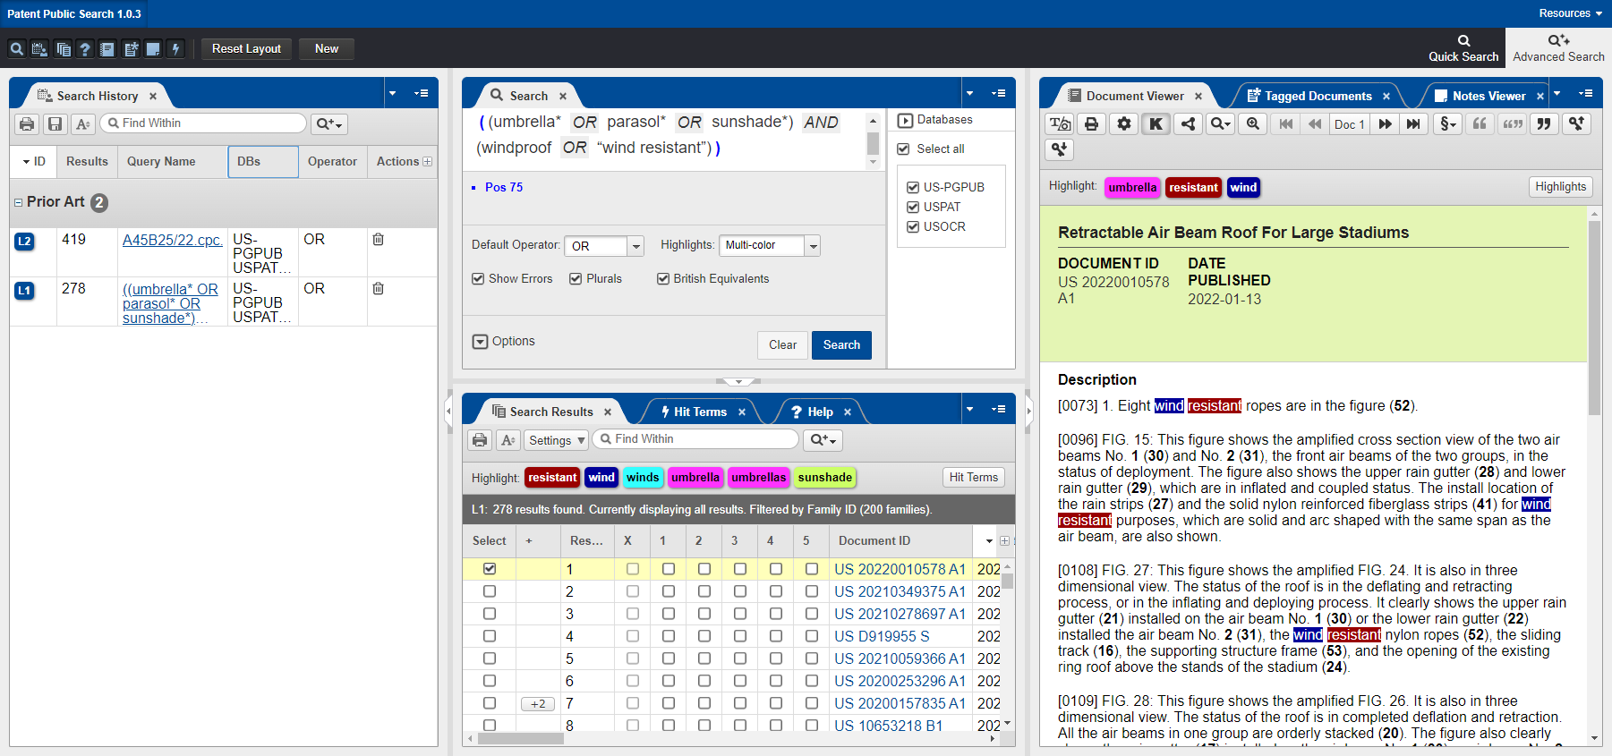
Keyword search

Slide 44
USPTO resources
Trademark Basics Boot Camp at: https://www.uspto.gov/about-us/events/trademark-basics-boot-camp

