Slide 2
Professional responsibility and practice before the USPTO
Office of Enrollment and Discipline (OED)

Slide 3
OED: enrollment
Authorization to practice before the USPTO in patent matters:
  Attorneys, agents, limited recognition.
3 factors for registration:
  Scientific and technical qualifications;
  Legal competence: registration exam; and
  Moral character.
  See 37 C.F.R. § 11.7 and General Requirements Bulletin.

Slide 4
Design Patent Practitioner Bar
On November 16, 2023, the USPTO published a final rule establishing scientific and technical criteria for design patent practitioner applicants.
Applicants should have a bachelor’s, master’s or doctorate of philosophy degree in any of the following areas from an accredited college or university:
  industrial design, product design, architecture, applied arts, graphic design, fine/studio arts, art teacher education, or a degree equivalent to one of the listed degrees.
  Once scientific and technical criteria are met, design patent practitioner applicants must take and pass the current registration examination, and pass a moral character evaluation.
  Upon registration, design patent practitioners may practice in design patent matters only.
  The application process for design patent practitioner applicants began January 2, 2024.
The design patent practitioner bar does not impact the ability of those already registered, and does not impact the ability of applicants who meet the current criteria, to practice in any patent matters, including design patent matters.
Additional information may be found at https://www.uspto.gov/sites/default/files/docuemnts/OEDDesignBarFlyer.pdf.

Slide 5
Practice before the USPTO and Artificial Intelligence (AI)
On Feb 6, 2024, the USPTO issued a Memorandum regarding the applicability of the USPTO Rules of Professional Conduct related to the use of AI.
When practicing before the USPTO, practitioners' use of IA may implicate ethical considerations.
37 C.F.R. § 11.18 imposes duties on parties and practitioners in connection with submissions before the USPTO.
37 C.F.R. § 11.18(b), in part, stipulates that parties presenting papers to the Office make a certification, formed after a reasonable inquiry, as to evidentiary support for factual contentions and allegations.
37 C.F.R. § 11.18(a) stipulates that each piece of correspondence filed with the Office by a practitioner must bear the practitioner’s signature pursuant to 37 C.F.R. §§ 1.4(d)(1), 2.193.
See https://www.uspto.gov/initiatives/artificial-intelligence/artificial-intelligence-resources

Slide 6
Practice before the USPTO
Activities that constitute practice before the USPTO are broadly defined in 37 C.F.R. §§ 11.5(b) and 11.14:
  Includes communicating with and advising a client concerning matters pending or contemplated to be presented before the USPTO (37 C.F.R. § 11.5(b));
  Consulting with or giving advice to a client in contemplation of filing a patent application or other document with the USPTO (37 C.F.R. § 11.5(b)(1)); or
  Consulting with or giving advice to a client in contemplation of filing a trademark application or other document with the USPTO (37 C.F.R. § 11.5(b)(2)).
  Nothing in this section (37 C.F.R. § 11.5(b)) proscribes a practitioner from employing or retaining non-practitioner assistants under the supervision of the practitioner to assist the practitioner in matters pending or contemplated to be presented before the USPTO.
  See also 37 C.F.R. § 11.14 for details regarding individuals who may practice before the USPTO in trademark and other non-patent matters.

Slide 7
OED: discipline
Mission: protect the public and the integrity of the patent and trademark systems.
Statutory authority:
  35 U.S.C. §§ 2(b)(2)(D) and 32.
Disciplinary jurisdiction (37 C.F.R. § 11.19):
  All practitioners engaged in practice before the USPTO, e.g., TM, pro hac vice in PTAB, Those representing others in OED proceedings, etc.; and
  Non-practitioners who engage in or offer to engage in practice before the USPTO.
Governing regulations:
  USPTO Rules of Professional Conduct 37 C.F.R. §§ 11.101-11.901; and
  Procedural rules: 37 C.F.R. §§ 11.19-11.60.

Slide 8
Investigation and formal complaint process
OED investigation begins with receipt of a grievance by the OED Director.
  Grievance: a written submission from any source received by the OED Director that presents possible grounds for discipline of a specified practitioner. See 37 C.F.R. § 11.1.
  Self-reporting is often considered as a mitigating factor in the disciplinary process.
Time period for filing formal complaint = 1 year from receipt of grievance but not later than 10 years from date of misconduct.
  See 35 U.S.C. § 32 and 37 C.F.R. § 11.34(d).
After investigation, OED Director may:
  Terminate investigation with no action;
  Issue a warning to the practitioner;
  Institute formal charges with the approval of the Committee on Discipline; or
  Enter into a settlement agreement with the practitioner and submit the same to the USPTO Director for approval.
  37 C.F.R. § 11.22(h).

Slide 9
USPTO disciplinary proceedings
Referral to the Committee on Discipline (COD)
  OED presents results of investigation to the COD
  COD determines if probable cause of misconduct exists
  If probable cause is found, the Solicitor’s Office, representing the OED Director, files formal complaint with hearing officer
  Hearing officer issues an initial decision; and
  Either party may appeal initial decision to USPTO Director, otherwise it becomes the final decision of the USPTO Director.
  See 37 C.F.R. §§ 11.22, 11.23, 11.32, 11.34, 11.40, 11.54 and 11.55.

Slide 10
OED: other functions
Pro Bono programs:
  Law School Clinic Certification Program; and
  Patent Pro Bono Program.
Outreach:
  Speaking engagements: continuing legal education, roundtables/panels, diversion, pro bono, recent rulemaking, etc.

Slide 11
OED Diversion Program
37 C.F.R §11.30
In 2016, the ABA Commission on Lawyer Assistance Programs and the Hazelden Betty Ford Foundation published a study of about 13,000 currently practicing attorneys and found the following:
  About 21% qualify as problem drinkers;
  28% struggle with some level of depression;
  19% struggle with anxiety; and
  23% struggle with stress.
Other difficulties include social alienation, work addiction, sleep deprivation, job dissatisfaction, and complaints of work-life conflict.
The USPTO launched the Diversion Pilot Program in 2017 and it became formalized as a rule in August 2023.
Guidance available at: https://www.uspto.gov/sites/default/files/documents/Diversion_Guidance_Document.pdf

Slide 12
Warnings – 37 C.F.R. § 11.21
“A warning is neither public nor a disciplinary sanction. The OED Director may conclude an investigation with the issuance of a warning. The warning shall contain a statement of facts and identify the USPTO Rules of Professional Conduct relevant to the facts.”
A warning will not be an option if a formal complaint has been filed with a hearing officer.

Slide 13
Disciplinary sanctions -37 C.F.R. § 11.20
Exclusion from practice before the USPTO
  minimum of five years. See 37 C.F.R. § 11.60(b)
  reinstatement only upon grant of petition. See 37 C.F.R. §§ 11.58(a), 11.60(a)
Suspension from practice before the USPTO for an appropriate period
  reinstatement only upon grant of petition upon expiration of suspension period. See id.
Reprimand or censure
Probation (in lieu of or in addition to other sanctions)
Possible conditions

Slide 14
Other types of discipline
Reciprocal discipline (37 C.F.R. § 11.24):
  Based on discipline by a state or federal program or agency, and
  Often conducted on documentary record only
Interim suspension based on conviction of a serious crime (37 C.F.R. § 11.25):
  Referred to a hearing officer for determination of final disciplinary action
Exclusion on Consent (37 C.F.R. § 11.27)
Notes:
The following 17 jurisdictions will take reciprocal discipline from a USPTO order: Colorado, Connecticut, Hawaii, Idaho, Indiana, Massachusetts, Michigan, Mississippi, Nebraska, Nevada, New Mexico, New York, Ohio, Pennsylvania, Utah, Washington, and Wisconsin.
The following 7 jurisdictions reported rules that seem to include the USPTO: California, Florida, Maryland, Missouri, New Jersey, Texas, and Virginia. Note, however, that while Virginia can do a reciprocal based on a USPTO order BUT WOULD NOT do a reciprocal based on an exclusion upon consent, according to the Rules of the Supreme Court of Virginia, Part 6, Sec. IV, Paras 13-24.
Also, another type of discipline available other than those already mentioned on slide is “Abeyance of disciplinary proceedings due to incapacity under 37 C.F.R. 11.28”

Slide 15
USPTO disciplinary matters

Slide 16
USPTO disciplinary matters

Slide 17
Ethics scenarios and select case law
OED

Slide 18
OED: Examples of misconduct
Neglect of client matters;
Failure to communicate with the client;
Lying to the client;
Lack of candor to the USPTO;
Trademark U.S. counsel cases; and
Fee and trust account issues.

Slide 19
Neglect/candor
In re Kroll, Proceeding No. D2014-14 (USPTO Mar. 4, 2016):
Patent attorney:
  Attorney routinely offered (and charged) to post client inventions for sale on his website;
  Did not use modern docket management system;
  Failed to file client’s application, but posted the invention for sale on his website; and
  Filed application 20 months after posting on the website.
Aggravating factors included prior disciplinary history.
Received two-year suspension.
Rule highlights:
  37 C.F.R. § 10.23(a) – Disreputable or gross misconduct;
  37 C.F.R. § 11.18(b) – Certification upon submitting of papers; and
  37 C.F.R. § 10.77(c) – Neglect.

Slide 20

Conflicts between clients

Slide 21
Conflict of interest
In re Radanovic, Proceeding No. D2014-29 (USPTO December 16, 2014)
  Patent attorney:
    Represented two joint inventors of patent application.
    No written agreement regarding representation.
    Attorney became aware of a dispute where one inventor alleged that the other did not contribute to the allowed claims.
    Continued to represent both inventors.
    Expressly abandoned application naming both inventors in favor of continuation naming one.
  Mitigating factors included clean 50-year disciplinary history.
  Received public reprimand.

Slide 22

Patent agent privilege

Slide 23
Patent agent privilege
Onyx Therapeutics, Inc. v. Cipla Ltd. et. al., C.A. No. 16-988-LPS (consolidated), 2019 WL 668846, (D. Del. Feb. 15, 2019)
  U.S. District Court found that a group of documents it inspected in camera would “almost certainly be within the scope of attorney client privilege,” but would not be “protected by the narrower patent agent privilege,” because they were not “reasonably necessary and incident to” the ultimate patent prosecution.
  Documents were communications between scientists referencing prior art found by an individual who performed a patent assessment at the direction of a patent agent.
  Email discussion among the scientists was found not to be protected by the patent-agent privilege “because the assessment was done as part of a plan to develop new chemical formulations, not to seek patent protection for already-developed formulations.”

Slide 24
Patent agent privilege
In re Queen’s University at Kingston, 820 F.3d 1287 (Fed. Cir. 2016)
  U.S. District Court granted Samsung’s motion to compel documents, including communications between Queen’s University employees and registered (non-lawyer) patent agents discussing prosecution of patents at issue in suit.
  Federal Circuit recognized privilege only as to those activities that patent agents are authorized to perform (see 37 C.F.R. § 11.5(b)(1)).
In re Silver, 540 S.W.3d 530 (Tex. 2018)
  Lower court ruled that communications between client and patent agent were not protected from discovery because Texas law did not recognize patent agent privilege.
  Supreme Court of Texas overturned, citing patent agents’ authorization to practice law.
Rule on Attorney-Client Privilege for Trials Before the Patent Trial and Appeal Board, 82 Fed. Reg. 51570 (Nov. 7, 2017)

Slide 25

Pop Quiz!
Rule 1.56

Slide 26
Pop Quiz – Rule 1.56
Which of the following persons is least likely to have a duty to disclose material information to the USPTO in connection with an application or proceeding pursuant to 37 CFR § 1.56?
A. A registered practitioner representing an applicant in a reexamination proceeding;
B. An inventor working with her employer’s counsel on prosecution of the patent application for her invention;
C. An unregistered R&D Director who coordinates related patent litigation and reexamination proceedings for a company; or
D. A typist working for a law firm prosecuting a patent application.

Slide 27
Pop Quiz – Rule 1.56
Answer: D - Typist
“Individuals having a duty of disclosure are limited to those who are ‘substantively involved in the preparation or prosecution of the application.’ This is intended to make clear that the duty does not extend to typists, clerks, and similar personnel who assist with an application.”
  - MPEP 2001.01

Slide 28
Inequitable conduct:
In re Tendler, Proceeding No. D2013-17 (USPTO Jan. 8, 2014)
Patent attorney filed Rule 131 declaration re: reduction to practice with USPTO.
Soon after, attorney learned that the inventor did not review the declaration and that declaration contained inaccurate information.
Respondent did not advise the office in writing of the inaccurate information and did not fully correct the record in writing.
District court held resultant patent unenforceable due to inequitable conduct, in part, because of false declaration. Intellect Wireless v. HTC Corp., 910 F. Supp. 1056 (N.D. Ill. 2012). Federal Circuit upheld.
  First requirement is to expressly advise the USPTO of existence of misrepresentation, stating specifically where it resides.
  Second requirement is that the USPTO be advised of misrepresented facts, making it clear that further examination may be required if USPTO action may be based on the misrepresentation.
  It does not suffice to merely supply the office with accurate facts without calling attention to the misrepresentation.
Settlement: Four-year suspension (eligible for reinstatement after two years).

Slide 29
Candor toward tribunal
In re Hicks, Proceeding No. D2013-11 (USPTO Sept. 10, 2013)
Attorney sanctioned by EDNY for non-compliance with discovery orders.
Federal Circuit affirmed sanction and found appellate brief to contain “misleading or improper” statements.
  Brief reads, “Both the Magistrate and the District Court Found that RTI's and its Litigation Counsel Hicks' Pre–Filing Investigation Was Sufficient.” However, neither the magistrate judge nor the district court ultimately found that RTI's or Mr. Hicks's pre-filing investigation was “sufficient.”
  Mr. Hicks also failed to inform the court that a case citation was non-precedential and therefore unavailable to support his legal contentions aside from “claim preclusion, issue preclusion, judicial estoppel, law of the case, and the like.”
  Rates Technology, Inc. v Mediatrix Telecom, Inc., 688 F.3d 742 (Fed. Cir. 2012).
Settlement: public reprimand and one-year probation.

Slide 30
Pop Quiz!
Signatures

Slide 31
Pop Quiz - signature
After consulting with Patent Agent, Client decided to have Patent Agent represent him in prosecuting his patent application before the USPTO. Client wants to grant Power of Attorney to Patent Agent with respect to the patent application.
Which of the following statements is accurate?
A. Patent Agent may sign the Power of Attorney since he is the Client’s representative;
B. Patent Agent may sign the Power of Attorney on behalf of Client as long as Client agrees;
C. Client, as the applicant, is the only authorized individual to sign the Power of Attorney; or
D. Patent Agent or anyone acting under the authority of Patent Agent may sign the Power of Attorney as long as Client gives prior consent.

Slide 32
Pop Quiz – signature
Answer: C – Client only
37 CFR § 1.32 Power of attorney.
*****
(b) A power of attorney must:
*****
(4) Be signed by the applicant for patent (§ 1.42) or the patent owner. A patent owner who was not the applicant under § 1.46 must appoint any power of attorney in compliance with §§ 3.71 and 3.73 of this chapter.

Slide 33
Pop Quiz – signature
Patent Agent represents Inventor and files Inventor’s patent application with the USPTO along with a properly executed Power of Attorney.
Which of the following statements is accurate with respect to the oath or declaration in the application?
A. Patent Practitioner Agent may sign the oath/declaration since he is the Inventor’s attorney/representative;
B. Patent Practitioner may sign the oath/declaration on behalf of Inventor as long as Inventor gives prior consent;
C. Inventor is the only individual authorized to sign the oath/declaration; or
D. Patent Practitioner or anyone acting under the authority of Patent Practitioner may sign the oath/declaration as long as Inventor gives prior consent.

Slide 34
Pop Quiz – signature
Answer: C – Inventor only
35 U.S.C. § 115(a)
“…Except as otherwise provided in this section, each individual who is the inventor or a joint inventor of a claimed invention in an application for patent shall execute an oath or declaration in connection with the application.”
See however, substitute statements pursuant to 35 U.S.C. § 115(d).

Slide 35
Signatures on patent documents
37 C.F.R. § 1.4(d)(1) Handwritten signature.
  “Each piece of correspondence, except as provided in paragraphs (d)(2), (d)(3), (d)(4), (e), and (f) of this section, filed in an application, patent file, or other proceeding in the Office which requires a person's signature, must:
    (i) Be an original, that is, have an original handwritten signature personally signed, in permanent dark ink or its equivalent, by that person; or
    (ii) Be a direct or indirect copy, such as a photocopy or facsimile transmission (§1.6(d)), of an original. In the event that a copy of the original is filed, the original should be retained as evidence of authenticity. If a question of authenticity arises, the Office may require submission of the original.

Slide 36
Signatures on trademark documents
37 C.F.R. § 2.193 Trademark correspondence and signature requirements:
  “(a)…Each piece of correspondence that requires a signature must bear:
    (1) A handwritten signature personally signed in permanent ink by the person named as the signatory, or a true copy thereof; or
    (2) An electronic signature that meets the requirements of paragraph (c) of this section, personally entered by the person named as the signatory….
    * * * * *
  (c) Requirements for electronic signature. A person signing a document electronically must:
    (1) Personally enter any combination of letters, numbers, spaces and/or punctuation marks that the signer has adopted as a signature, placed between two forward slash (“/”) symbols in the signature block on the electronic submission; or
    (2) Sign the document using some other form of electronic signature specified by the Director.”

Slide 37
Post-Registration TM audit program
Launched as a pilot in 2012 to assess accuracy of use claims in TM registration maintenance filings:
- Random selection of 500 TM registrations with six-year Section 8 or 71 declarations of use;
51% (253) of audited registrations did not verify previously claimed use:
  35% deleted good/services; and
  16% failed to respond to office actions and were cancelled.
Effective November 2017, the pilot program became a finalized rule permitting the USPTO to require TM owner for information, exhibits and/or affidavits of declaration:
  Registration may be audited if a Section 8 or 71 declaration is filed and registration includes one class with 4 or more goods/services OR two classes with 2 or more goods/services.
Effective Jan 2, 2021, $250 per class fee required when:
  Goods/services, and/or class deleted after Section 8 or 71 is filed and before acceptance.

Slide 38
Post-registration TM audit program statistics
The following data shows a running total of audit actions and various other statistics since the
inception of the audit program in November 2017. This data is updated quarterly.
Audit actions to date
Type of action | Nov 2017 - Dec 2023
First office actions issued | 29,022
Registrations with a response deleting goods/services/classes | 49.53%
Total registration cancellations | 3,883
Represented by U.S. attorney
Attorney representation | Nov 2017 - Dec 2023
Respondents represented by U.S. attorney | 83%
Unrepresented respondents | 17%

Slide 39

U.S. Counsel Rule

Slide 40
Trademarks: U.S. Counsel Rule
Increase in foreign parties not authorized to represent trademark applicants and improperly representing foreign applicants in trademark (TM) matters.
Fraudulent or inaccurate claims of use are a burden on the trademark system and the public and jeopardize validity of marks.
Effective August 3, 2019:
  Foreign-domiciled trademark applicants, registrants, and parties to Trademark Trial and Appeal Board proceedings must be represented at the USPTO by an attorney who is licensed to practice law in the United States.
Final rule: 84 Fed. Reg. 31498 (July 2, 2019).
Canadian patent agents are no longer able to represent Canadian parties in U.S. TM matters.
Canadian TM attorneys and agents will only be able to serve as additionally appointed practitioners:
  Clients must appoint U.S.-licensed attorney to file formal responses; and
  The USPTO will only correspond with U.S. licensed attorney.

Slide 41
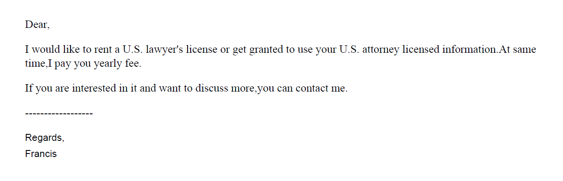
U.S. Counsel Rule – solicitation

Slide 42
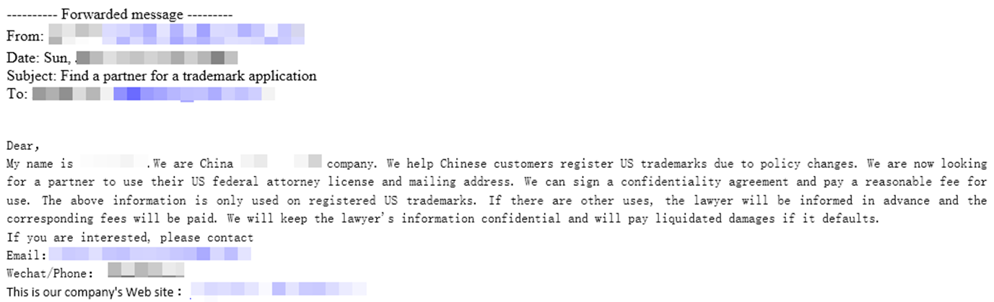
Filing mill scams: example
Notes:
Sarah
Here's an example of a solicitation that you might find suspicious, and that many of you reported to us that you had received. As you can see, the sender is interested in a US license and mailing address. They even go so far as to say they pay a "fee for use" of your license and mailing address in "registered US trademarks." This should cause you to ask some questions, such as "how exactly will my name and bar information be used" and "who exactly am I working with."

Slide 43
U.S. Counsel Rule – solicitation
美标源头律师合作，非华人律师
1 message
US_Trademark_Agent <tony@zcompany.com> Sat, Mar 12, 2022 at 2:23 AM
Reply-To: tony@zcompany.cn
To: @gmail.com
您好，
初步沟通后，可提供美国白皮律师（非华人）商标方案如下：
*符合4月9日新规，USPTO律师实人认证；
*可协助OBJ制作（律师助手子账号操作）；
*使用USPTO Payement Account支付商标官费；

Slide 44
U.S. Counsel Rule Decisions
  Yiheng Lou, Proceeding No. D2021-04 (USPTO May 12, 2021)
    NY-licensed attorney contracted with Chinese IP firm (5/12/2021)
  Devasena Reddy, Proceeding No. D2021-13 (USPTO Sept. 9, 2021)
    CA-licensed attorney contracted with Indian TM filing firm (9/9/2021)
  Bennett David, Proceeding No. D2021-8 (USPTO Sept. 24, 2021)
    Patent attorney and MA-licensed attorney contracted with Chinese IP firm (9/24/2021)
  Di Li, Proceeding No. D2021-16 (USPTO Oct. 7, 2021)
    CA-licensed attorney contracted with Chinese firm that consults with online retailers (10/7/2021)
  Tony Hom, Proceeding No. D2021-10 (USPTO Dec. 17, 2021)
    NY-licensed attorney contracted with several different Chinese firms (12/17/2021)

Slide 45
U.S. Counsel Rule Decisions
  Jonathan Morton, Proceeding No. D2022-07 (USPTO Apr. 20, 2022)
    NY-licensed attorney contracted with foreign entities
  Kathy Hao, Proceeding No. D2021-14 (USPTO Apr. 27, 2022)
    California licensed attorney contracted with several foreign entities
  Weibo Zhang, Proceeding No. D2022-16 (USPTO July 11, 2022)
    NY licensed attorney contracted with several foreign entities
  Elizabeth Yang, Proceeding No. D2021-11 (USPTO Dec. 17, 2021)
    CA-licensed attorney contracted with foreign firm serving online retailers
_ Zhihua Han, Proceeding No. D2022-23 (USPTO Jan. 09, 2023)
    WA-licensed attorney contracted with several foreign firms to file both trademark and patent applications

Slide 46
U.S. Counsel Rule Decisions
  Daoyou T. Liu, Proceeding No. D2022-03 (USPTO Aug. 9, 2022)
    TX-licensed attorney contracted with foreign entities
  Yi Wan, Proceeding No. D2022-04 (USPTO Apr. 11, 2022)
    NY-licensed attorney contracted with several foreign entities
  Jingfeng Song, Proceeding No. D2023-10 (USPTO May 4, 2023)
    IL-licensed attorney contracted with a foreign entity
  Kevin R. Gallagher, Proceeding No. D2023-28 (USPTO June 23, 2023)
    NJ and PA-licensed attorney contracted with two foreign entities
_ Yue Niu, Proceeding No. 2023-32 (USPTO Jan 3, 2024)
    NY and CA-licensed attorney contracted with two foreign entities

Slide 47
U.S. Counsel Rule Decisions
  Puja Jabbour, Proceeding No. D2023-33 (USPTO Sept 6, 2023)
    GA-licensed attorney contracted with foreign entity
  Grace Lee Huang, Proceeding No. D2023-37 (USPTO Jan 8, 2024)
    MO-licensed attorney contracted with foreign entity
  Jing Wang, Proceeding No. D2023-38 (USPTO Nov 21, 2023)
    CA-licensed attorney contracted with two foreign entities
  Jie Yang, Proceeding No. D2024-04 (USPTO Feb 2, 2024)
    IL-licensed attorney contracted with foreign entity
_ Francis Koh, Proceeding No. D2024-07 (USPTO Feb 7, 2024)
    D.C., VA, and MD-licensed attorney contracted with several foreign entities
_ Che-Yang Chen, Proceeding No. D2024-01 (USPTO Mar 20, 2024)
    D.C.-licensed attorney contracted with several foreign entities

Slide 48
Hijacking of U.S. practitioner data
Since the implementation of the U.S. counsel rule, the Office has encountered several instances of co-opting/hijacking of U.S. practitioner’s name, address, and/or bar number.
Referral to state bars and other agencies that address fraud and consumer protection.

Slide 49
U.S. counsel rule - sponsorship
Per the USPTO.gov User Agreement, U.S. trademark (TM) practitioners may only sponsor USPTO.gov accounts for their own employees whom they supervise.
Lately, there have been instances where U.S. TM practitioners have been solicited to sponsor USPTO.gov accounts for foreign trademark filing entities. Also, there have been instances where U.S. TM practitioners have sponsored users from foreign trademark filing entities.
Such conduct violates the terms of the USPTO.gov User Agreement. Accordingly, the Commissioner of Trademarks has suspended accounts of practitioners who engage in this conduct.
This conduct is also subject to investigation by the Office of Enrollment and Discipline for ethical violation(s) of the USPTO Rules of Professional Conduct.
In the future, all users (attorneys along with paralegals and other sponsored account users) will be required to verify their identity before filing TM documents with the USPTO.

Slide 50
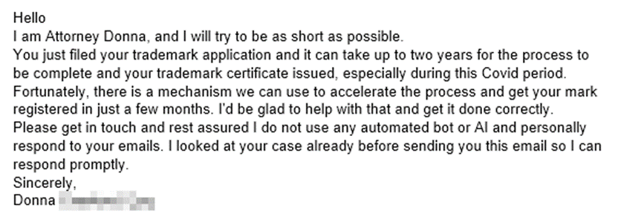
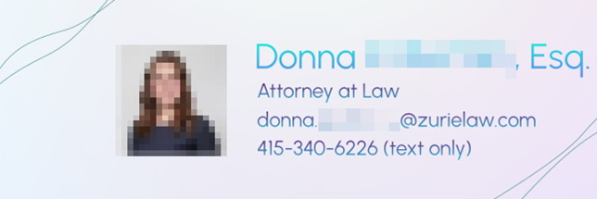
Fake correspondence scams: example
Notes:
Sarah
Here's an example of a scam where this occurred. There was no attorney by this name that worked for an organization called Zuriel Law, nor did they look anything like the person in the picture. But the scammers used her name and identity to correspond with and build credibility with victims, and unfortunately, steal money.

Slide 51
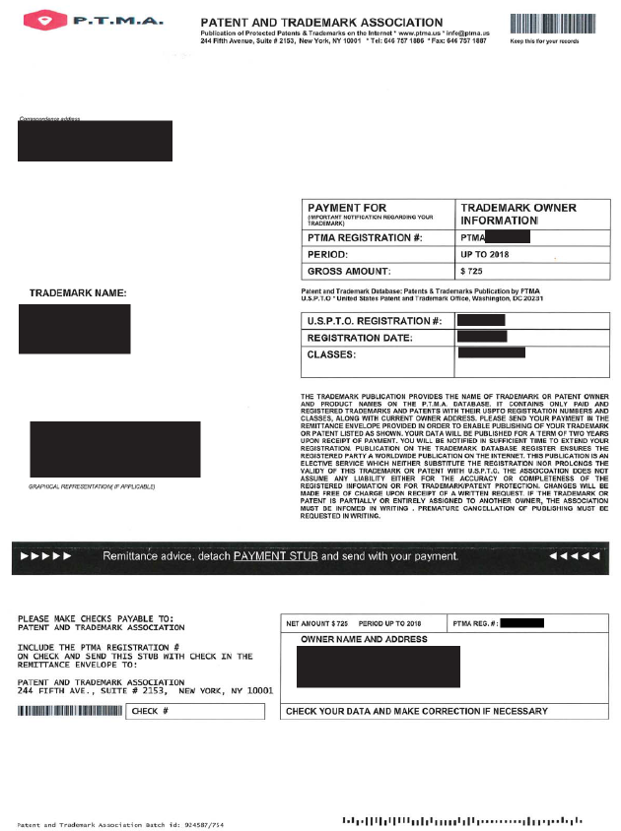
Trademark Scams: Domestic

Slide 52
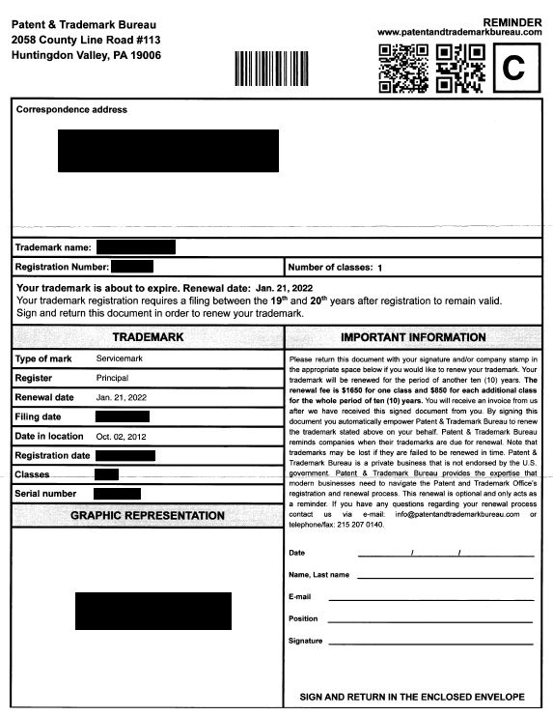

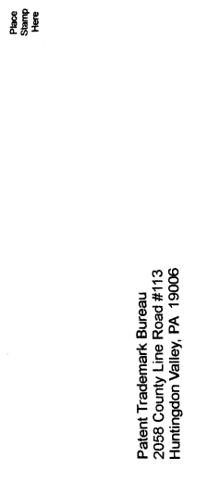
Trademark Scams: Domestic cont’d

Slide 53
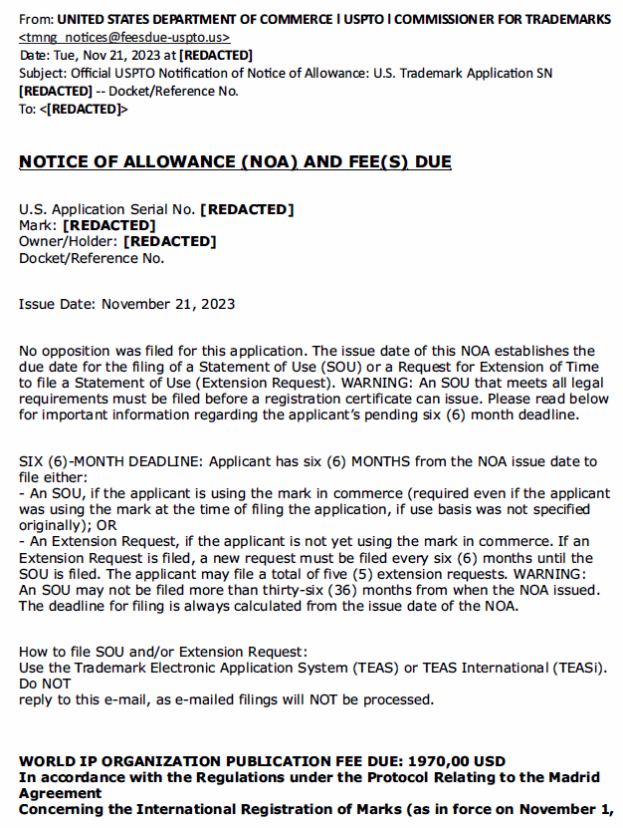
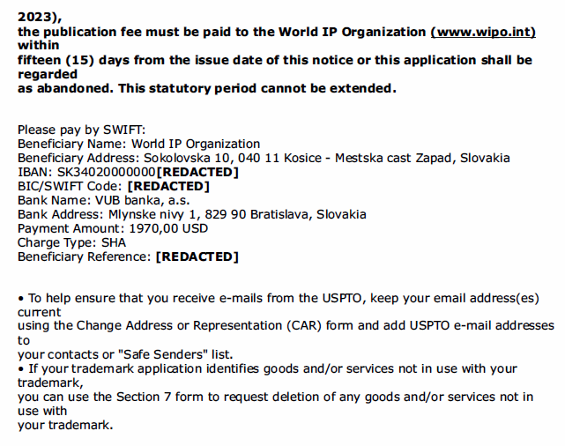
Trademark Scams: Foreign

Slide 54
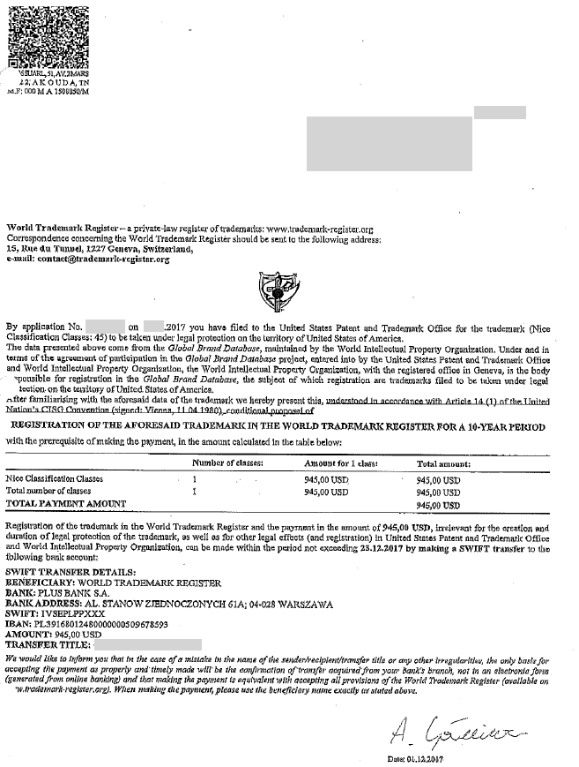
Trademark Scams: Foreign cont’d
See https://www.uspto.gov/trademarks/protect/caution-misleading-notices

Slide 55
Fees and trust account issues
In the Matter of Everitt Beers, Proceeding No. D2016-8 (USPTO June 10, 2016)
  Registered patent attorney:
    Client hired Respondent to file eight TM applications.
    Respondent billed for and received $2,600 advanced costs as filing fees.
    Respondent failed to deposit any of the $2,600 in a trust account.
    Respondent then billed and received $5,005 advanced fees to prepare and file eight TM applications, neither of which he did.
    Respondent then sent a list of work purportedly performed – eight fictitious TM applications.
    Converted all advanced costs and fees for his own use and failed to deposit unearned legal fees and USPTO fees in a trust account.
  Mitigating factors included no prior disciplinary history during 12 years of practice.
  Suspended for four months.

Slide 56
Dealings with foreign entities
In the Matter of Tung-Yun McNally, Proceeding No. D2023-22 (USPTO April7, 2023)
  Registered patent agent:
    Submitted more than 688 design patent applications on behalf of applicants between Aug 2019 and Sept 2021.
    USPTO issued a Notice of Payment Deficiency for 21 of these applications where Respondent signed, executed and submitted a Certification of Micro Entity Status.
    Respondent signed certifications based upon representations made to her by a foreign associate for the applicants.
    Except for one application, Respondent claimed she was not aware of the Notices of Deficiency, changes in certifications, or the payment of the deficiency amounts until she received communication from OED.

Slide 57
Dealings with foreign entities, cont’d
    Respondent relied upon the foreign associate’s representations, with whom Respondent’s law firm had an existing relationship.
    No firm procedures or guidelines were in place to personally verify the underlying basis for Certification of Micro Entity status.
  Mitigating factors:
    Respondent sua sponte investigated at least one filing made prior to receiving any communication from OED
    Worked with firm and foreign associate to implement new procedures for micro entity status certification and adopted law firm protocols to verify an applicant’s claim of micro entity status.
    No prior discipline and cooperation with OED’s investigation.
  Reprimanded.

Slide 58

37 C.F.R. § 1.3

Slide 59
Decorum required in trademark (TM) communications
All those who practice TM matters before the USPTO are required to conduct their business with decorum and courtesy. See 37 C.F.R. § 2.192; TMEP 709.07.
If a submitted document contains rude or discourteous remarks, it may be referred to the Deputy Commissioner for Trademark Examination Policy for review.
If it is determined that the document is in violation of 37 C.F.R. § 2.192, the document will not be considered and will be removed from the file.

Slide 60
Disreputable or gross misconduct
In re Schroeder, Proceeding No. D2014-08 (USPTO May 18, 2015):
Patent attorney:
  Submitted unprofessional remarks in two separate Office action responses;
  Remarks were ultimately stricken from application files pursuant to 37 C.F.R. § 11.18(c)(1);
  Order noted that behavior was outside of the ordinary standard of professional obligation and client’s interests; and
  Aggravating factor: has not accepted responsibility or shown remorse for remarks.
Default: 6-month suspension.
Rule highlights:
  37 C.F.R. § 10.23(a) – Disreputable or gross misconduct;
  37 C.F.R. § 10.89(c)(5) – Discourteous conduct before the Office;
  37 C.F.R. § 10.23(b)(5) – Conduct prejudicial to the administration of justice; and
  37 C.F.R. § 11.18 – Certification upon filing of papers.

Slide 61
Disreputable or gross misconduct
In re Tassan, Proceeding No. D2003-10 (USPTO Sept. 8, 2003):
Registered practitioner who became upset when a case was decided against his client, and left profane voicemails with TTAB judges.
Called and apologized one week later; said he had the flu and was taking strong cough medicine.
Also had a floral arrangement and an apology note sent to each judge.
Mitigating factors: private practice for 20 years with no prior discipline; cooperated fully with OED; showed remorse and voluntary sought and received counseling for anger management.
Settlement: Reprimanded and ordered to continue attending anger management and have no contact with Board judges for 2 years.

Slide 62
Other examples of disreputable or gross misconduct
Speaking to a TTAB interlocutory, practitioner was in a rage and screamed at him, and to another, he yelled and told the interlocutory “how awful [you] all are” and “how terrible all government workers are.”
While yelling at an interlocutory over the phone, Practitioner claimed to be a friend of TTAB Chief Judge Rogers and that he should receive special treatment, and again attacked the character of PTO employees, and demanded that the interlocutory on his case be replaced. Another instance, after yelling at the interlocutory, he hung up on her.

Slide 63
Decisions imposing public discipline available in “FOIA Reading Room”
foiadocuments.uspto.gov/oed/
Official Gazette for Trademarks:
  www.uspto.gov/learning-and-resources/official-gazette/trademark-official-gazette-tmog

Slide 64
OED
571-272-4097

