Slide 1
Edison Research Fellows and the Executive Actions
December 9, 2014

Slide 2
Edison Scholar Program
Bring distinguished academic researchers to the USPTO to study intellectual property (IP) issues that further the agency’s mission and the public interest
The White House Task Force on High-Tech Patent Issues:
  “expansion of the PTO Edison Scholars Program, which will bring distinguished academic experts to the PTO to develop — and make available to the public — more robust data and research on the issues bearing on abusive litigation”
Edison Research Fellows

Slide 3
What Issues Bear on Patent Litigation?
Market structure
Competitive landscape and Business models
Markets for technology
Ease of entry and exit
Complex manufacturing and standards
Patent “quality”
Examination quality control
Managerial and legal guidance and training
Examiners’ search tools
Appeals and post-grant procedures
Disputes
Claim construction challenges
Costs of litigation
Standards of review and legal presumptions
Other factors
Macro-economic conditions
Technological change
Liquidity and access to capital
Patent
Litigation

Slide 4
Edison Research Fellows
3 fellows started in Summer 2014 to research issues
related to abusive patent litigation with a focus on high-tech patents
  Joseph Bailey, University of Maryland, Smith School of Business
  Jonas Anderson, American University, Washington College of Law
  Deepak Hegde, New York University, Stern School of Business
http://www.uspto.gov/ip/init_events/edisonscholar.jsp

Slide 5
Machine Learning for Prior Art Retrieval
Joe Bailey, PhD
Edison Research Fellow

Slide 6
Research Question
How can machine learning best be used to uncover prior art during patent examination?

Slide 7
Proposed Algorithm
Each application and reference is clustered based on its classification; classification vectors are used to find nearest neighbors
Stemming and lemmatization are done within each category for subsequent analysis
K-NN is used to look at the nearest neighbors
Results may be filtered to look within as well as across clusters
Art may be added and subtracted from clusters
Clusters may be created or retired

Slide 8
Methodology
Identify current state
  Examine algorithms currently used
  Evaluate the algorithms
  Propose an algorithm
  Evaluate the proposed algorithm
  Improve the algorithm and expand its application
Out of scope (but related)
  Classification
  Routing
  Assignment
  Image searching

Slide 9
Example Search in EAST
Seq. | Words | Hits
S1 | (website “web site” webpage “web page” internet interactive server online “online”) with (purchase customer buyer consumer user) | 520,887
S2 | ((data near (mine mining)) ((statistical purchase history) near (analyz$3 analys$3)) ((past history future) near (purchase))) | 91,143
S3 | (discount coupon (reduc$5 near (fee price cost))) with (bulk group ((many multiple two more number) near2 (user consumer customer purchaser buyer))) | 11,023
S4 | S1 & S2 & S3 | 1,036

Slide 10
Analysis of Current Tools
 | Pros | Cons
Google | Fast response time Some algorithm transparency and filtering | Lack of algorithm transparency Concerns about use of search data
IP.com | Some filtering of results | Lack of algorithm transparency
PLUS | Internal to the USPTO USPTO controls the system | Relatively slow response time Lack of algorithm transparency Lack of filtering of results Issues related to scalability of platform

Slide 11
User Centered Design Council (UCDC)
Working group of 12 examiners from 2100, 2400, and 3600
Co-Chaired with Examiner Jamie Kucab
Evaluation of language processing engines:
  1: §102 reference or §103 base reference
  2: secondary §103 reference
  3: not applicable
Three applications, one in each area

Slide 12
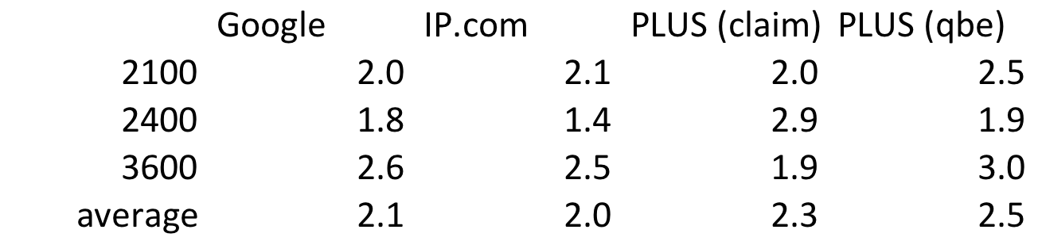
UCDC Evaluations
One application in each Technology Center
4 references for each tool
(surprisingly, there was little overlap of references)
N = 48

Slide 13
Proposed Algorithm
Each application and reference is clustered based on its classification; classification vectors are used to find nearest neighbors
Stemming and lemmatization are done within each category for subsequent analysis
K-NN is used to look at the nearest neighbors
Results may be filtered to look within as well as across clusters
Art may be added and subtracted from clusters
Clusters may be created or retired

Slide 14
Cluster Vectors
 | 705/35 | 705/37 | 705/38 | G06Q20 | G06Q30 | G06Q40
573 | 1 | 1 | 0 | 0 | 0 | 1
643 | 0 | 0 | 0 | 0 | 1 | 0
857 | 1 | 0 | 0 | 0 | 0 | 1
948 | 0 | 0 | 1 | 1 | 0 | 1
Score
2
3
App.
3

Slide 15
2. Stemming and Lemmatization
857 (app - claim) | 573 (prior art) | stem match? | lemmatization match?
aggregating | aggregator | yes | yes
aggregating | pooled | no | yes
bulk sale | sale | no | no
catalogue | catalog | yes | yes
encryption | encryption | yes | yes
online | interent | no | yes
threshold number | limit | no | yes
web site | web server | no | yes
Word Frequency Count for U.S. Cl. 705/35

Slide 16
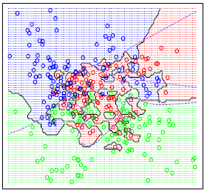
3. Clustering and 4. Filtering
Example clusters

Slide 17
5. Add/Subtract
Add
  When new prior art is cited by the courts, examiners
  When examiners (or the crowd?) thinks it belongs
Subtract
  When a reference becomes too old
  When a reference is reclassified
  When examiners (or the crowd?) thinks it doesn’t belong

Slide 18
6. Create/Retire
Create
  When a new category makes sense
  A category gets too crowded
  Lexicographers or policy makers mandate it
Retire
  When a category becomes dormant or irrelevant
  When combining categories improves search results

Slide 19
Prototype Design: Requirements
Input
  Intuitive
  Easy
  Claim search vs. QBE
System
  Low latency
  Transparent Algorithm
  Learning Algorithm
Output
  Filtering
  Connection to EAST

Slide 20
Algorithm Evaluation
Current Algorithm
Results
no
Art areas 2100/ 2400/ 3600?
Submit PLUS request
Comparison
done by
examiner
focus group
yes
Prototype Algorithm
Prototype Results
This is what we will build

Slide 21
Potential Next Steps
Art may be annotated by humans
Additional art may be ingested
Examiners and the “crowd” may participate in these processes as well as 5) add/subtract and 6) create/retire

Slide 22
Conclusions
Commercial platforms are helpful but may never be sufficient
PLUS has a place at the PTO
Greater investment in PLUS algorithms may improve their success
Greater transparency, lower latency, a more scalable architecture, and improved training may improve PLUS
Feedback loops that build on the collective knowledge of the Patent Corps may continually improve a PLUS successor

Slide 23
Claim Clarity at the USPTO
Jonas Anderson
Edison Research Fellow

Slide 24
Fundamental Question
Can the federal court’s experience with claim construction be leveraged to improve claim clarity during examination at the PTO?

Slide 25
Claim Clarity
For a system of property rights to function, the boundaries of those rights must be reasonably clear
Unfortunately, boundaries for patents and other intangibles are much more difficult to identify than the boundaries of tangible objects
Despite this limitation, there are ways to improve clarity

Slide 26
Claim Clarity at the PTO:
Current Initiatives
Examiner training for functional claiming
Identifying PTAB decisions involving functional claiming
Glossary pilot program
Stakeholder engagement sessions
Revising the quality review process

Slide 27
Claim Clarity: An Overview of Academic Approaches
Comparative Approach
Doctrinal Approach
Administrative Approach
Incentive Approach

Slide 28

Claim Construction Appeals
Informal Deference: A Historical, Empirical, and Normative Analysis of Patent Claim Construction, 108 Nw. U. L. Rev. 1 (2014) (with Peter S. Menell)

Slide 29
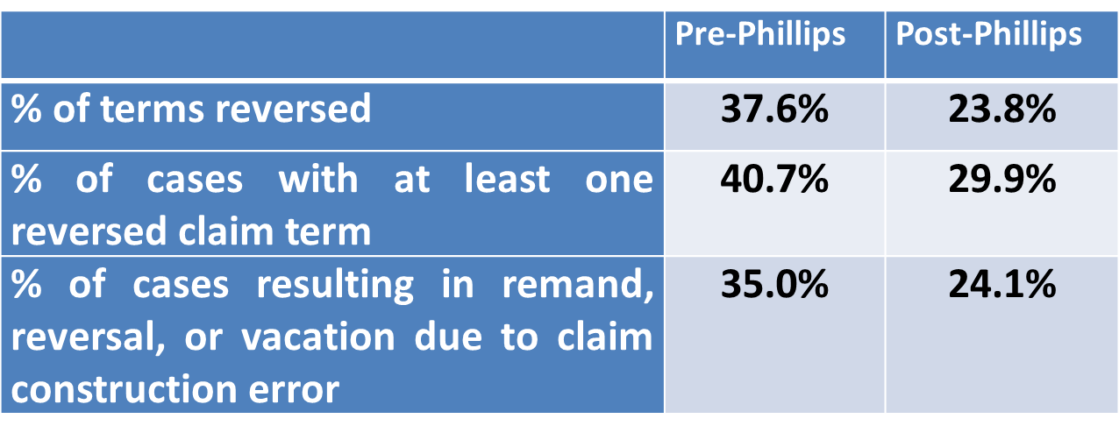
Claim Construction Reversal Rates: 2000-2010

Slide 30
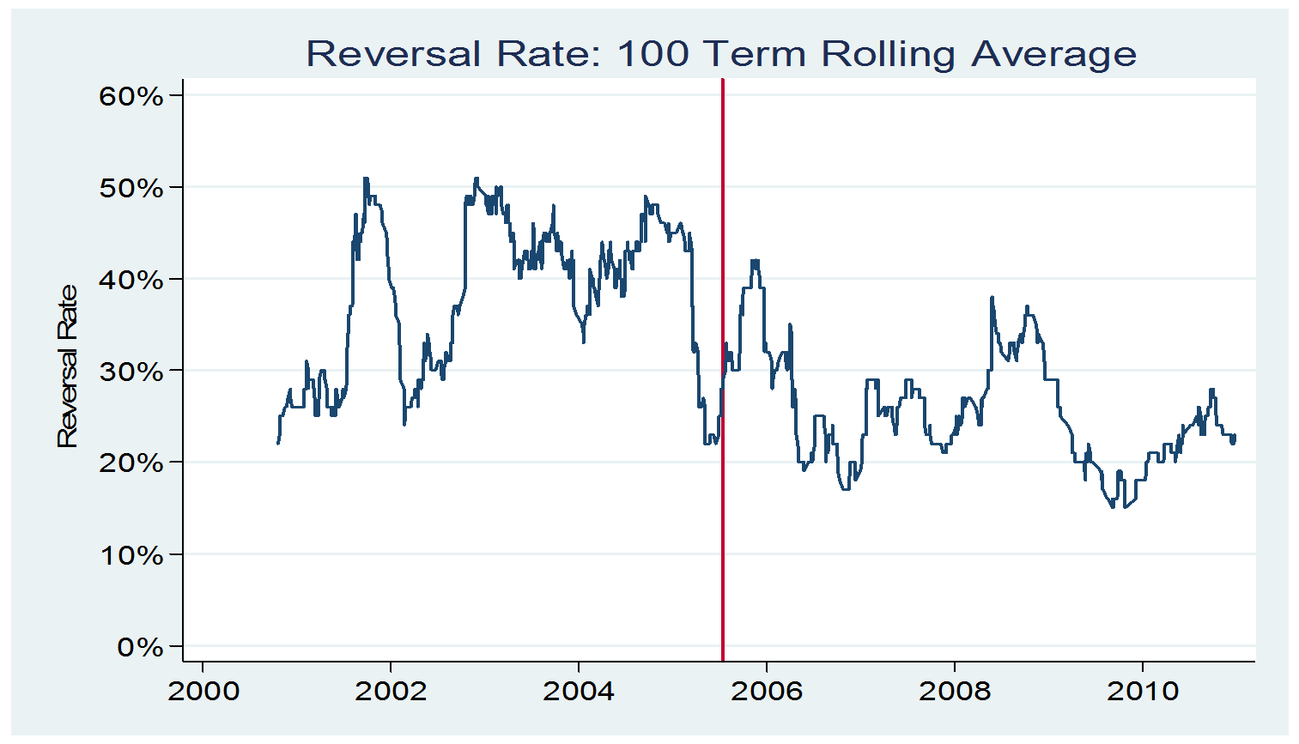
Claim Construction Reversal Rates: 2000-2010

Slide 31
Claim Construction: Use of Dictionaries at CAFC

Slide 32

Step 1: Quantifying the Clarity Problem in Litigation

Slide 33
Categorizing Disputed Claim Terms (Examples)
  By claim/limitation type
    i. Means + Function claims
    Preamble limitations
  By linguistic or textual details
    i. Functional claims
    ii. Technical specificity
    C. By dispute type
    Multiple, valid potential meanings
    Indeterminate meaning

Slide 34
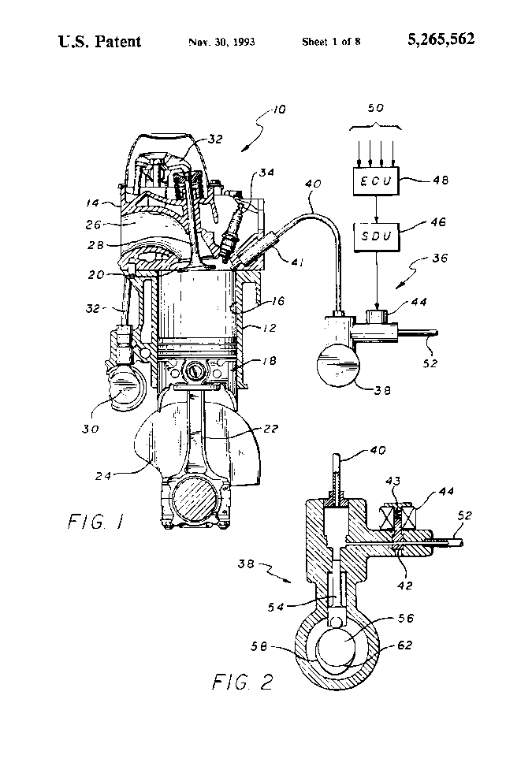
Disputed Claim Terms
(2013 Sample)
“substantially isothermal process”
Patent No. 5,265,562: Internal combustion engine with limited temperature cycle

Slide 35
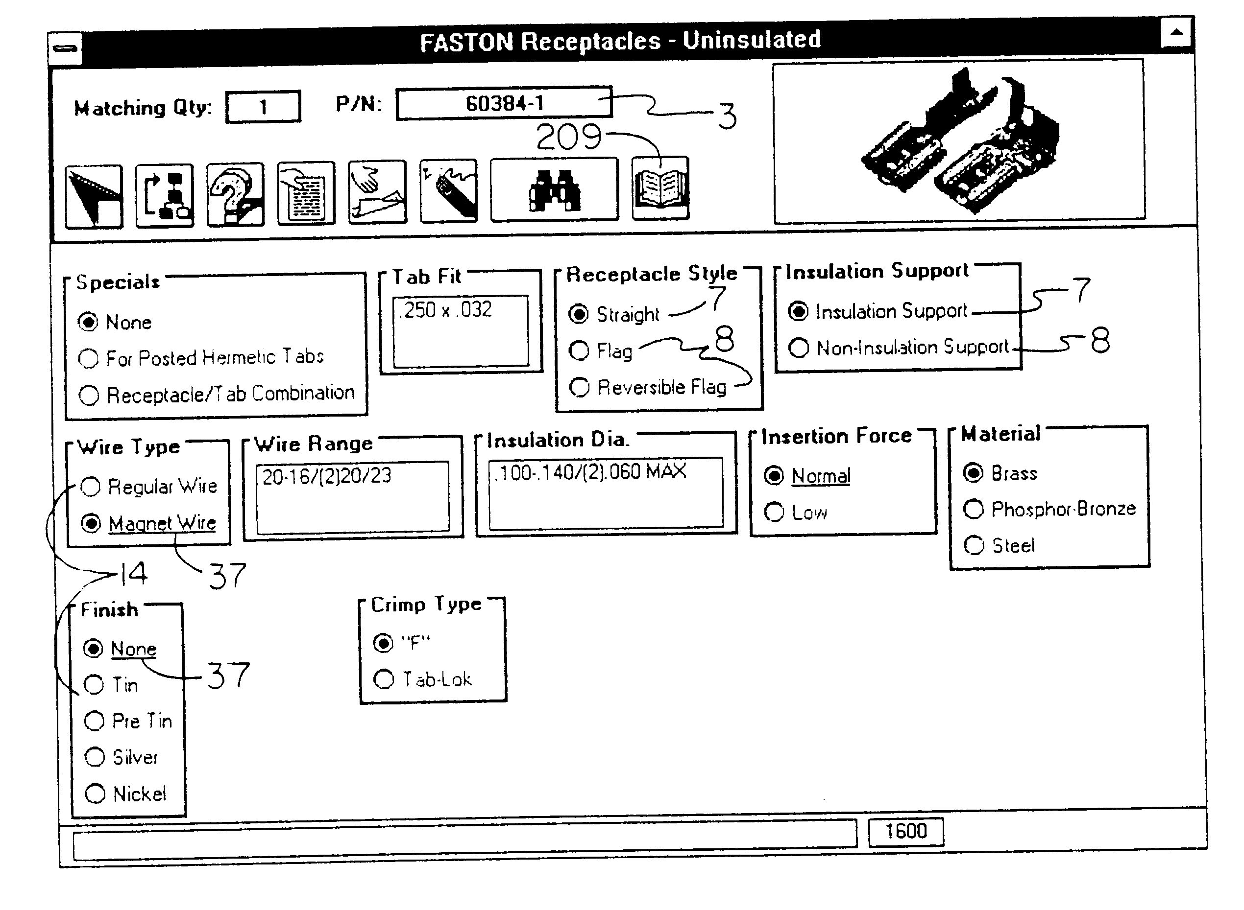
Disputed Claim Terms
(2013 Sample)
“resubmission to server”
“displaying”
Patent No. 6,275,821: Method and system for executing a guided parametric search

Slide 36
Step 2: Comparing Claim Construction to Application Data

Slide 37
Comparing Claim Construction to Application Data
  By claim/limitation type
    i. Means + Function claims
    Preamble limitations
  By linguistic or textual details
    i. Functional claims
    ii. Technical specificity
    C. By dispute type
    Multiple, valid potential meanings
    Indeterminate meaning

Slide 38
Next Steps
Examining prosecution history for clarity disputes
Comparing prosecution database with litigation database
Using natural language processing to identify the frequency of patent applications that exhibit the sorts of problematic claims observed in litigation

Slide 39
Conclusions
Claim construction litigation provides a window into the claim terms that are the most difficult to understand
Leveraging the data from litigation can shed light on the value of claim clarity projects currently under way at the PTO
Additionally, it may provide avenues of further study and examination

Slide 40
Patent Allowance Rates and Examination Quality
Deepak Hegde
Edison Research Fellow

Slide 41
Research Questions
What are patent allowance rates at the USPTO?
How are allowance rates and examination quality related?
What factors affect allowance rates and examination quality?

Slide 42


Why Study Allowance Rates and Examination Quality?
“the problem of patent trolls is a function in part of the promiscuity with which the patent office has issued patents..” (Becker & Posner 2013)

Slide 43
I. What Are Patent Allowance Rates at the USPTO?
Analyzed data on each of the 2.15 million original applications (applications unrelated to any previous application) filed between 1995 and 2005
Each application tracked through July 31, 2013
(98.5 percent of the original applications were either granted or abandoned)
Tracked “continuations,” many of which are docketed as new applications

Slide 44
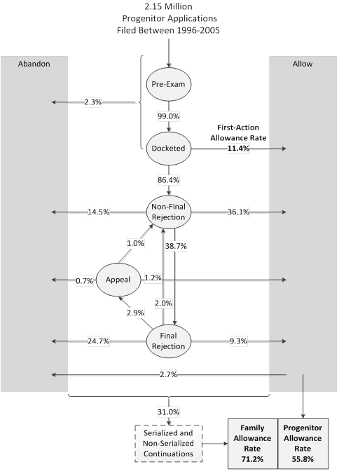
Patent Examination Process

Slide 45
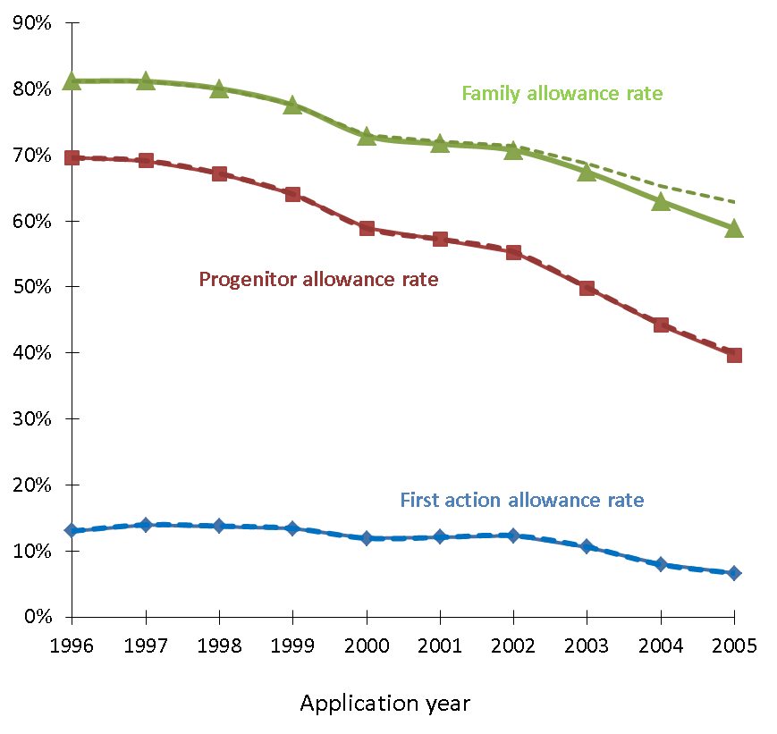
Patent Allowance Rates Declined for Applications between 1996 and 2005

Slide 46
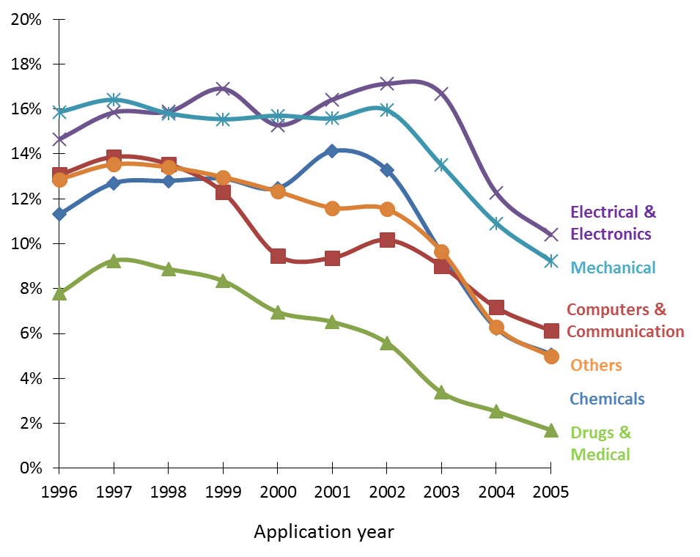
First Action Allowance Rates Declined for All Technology Fields

Slide 47
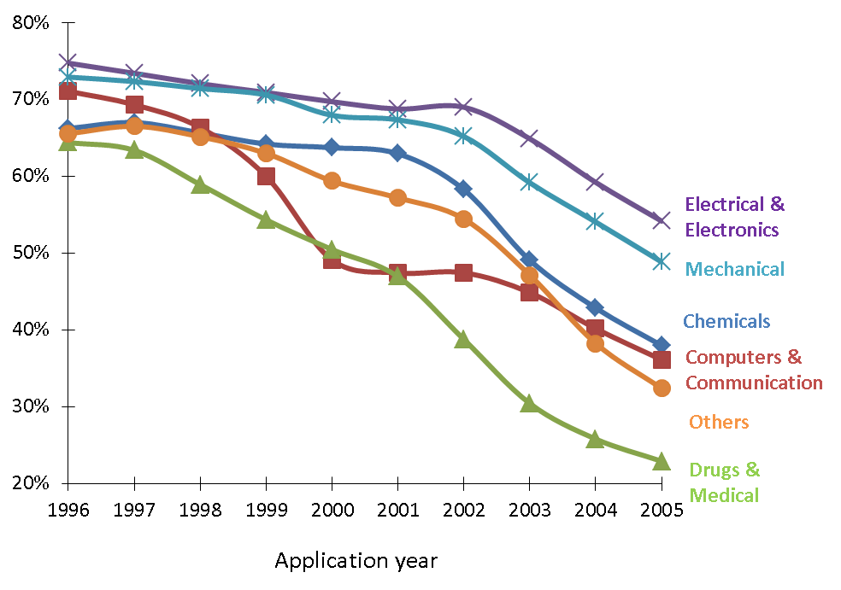
Progenitor Allowance Rates Declined for All Technology Fields

Slide 48
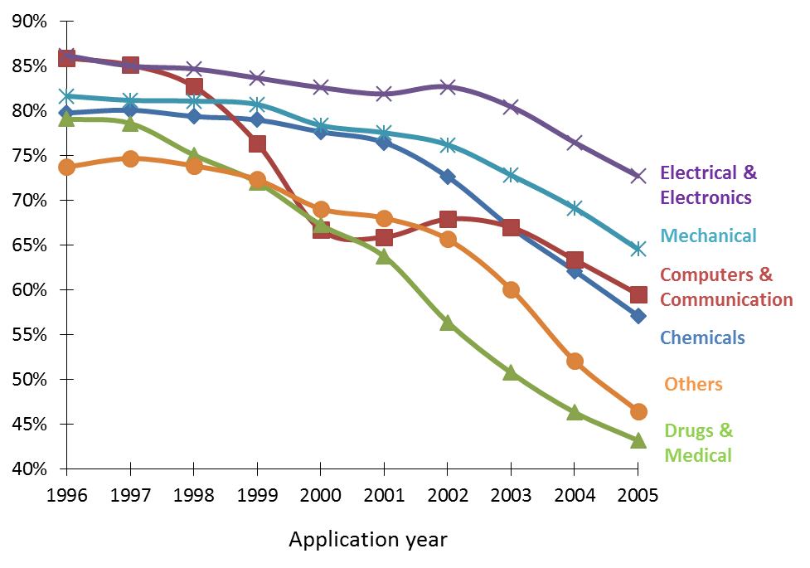
Family Allowance Rates Declined for All Technology Fields

Slide 49
What are Patent Allowance Rates at the USPTO?
Carley, M., Hegde, D., and Marco, A., What is the Probability of Receiving a US Patent?, forthcoming, Yale Journal of Law and Technology http://ssrn.com/abstract=2367149

Slide 50
Next Steps
How are patent allowance rates related to examination quality?
  How to measure examination quality?
What factors affect patent allowance rates and examination quality?
  Study the effects of examination related policies at the USPTO

Slide 51
Questions/Comments
Joseph.Bailey@uspto.gov
Jerome.Anderson@uspto.gov
Deepak.Hedge1@uspto.gov
Alan.Marco@uspto.gov
edisonscholar@uspto.gov

Slide 52
Thank You

