Slide 1
Cybersecurity Partnership Meeting
United States Patent and Trademark Office
February 10, 2016 in San Jose, CA
February 10, 2016 in San Jose, CA

Slide 2
Welcome
John Cabeca
Director, Silicon Valley USPTO
United States Patent and Trademark Office
February 10, 2016 in San Jose, CA
February 10, 2016 in San Jose, CA

Slide 3
Opening Remarks
Russell Slifer
Deputy Director of the USPTO
United States Patent and Trademark Office
February 10, 2016 in San Jose, CA
February 10, 2016 in San Jose, CA

Slide 4
Cybersecurity Partnership Information Session on Cybersecurity Patent Application and Examination
Nestor Ramirez
Director, Technology Center 2400
United States Patent and Trademark Office
February 10, 2016 in San Jose, CA
February 10, 2016 in San Jose, CA

Slide 5
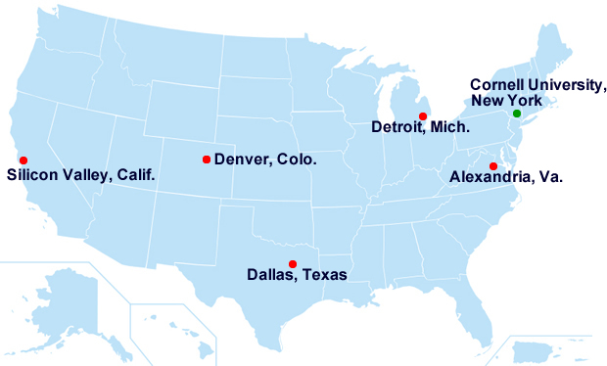
About USPTO
Mission: Fostering innovation, competitiveness and economic growth, domestically and abroad to deliver high quality and timely examination of patent and trademark applications, guiding domestic and international intellectual property policy, and delivering intellectual property information and education worldwide, with a highly skilled, diverse workforce.
The USPTO operates a headquarters in Alexandria, Virginia and four regional offices.
12000+ professionals, including
engineers, scientists and attorneys

Slide 6
Who Are We?
1600
Biotechnology and Organic Chemistry
1700
Chemical and Materials Engineering
2100
Computer Architecture and Software
2400
2600
2800
2900
3600
Communications
3700
Semiconductors, Electrical and Optical Systems and Components
Designs
Mechanical Engineering, Manufacturing and Medical Devices/Processes
Networking, Multiplexing, Cable, and Security
Transportation, Construction, Electronic Commerce, Agriculture, National Security, and License & Review

Slide 7
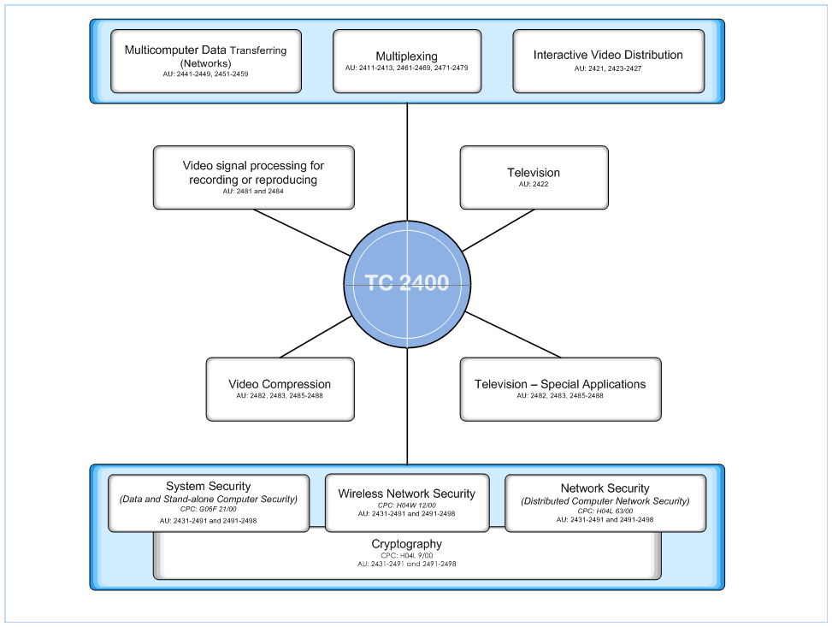
Information Security and Cryptography

Slide 8
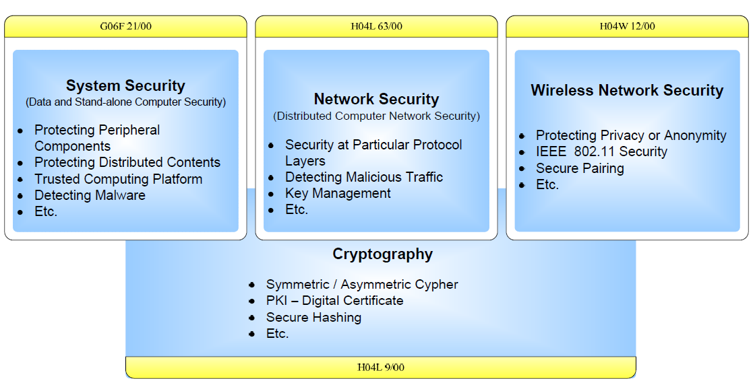
Computer Security Workgroup Applications

Slide 9
Our Workforce - Information Security and Cryptography Art Units

Slide 10
Our Workforce - Information Security and Cryptography Patent Examiners

Slide 11
Teleworking in Information Security and Cryptography Workgroup
 | PROGRAM TYPE | PARTICIPANTS
EXAMINERS | PTP10 | 24
 | PTP20 | 23
 | PTP32 | 33
 | PHP | 51
 | PHP-TEAPP | 45
SPEs | PMTP | 14
 | FMTP | 2

Slide 12
Filing - Top 15 Assignees Information Security and Cryptography Applications
2011
No. Apps | Assignee
210 | IBM
199 | Microsoft
99 | Google
98 | Symantec
86 | McAfee
68 | EMC
63 | Apple
60 | Amazon
60 | ETRI
57 | Samsung
54 | Toshiba
53 | Sony
51 | HP
49 | Cisco
46 | RIM
2012
No. Apps | Assignee
297 | IBM
214 | Google
137 | Microsoft
125 | EMC
123 | Intel
91 | Symantec
90 | Samsung
87 | Amazon
81 | Toshiba
78 | Blackberry
50 | Cisco
49 | HP
49 | ETRI
47 | Sony
46 | Broadcom
2013
No. Apps | Assignee
373 | IBM
153 | Intel
152 | Google
145 | Amazon
120 | Symantec
114 | EMC
111 | Microsoft
91 | Samsung
83 | Qualcomm
76 | Toshiba
66 | Cisco
66 | HP
48 | Fujitsu
47 | NEC
46 | Tencent
2014
No. Apps | Assignee
325 | IBM
204 | Amazon
195 | Microsoft
159 | Intel
152 | Symantec
129 | Google
117 | Samsung
92 | Qualcomm
78 | Tencent
73 | EMC
66 | Bank of America
64 | Kabushiki
62 | ETRI
61 | Cisco
61 | Huawei
2015
No. Apps | Assignee
472 | IBM
144 | Symantec
120 | Microsoft
100 | Samsung
97 | Amazon
95 | Google
88 | EMC
82 | Qualcomm
72 | Tencent
64 | Cisco
63 | Fujitsu
54 | Intel
54 | Oracle
50 | Bank of America
48 | HP

Slide 13
Filing - Top 15 Countries Information Security and Cryptography Applications (by Country of Assignee)
2011 |  | 2012 |  | 2013 |  | 2014
No. Apps | Assignee | No. Apps | Assignee | No. Apps | Assignee | No. Apps | Assignee
2607 | U.S. | 3210 | U.S. | 3697 | U.S. | 4175 | U.S.
415 | Japan | 413 | Japan | 501 | Japan | 489 | Japan
189 | Korea | 229 | Korea | 243 | Korea | 322 | Korea
132 | France | 166 | China | 199 | China | 299 | China
119 | China | 135 | France | 125 | Germany | 177 | Germany
106 | Canada | 133 | Canada | 108 | France | 136 | France
93 | Germany | 127 | Germany | 104 | Taiwan | 87 | Taiwan
81 | Finland | 76 | Taiwan | 94 | Canada | 84 | United Kingdom
81 | Taiwan | 74 | United Kingdom | 65 | Israel | 83 | Israel
67 | Sweden | 56 | Finland | 57 | United Kingdom | 74 | Canada
52 | Netherlands | 49 | Sweden | 57 | Sweden | 69 | Netherlands
42 | United Kingdom | 35 | Israel | 50 | Finland | 64 | Finland
33 | Israel | 30 | Netherlands | 34 | Russian Federation | 57 | Cayman Islands
26 | Switzerland | 26 | Russian Federation | 31 | Netherlands | 50 | Sweden
24 | Russian Federation | 23 | Switzerland | 31 | Cayman Islands | 37 | Russian Federation
2015
No. Apps | Assignee
3454 | U.S.
397 | Japan
266 | China
250 | Korea
121 | Germany
91 | France
75 | Israel
66 | Taiwan
57 | Canada
56 | Netherlands
55 | Cayman Islands
52 | Sweden
51 | United Kingdom
49 | Finland
42 | Switzerland

Slide 14
Information Security and Cryptography Applications - Filed vs. Issued
 | 2011 | 2012 | 2013 | 2014 | 2015
Number of Security Applications Filed | 5235 | 6510 | 7686 | 6878 | 7434
Number of Security Applications Issued | 3264 | 4408 | 5777 | 6878 | 6807

Slide 15
Pendency Metrics – FY 2014 vs FY 2015 Information Security and Cryptography Applications
Security Patent Applications | FY-2014 Pendency | FY-2015 Pendency
First Action Pendency (Average number of months between filing date and first action) | 16.14 months | 14.89 months
Total Action Pendency (Average number of months between filing date and issue or abandonment) | 29.04 months | 27.21 months
Security Patent Applications | FY-2014 Percentage of Actions with a Pendency within 4 months | FY-2015 Percentage of Actions with a Pendency within 4 months
Amendments | 93.4% | 95.1%
RCE | 50.1% | 70.4%
Patent Trial and Appeal Board (PTAB) | 99.0% | 98.8%

Slide 16
Appeal Metrics Information Security and Cryptography Applications
Security Patent Applications | 2015
Appeal Briefs Filed | 233
Examiner’s Answers | 192
Abandonment after Board Decision | 301
Allowance after Board Decision | 153
Reopened after Board Decision | 9

Slide 17
Patent Application Initiatives Website
http://www.uspto.gov/patent/initiatives/uspto-patent-application-initiatives-timeline

Slide 18
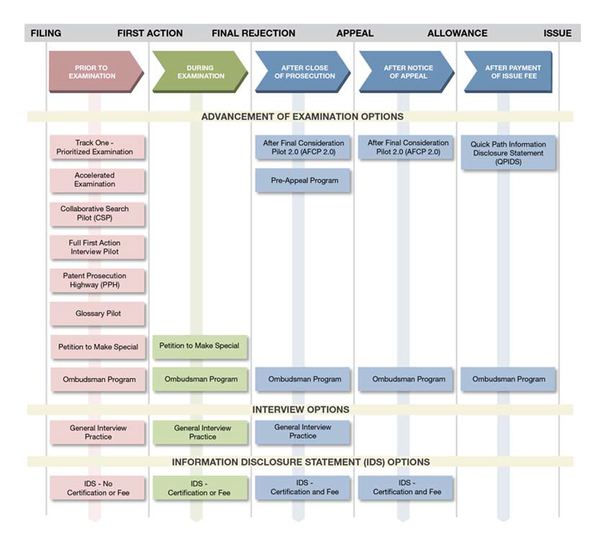
Patent Application Initiatives (PAI)

Slide 19
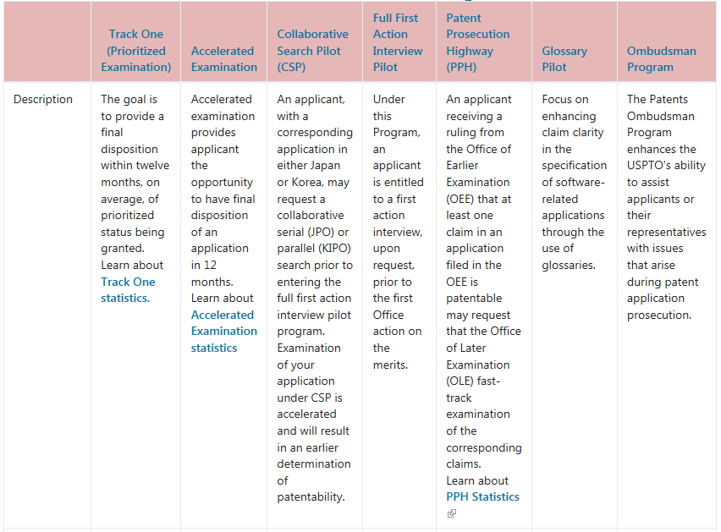
Patent Application Initiatives (PAI)
Prior to Examination

Slide 20
Patent Application Initiatives: Collaborative Search Pilot Program (CSP)
The USPTO is conducting two collaborative search pilots, one with the Japanese Patent Office (JPO) and a second with the Korean Intellectual Patent Office (KIPO).
Both search pilot procedures are based upon the First Action Interview (FAI) program.
These pilots are slightly different:
In the JPO pilot, the initial search and evaluation by the two offices are exchanged prior to the examiner completing the Pre-Interview Communication (PIC) form so that the PIC contains both Office’s input.
In the KIPO pilot, the USPTO’s Pre-Interview Communication (PIC) form is conducted independent of the KIPO work and both work items are provided to the applicant for their consideration.

Slide 21
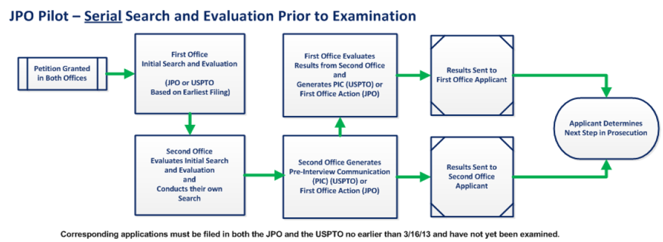
Patent Application Initiatives (PAI) Collaborative Search Pilot - JPO
http://www.uspto.gov/sites/default/files/documents/GeneralCSPInfo.pdf

Slide 22
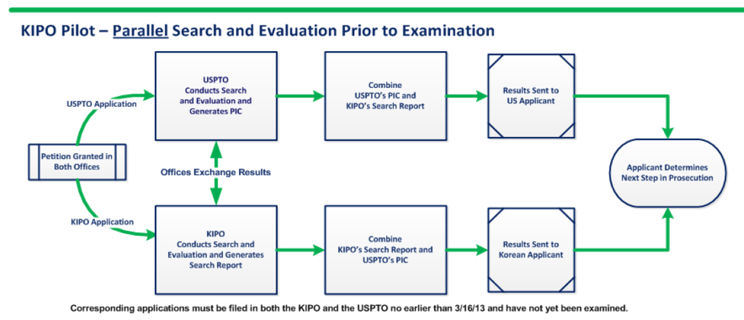
Patent Application Initiatives (PAI) Collaborative Search Pilot - KIPO
http://www.uspto.gov/sites/default/files/documents/GeneralCSPInfo.pdf

Slide 23
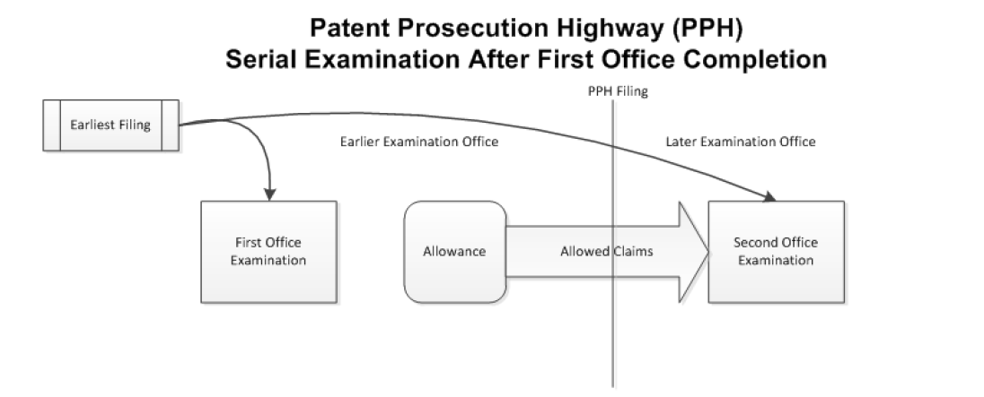
Patent Application Initiatives (PAI) PPH - Prior to Examination -
http://www.uspto.gov/sites/default/files/documents/GeneralCSPInfo.pdf

Slide 24
Patent Application Initiatives: Pendency to First Office Action Information Security and Cryptography Applications
*Track One program starts in FY 2012
** No First Actions for Accelerated Examination in FY 2015

Slide 25
Patent Application Initiatives: Allowance Rate Information Security and Cryptography Applications
*Track One program starts in FY 2011

Slide 26
Patent Application Initiatives Information Security and Cryptography Applications
*Track One program starts in FY 2011

Slide 27
Patent Application Initiatives (PAI)
During Examination

Slide 28
Patent Application Initiatives: Interview Practice Metrics

Slide 29
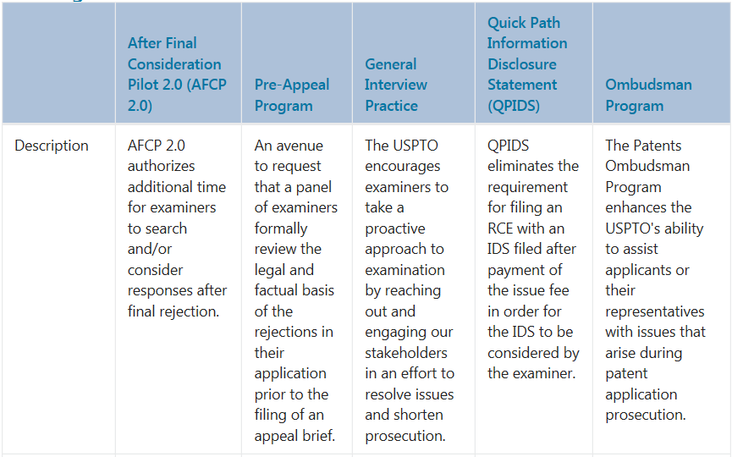
Patent Application Initiatives (PAI)
After Close of Prosecution

Slide 30
Patent Application Initiatives: QPIDS Metrics Information Security and Cryptography Applications

Slide 31
Patent Application Initiatives: AFCP 2.0 Metrics
(May 19, 2013* – January 29, 2016)
*Start Date of AFCP

Slide 32
Questions or Comments?
Nestor Ramirez
Director, TC2400
Nestor.Ramirez@uspto.gov
CyberSecurityPartnership@uspto.gov

Slide 33
Cybersecurity Partnership Cooperative Patent Classification (CPC) Updates
Jung (Jay) Kim
February 10, 2016 in San Jose, CA

Slide 34
About CPC
The CPC is the patent classification scheme common to the USPTO and the European Patent Office (EPO). Just as other existing schemes, it provides a structured system which assists its users in finding prior art publications, primarily patent documents.
The CPC was initiated as a joint partnership between the USPTO and the EPO where the Offices agreed to harmonize their existing classification systems (USPC and ECLA, respectively).
USPTO officially transitioned to the CPC on January 1, 2013.

Slide 35
CPC Benefits
Provides the examination corps and stakeholders with:
An international classification system that is an International Patent Classification (IPC) compliant scheme
The IPC is the most widespread classification scheme worldwide.
A single classification symbol set for all USPTO and EPO documents
Classification is the foundation for all harmonization efforts.
A classification scheme/system that is adaptive and more actively maintained
The CPC is continuously revised in collaboration between USPTO and EPO experts. The revision process is flexible enough as to ensure the structure is up-to-date.

Slide 36
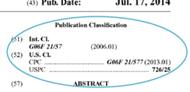
CPC Overview
CPC does not change standards of patentability
CPC provides 250,000 breakdowns vs. 150,000 for USPC
CPC only includes Utility inventions
CPC does not impact Plant and Design schemes.
CPC is primarily based on EPO’s ECLA/ICO classification system with best practices of USPC
Classification is assigned based on invention information (CPC) vs. claimed invention (USPC)
Classification is assigned based on family members (CPC) vs. individual documents (USPC)
A patent family is a collection of documents sharing the same priority, including US patent documents and foreign patent documents.

Slide 37
CPC Timeline
CPC Milestones | Timeframe
USPTO and EPO agree to work toward the formation of a joint classification system. | 2010
CPC symbols applied to PGPUB pipeline documents and Patent Grants. | 2013
USPC and CPC symbols searchable in EAST/WEST, while application routing remains based on USPC. | 2013
Other national offices commit to classifying their patent documents into the CPC including SIPO, KIPO and Rospatent. | 2013
Final stage of CPC implementation. | 2015
Ongoing collaborative revision projects between USPTO and EPO. | 2015+

Slide 38
CPC Structure /Schema
A-H or Y
00-99
A-Z
0-9999/
00-999999
Section
Class
Subclass
Group
A: Human Necessities
B: Performing Operation; Transporting
C: Chemistry; Metallurgy;
D: Textiles; Paper
E: Fixed Constructions
F: Mechanical Engineering
G: Physics
H: Electricity
Y: General Tagging of New Technological Developments
Subgroup
H04L 9/065 is an example of a CPC symbol
H is the section
H04 is the class
H04L is the subclass identifier
H04L 9 is the group identifier
H04L 9/065 is the subgroup identifier

Slide 39
CPC Structure /Schema
CPC hierarchy example
Main group (always “/00”)
Subgroup (‘1 dot’ level)
Subgroup (‘2 dot’ level)

Slide 40
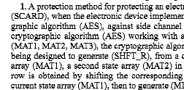
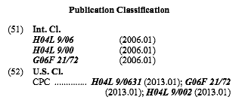
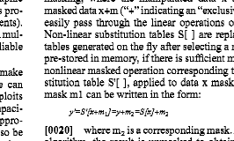
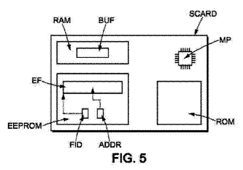
Patent Document Classification
The classification assignment is based on the entirety of the information that the document provides. The different pieces of information are not all provided at the same level, therefore they are given different emphasis in the classification process.

Slide 41
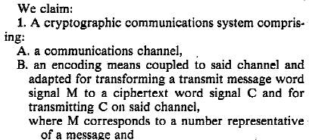
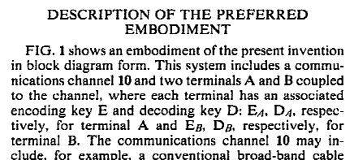
Patent Document Classification
The Claims define the invention as the inventor sees it at the time of filing. Hence, they provide classification related information, but the claims do not exclusively determine where a document is classified.
The Specification describes elements such as the problem solved with the invention, the advantages of the invention, and specific embodiments.
In CPC, all this information is useful for allocating classification symbols. The idea is to be able to afterwards retrieve all the useful information, regardless of whether it was present in claims or description.

Slide 42
Patent Document Classification
Invention information is technical information in the disclosure of the document (claims, description or drawings) that represents an addition to the state of the art (i.e. all novel and unobvious subject matter disclosed).
Additional information is technical, does not add anything to what is already known in the art, but, is not trivial.
In CPC, both the invention information and the additional information can be classified. Hence, a CPC symbol can be allocated as either invention information or additional information.

Slide 43
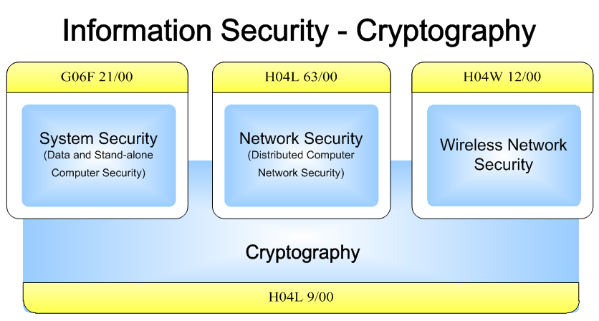
Patent Document Classification

Slide 44
Patent Document Classification
Cryptography
System Security
Symmetric Cipher
H04L 9/06
Asymmetric Cipher
H04L 9/30
Protecting Distributed Contents
G06F 21/10
Authentication
G06F 21/30-40
Hash - HMAC
H04L 9/32
PKI-Digital Certificate
H04L 9/3263
Detecting Local Intrusion/Malware
G06F 21/52-56
Trusted Computing Platform
G06F 21/57
Key Management
H04L 9/08
Quantum Cryptography
H04L 9/0852
Protecting Data – Access Control
G06F 21/60
Protecting Peripheral Components
G06F 21/70-80
H04L 9/00
Cryptographic mechanisms or cryptographic arrangements for secret or secure communication
G06F 21/00
Security arrangements for protecting computers, components thereof, programs or data against unauthorized activity

Slide 45
Patent Document Classification
Network Security
Wireless Security
Monitoring and Protecting Network
H04L 63/02
Data Network Confidentiality
H04L 63/04
Protecting Privacy or Anonymity
H04W 12/02
Key Management
H04L 63/06
Authentication
H04L 63/08
Key Management
H04W 12/04
Network Access Control
H04L 63/10
Network Data Verification
H04L 63/12
Authentication – Access Control
H04W 12/06-08
Detecting Malicious Traffic
H04L 63/14
Security at Protocol Layers
H04L 63/16
Integrity – Fraud Detection
H04W 12/10-12
Out of Band Security
H04L 63/18
Network Security Policies
H04L 63/20
H04W 12/00
Security Arrangements for Wireless
Communication Networks
H04L 63/00
Network architectures or network communication protocols for network security

Slide 46
CPC Security Classifications
Published Patent Applications by year designating a Computer/Network Security Inventive Classification
Year | Total applications published with security inventive classification*
2015 | 11,560
2014 | 10,775
2013 | 8,879
2012 | 7,204
2011 | 6,438
*Total Applications are all published patent applications for a given year that are allocated an inventive classification system
from G06F21/00, H04L 9/00, H04L 63/00, H04W 12/00, or G09C

Slide 47
CPC Security Classifications
Patents issued by year designating a Computer/Network Security Inventive Classification
Year | Total patents issued with security inventive classification*
2015 | 10,181
2014 | 10,049
2013 | 8,329
2012 | 6,782
2011 | 5,377
*Total Patents are all issued patents for a given year that are allocated an inventive classification symbol from
G06F21/00, H04L 9/00, H04L 63/00, H04W 12/00, or G09C

Slide 48
CPC Revision Process
The CPC is constantly revised in collaboration between USPTO and EPO experts. The revision process is flexible enough as to ensure the structure is up-to-date. The user can rely on it to represent an accurate source of information
USPTO
EPO
Constant Revision Process

Slide 49
Recent Updates on Security-Crypto CPC
Current H04W 12/00 (Wireless Security) Scheme:
H04W 12/00 Security arrangements
H04W 12/02 . Protecting privacy or anonymity
H04W 12/04 . Key management
H04W 12/06 . Authentication
H04W 12/08 . Access security
H04W 12/10 . Integrity

Slide 50
Recent Updates on Security-Crypto CPC
Revised H04W 12/00 (Wireless Security) Scheme: (only showing changes at the “one-dot” level)
H04W 12/00 Security arrangements
H04W 12/02 . Protecting privacy or anonymity
H04W 12/03 . Protecting confidentiality
H04W 12/04 . Key management
H04W 12/06 . Authentication
H04W 12/08 . Access security
H04W 12/10 . Integrity
H04W 12/12 . Fraud detection or prevention
H04W 12/14 . Mobile device and application security
H04W 12/16 . Using identity modules
H04W 12/18 . Secure pairing of devices
H04W 12/20 . Context aware security
H04W 12/30 . Lawful Interception
H04W 12/50 . for specific networks

Slide 51
More information on CPC
CPC General Website
http://www.cpcinfo.org
Link to USPTO Classification Homepage
http://www.uspto.gov/patents-application-process/patent-search/classification-standards-and-development
USPTO CPC search portal
http://www.uspto.gov/web/patents/classification/index.htm
Patent and Trademark Resource Centers (PTRCs)
http://www.uspto.gov/learning-and-resources/support-centers/patent-and-trademark-resource-centers-ptrcs
Feedback
CybersecurityPartnership@uspto.gov

Slide 52
Questions or Comments?
Jung (Jay) Kim
jung.kim@uspto.gov
CybersecurityPartnership@uspto.gov

Slide 53
Break

Slide 54
Enhanced Patent Quality Initiative
Andrew Koenig
Regional Manager of the Silicon Valley United States Patent and Trademark Office
Wednesday, February 10th, 2016
Cybersecurity Partnership Meeting

Slide 55
Creating a World-Class Patent System
This is the Right Time for a Greater Focus on Quality
America Invents Act (AIA) provides USPTO with a stable budget
USPTO continues to reduce patent application inventory and pendency
On-going investments in IT and training provide an opportunity to improve quality in our patent system

Slide 56
Enhanced Patent Quality Initiative – Core Pillars
Excellence in work products
Excellence in measuring patent quality
Excellence in customer service

Slide 57
Pillar 1: Excellence in Work Products Topic Submission for Case Studies
Data Analysis
Pillar 1
Topic Submission for Case Studies
This program is a way for applicants to suggest some general examination topics for case studies to the Office of Patent Quality Assurance (OPQA). Case studies of proposed topics could include analysis of rejections, MPEP guidance, Office policy, etc.
Results of the case studies will be used to enhance work product quality.

Slide 58
Program Goals
Use results of study to better understand and/or improve USPTO work products and processes to enhance patent quality:
Better understand the quality of its work products
Identify correlations or trends
Address quality issues when identified, such as where training is needed
Detect opportunities for change in processes or procedures
Formulate best practices to further enhance patent quality
58

Slide 59
Submission Format
Title
Proposal for Study
Identify potential trends or correlations
If possible, suggest methodology for investigation
Explanation
Need
Impact on USPTO and patent system
Do not include any application or examiner specific information
Outside the scope of this study

Slide 60
Case Study Example Submission
Title: “Pre-first action interviews and prosecution quality”
Proposal for Study: Do first action interviews result in a shorter time-to-issuance in applications that mature into patents?
Suggested Methodology: USPTO should study patented applications to determine any correlation between time-to-issuance and pre-first action interviews.
Explanation: Pre-first action interviews can minimize claim misinterpretation, disagreements over teachings of art, etc.
Resolving these issues at the outset may focus prosecution
This might lead to a shorter overall prosecution

Slide 61
How to Submit Topics for Case Study Program
By email to: TopicSubmissionForCaseStudies@uspto.gov
Submit by February 12, 2016

Slide 62
Pillar 3: Excellence in Customer Service Examiner/Applicant Interviews
Data Analysis
Pillar 3
Interview Options
A policy change permitting verbal Authorization for Video Conferencing, an easy web-based Automated Interview Request Form, and options for conducting interviews via Webex or through Public Interview Rooms in order to have virtual in-person interviews make communication between examiners and applicants easy and convenient.

Slide 63
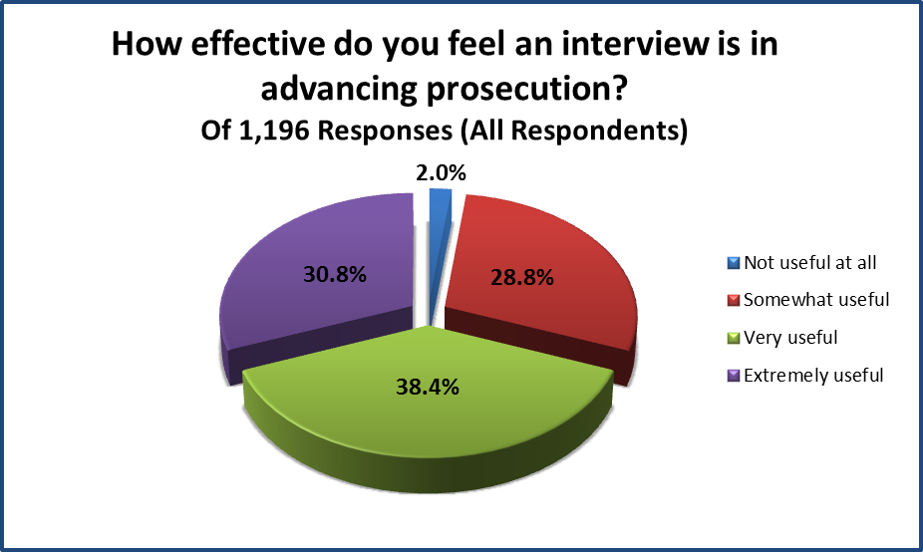
Interview Survey Results
For advancing prosecution, Applicants were very positive.

Slide 64
Verbal Authorization for Video Conferencing
Change to Internet Usage Policy to Permit Oral Authorization for Video Conferencing Tools
MPEP § 502.03 now allows a verbal request to authorize a WebEx interview, instead of submitting a written request.
The verbal authorization is limited to the video conference interview and does not extend to other communications regarding the application.

Slide 65
Automated Interview Request (AIR) Form
Applicants can submit a request from our Interview Practice website (http://www.uspto.gov/patent/laws-and-regulations/interview-practice) by simply filling out the AIR form. The request will be sent directly to the Examiner’s E-mail box.
The form will provide the authorization (MPEP §502.03) needed for internet communication.
Request must be at least one week from date of interview.

Slide 66
WebEx Interview Option interview from your location
A high-speed Internet connection is recommended for your computer.
No software needs to be downloaded or purchased. Works on all OS’s.
A telephone will be used to provide audio while a video camera may be used as part of the visual component.
Can request additional training via ExaminerInterviewPractice@USPTO.GOV

Slide 67
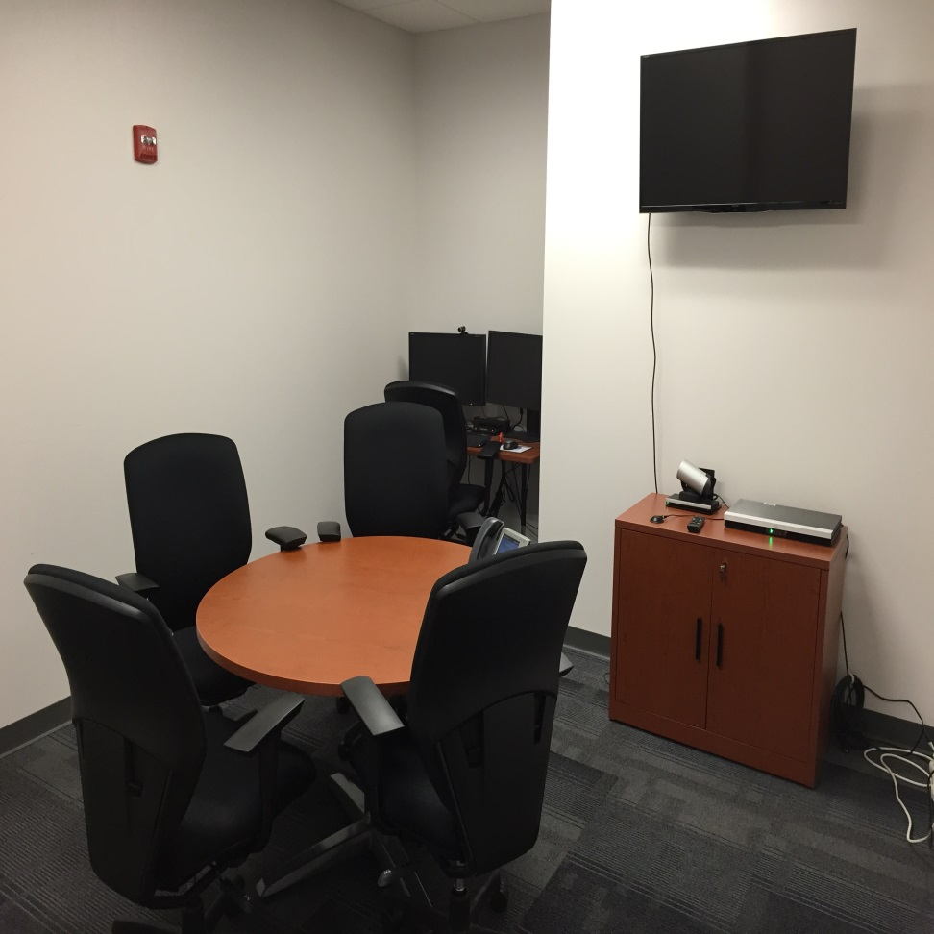
Public Interview Rooms
A Public Interview Room is a video conference room on each USPTO campus designated for Applicants to use to connect and collaborate with examiners that are working remotely or at a different USPTO campus
Must be reserved by Examiner at least two business days prior to interview.
Written or verbal authorization to communicate electronically is required prior to reserving a public interview room (see MPEP § § 502.03 and 713.01, and 80 Fed. Reg. 23787, April 2015).

Slide 68
Interview Specialist
Subject matter expert on interview practice and policy in each Technology Center
To assist Examiners and Applicants in facilitating effective interviews
The list of TC Specialists can be found here:
http://www.uspto.gov/patent/laws-and-regulations/interview-practice/interview-specialist

Slide 69
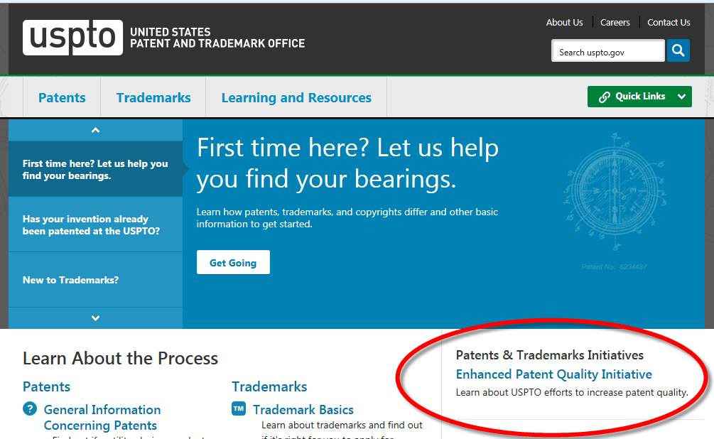

Slide 70
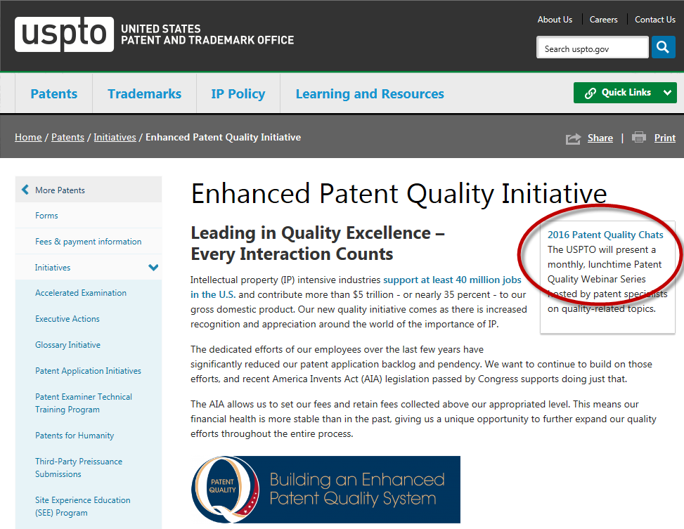

Slide 71
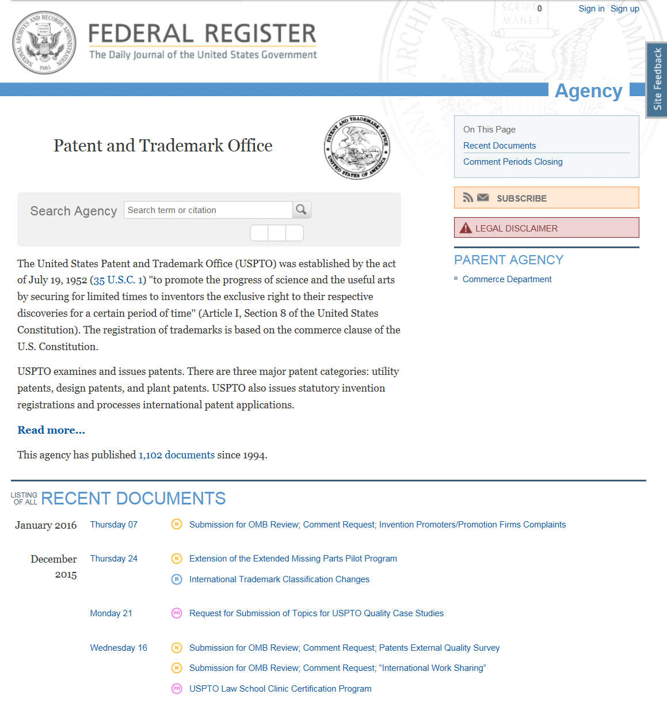
Can subscribe via e-mail or RSS feed
https://www.federalregister.gov/agencies
/patent-and-trademark-office

Slide 72
Questions?
Andrew Koenig
Regional Manager of the Silicon Valley United States Patent and Trademark Office

Slide 73
Interim Guidance on Patent Subject Matter Eligibility
Carolyn B. Kosowski
February 10, 2016
Presented at the USPTO Cybersecurity Partnership Meeting

Slide 74
Overview
Eligibility Guidance Development Process
Eligibility Guidance Overview

Slide 75
Eligibility Guidance Development Process

Slide 76
USPTO Iterative Guidance Process
Issue updated examination guidance after a Supreme Court decision
Solicit public feedback, e.g., via comment process, public forums, and public outreach
Consult business groups within USPTO (e.g., examining corps, Solicitor, PTAB)
Monitor judicial developments
Issue updated examination guidance

Slide 77
Feedback on the December 2014 Interim Eligibility Guidance (IEG)
Six themes emerged from the public comments:
Request for additional examples
Further explanation of the Markedly Different Characteristics analysis
Identifying an abstract idea
Making a prima facie case
Application of guidance in the examining corps
Role of preemption and streamlined analysis

Slide 78
July 2015 Update July 30, 2015
Provides clarifications on the IEG and responds to feedback
Provides additional abstract idea examples based on cases and hypotheticals (Appendix 1)
Provides an index of examples by abstract idea and “significantly more” treatment (Appendix 2)
Includes an updated case law chart cross-referencing cases to discussions of cases in the IEG, examples, and Update (Appendix 3)

Slide 79
Next Steps
Feedback from the public and the examining corps is being analyzed
Public comment period closed Oct. 28, 2015
Received 34 comments
Comments are posted here: http://www.uspto.gov/patent/laws-and-regulations/comments-public/comments-july-2015-update-subject-matter-eligibility
Federal Circuit decisions relating to subject matter eligibility may continue to fill in gaps
Focusing on improving the consistent application of the guidance in the examining corps

Slide 80
Eligibility Guidance Overview

Slide 81
Eligibility Analysis
Examiners are to:
Use the broadest reasonable interpretation (BRI) of the claim
Analyze eligibility based on the claim as a whole
Practice compact prosecution

Slide 82
Step 1: Statutory Categories
Step 1: Is the claim directed to a process, machine, manufacture, or composition of matter?
The claim must be directed to one of the four patent-eligible subject matter categories
If no, the claim is not eligible and should be rejected as being drawn to non-statutory subject matter
If yes, examiners are to proceed to Step 2

Slide 83
Step 2: Judicial Exceptions
Step 2: This is a two-part analysis to determine whether a claim that is directed to a judicial exception (i.e., a law of nature, a natural phenomenon, or an abstract idea) recites additional elements that amount to significantly more than the exception
This analysis should be used for all claims
MPEP 2106(II) contains a discussion of judicial exceptions

Slide 84
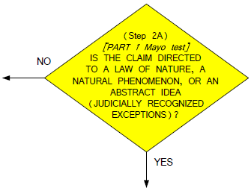
Step 2A: “Directed to” a Judicial Exception
“Directed to” means the exception is recited in the claim, i.e., the claim sets forth or describes the exception (Step 2A: YES)
If the invention is merely based on or involves an exception, the claim is not directed to an exception (Step 2A: NO) and is eligible

Slide 85
Identifying Abstract Ideas
IEG/Update guides examiners to identify abstract ideas based on similarity to concepts previously identified as abstract
Concepts from case law are associated with four judicial descriptors:
Fundamental Economic Practices
Certain Methods of Organizing Human Activity
An Idea “Of Itself”
Mathematical Relationships/Formulas
Examiners should not identify a concept as an abstract idea unless it is similar to at least one concept that the courts have identified as an abstract idea

Slide 86
Identifying Abstract Ideas
Concepts relating to the economy and commerce, such as agreements between people in the form of contracts, legal obligations, and business relations
An idea standing alone such as an uninstantiated concept, plan or scheme, as well as a mental process (thinking) that “can be performed in the human mind, or by a human using a pen and paper”
“Fundamental Economic Practices” | “An Idea ‘Of Itself’”
Creating a contractual relationship (buySAFE) Hedging (Bilski) Mitigating settlement risk (Alice) | Collecting and comparing known information (Classen) Comparing data to determine a risk level (Perkin-Elmer) Obtaining and comparing intangible data (Cybersource) Displaying an advertisement in exchange for access to copyrighted media (Ultramercial) | Comparing new and stored information and using rules to identify options (SmartGene) Using categories to organize, store and transmit information (Cyberfone) Data recognition and storage (Content Extraction) Organizing information through mathematical correlations (Digitech)

Slide 87
Identifying Abstract Ideas
Mathematical concepts such as mathematical algorithms, mathematical relationships, mathematical formulas, and calculations
Concepts relating to interpersonal and intrapersonal activities, such as managing relationships or transactions between people, social activities, and human behavior; satisfying or avoiding a legal obligation; advertising, marketing, and sales activities or behaviors; and managing human mental activity

Slide 88
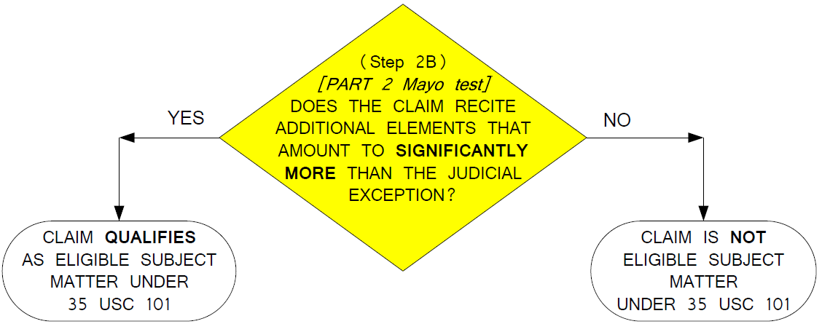
Step 2B: Significantly More
Does the claim as a whole amount to significantly more than the judicial exception?
Claim is analyzed as a whole:
Identify additional elements, and
Consider additional elements both individually and as an ordered combination

Slide 89
Significantly More Analysis
Considerations that assist in determining whether claim elements provide significantly more than a judicial exception:
May provide “significantly more”
Improvements to another technology or technical field
Improvements to the functioning of the computer itself
Applying the judicial exception with, or by use of, a particular machine
Effecting a transformation or reduction of a particular article to a different state or thing
Adding a specific limitation other than what is well-understood, routine and conventional in the field
Adding unconventional steps that confine the claim to a particular useful application
Other meaningful limitations beyond generally linking the use of the judicial exception to a particular technological environment
May not provide
Generic computer performing generic computer function
Words equivalent to “apply the exception”
Mere instructions to implement a judicial exception on a computer
Insignificant extra-solution activity, such as mere data gathering
Generally linking the use of the judicial exception to a particular technological environment or field of use
Merely appending well understood, routine, conventional activities previously known to the industry, specified at a high level of generality

Slide 90
Significantly More Analysis
July 2015 Update stresses vital importance of considering additional elements in combination
Examples illustrate how a combination of additional elements amounts to significantly more, even if the elements individually are generic or well-understood, routine & conventional, e.g.:
Example 3 (AI-3: digital image processing)
Example 4 (AI-4: global positioning system)
Example 21 (transmission of stock quote data)
Example 25 (rubber manufacturing)

Slide 91
Prima Facie Case
Prima facie case of ineligibility requires clear articulation of the reason(s) why the claimed invention is not eligible:
Identify judicial exception, and explain why it is an exception
Identify additional elements (if any), and explain why they do not amount to significantly more
Office has provided sample rejections satisfying this burden:
Training slides 37 (Mayo claim 1) and 41-42 (Alice Corp. claim 26)
Abstract Idea Workshop Materials: worksheets for examples 5-8, 21 and 23

Slide 92
Examples
Several sets of examples have been developed to illustrate the application of the IEG:
Nature-based products (December 2014)
Abstract ideas (January 2015)
Streamlined analysis (CBT posted March 2015)
Abstract ideas & streamlined analysis (July 2015)
Examples show eligible and ineligible claims, in accordance with case law and based on hypothetical fact patterns

Slide 93
July 2015 Update: Examples
Illustrate significantly more (Step 2B) analysis:
Example 21 (business method)
Examples 22 & 23 (GUI)
Example 24 (Flook: updating alarm limits)
Example 25 (Diehr: rubber manufacturing)
Illustrate streamlined analysis:
Example 26 (internal combustion engine)
Example 27 (software)
Illustrate claims that are not directed to an exception:
Example 23 (GUI)
Example 27 (software)

Slide 94
Applying Guidance @ USPTO
July 2015 Update is part of comprehensive & on-going approach to enhancing examiner understanding of eligibility
Guidance documents discussing legal principles (e.g., IEG, July 2015 Update, Quick Reference Sheets)
Examples illustrating application of legal principles
Indices to assist in locating most pertinent examples and case law precedent
Training

Slide 95
Eligibility Training
Completed two-phase training of examining corps on IEG
Included training on IEG (Phase 1) and examples (Phase 2)
Multiple modalities (e.g., lectures, group discussion, workshops)
Abstract Idea Workshop materials
Walk examiners through application of legal principles
For ineligible claims, guide examiners to clearly articulate reason(s) why the claimed invention is not eligible
Provide sample rejections satisfying prima facie burden (see worksheets for Examples 5-8)
Additional training has been provided on the July 2015 Update
Workshop II focuses on Examples 21 and 23
Materials available on our website

Slide 96
Additional Resources
General examination guidance and training materials
http://www.uspto.gov/patent/laws-and-regulations/examination-policy/examination-guidance-and-training-materials
Interim Eligibility Guidance
http://www.uspto.gov/patent/laws-and-regulations/examination-policy/2014-interim-guidance-subject-matter-eligibility-0
Includes guidance documents, example sets, training materials, and relevant case law
Includes links to public comments
Any updates will be posted to this page

Slide 97
Contact Information:
Carolyn B. Kosowski
Office of Patent Legal Administration, USPTO
(571) 272-7688
Carolyn.Kosowski@uspto.gov

Slide 98
Section 101 Landscape at the Courts and USPTO USPTO Cybersecurity Partnership Meeting Silicon Valley USPTO February 10, 2016
Bart Eppenauer
Partner
Shook Hardy & Bacon
Seattle

Slide 99
Current Section 101 Landscape
Decisions since Alice Corp v. CLS Bank (June 2014)
 | Total | Total Invalid under §101 | % Invalid
Federal Court Decisions | 208 | 150 | 72.1%
Federal Circuit | 23 | 22 | 95.7%
District Courts | 185 | 128 | 69.2%
Patents | 410 | 132 | 32.2%
Claims | 12,016 | 7,548 | 62.8%
Motions on Pleadings | 106 | 76 | 71.7%
PTAB CBM Institutions | 105 | 89 | 84.8%
PTAB CBM Final | 38 | 38 | 100.0%
Source: Fenwick & West's Bilski Blog, January 22 2016

Slide 100
Section 101 at the Federal Circuit
Negative Decisions
Positive Decisions
DDR Holdings v. Hotels.com - claimed solution is “necessarily rooted in computer technology to overcome a problem specifically arising in the realm of computer networks”
22 of 23
1 of 23
Key Upcoming Cases
Nearly all patents involved simple financial or business practices or other non-technical practices implemented on generic computers
McRO (Planet Blue) v. Activision Blizzard, et al. - Techniques for automatically animating lip synchronization and facial expressions of 3D animated characters
Thales Visionix v. USA - Sensor based motion tracking system
Intellectual Ventures v. Symantec – Malware and spam detection and email screening

Slide 101
Section 101 at District Courts
Nearly 200 district cases with Section 101 challenges since Alice
Almost 70% found patent claims invalid under Section 101
High success rate with motions on pleadings
D. Del. invalidity rate at 90%, N.D Cal and C.D. Cal above 70%, E.D. Tex. at 35%
Patents on Business Methods, Data Processing, or Communications facing highest number of challenges

Slide 102
Section 101 at District Courts - Security Technology
Date | Case | Court | Motion | Order | Patent Technology Area
1/28/16 | OpenTV v. Apple | N.D. CA | Motion to Dismiss | Granted | DRM for delivery of digital content
10/19/15 | Protegrity v. Netskope | N.D. CA | Judgment on Pleadings | Granted | Database intrusion detection
10/16/15 | Kinglite Holdings v. Micro-Star International | C.D. CA | Judgment on Pleadings | Granted | BIOS authentication
10/5/15 | ContentGuard Holdings v. Amazon.com and Google | E.D. TX | Judgment on Pleadings | Denied | Managing digital content usage rights
8/10/15 | Joao Bock Transaction Systems v. Fidelity National Information Services | M.D. FL | Summary Judgment | Granted | Account monitoring and authorization
6/24/15 | FairWarning v. Iatric Systems | M.D. FL | Motion to Dismiss | Granted | Fraud detection of protected health information
6/11/15 | Intellectual Ventures I v. Capital One | D. MD | Summary Judgment | Grant Recommended | Data access/ Firewall
5/7/15 | Jericho Systems v. Axiomatics | N.D. TX | Judgment on Pleadings (On Appeal at CAFC) | Granted | Information access authorization
4/28/15 | Intellectual Ventures II v. JP Morgan Chase | S.D. NY | Summary Judgment | Granted | Data security screening
4/22/15 | Intellectual Ventures I v. Symantec | D. Del | JMOL (On Appeal at CAFC) | Granted | Malware, spam detection and email screening

Slide 103
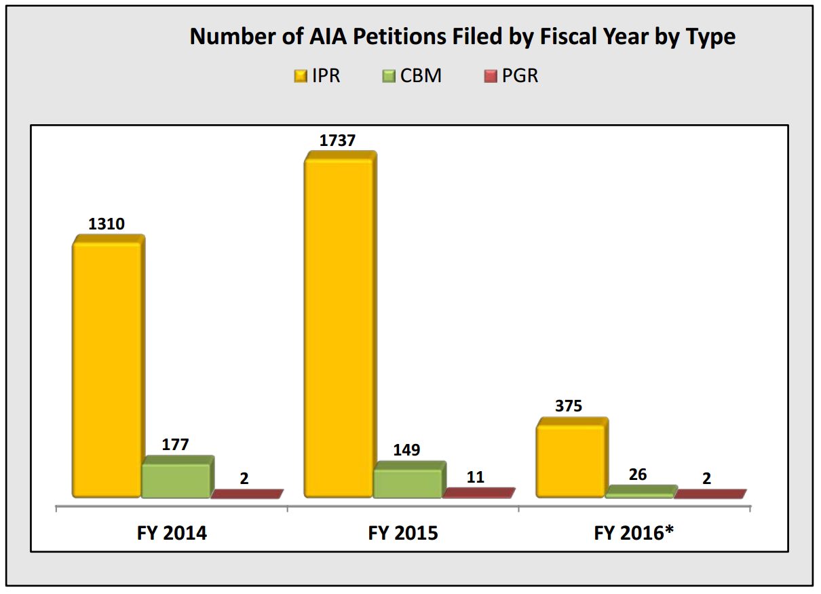
Section 101 – PTAB CBM Reviews
Patents found ineligible in 100% of Section 101 CBM Final Written Decisions
Institution Rate of Section 101 CBM Reviews at 85%
No cybersecurity or security-related patents found ineligible in any CBM Final Written Decision to date
Overall number of CBM Reviews declining year over year
Most patents found ineligible relate to financial methods, payment systems, information management, internet business methods, etc.
Source: USPTO as of 12/31/15

Slide 104
“Abstract” vs. “Technological”
Ongoing challenge in defining an “Abstract Idea”
Any easier to define “Technological”?
Guidance from AIA provisions for CBM Patents?
§ 42.301 Definitions.
In addition to the definitions in § 42.2, the following definitions apply to proceedings under this subpart D: 94
(a) Covered business method patent means a patent that claims a method or corresponding apparatus for performing data processing or other operations used in the practice, administration, or management of a financial product or service, except that the term does not include patents for technological inventions.
(b) Technological invention. In determining whether a patent is for a technological invention solely for purposes of the Transitional Program for Covered Business Methods (section 42.301(a)), the following will be considered on a case-by-case basis: whether the claimed subject matter as a whole recites a technological feature that is novel and unobvious over the prior art; and solves a technical problem using a technical solution.

Slide 105
Practice Tips – Claims
Direct claims to a solution to a technological problem - i.e., specific improvements provided by the claims are technical
Improve another technological process or technical field (not solely due to computer implementation), or the functionality of a computer itself
Include non-conventional HW elements (or tie to a particular machine) and/or recite non-generic (specific) computer functions or programming
Show how claim elements cannot be performed by human activities
Include the application or step that applies the result, if claiming an algorithm/computation

Slide 106
Practice Tips – Specification
Avoid characterizing invention as one of the enumerated abstract-ideas categories (e.g., fundamental economic practices, organizing human activity)
Tell the story of the invention - include advantages, technical benefit, practical application with as much technical detail as possible
If invention uses a computer, describe why that is important and what improvement is provided
Emphasize hardware aspects, transformative aspects representative of the physical world, tie embodiments to non-generic hardware elements
Explain why subject matter to be claimed cannot be performed manually

Slide 107
Contact Information Bart Eppenauer Partner Shook, Hardy & Bacon LLP
701 Fifth Avenue
Suite 6800
Seattle, WA (206) 344-7600 beppenauer@shb.com

Slide 108
Cybersecurity and Patent Eligible Subject Matter: an In-House Perspective
Aaron Smith
Senior Corporate Patent Counsel

Slide 109
Notes:
Other Tech and Product Areas:
Norton
Threat Protection
Information Protection (Identity, DLP, Authentication)
Cyber Security Services
Website Security
Mobile

Slide 110
Agenda
1
Eligibility of Cybersecurity Patents
2
Drafting and Prosecution Practical Tips
3
Concerns Regarding Patent Eligibility
Notes:
110

Slide 111
Eligibility of Cybersecurity Patents
Solid Ground in USPTO
Real Targets of Alice
Mathematical Algorithms
DON’T
Simply use computer to perform a series of steps.
101 rejections
Cybersecurity inventions: concrete and useful
Fundamental Business Practices
Techniques are useless outside the context of a computer
Use result to improve the functioning of computer itself
DO
Demonstrate invention is “Significantly More” than an abstract idea

Slide 112
USPTO Example Claim Illustrating IEG
Removing Malicious Code From Email Messages
1. A computer-implemented method for protecting a computer from an electronic communication containing malicious code, comprising executing on a processor the steps of:
receiving an electronic communication containing malicious code in a computer with a memory having a boot sector, a quarantine sector and a non-quarantine sector;
storing the communication in the quarantine sector of the memory of the computer, wherein the quarantine sector is isolated from the boot and the non-quarantine sector in the computer memory, where code in the quarantine sector is prevented from performing write actions on other memory sectors;
extracting, via file parsing, the malicious code from the electronic communication to create a sanitized electronic communication, wherein the extracting comprises
scanning the communication for an identified beginning malicious code marker, flagging each scanned byte between the beginning marker and a successive end malicious code marker,
continuing scanning until no further beginning malicious code marker is found, and
creating a new data file by sequentially copying all non-flagged data bytes into anew file that forms a sanitized communication file;
transferring the sanitized electronic communication to the non-quarantine sector of the memory; and
deleting all data remaining in the quarantine sector.

Slide 113
Example Claim: Found Patentable
Step 1: Is it Statutory?
It’s a “process"
Not an abstract idea:
Therefore, the claim is patent eligible
Step 2: Is it abstract?
Series of acts for protecting a computer from an e-communication containing malware
Physically isolates communication on a memory sector and extracts malicious code
Concept is inextricably tied to computer technology

Slide 114
Cybersecurity patents: Classification and Art Units:
Shift from USPC to CPC
Art Unit assignments for CyberSecurity cases
Majority: Tech Center 2400
No significant impact on art unit assignment or examination quality
eCommerce cases may be more problematic
Small percentage to 3620, 3680, and 3690
Reference to money or finance in the title, abstract, and/or claims

Slide 115
Drafting and Prosecution Practical Tips
Avoid mental or “pen-and-paper” claims
Add innate details into your independent claim.
However, claim value may be sacrificed with longer claims and value.
Add benefit of invention into claim. Use wherein clauses
Benefits are often inherent
Adds "inventive concept”, which provides context and makes claim less abstract
Lengthen claims and add detail without substantially narrowing claim scope
Creates concreteness and avoids allegations of abstractness
Tie result back to how security of computer/network/environment is improved

Slide 116
Drafting and Prosecution Practical Tips
Computer-Specific
Learn from CBM, PGR (and IPR) results
Emphasize how invention overcomes problems using a computer that may not have existed in non-computer world
Incorporate lessons from patent challenges into prosecution best-practices.
Refine disclosure process
For business-method-like inventions, is the invention applicable in other contexts?
Securing communications rather than financial transactions
E.g., business, finance, money, stocks, equity, tax, purchase, or even transactions
Avoid them by not referencing eCommerce principles in title/abstract.
Cybersecurity applications should not go to the 3600 art units.
Provide proper guidance/influence for art unit selection

Slide 117
Patent Eligibility Concerns
Problematic USPTO Guidelines
Some Examiners Follow Suit
“Eligible” claim could cause patentees to pursue claims that are invalid in light of Alice.
Some Examiners suggest (and accept) addition of generic computer features to overcome 101 rejections.
Many examples did not add innovative concepts
Likely ingrained culture: computer implementation removes claim from mental process
Encourage Examiners to focus on substance of claim over how it is implemented.
Instead, generic computer features were added
E.g., “computer-implemented”, “processor”, “memory location”, etc.), which are considered irrelevant to patent eligibility by Alice

Slide 118
Is Future of Cybersecurity Patent-Eligible?

Slide 119
Thank You!
Contact Information:
Aaron Smith
Aaron_Smith@symantec.com

Slide 120
Panel Q & A
CybersecurityPartnership@uspto.gov

Slide 121
Closing Remarks

