Slide 2
Technology Center 2800 virtual customer partnership meeting

Slide 3
Quality improvement

Slide 4
Agenda
Quality improvement cycle
Training slides
Collaboration opportunities

Slide 5
Quality improvement cycle
Analyze quality
Prioritize
Implement training
Measure impact of training

Slide 6
Statutory compliance
Statutory category | Goal
§101 | ≥ 97%
§102 | ≥ 95%
§103 | ≥ 93%
§112 | ≥ 93%

Slide 7
Enhancing clarity by ensuring that claims are definite under 35 U.S.C. 112(b)

Slide 8
Training slides
The training slides below are a subset of a slide set titled Introduction to 35 U.S.C. 112(b) and (d)
https://www.uspto.gov/learning-and-resources/examiner-training-materials

Slide 9
Definiteness requirement
The definiteness requirement states that claims must particularly point out and distinctly claim the invention
The claims must have a clear and definite meaning when construed in light of:
The content of the particular application disclosure,
The teachings of the prior art, and
The claim interpretation that would be given by one of ordinary skill in the art at the time the invention was made
MPEP §2173.02

Slide 10
Drafting a §112(b) rejection
Examiners must identify the specific claim language that is indefinite, and explain why that language renders the boundaries of the claim unclear
Enough information must be provided to enable applicant to make a meaningful response
Provide an explanation regarding claim construction when needed to assist in clarifying position
Whenever practicable, the examiner should indicate how the issues may be resolved, e.g. by suggesting amendments to the claims that resolve the issues

Slide 11
Clarity of the prosecution record
Clarity of the prosecution record is of utmost importance, because the record explains what deficiencies the examiner addressed, and how the applicant overcame them during prosecution
The prosecution record will provide a map for the public to understand the boundaries of the patent protection and provide clear notice of patent rights
The PTAB and courts will be informed as to what the examiner and the applicant understood the claims to mean
In the context of § 112(b), a clear record improves the clarity of claim limitations in a granted patent, by reflecting the mutual understanding of the scope and content of the claim reached by the examiner and the applicant

Slide 12
35 U.S.C. §112(b): specific topics
A sample of topics addressed in MPEP §2173.05 (a) – (u):
New terminology
Relative terminology
Numerical ranges and amounts
Exemplary language
Lack of antecedent basis
References to limitations in other claims
Functional limitations
Alternative limitations
Negative limitations
Product-by-process or product and process
“Use” claims
Trademarks or trade names in a claim

Slide 13
Lack of antecedent basis
Indefiniteness may result from a lack of antecedent basis (in that claim or any claims to which it refers)
Where a claim refers to “said lever” or “the lever” without any previous recitation of any lever
Where two different levers are recited followed by the recitation of “said lever”
Where a claim recites “a lever” followed by the recitation of “said aluminum lever”
MPEP §2173.05(e)

Slide 14
Lack of antecedent basis (cont.)
Inherent components or characteristics of properly recited elements have antecedent basis in the recitation of the component itself
“the outer surface of said sphere” does not require antecedent recitation of “outer surface” which is inherent to any sphere

Slide 15
35 U.S.C. §112(b) summary
Ensuring that the boundaries of the claimed invention are clear to one of ordinary skill in the art enhances patent quality and clarity
Establishing a clear written prosecution record of how the claim boundaries were defined prior to issuance depends on both examiners and applicants
Clarifying the record establishes a foundation for claim interpretation throughout prosecution and the life of the patent, which benefits the examiner, the applicant, and the public

Slide 16
Where we need your assistance
Check antecedence in claims
None, too many, difference in naming
Look for claim to specification mismatches
Confusion in naming of elements/steps
Verify antecedence after amendments
Changes in dependency

Slide 17
Where we can work together
Interviews
Clarifying claim limitations
Building a strong prosecution record

Slide 18
Artificial intelligence for patents

Slide 19
AI as a strategic focus
2018-2022 USPTO Strategic Plan:
Optimize development and delivery of information technology tools, including artificial intelligence and machine learning, for internal users of patent systems to ensure that they have the tools they need for a thorough search and examination.*
* Goal I: Optimize patent quality and timeliness; Objective 3: Foster innovation through business effectiveness

Slide 20
Challenges with AI
AI is trained, not pre-programmed
Performance of AI depends on quality data
Models may not be generalizable
Perception of a “black box”
Expense of intellectual validation
Models may require continuous updates

Slide 21
Strategy for reliable AI
Curation of high-quality data is critical
Apply solutions for validation and refinement
Expand practical knowledge in AI
Extensive outreach and market research
AI is for augmentation
Explainable AI

Slide 22
AI priorities for patents
Operational goal: leverage AI to improve effectiveness of examiners and the agency
AI for enhanced search
Assessing prototype AI-based search enhancements
Investigating image recognition
CPC auto-classification
Full CPC classification
Identification of CPC symbols associated with claims

Slide 23
Patent application initiatives

Slide 24
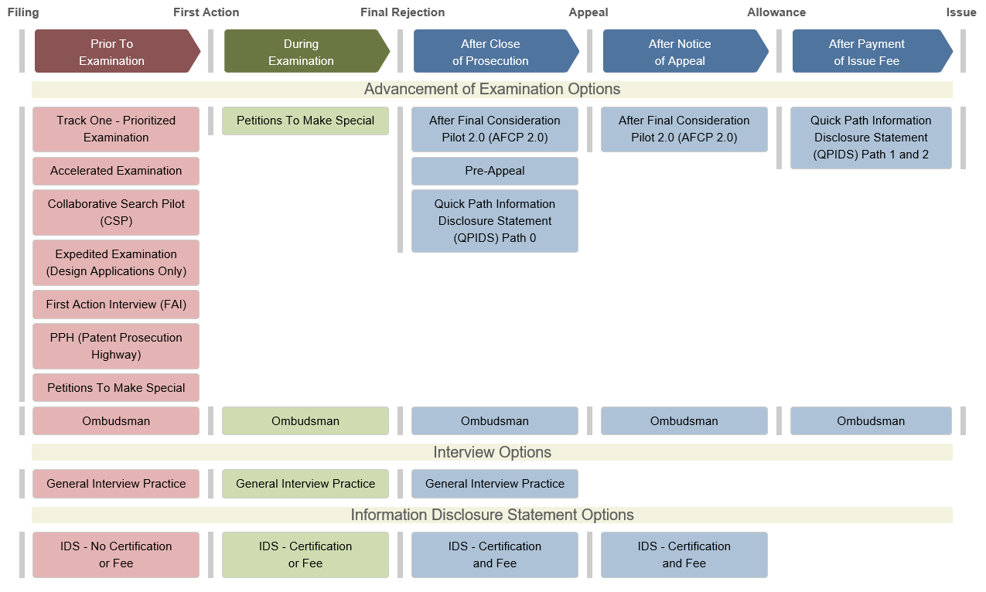
Overview

Slide 25
Prior to examination initiatives
Prioritized examination initiatives
Accelerated Examination (AE)
Track One
Patent Prosecution Highway (PPH)
Collaborative Search Pilot (CSP)
Others (age, health, COVID-19, counter-terrorism, etc.)
First Action Interview (FAI)

Slide 26
Prior to examination initiatives
Similarities
Differences
Out of turn examination with special status
The application are subject to limits on independent and total number of claims and no multiple dependent claims*
Pre-examination search and support documents
Search
Fees
Related foreign application
*Track One: 4 or fewer independent and 30 or fewer total claims
Other initiatives: 3 or fewer independent and 20 or fewer total claims

Slide 27
Prioritized examination initiatives
 | AE | Track One | PPH | CSP
Pre-examination search and support documents | Yes, required | Not required | Not required | Not required
Additional search | Yes, pre-examination search from applicant | No | Yes, examiners have access to search report from foreign IP office | Yes, sharing search report with partnering foreign IP office
Fee | Yes ($140/70/35)* | Yes ($4K/2K/1K)* | No | No
Related foreign application | Not required | Not required | Required | Required
* Regular/Small Entity/Micro Entity. Subject to change. Based on June 27, 2020.

Slide 28
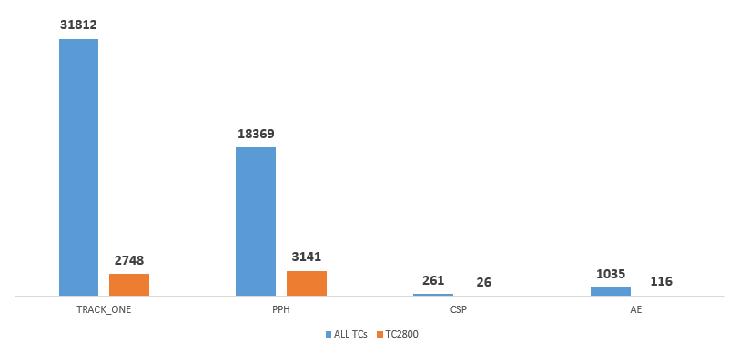
Number of petition filings
Above shown numbers are based on petitions filed between October 1, 2017 and June 27, 2020

Slide 29
Examples of petitions not granted
AE
Notice of allowance mailed before petition is decided*
Insufficient information in examination support document
Track One
National stage application is excluded from the program
Fee not paid
PPH or CSP
Discrepancy of claim correspondence between counterpart applications
CSP
Not filing petition in partnering foreign intellectual property office(s) within 20 days
* Other initiatives will not be granted for the same reason

Slide 30
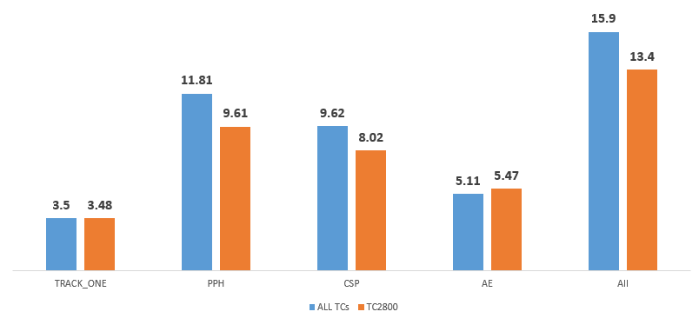
Months between application filing and first action
Above shown numbers are based on petitions filed between October 1, 2017 and June 27, 2020
As to “All” cases, it is based on the last three months of first action mailed or issued.

Slide 31
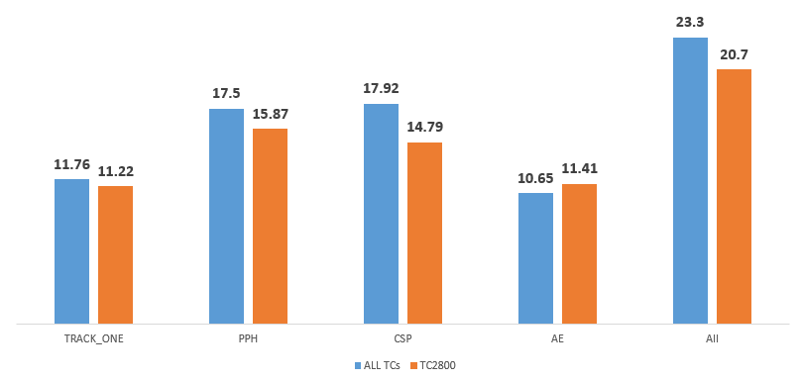
Months between application filing and issue
Above shown numbers are based on petitions filed between October 1, 2017 and June 27, 2020
As to “All” cases, it is based on the last three months of first action mailed or issued.

Slide 32
Conclusion
The USPTO offers variety of patent application initiatives prior to examination
The applicants may select one of them to meet their needs

Slide 33
Links to the initiatives
Link to AE at the USPTO internet site
https://www.uspto.gov/patent/initiatives/accelerated-examination
Link to Track One at the USPTO internet site
https://www.uspto.gov/patents-application-process/petitions/25-prioritized-examination-track-one
Link to PPH at the USPTO internet site
https://www.uspto.gov/patents-getting-started/international-protection/patent-prosecution-highway-pph-fast-track
Link to CSP at the USPTO internet site
https://www.uspto.gov/patents-getting-started/international-protection/collaborative-search-pilot-program-csp

