Slide 2
An overview of the
Patent Pro Bono Program
Patent Pro Bono Team
Office of Enrollment and Discipline (OED)
United States Patent and Trademark Office

Slide 3
Patent Pro Bono Program (PPBP)
PPBP assists financially under-resourced independent inventors and small businesses.
  Section 32 of the America Invents Act – The USPTO Director shall work with and support intellectual property law associations across the country in the establishment of pro bono programs designed to assist financially under-resourced independent inventors and small businesses.
21 regional programs work to match financially under-resourced inventors and small businesses with volunteer practitioners to prepare, file, and prosecute patent applications.

Slide 4
Regional patent pro bono programs
Each regional program covers one or more states.
Regional programs are independent of the USPTO and are operated by:
  Nonprofit organizations that focus on intellectual property
  Universities
  Bar associations
Regional programs follow general guidelines but set their own policies and procedures.
Regional programs ensure that applicants qualify for patent pro bono assistance by screening for:
  Income (less than 3X the poverty guidelines)
    Regional programs are independent of the USPTO and may vary the guidelines
  Have a provisional application on file and/or have completed a certificate training course
    http://www.uspto.gov/video/cbt/certpck/index.htm (also available in Spanish)
  An actual invention (more than an idea)

Slide 5
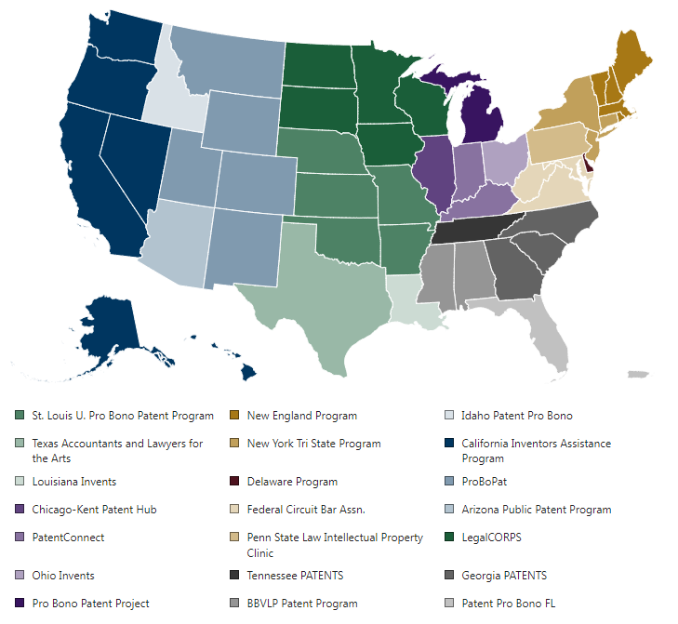
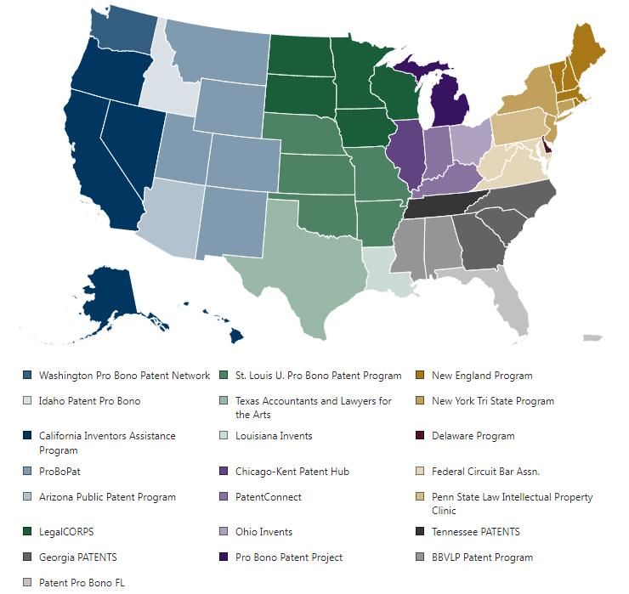
Current nationwide coverage

Slide 6
Program Statistics
Life of Program Totals
Hours donated: 95,874
Applications Filed: 2,019
Inventor Inquires: 17,979
Inventors Assisted: 3,898
* Data collection began in Q2 of CY 2015

Slide 7
PPBP and under-represented communities
Applicant Gender Demographics
Applicant Race Demographics
Male | Female | Did not Specify
785 | 549 | 386
Black | American Native | White | Asian | 2 or More | Did not specify
351 | 18 | 661 | 66 | 74 | 506
Note: Persons claiming Hispanic origin are estimated to be 14.2% of survey respondents

Slide 8
Patent practitioners are the linchpin
More than 1,600 practitioners have signed on to volunteer:
  Need outpaces supply.
  Unlike other forms of pro bono representation, only registered practitioners can represent financially under-resourced inventors to prepare, file, and prosecute patent applications before the USPTO.
Improved patent quality:
  A pro se inventor is now represented.
  The inventor is educated about the patent system.
  Professional advice may help the inventor make better decisions.
  “No” may be what the inventor needs to hear.
Practitioner benefits:
  Patent practitioners can volunteer in their area of expertise.
  State bars increasingly are offering continuing legal education credit for pro bono service.
  Creates a path for inventors to become job creator.
  Inventors may become paying clients.

Slide 9
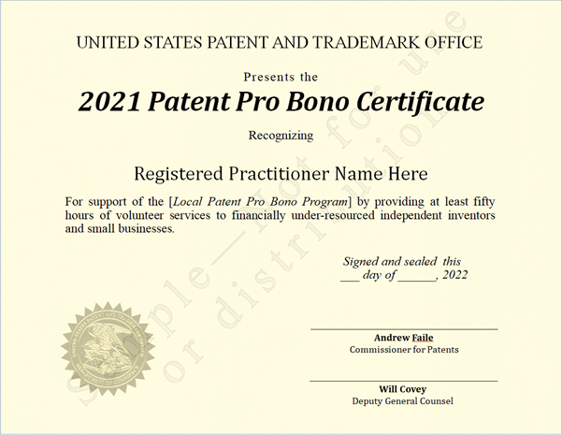
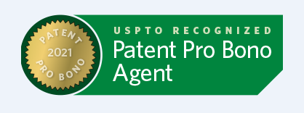
Practitioner recognition
The USPTO issues certificates to registered patent practitioners who provide 50+ hours of patent pro bono service in a calendar year.
Patent practitioner name, firm, and regional program are posted on the USPTO website.
The USPTO has issued over 450 certificates to patent practitioners since 2017.
The USPTO expanded recognition to include consecutive recipients.
Certificate recipients also receive signature graphic.

Slide 10
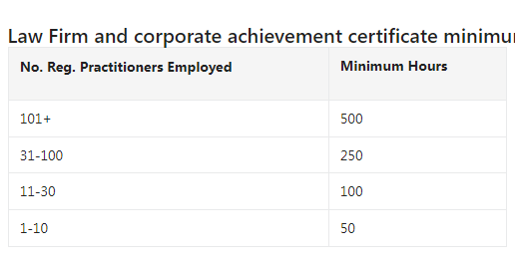
Law firm/corporation recognition
The USPTO recognizes law firms and corporations that support the PPBP.
Certificates awarded annually based on cumulative hours/firm and firm size.
Recipient names are posted on the USPTO website.
The USPTO recognized more than 20 firms/corporations in 2021.
Law firm hours expanded to include non-practitioner assistance.

Slide 11
More information
Visit https://www.uspto.gov/probonopatents
Email probono@uspto.gov
OED Phone 571-272-4097

