Slide 1
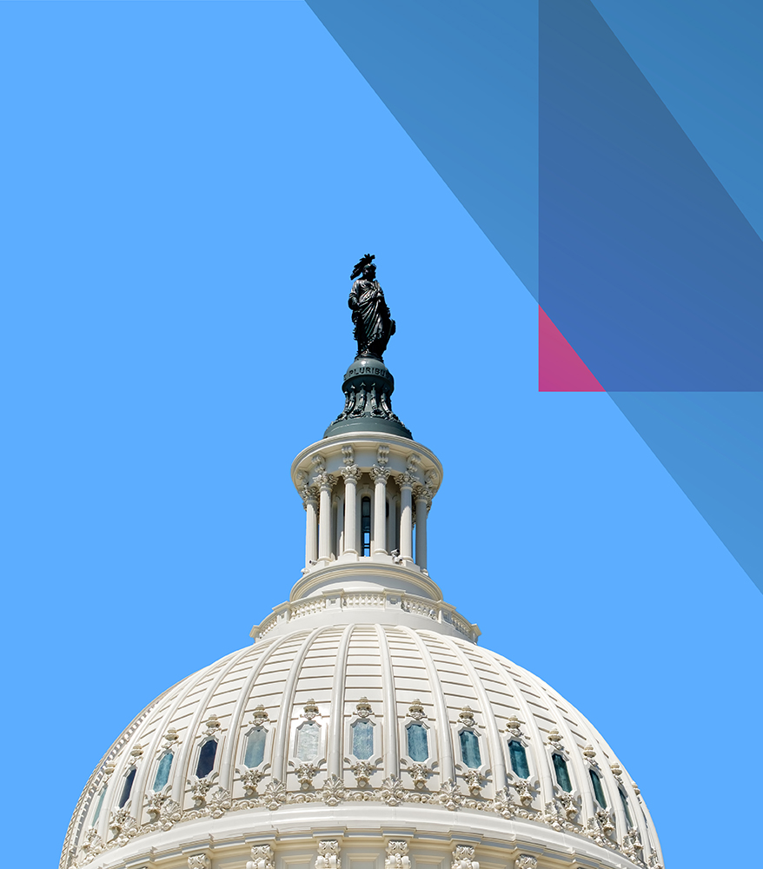
IPLSPRING
IP Ethics Update at the USPTO: What Every Patent and Trademark Practitioner Needs to Know
Teresa Stanek Rea – Rea Consulting LLC
Emil J. Ali– McCabe Ali LLP
Will Covey – Director, Office of Enrollment and Discipline, USPTO
April 17 – April 19, 2024

Slide 2
Disclaimers
This presentation is for educational purposes only.
None of the participants endorses, expressly or impliedly, the services of any other participant.
Statements of fact and opinions expressed are those of the participants individually and not the opinion or position of their respective employers, clients, the USPTO, or the ABA.
No legal advice is being provided and no attorney-client relationship is formed by this presentation.
2
Notes:
MM:

Slide 3
Presenters
Teresa Stanek Rea – Rea Consulting LLC (Moderator)
Michael E. McCabe, Jr. – McCabe Ali LLP
William Covey – Deputy General Counsel and Director of the Office of Enrollment and Discipline, USPTO
3
Notes:
MM:

Slide 4
Overview
A few words about Ethics and AI
Rule 11.18 and PTO ethics:
Trademark case study
Patent case study
Continuing IP conflicts issues
Diversion program
Compliance takeaways
4
Notes:
MM:

Slide 5
Practice before the USPTO and Artificial Intelligence (AI)
On Feb 6, 2024, the USPTO issued a Memorandum regarding the applicability of the USPTO Rules of Professional Conduct related to the use of AI.
When practicing before the USPTO, practitioners' use of AI may implicate ethical considerations.
37 C.F.R. § 11.18 imposes duties on parties and practitioners in connection with submissions before the USPTO.
37 C.F.R. § 11.18(b), in part, stipulates that parties presenting papers to the Office make a certification, formed after a reasonable inquiry, as to evidentiary support for factual contentions and allegations.
37 C.F.R. § 11.18(a) stipulates that each piece of correspondence filed with the Office by a practitioner must bear the practitioner’s signature pursuant to 37 C.F.R. §§ 1.4(d)(1), 2.193.
See https://www.uspto.gov/initiatives/artificial-intelligence/artificial-intelligence-resources

Slide 6
Rule 11.18 - Certifications and Pre-Filing Duties

Slide 7
Rule 11.18(a) – Personal Signature
Signature Certification
“each piece of correspondence filed by a practitioner . . must bear a signature, personally signed or inserted by such practitioner, in compliance with §1.4(d)(1) or § 2.193(a) of this chapter . . .”
- 37 CFR 11.18(a)
7
Notes:
MM:

Slide 8
Personal /s/ Means Personal /s/
37 CFR § 1.4(d):
(2) S-signature:
(i) the S-signature must consist only of letters, or Arabic numerals, or both, with appropriate spaces and commas . . . and the person signing the correspondence must insert his or her own S-signature with a first single forward slash mark before, and a second single forward slash mark after, the S-signature . . . . .
(4)(i) Certification as to the paper presented.
The presentation to the Office (whether by signing, filing, submitting, or later advocating) of any document;
Certification under § 11.18(b);
Violations may result in sanctions under § 11.18(c) and disciplinary action under § 11.18(d).
(4)(ii) Certification as to the signature.
Person inserting sig. certifies its their own or they have reasonable basis to believe signature entered by named person
8
Notes:
Bill

Slide 9
Personal /s/ Means Personal /s/
37 CFR § 2.193:
(c) Requirements for electronic signature. A person signing a document electronically must:
(1) Personally enter any combination of letters, numbers, spaces and/or punctuation marks that the signer has adopted as a signature, placed between two forward slash (“/”) symbols in the signature block . . . .
(f) Presentation as certification.
The presentation to the Office (whether by signing, filing, submitting, or later advocating) of any document:
constitutes a certification under § 11.18(b);
violations may jeopardize validity of application or registration . . . and may result in sanctions under § 11.18(c)
practitioner violating § 11.18(b) may also be subject to disciplinary action. See § 11.18(d).
9
Notes:
Bill

Slide 10
Rule 11.18(b)(1) – Truth Certification
Truth Certification
“All statements made therein of the party’s own personal knowledge are true, and all statements made therein on information and belief are believed to be true.”
- 37 CFR 11.18(b)(1)
10
Notes:
MM:

Slide 11
Rule 11.18(b)(2) – Reasonable Inquiry
Inquiry Certification
To the best of knowledge, information and belief, formed after an inquiry reasonable under the circumstances—
(i) Not presented for improper purpose;
(ii) Legal contentions warranted;
(iii) Factual contentions evidentiary support;
(iv) Denials warranted on evidence.
- 37 CFR 11.18(b)(2)
11
Notes:
MM:

Slide 12
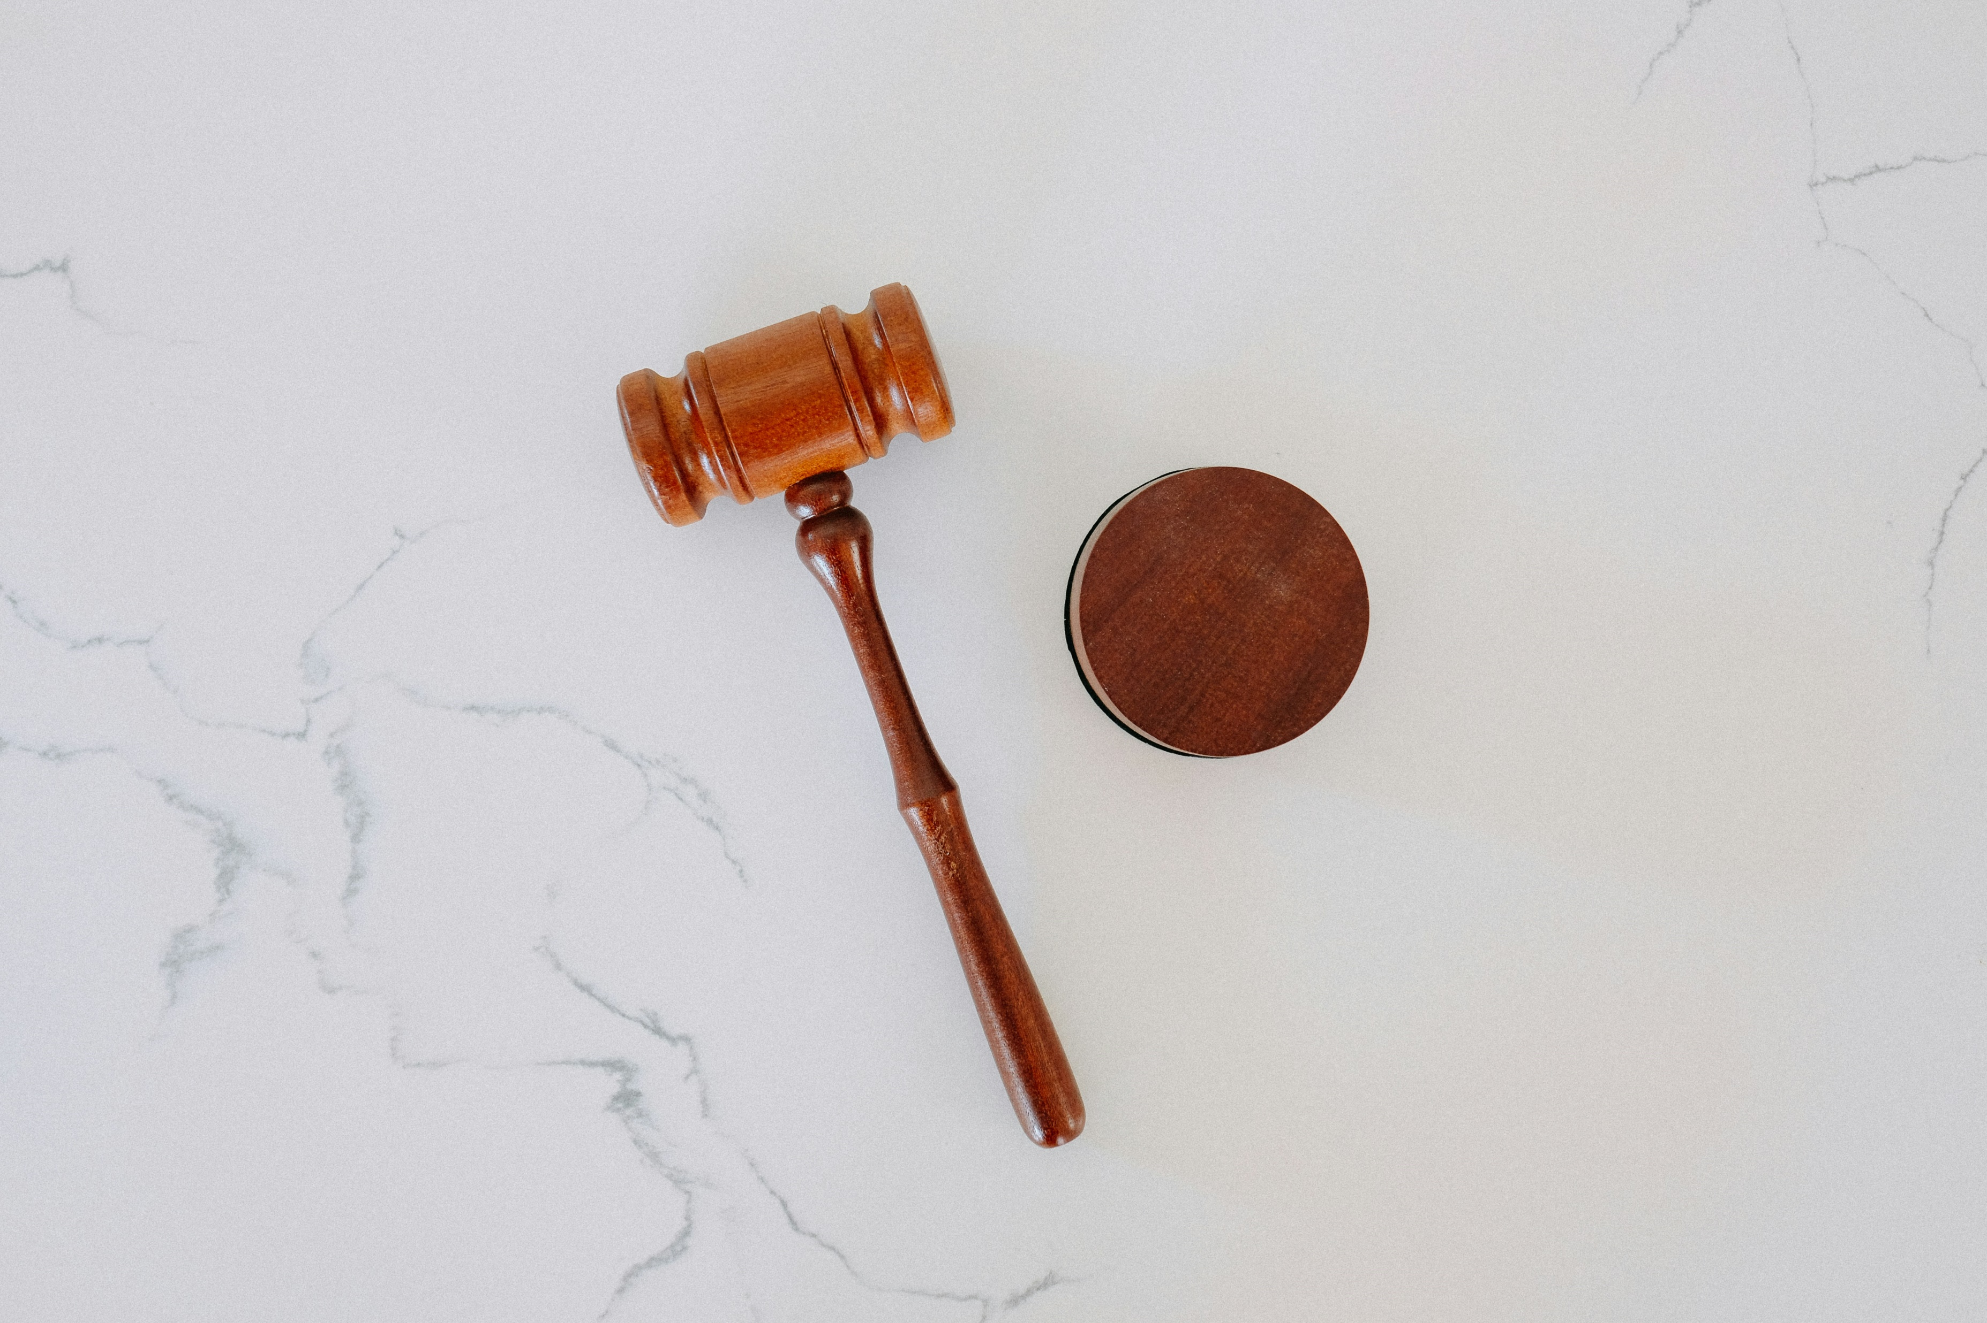
Discipline Examples From USPTO

Slide 13
Rule 11.18 and TM Applications From China
13
Notes:
MM:

Slide 14
TM Rule 11.18 Concerns
Bad specimens
Sketchy proof of use in commerce
Difficulty verifying true applicant
Mass filings w/ same address
Unclear who is preparing, signing and/or filing
No U.S. attorney apparently involved
Practical problems enforcing U.S. law prohibiting Unauthorized Practice of Law abroad
14
Notes:
MM:

Slide 15
Improper TM Signatures/Failure to Review
In re Zhang, Proc. No. D2022-16 (USPTO July 11, 2022)
“Agents” in CN hire Atty to be of record in TM applications prepared by foreign non-attorney
Paid $40-$60 per application
8,500 applications filed in 2020
9,800 applications in 2021
Over 350 applications in a single day
Cursory review
Permitted agent to sign name
Atty agrees conduct misrepresented facts to tribunal, failed to communicate, aided UPL
90-day suspension
15
Notes:
MM:

Slide 16
Improper signatures/failure to supervise
In re Sapp, Proceeding No. D2019-31 (USPTO May 15, 2019)
Trademark (TM) attorney was AOR for numerous TM applications for law firm.
Had TM documents filed with USPTO where non-practitioner assistants signed the documents instead of named signatory.
Did not take reasonable steps to learn whether non-practitioner assistants were obtaining signatures properly.
After learning of impermissible signatures, did not notify clients or USPTO.
Rule highlights:
37 C.F.R. § 11.101–Competence
37 C.F.R. § 11.103–Diligence
37 C.F.R. § 11.503–Responsibilities regarding non-practitioner assistance
37 C.F.R. § 11.104(a) & (b)–Client communication
37 C.F.R. § 11.303–Candor toward tribunal
37 C.F.R. §§ 11.804(c) (misrepresentation) and (d) (conduct prejudicial to the administration of justice)

Slide 17
Meritorious Claims – Rule 3.1
“A practitioner [lawyer] shall not bring or defend a proceeding, or assert or controvert an issue therein, unless there is a basis in law and fact for doing so that is not frivolous. . . .”
37 CFR 11.301
Rule requires lawyers to:
Inform selves about facts of clients’ cases and applicable law;
Determine they can make good faith arguments in support of clients’ position;
Not abuse legal procedure
ABA M.R. 3.1 cmts. [1], [2]
Analog to 11.18(b) certifications.
17
Notes:
MM:

Slide 18
Candor to the Tribunal – Rule 3.3
“A practitioner [lawyer] shall not knowingly:
Make a false statement of fact or law to tribunal;
Fail to correct a false statement of fact or law previously made to tribunal;
37 CFR 11.303(a)(1); ABA M.R. 3.3(a)(1)
“A practitioner [lawyer] shall not knowingly:
Offer evidence known to be false
37 CFR 11.303(a)(c); ABA M.R. R. 3.3(a)(3)
Is presentation of incorrectly signed S-signature a “misrepresentation”?
18
Notes:
MM:

Slide 19
Supervisory Duties – Rules 5.1-5.3
Partners, others with managerial authority, and direct supervisors, duty to ensure firm has in effect measures giving reasonable assurance that all practitioners conform to the USPTO ethics rules
37 CFR 11.501(a); ABA M.R. 5.1(a)
Practitioners owe same duties regarding services by non-practitioner assistants
37 CFR 11.503(a); ABA M.R. 5.3(a)
Allowing non-practitioners to communicate with client about needs, give advice, sign atty’s name, may violate supervisory duties.
19
Notes:
MM:

Slide 20
Aiding UPL – Rule 5.5
“A practitioner [lawyer] shall not practice law in a jurisdiction in violation of the regulation of the legal profession in that jurisdiction or assist another in doing so.”
37 CFR 11.505; ABA M.R. 5.5(a)
Lawyers may employ paraprofessionals and delegate functions to them, but lawyer must:
Supervise delegated work; and
Retain responsibility for their work
37 CFR 11.5
20
Notes:
MM:

Slide 21
Patent Conduct - In Re Chew
In re Chew, Proc. No. D2023-08 (USPTO Jan. 20, 2023)
Agent files approx. 4,000 design applications.
Micro entity certification rejected in 171 apps for exceeding filing limit.
Practitioner did not inquire into own firm records to verify if applicant qualified for reduced fee
Exceeded limit of 4 reduced fee applications.
Public reprimand for failing to exercise diligence in determining if clients qualified for micro entity status
21
Notes:
MM:

Slide 22
Conflicts of Interest

Slide 23
Current Client Conflicts
May not represent a client in a matter directly adverse to another client
37 CFR 11.107(a)(1); ABA M.R. 1.7(a)(1)
May not represent a client in a matter when significant risk that representation will be materially limited by duties to others or self-interest
37 CFR 11.107(a)(2); ABA M.R. 1.7(a)(2)
Conflicts waiveable with informed consent confirmed in writing
23
Notes:
MM:

Slide 24
Former Client Conflicts
May not represent a client in a matter directly adverse to a former client if the subject matter of the new and previous matters are the "same" or "substantially related"
37 CFR 11.109; ABA M.R. 1.9
Conflict can be waived with informed consent of both former and current client.
24
Notes:
MM:

Slide 25
Example 1: The “Just Trademark” Client
Firm represents Company A in one trademark application
New Client (Company B) wants Firm to sue Company A for unrelated six-patent infringement case
Can Firm represent Company B?
Does it matter that the cases are unrelated?
Can Firm drop Company A as a client thereby resolving the conflict?
“Hot potato” drop
Prohibits lawyers from reclassifying current client as former client so they can justify suing them on unrelated matter
25
Notes:
MM:

Slide 26
Example 2: Corporate Family Client Conflicts
Your firm represents Company AB, a subsidiary of Company A, for patent matters
May you represent another client directly adverse to Company AC, another subsidiary of Company A?
Wholly vs. partially owned
Common employees or interfaces
Engagement agreement
Outside counsel guidelines
Dr. Falk Pharma v Generico, 916 F.3d 975 (Fed. Cir. 2019)(OCG defined “client” to include family; firm disqualified)
26
Notes:
MM:

Slide 27
Example 3: Applicants v. Inventors
Two inventors meet with you to prepare patent application on joint invention.
Inventor 1 is long-term client and pays bills. No applicant identified.
No engagement agreement.
Atty only takes direction from Inventor 1.
Amends claims that cut out Inventor 2.
Conflict?
Was Inv. 2 a joint client?
Was a TBD entity client?
27
Notes:
MM:

Slide 28
Example 4: Subject Matter Conflicts
You represent Company A for patent on new automotive battery
Company B wants to retain you to file patent application on a new automotive battery
Is it a conflict with Company A?
Directly adverse?
Material limitation?
Similarity measured by claims
Maling v. Finnegan, Henderson, 473 Mass. 336 (2015)
28
Notes:
MM:

Slide 29
Diversion

Slide 30
OED Diversion Program
In 2016, the ABA Commission on Lawyer Assistance Programs and the Hazelden Betty Ford Foundation published a study of about 13,000 currently practicing attorneys and found the following:
About 21% qualify as problem drinkers
28% struggle with some level of depression
19% struggle with anxiety
23% struggle with stress
Other difficulties include social alienation, work addiction, sleep deprivation, job dissatisfaction, and complaints of work-life conflict.
The USPTO launched Diversion as a Pilot Program in 2017.

Slide 31
OED Diversion Program – criteria
Practitioner must have willingness and ability to participate in the program.
In some circumstances, prior discipline is not a bar to diversion.
Misconduct at issue must not:
Involve misappropriation of funds or dishonesty, fraud, deceit, or misrepresentation
Result in or be likely to result in substantial prejudice to a client or other person
Constitute a “serious crime” (see 37 C.F.R. § 11.1)
Be part of a pattern of major similar misconduct or be of the same nature as misconduct for which practitioner has been disciplined within the past five years

Slide 32
Takeaways

Slide 33
Compliance Takeaways
Confirm compliance with “personal” signature requirements on all patent and TM filings
Be wary of high-volume referral sources
Be wary of “to good to be true” engagements
Document terms of representation with foreign intermediary and client-applicants
Supervise lawyers and staff by instilling practices, procedures and training on compliance with the Rules of Professional Conduct
33

Slide 34
Compliance Takeaways (cont’d)
Intake and conflict clearance procedures should be automated and robust
Related entities
When does representation end
Prior to filing – “subject matter” conflict check for similar patents/inventions and TMs worked on by your firm
34

Slide 35
Decisions imposing public discipline available in “FOIA Reading Room”
foiadocuments.uspto.gov/oed/
Official Gazette for Trademarks:
www.uspto.gov/learning-and-resources/official-gazette/trademark-official-gazette-tmog

Slide 36
THANK YOU!
Teresa Stanek Rea – Rea Consulting LLC – tsr22309@gmail.com
Michael E. McCabe, Jr. – McCabe Ali LLP – mike@mccabeali.com
William Covey – Deputy General Counsel and Director of the Office of Enrollment and Discipline, USPTO – oed@uspto.gov
36
Notes:
MM:

