Slide 2
Professional responsibility and practice before the USPTO
Office of Enrollment and Discipline (OED)
United States Patent and Trademark Office

Slide 3
Practice before the USPTO
Activities that constitute practice before the USPTO are broadly defined in 37 C.F.R. §§ 11.5(b) & 11.14:
  Includes communicating with and advising a client concerning matters pending or contemplated to be presented before the office (37 C.F.R. § 11.5(b))
  Consulting with or giving advice to a client in contemplation of filing a patent application or other document with the office (37 C.F.R. § 11.5(b)(1))
  Consulting with or giving advice to a client in contemplation of filing a trademark application or other document with the office (37 C.F.R. § 11.5(b)(2))
  Nothing in this section (37 C.F.R. § 11.5(b)) proscribes a practitioner from employing or retaining non-practitioner assistants under the supervision of the practitioner to assist the practitioner in matters pending or contemplated to be presented before the office
  See also 37 C.F.R. § 11.14 for details regarding individuals who may practice before the office in trademark and other non-patent matters

Slide 4
OED discipline: grievances and complaints
An investigation into possible grounds for discipline may be initiated by the receipt of a grievance (see 37 C.F.R. § 11.22(a)).
Grievance: “a written submission from any source received by the OED Director that presents possible grounds for discipline of a specified practitioner” (37 C.F.R. § 11.1).
In the course of the investigation, the OED Director may request information and evidence regarding possible grounds for discipline of a practitioner from:
  The grievant,
  The practitioner, or
  Any person who may reasonably be expected to provide information and evidence needed in connection with the grievance or investigation.
  (37 C.F.R. § 11.22(f)(1))

Slide 5
OED discipline: grievances and complaints
Upon the conclusion of an investigation, the OED Director may:
  Close the investigation without issuing a warning or taking disciplinary action,
  Issue a warning to the practitioner,
  Institute formal charges upon the approval of the Committee on Discipline, or
  Enter into a settlement agreement with the practitioner and submit the same for approval of the USPTO Director.
  (37 C.F.R. § 11.22(h))

Slide 6
OED discipline: grievances and complaints
If investigation reveals that grounds for discipline exist, the matter may be referred to the Committee on Discipline to make a probable cause determination (see
37 C.F.R. § 11.32).
37 C.F.R. § 11.34(d) specifies that the timing for filing a complaint shall be within one year after the date on which the OED Director receives a grievance.
37 C.F.R. § 11.34(d) also states that no complaint may be filed more than 10 years after the date on which the misconduct occurred.
Self-reporting is often considered as a mitigating factor in the disciplinary process.

Slide 7
Other types of discipline
Reciprocal discipline (37 C.F.R. § 11.24)
  Based on discipline by a state or federal program or agency
  Often conducted on documentary record only
Interim suspension based on conviction of a serious crime (37 C.F.R. § 11.25)
  Referred to a hearing officer for determination of final disciplinary action

Slide 8
USPTO disciplinary matters
8

Slide 9
USPTO disciplinary matters
9

Slide 10
Discussion of select case law and regulations

Slide 11
Duty of Candor and Other Related Regulations
37 C.F.R. § 1.56 – Duty to disclose information material to patentability
37 C.F.R. §11.18 - Certification upon filing of papers
37 C.F.R. § 11.303 (a) (1)-(3) – Candor toward the tribunal
37 C.F.R. § 11.804 (c), (d), and (i)
  Misconduct involving deceit;
  Engage in conduct prejudicial to the administration of justice;
  Other conduct that adversely reflects on practitioner’s fitness to practice

Slide 12
Neglect/candor
In re Kroll, Proceeding No. D2014-14 (USPTO Mar. 4, 2016)
Patent attorney
  Attorney routinely offered (and charged) to post client inventions for sale on his website
  Did not use modern docket management system
  Failed to file client’s application, but posted the invention for sale on his website
  Filed application 20 months after posting on the website
Aggravating factors included prior disciplinary history.
Received two-year suspension
Rule highlights:
  37 C.F.R. § 10.23(a) – Disreputable or gross misconduct
  37 C.F.R. § 11.18(b) – Certification upon submitting of papers
  37 C.F.R. § 10.77(c) – Neglect

Slide 13
Conflict of interest
In re Walpert, Proceeding No. D2018-07 (USPTO Apr 29, 2021)
Disciplinary complaint alleged:
  Respondent entered into business relationship with his client and was given partial ownership interest in client company as compensation for providing legal services.
  Did not obtain informed consent from company or disclose any potential risks associated with transacting business with a client
  Several patent applications Respondent had worked on for the company became abandoned.
  Fabricated emails purportedly showed that he notified the company of application filing irregularities.
  Failed to notify company of the problems with their applications
Exclusion from practice before the office.
Rule highlights:
  37 C.F.R. § 10.62 (2012) Refusing employment where the interest of practitioner may impair practitioner’s independent judgment
  37 C.F.R. § 10.65 (2012) Limiting business relations with a client
  37 C.F.R. § 11.108 - Conflict of interest
  37 C.F.R. § 11.303(a) – Candor towards the tribunal
  37 C.F.R. § 11.804(c) – Conduct that involves dishonesty, fraud, deceit, or misrepresentation

Slide 14
Improper signatures/failure to supervise
In re Sapp, Proceeding No. D2019-31 (USPTO May 15, 2019)
Trademark (TM) attorney was attorney of record or responsible attorney for numerous trademark applications for law firm.
  Had TM documents filed with USPTO where non-practitioner assistants signed the documents instead of the named signatory
  Did not take reasonable steps to learn whether non-practitioner assistants were obtaining signatures properly
  After learning of impermissible signatures, did not notify clients of improper signatures or potential consequences
  After learning of impermissible signatures (including on declaration relied upon by TM examiners), did not notify the USPTO
Mitigating factors:
  Fourteen-year practice with no prior disciplinary history
  Acknowledged ethical lapses and understands seriousness of submitting impermissible signatures to USPTO
  Cooperated with OED investigation
  Upon learning of impermissible signatures, retrained practitioners and non-practitioner assistants to ensure future compliance
Settlement: public reprimand and one-year probation.
Rule highlights:
  37 C.F.R. § 11.101 – Competence
  37 C.F.R. § 11.103 – Diligence
  37 C.F.R. § 11.503 – Responsibilities regarding non-practitioner assistance
  37 C.F.R. § 11.104(a) & (b) – Client communication
  37 C.F.R. § 11.303 – Candor toward tribunal
  37 C.F.R. §§ 11.804(c) (misrepresentation) and (d) (conduct prejudicial to the administration of justice)

Slide 15
Signatures on trademark documents
37 C.F.R. § 2.193 Trademark correspondence and signature requirements
  “(a)…Each piece of correspondence that requires a signature must bear:
    (1) A handwritten signature personally signed in permanent ink by the person named as the signatory, or a true copy thereof; or
    (2) An electronic signature that meets the requirements of paragraph (c) of this section, personally entered by the person named as the signatory….
    * * * * *
  (c) Requirements for electronic signature. A person signing a document electronically must:
    (1) Personally enter any combination of letters, numbers, spaces and/or punctuation marks that the signer has adopted as a signature, placed between two forward slash (“/”) symbols in the signature block on the electronic submission; or
    (2) Sign the document using some other form of electronic signature specified by the Director.”

Slide 16
Signatures on patent documents
37 C.F.R. § 1.4(d)(1) Handwritten signature.
  “Each piece of correspondence, except as provided in paragraphs (d)(2), (d)(3), (d)(4), (e), and (f) of this section, filed in an application, patent file, or other proceeding in the Office which requires a person's signature, must:
    (i) Be an original, that is, have an original handwritten signature personally signed, in permanent dark ink or its equivalent, by that person; or
    (ii) Be a direct or indirect copy, such as a photocopy or facsimile transmission (§1.6(d)), of an original. In the event that a copy of the original is filed, the original should be retained as evidence of authenticity. If a question of authenticity arises, the Office may require submission of the original.
37 C.F.R. § 1.4(d)(2) S-signature.
  “(i)…the person signing the correspondence must insert his or her own S-signature…”
37 C.F.R. § 1.4(d)(4)(ii) Certification as to the signature.
  “The person inserting a signature under paragraph (d)(2) or (d)(3) of this section in a document submitted to the Office certifies that the inserted signature appearing in the document is his or her own signature.”
Note: recent removal of of 37 C.F.R. § 1.4(e) (original handwritten signatures in permanent dark ink for OED correspondence and non EFS credit card payments).
  See 86 FR 35226 (July 2, 2021).

Slide 17
Trademarks: local counsel rule
Increase in foreign parties not authorized to represent trademark applicants improperly representing foreign applicants in trademark (TM) matters
Fraudulent or inaccurate claims of use are a burden on the trademark system and the public and jeopardize validity of marks
Effective August 3, 2019:
  Foreign-domiciled trademark applicants, registrants, and parties to Trademark Trial and Appeal Board proceedings must be represented at the USPTO by an attorney who is licensed to practice law in the United States.
Final rule: 84 Fed. Reg. 31498 (July 2, 2019)
Canadian patent agents are no longer able to represent Canadian parties in U.S. TM matters.
Canadian TM attorneys and agents will only be able to serve as additionally appointed practitioners.
  Clients must appoint U.S.-licensed attorney to file formal responses.
  The USPTO will only correspond with U.S. licensed attorney.

Slide 18
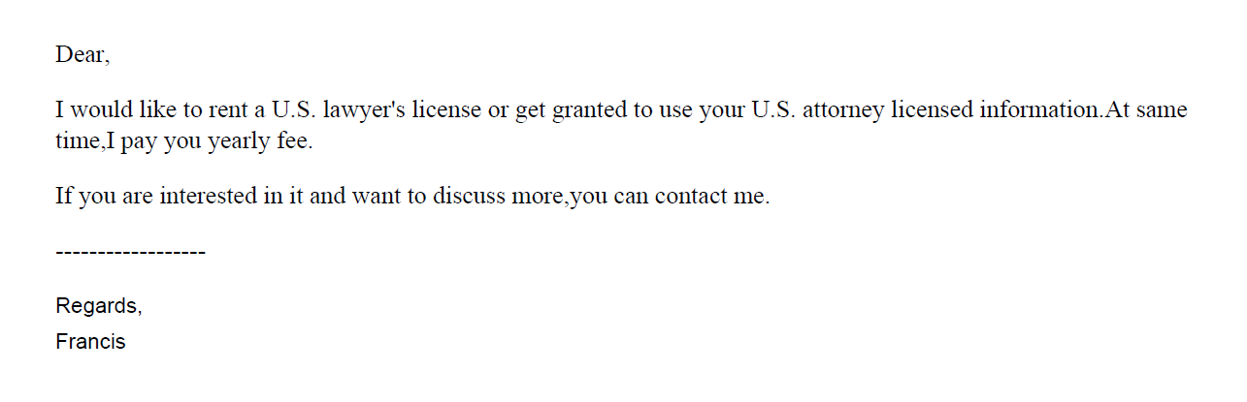
Trademarks: local counsel rule

Slide 19
Competence, informed consent, dishonesty
In re Caraco, Proceeding No. D2019-50 (USPTO Sept. 12, 2019)
TM attorney:
  Worked with a reciprocally-recognized Canadian practitioner to represent clients located in Canada before the USPTO in trademark matters
  Reviewed TM applications and related documents prior to filing, but never consulted or spoke with clients
  Allowed Canadian practitioner and her non-practitioner assistants to enter his signature on TM filings
  Failed to notify any of the TM clients that he failed to personally sign any of the declarations in TM filings or any of the potential adverse consequences
  Failed to notify trademark operations at USPTO of the impermissible signatures
  Excluded
Rule highlights:
  37 C.F.R. § 11.303(a)(1) - False statements of fact or law to the USPTO
  37 C.F.R. § 11.303(a)(3) - Requiring a practitioner to take reasonable remedial measures if practitioner becomes aware of falsity of material evidence

Slide 20
Improper signatures/communication
In re Lou, Proceeding No. D2021-04 (USPTO May 12, 2021)
  Trademark attorney had business relationship with foreign company that provided IP services to merchants
  Over the course of their relationship, attorney reviewed up to 500 applications per month and received over $10,000 in compensation
  As of Oct. 12, 2020, all of the attorney’s TM cases were received from the foreign company
  Attorney impermissibly gave a company employee authorization to enter his electronic signature in the applications and attendant declarations.
    Did not subsequently inform applicants that their applications were impermissibly signed
  Provided the foreign company’s email address as correspondence address in applications
    Did not monitor the email address; relied on the foreign company to provide him with updates on USPTO correspondence
  Did not conduct conflicts checks for clients received from the foreign company
  Settlement: three-month suspension
  Rule highlights:
    37 C.F.R. § 11.101 – Competence
    37 C.F.R. §§ 11.104(a) & (b) – Client communications
    37 C.F.R. §§ 11.303(a)(1), (a)(2), (b) & (d) – Candor toward tribunal
    37 C.F.R. § 11.503(b) – Responsibilities regarding non-practitioner assistance
    37 C.F.R. § 11.505 – Aiding UPL

Slide 21
Hijacking of U.S. practitioner data
Since the implementation of the local counsel rule, the USPTO has encountered several instances of co-opting/hijacking of U.S. practitioner’s name, address, and/or bar number.
Referral to state bars and other agencies that address fraud and consumer protection.

Slide 22
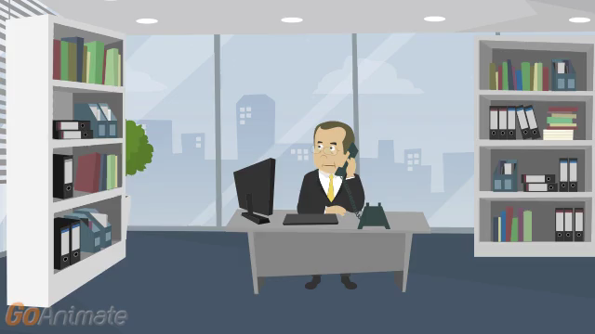

Slide 23
Disreputable or gross misconduct
In re Schroeder, Proceeding No. D2014-08 (USPTO May 18, 2015)
Patent Attorney:
  Submitted unprofessional remarks in two separate Office action responses
  Remarks were ultimately stricken from application files pursuant to 37 C.F.R. § 11.18(c)(1)
  Order noted that behavior was outside of the ordinary standard of professional obligation and client’s interests
  Aggravating factor: has not accepted responsibility or shown remorse for remarks
Default: 6-month suspension
Rule highlights:
  37 C.F.R. § 10.23(a) – Disreputable or gross misconduct
  37 C.F.R. § 10.89(c)(5) – Discourteous conduct before the office
  37 C.F.R. § 10.23(b)(5) – Conduct prejudicial to the administration of justice
  37 C.F.R. § 11.18 – Certification upon filing of papers

Slide 24
Decisions imposing public discipline available in “FOIA Reading Room”
foiadocuments.uspto.gov/oed/
Official Gazette for Trademarks:
  www.uspto.gov/learning-and-resources/official-gazette/trademark-official-gazette-tmog

Slide 25
OED
571-272-4097

