Slide 2
Intellectual Property for the Ethics Lawyer
Robin Crabb, Associate Solicitor
Kimberly Weinreich, Staff Attorney
September 21, 2022

Slide 3
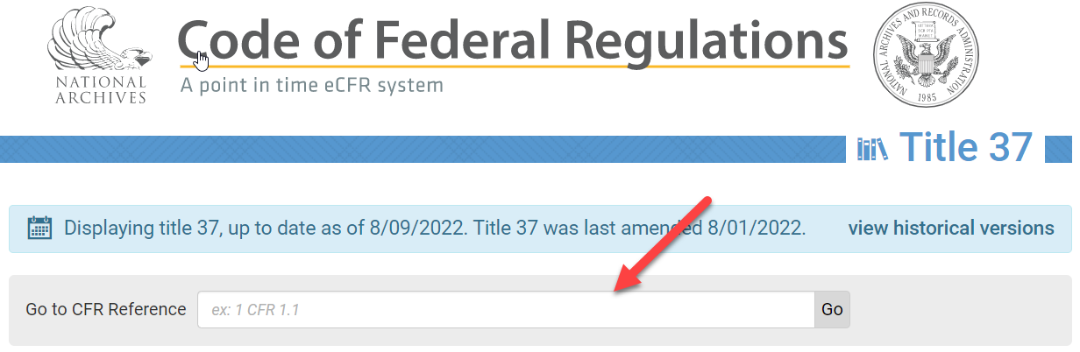
USPTO ethics rules
37 CFR Part 11 Representation of Others Before the USPTO
  Includes:
    Rules regarding who can practice (enrollment)
    USPTO Rules of Professional Conduct (similar to ABA Model Rules)
    Rules regarding disciplinary procedures
  Available at: ecfr.gov

Slide 4
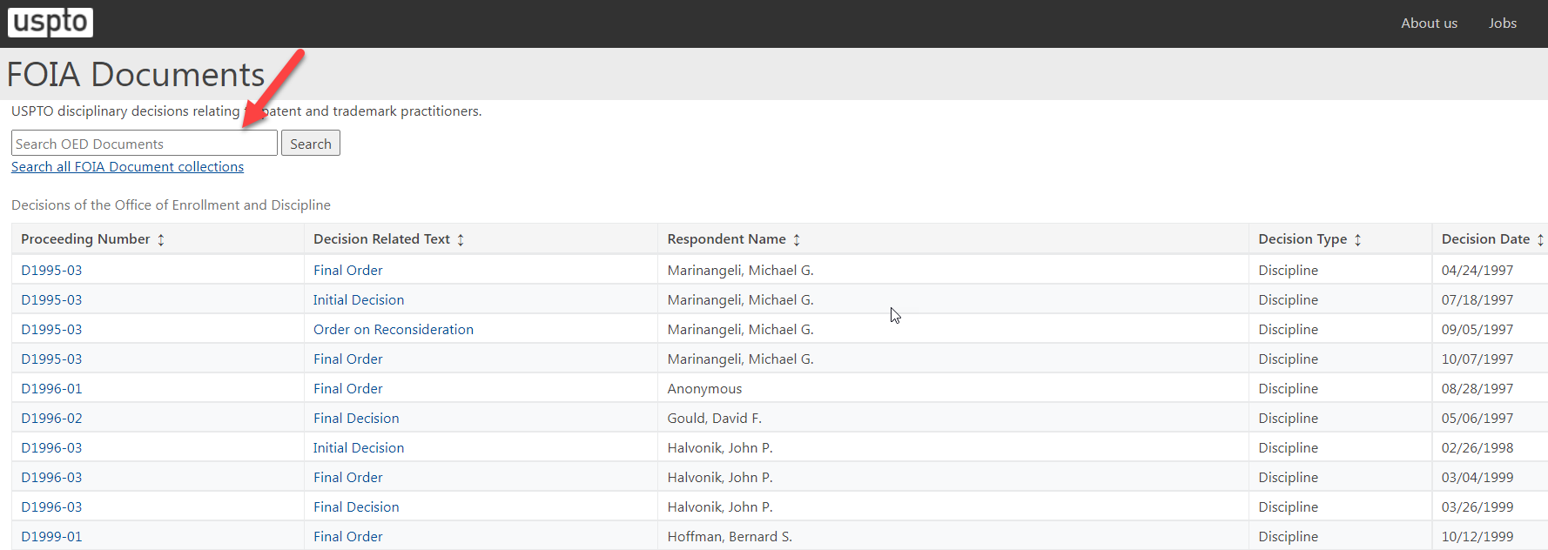
USPTO ethics cases
To find disciplinary cases: https://foiadocuments.uspto.gov/oed/

Slide 5

What is “intellectual property”?
Creations of the mind
Intangible asset (as opposed to “real property,” i.e. land or goods)
Creator or owner is given rights to the creation for a period of time
Intellectual property litigation usually involves protection of those rights
The Santa Maria del Fiore Cathedral
in Florence by Fillippo Brunelleschi.
Image is in the Public Domain
https://commons.wikimedia.org/w/index.php?curid=904982

Slide 6
Types of intellectual property
Patents and Copyrights: Article One, section 8, clause 8.
  "To promote the progress of science and useful arts, by securing for limited times to authors and inventors the exclusive right to their respective writings and discoveries."
Trademarks: Commerce Clause* → Lanham Act; and state laws.
  “The Congress shall have the power to… regulate commerce with foreign nations, and among the several states, and with the Indian tribes.”
Trade secrets
Industrial design rights
Plant variety rights
Geographical indications
*Commerce Clause can be found in Article One, section 8, clause 3

Slide 7
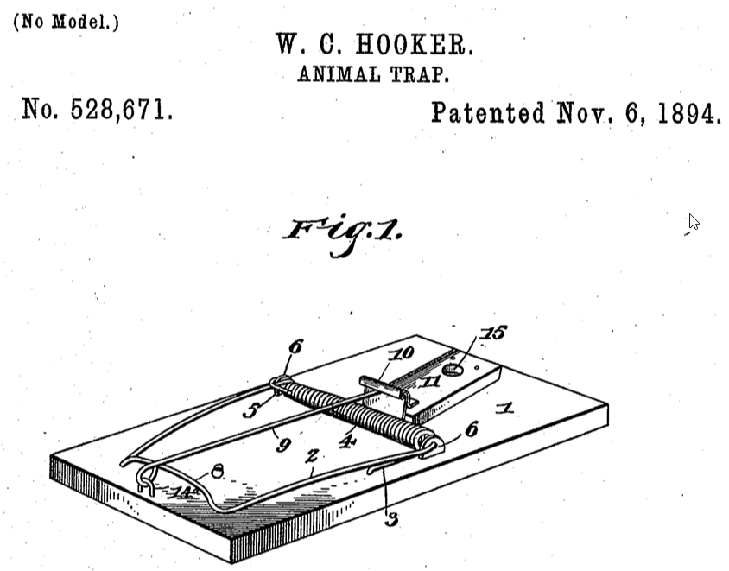
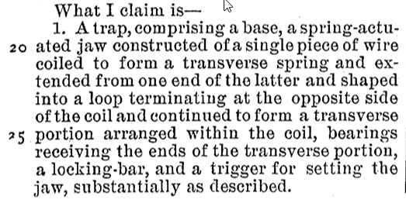
Patents
A grant of a right to exclude others from making, using, or offering for sale or selling the invention in the United States for a set period of time (generally, 20 years from the date of application).

Slide 8
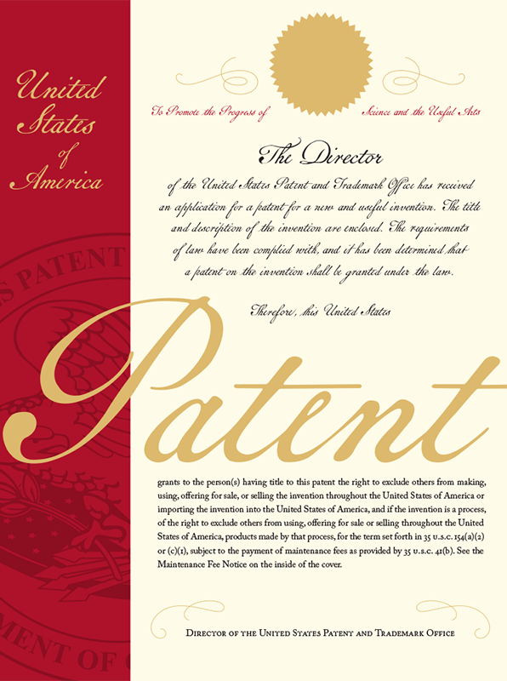
Types of patent applications
Provisional
Design
Nonprovisional/Utility
Nonprovisional/Plant
International (PCT)

Slide 9
Utility patent requirements
Requirements:
(1) Patentable subject matter
  35 U.S.C. § 101 “Whoever invents or discovers any new and useful process, machine, manufacture, or composition of matter, or any new and useful improvement thereof, may obtain a patent therefor, subject to the conditions and requirements of this title.” (emphasis added).
  Patentable subject matter includes “anything under the sun that is made by [hu]man.” (Pasquale Joseph Frederico, USPTO, 1951).
(2) Novel
(3) Nonobvious
(4) Written Description
(5) Enablement

Slide 10
Patent prosecution
Patent prosecution:
Draft and prepare patent application;
Submit to USPTO for examination;
USPTO issues “Office Actions” notifying applicant of any inadequacies in the application;
Applicant responds;
Repeat steps 3 and 4;
USPTO issues the patent or a final decision;
Applicant appeals (if applicable); and
If issued, there are fees due to maintain the patent (maintenance fees), and potential cost of PTAB proceedings (if applicant appeals).

Slide 11
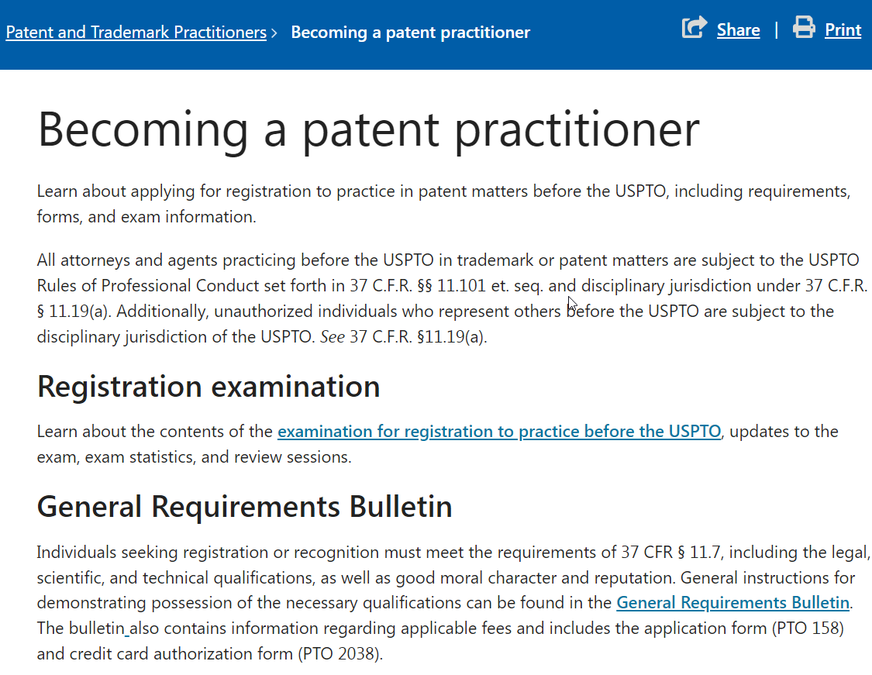
Patent practitioners
Must have a scientific and technical background
May be an attorney
Generally, must apply for and take registration examination (“patent bar exam”) and pass a moral character evaluation
Patent attorneys and patent agents

Slide 12
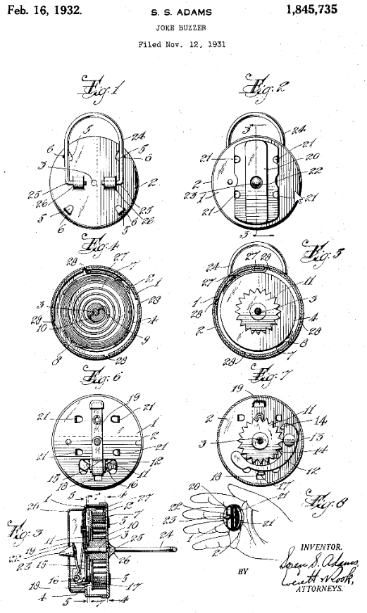
Ethical issues in patent cases
Duty of candor
  37 CFR § 1.56 Duty to disclose information material to patentability.
    “…Each individual associated with the filing and prosecution of a patent application has a duty of candor and good faith in dealing with the Office, which includes a duty to disclose to the Office all information known to that individual to be material to patentability as defined in this section…”
  Inequitable conduct

Slide 13
Ethical issues in patent cases
Duty of candor (cont’d)
In re Tendler, Proceeding No. D2013-17 (USPTO Jan. 8, 2014).
Patent attorney filed Rule 131 declaration regarding date of reduction to practice.
Attorney learned that the inventor did not review the declaration and that declaration contained inaccurate information.
Attorney did not advise the USPTO in writing of the inaccurate information and did not fully correct the record in writing.
District court held resultant patent unenforceable due to inequitable conduct, in part, because of false declaration. Intellect Wireless v. HTC Corp., 910 F. Supp. 1056 (N.D. Ill. 2012). Federal Circuit upheld.
Received 4 year suspension (eligible for reinstatement after 2 years).

Slide 14
Ethical issues in patent cases
Conflicts of interest: Subject matter case
Maling v. Finnegan, 42 N.E. 3d 199 (Mass. 2015).
  Plaintiff engaged law firm to prosecute patents for screwless eyeglass hinge.
  After patents were obtained, plaintiff learned that firm had simultaneously represented another client in the same industry.
  Plaintiff’s work was done in firm’s Boston office; 2nd party’s work was done in D.C. office.
  Plaintiff alleged that firm belatedly commenced preparation of one of his applications and that it inexplicably took a long time to do so.
  Plaintiff alleged he would not have made investment in developing his product if firm had disclosed its conflict and work on 2nd party’s patents.
  Court found no conflict in part because there was no evidence that Plaintiff’s claims were altered or limited because of the simultaneous representation

Slide 15
Ethical issues in patent cases
Maling (cont.)
  KEY TAKEAWAY:
  “This court has not defined a minimum protocol for carrying out a conflict check in the area of patent practice, or any other area of law. However, no matter how complex such a protocol might be, law firms run significant risks, financial and reputational, if they do not avail themselves of a robust conflict system adequate to the nature of their practice.”

Slide 16
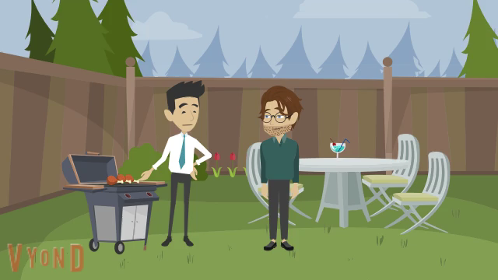
Ethical issues in patent cases
Conflicts of interest: Between multiple inventors

Slide 17
Ethical issues in patent cases
Conflicts of interest: Government conflicts
  Practice before the Office by Government employees is subject to any applicable conflict of interest laws, regulations or codes of professional responsibility. 37 C.F.R. § 11.10(e)
  18 U.S.C. §§ 203, 205: prohibit government employees from representing others before the Government in which the US is a party or has a “direct and substantial interest.”
  The government hires patent attorneys to help develop its technology.
  In re Correll, Proceeding No. D2018-12 (USPTO 2019).

Slide 18
Ethics issues in patent cases
Patent agents & patent agent privilege
  Patent prosecution is the practice of law. Sperry v. Florida, 373 U.S. 379, 383 (1963).
  There is patent agent-client privilege. The Federal Circuit recognizes the privilege only as to those activities that patent agents are authorized to perform (see 37 C.F.R. § 11.5(b)(1)). In re Queen’s University at Kingston, 820 F.3d 1287 (Fed. Cir. 2016).
  Patent agents cannot litigate in federal and state courts, and cannot offer infringement opinions.
  No work-product immunity.
  Rule on Attorney-Client Privilege for Trials Before the Patent Trial and Appeal Board, 82 Fed. Reg. 51570 (Nov. 7, 2017)

Slide 19
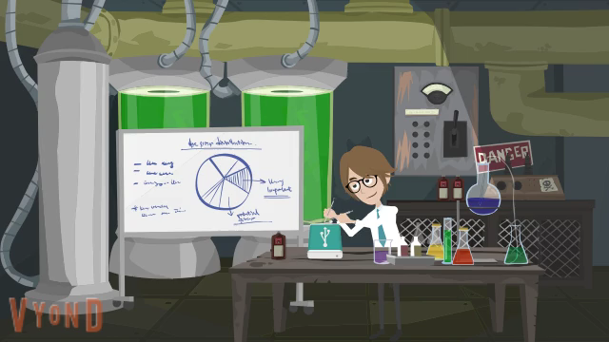
Ethics issues in patent cases

Slide 20
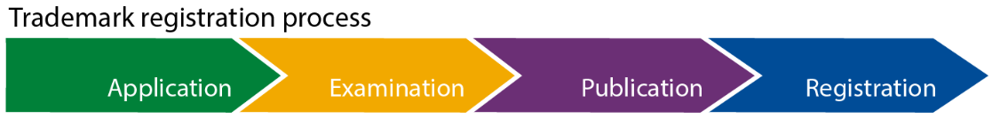
Trademarks ™ SM ®
A trademark can be any word, phrase, symbol, design, or a combination of these things that identifies your goods or services.

Slide 21
Trademarks ™ SM ®
Trademark Search
Application
  Intent to use or use in commerce
  Specimen: sample of how the mark is used in commerce
  Identify goods/services
  Declarations that are signed under penalty of perjury

Slide 22
Trademark practitioners
Must be a U.S.-licensed attorney (an individual who is an active member in good standing of the bar of the highest court of any State)
  Attorneys must provide their bar information on trademark documents.
U.S. Counsel Rule: If you are a foreign-domiciled trademark applicant or registrant, you must have a U.S.-licensed attorney represent you. Requirement of U.S. Licensed Attorney for Foreign Trademark Applicants and Registrants, 84 FR 31498.

Slide 23
Ethical issues in trademarks cases
“Bad” specimens
  Mocked-up or digitally altered specimens are not proper because they do not demonstrate use in commerce.
  In re Morton, Case No. D2022-07 (USPTO 2022)
    Violated 37 C.F.R. § 11.804(c) (misrepresentation) and (d) (conduct prejudicial) by signing declarations attesting that the specimen(s) showed the mark as used on or in connection with the goods in the application where Respondent had not performed an inquiry reasonable under the circumstances.

Slide 24
Ethical issues in trademark cases
Signatures
37 C.F.R. § 2.193 Trademark correspondence and signature requirements
  “(a)…Each piece of correspondence that requires a signature must bear:
    (1) A handwritten signature personally signed in permanent ink by the person named as the signatory, or a true copy thereof; or
    (2) An electronic signature that meets the requirements of paragraph (c) of this section, personally entered by the person named as the signatory….
    * * * * *
  (c) Requirements for electronic signature. A person signing a document electronically must:
    (1) Personally enter any combination of letters, numbers, spaces and/or punctuation marks that the signer has adopted as a signature, placed between two forward slash (“/”) symbols in the signature block on the electronic submission; or
    (2) Sign the document using some other form of electronic signature specified by the Director.
    * * * * *
  (f) Signature as certification. The presentation to the Office (whether by signing, filing, submitting, or later advocating) of any document by any person, whether a practitioner or non-practitioner, constitutes a certification under §11.18(b) of this chapter. Violations of §11.18(b) of this chapter may jeopardize the validity of the application or registration, and may result in the imposition of sanctions under §11.18(c) of this chapter. Any practitioner violating §11.18(b) of this chapter may also be subject to disciplinary action. See §11.18(d) and §11.804 of this chapter.”

Slide 25
Ethical issues in trademark cases
Signatures
  In re Yang, Proceeding No. 2021-11 (USPTO 2021)
    Ms. Yang had a business relationship with Shenzhen Qianhai Be-Victory Network Technology Co., Ltd. (“Sellergrowth”) and its employees, none of whom were authorized to represent trademark applicants, registrants, or parties before the USPTO.
    Ms. Yang agreed to allow Sellergrowth and its employees to use her name and bar credentials to file trademark application documents on behalf of foreign-domiciled applicants.
    Violations: 37 C.F.R. §§ 11.103 (diligence), 11.303 (candor to the USPTO), 11.503(b) (responsibilities re non-practitioner assistance), 11.505 (assisting in UPL), 11.804(d) (conduct prejudicial to the integrity of the US trademark system).
    30 day suspension + 1 year probation

Slide 26
Copyrights ©
Copyright protects original works of authorship as soon as an author fixes the work in a tangible form of expression. Copyright exists automatically in an original work of authorship once it is fixed.
Different types of works, including paintings, photographs, illustrations, musical compositions, sound recordings, computer programs, books, poems, blog posts, movies, architectural works, plays, and so much more!
Generally, works created on or after January 1, 1978, have a copyright term of life of the author plus seventy years after the author’s death.
Copyright owners can then: reproduce the work; prepare derivative works; distribute copies; perform the work; and display the work.
Registering a work is not mandatory, but for U.S. works, registration (or refusal) is necessary to enforce the exclusive rights of copyright through litigation.
U.S. Copyright Office, https://www.copyright.gov/what-is-copyright/

Slide 27
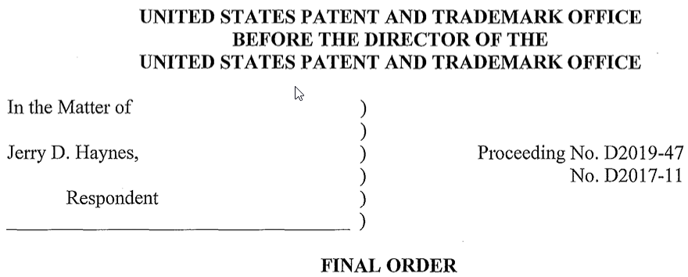
Ethical issues in copyright cases
The Copyright Office only looks to see if the work is eligible for protection. Most do not hire attorneys to register their copyright. So, the USPTO does not see a lot of ethics violations concerning copyrights.
The USPTO has disciplined attorneys for improperly associating with promotion companies, in which a part of the work was copyright registration.

Slide 28
Robin Crabb
Robin.Crabb@uspto.gov
Kimberly Weinreich
Kimberly.Weinreich@uspto.gov

