Slide 2
2019 Revised Patent
Subject Matter Eligibility Guidance
Introductory Module

Slide 3
Training overview
This is an introductory training module on the 2019 Revised Patent Subject Matter Eligibility Guidance.
These training slides are available on the Subject Matter Eligibility microsite.
  You can download the slides from this link:
  www.uspto.gov/patent/laws-and-regulations/examination-policy/subject-matter-eligibility
  The slides will be made public once this phase of training has been completed.
Notes:
This presentation is an introductory training module on the 2019 Revised Patent Subject Matter Eligibility Guidance.
These training slides and related materials are available on the Subject Matter Eligibility microsite. You can download the slides from the Examiner Training and Resource Materials microsite at the link shown on the slides: www.uspto.gov/patent/laws-and-regulations/examination-policy/subject-matter-eligibility. The slides will be made public once this phase of training has been completed.

Slide 4
Introduction

Slide 5
USPTO Strategic Plan
Key goal is to optimize patent reliability
  As the Under Secretary of Commerce for Intellectual Property and Director of the United States Patent and Trademark Office Andrei Iancu has explained, “[r]eliable patent rights are key to economic growth. Providing high quality, efficient examination of patent applications will serve the American economy well.”
  Initiatives to achieve this goal include:
    Improving examiner access to prior art.
    Enhancing operations of the PTAB.
    Training and guidance initiatives to support high-quality examination.
Notes:
Although today’s session is primarily about subject matter eligibility, we want to briefly discuss the “big picture” into which this legal doctrine fits.
As you all know, one of our key goals here at the USPTO is to optimize patent reliability. The Under Secretary of Commerce for Intellectual Property and Director of the United States Patent and Trademark Office Andrei Iancu has also stressed the need for reliable patent rights in his testimony before Congress, which included the quote on this slide.
Some of the USPTO’s initiatives that are designed to achieve this goal include:
Improving examiner access to prior art, for example, the Relevant Prior Art Initiative, which is designed to automatically collect and consolidate the art cited in related applications. Automating this task frees up examiner and applicant time to focus their search efforts on finding new prior art.
Enhancing operations of the PTAB, for example, improving the standard operating procedures.
Training and guidance initiatives to support high-quality examination, as further discussed on the next slide.

Slide 6
Current training & guidance initiatives
Initiatives rolled out in 2018 focus on reinforcing examiners’ knowledge of the current procedures and legal tests, and on teaching analytical and writing techniques:
  Prior Art Capstone Workshop on 35 U.S.C. 102 and 103
  Legal Analysis and Writing (LAW) Workshop III Training
Two new initiatives:
  Examining Computer-Implemented Functional Claim Limitations for Compliance with 35 U.S.C. 112
  2019 Revised Patent Subject Matter Eligibility Guidance on 35 U.S.C. 101
Notes:
While there are many training and guidance initiatives at the USPTO, this slide features a few initiatives that affect many examiners in the corps.
Two initiatives rolled out in 2018 focused on reinforcing examiners’ knowledge of the current procedures and legal tests, and on teaching analytical and writing techniques. These include the Prior Art Capstone Workshop on 35 U.S.C. 102 and 103, and the Legal Analysis and Writing (LAW) Workshop III Training. The training materials for these initiatives are posted on the Examiner Training and Resource Materials microsite.
Two new initiatives are the Examining Computer-Implemented Functional Claim Limitations for Compliance with 35 U.S.C. 112, which is discussed briefly on the next slide, and the 2019 Revised Patent Subject Matter Eligibility Guidance on 35 U.S.C. 101, which will be the focus of today’s session.

Slide 7
Section 112 initiative
Addresses issues under 35 U.S.C. 112 related to the examination of computer-implemented functional claims
  Covers claim interpretation, including interpretation under 35 U.S.C. 112(f)
  Covers the Section 112 requirements for definiteness, enablement, and an adequate written description
The purpose of this initiative is to reinforce good practices in claim interpretation and evaluation of the Section 112 requirements.
  It emphasizes that problems with functional claiming can be effectively addressed using long-standing, well-understood principles under Section 112.
  It reinforces examination practice with respect to claim interpretation and does not alter any guidance provided in the MPEP.
  The Federal Register Notice announcing this initiative provides a refresher on these topics, in order to enhance the quality of examination.
Training on Section 112 is planned as part of this initiative.
Notes:
The new Section 112 initiative will assist in the examination of claims that contain functional language, particularly where functional language is used to claim computer-implemented inventions.
The initiative was announced in a Federal Register Notice that addresses several issues, including:
Claim interpretation, including claim interpretation under 35 U.S.C. 112(f)
Section 112’s requirements that claims be definite, and
Section 112’s requirements for the application to enable and provide an adequate written description of the claimed invention.
The purpose of this initiative is to reinforce good practices in claim interpretation and evaluation of the Section 112 requirements.
It emphasizes that problems with functional claiming can be effectively addressed using long-standing, well-understood principles under Section 112.
It reinforces examination practice with respect to claim interpretation and does not alter any guidance provided in the MPEP.
The Federal Register Notice announcing this initiative provides a refresher on these topics, in order to enhance the quality of examination.
Training on Section 112 is planned as part of this initiative.
The Notice is posted on the Examiner Training and Resource Materials microsite.

Slide 8
Section 101 initiative: Revised guidance
The 2019 Revised Patent Subject Matter Eligibility Guidance (hereinafter “2019 PEG”) published in January 2019.
The guidance was revised for several reasons:
  Increase clarity, predictability, and consistency in how Section 101 is applied during examination.
  Enable examiners to more readily determine if a claim does (or does not) recite an abstract idea.
Notes:
The Section 101 initiative introduces new guidance that revises the procedures for how examiners analyze claims under Section 101.
This new guidance published in January 2019 and is called the 2019 Revised Patent Subject Matter Eligibility Guidance. We will be referring to this guidance as the “2019 PEG” in the remainder of this presentation. You should already have the 2019 PEG, but if you need another copy, you can obtain it from the Examiner Training and Resource Materials microsite.
As explained in more detail in the Federal Register Notice announcing the 2019 PEG, the USPTO’s subject matter eligibility guidance was revised for several reasons:
To increase clarity, predictability, and consistency in how Section 101 is applied during examination;
To enable examiners to more readily determine if a claim does (or does not) recite an abstract idea; and
To promote early and efficient resolution of patent eligibility by identifying more eligible subject matter in Step 2A, rather than Step 2B.

Slide 9
2019 PEG

Slide 10
Overview of 2019 PEG
Makes two changes in Step 2A:
  Sets forth new procedure for Step 2A (called “revised Step 2A”) under which a claim is not “directed to” a judicial exception unless the claim satisfies a two-prong inquiry; and
  For abstract ideas, replaces the “Eligibility Quick Reference Sheet Identifying Abstract Ideas” with an identification of particular groupings of abstract ideas.
Notes:
The 2019 PEG makes two changes in Step 2A:
It sets forth new procedure for Step 2A (called “revised Step 2A”) under which a claim is not “directed to” a judicial exception unless the claim satisfies a two-prong inquiry; and
For abstract ideas, replaces the “Eligibility Quick Reference Sheet Identifying Abstract Ideas” with an identification of particular groupings of abstract ideas. Examiners will use these groups to identify if a claim recites an abstract idea. The groupings are consistent with judicial precedent and are based on an extraction and synthesis of the key concepts identified by the courts as being abstract.

Slide 11
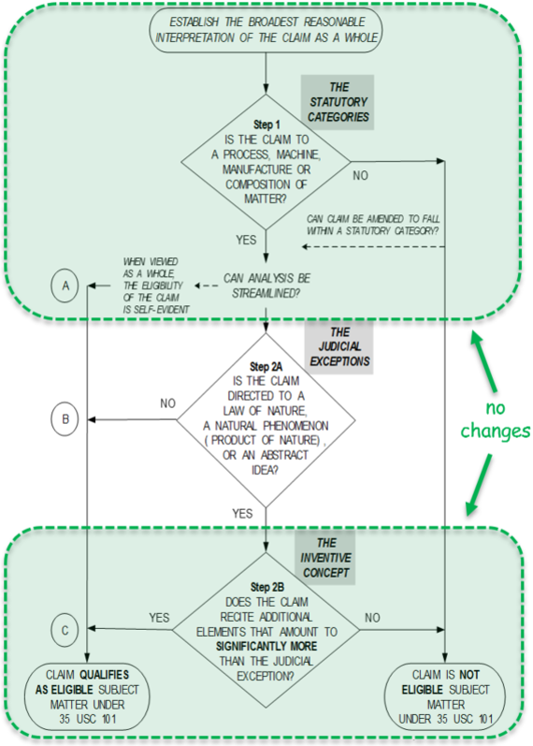
What remains the same
No changes to:
  Step 1 (statutory categories)
  Streamlined analysis
  Step 2B
Notes:
The 2019 PEG revised only certain aspects of the Section 101 analysis. For instance, there are no changes to Step 1 (statutory categories), the streamlined analysis, or Step 2B.
Examiners should continue the existing practice of beginning their Section 101 analysis by establishing the broadest reasonable interpretation of the claim as a whole, and then walking through the flowchart by first evaluating Step 1 (statutory categories), and then determining whether the streamlined analysis is appropriate. If the analysis proceeds to Step 2A, then examiners should apply the revised procedure in the 2019 PEG.

Slide 12
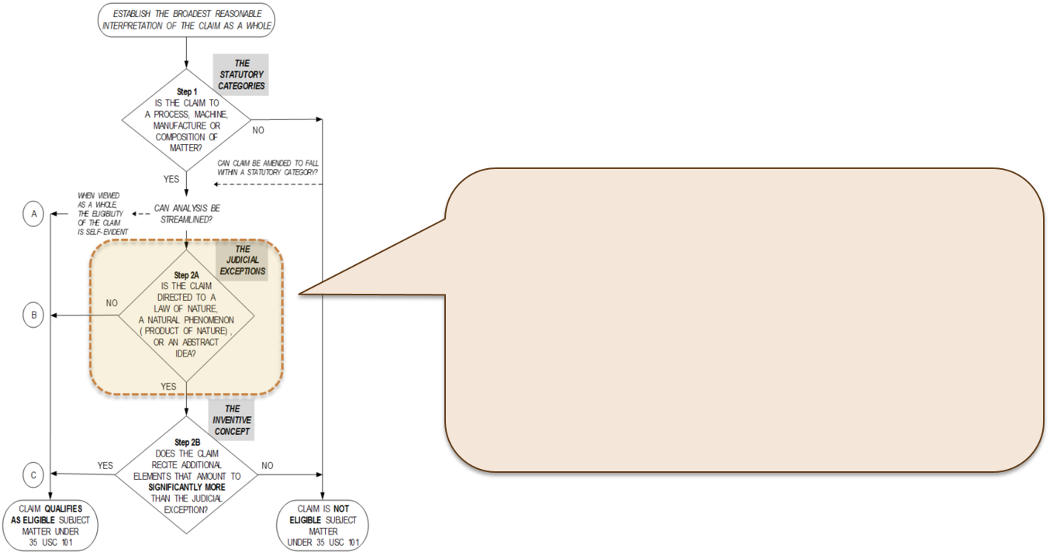
What has changed: Revised Step 2A
2019 PEG revises Step 2A:
  Creates new two-prong inquiry for determining whether a claim is “directed to” an exception
  Groups abstract ideas
Notes:
With respect to all judicial exceptions, the 2019 PEG changes the USPTO’s interpretation of the words “directed to” in the Step 2A diamond.
In particular, the 2019 PEG revises the procedure at Step 2A for determining whether a claim is “directed to” an exception, by creating a new two-prong inquiry.
The 2019 PEG also groups abstract ideas.
These changes are discussed in more detail on the following slides.

Slide 13
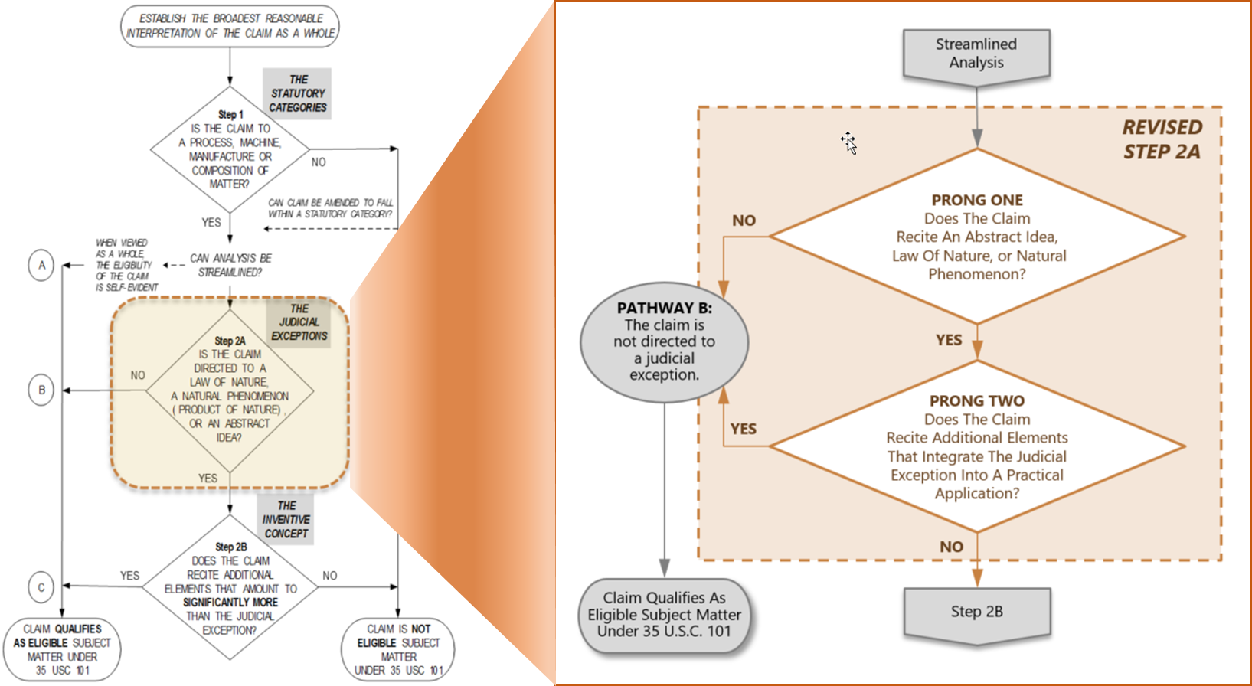
MPEP flowchart including revised Step 2A
MPEP flowchart
Revised
Step 2A
flowchart
Notes:
The graphic on this slide depicts the relationship between the existing MPEP flowchart for the full eligibility analysis and a new flowchart for revised Step 2A. The details of the new flowchart are discussed on the next slide.

Slide 14
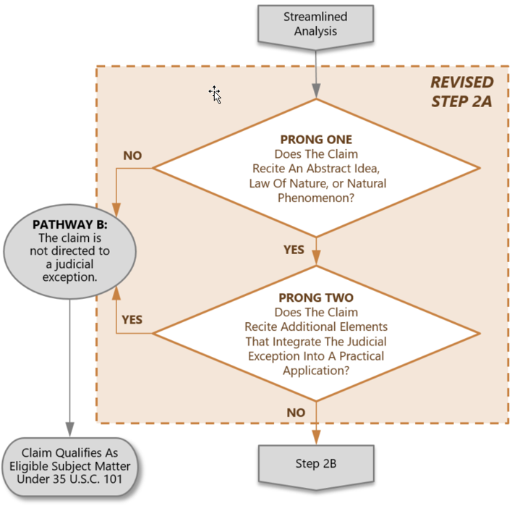
What has changed: Revised Step 2A
This flowchart depicts revised Step 2A.
Under this new two-prong inquiry, a claim is now eligible at revised Step 2A unless it:
  Recites a judicial exception and
  The exception is not integrated into a practical application of the exception.
Notes:
This slide depicts revised Step 2A, which applies to all judicial exceptions.
Under this new two-prong inquiry, a claim is eligible at revised Step 2A unless it:
Recites a judicial exception and
The exception is not integrated into a practical application of the exception.
This two-prong inquiry is discussed in more detail on the following slides.

Slide 15
Revised Step 2A is a two-prong inquiry
Prong One: Evaluate whether the claim recites a judicial exception (an abstract idea enumerated in the 2019 PEG, a law of nature, or a natural phenomenon).
  If no exception is recited, the claim is eligible. This concludes the eligibility analysis.
  If claim recites an exception, go to Prong Two.
Prong Two: Evaluate whether the claim recites additional elements that integrate the exception into a practical application of the exception.
  If the recited exception is integrated into a practical application, then the claim is eligible. This concludes the eligibility analysis.
  If the exception is not integrated into a practical application, then the claim is “directed to” the exception. Go to Step 2B for further analysis.
Notes:
This slide is an overview of the two-prong inquiry.
In Prong One, examiners evaluate whether the claim recites a judicial exception (an abstract idea enumerated in the 2019 PEG, a law of nature, or a natural phenomenon).
If no exception is recited, the claim is eligible. This concludes the eligibility analysis.
If claim recites an exception, go to Prong Two.
In Prong Two, examiners evaluate whether the claim recites additional elements that integrate the exception into a practical application of the exception.
If the recited exception is integrated into a practical application, then the claim is eligible. This concludes the eligibility analysis.
If the exception is not integrated into a practical application, then the claim is “directed to” the exception. Go to Step 2B for further analysis.

Slide 16
Prong One: Overview
Prong One vs. prior guidance
  For laws of nature and natural phenomena, Prong One does not represent a change from prior guidance.
    Continue to use the “recite” standard set forth in MPEP 2106.04(b) and (c), including the markedly different characteristics analysis, to determine if a claim recites a law of nature or natural phenomenon.
    If the claim recites a law of nature or natural phenomenon (including a product of nature), the analysis proceeds to Prong Two.
  For abstract ideas, Prong One represents a change from prior guidance.
    Now use groupings of abstract ideas.
    No longer use the “Eligibility Quick Reference Sheet Identifying Abstract Ideas” when determining whether a claim recites an abstract idea.
Notes:
Prong One represents a change for some judicial exceptions, but not for others.
For laws of nature and natural phenomena, Prong One does not represent a change from prior guidance. Examiners should continue to use the “recite” standard set forth in MPEP 2106.04(b) and (c) to determine if a claim recites a law of nature or natural phenomenon, and if it does, should proceed to Prong Two. Thus, in Prong One, examiners will still use the markedly different characteristics analysis to determine if a recited nature-based product limitation is a product of nature.
For abstract ideas, Prong One represents a change in procedure from prior guidance, in that examiners now use the enumerated groupings of abstract ideas from the 2019 PEG to identify abstract ideas.
In particular, examiners are no longer to use the document entitled “Eligibility Quick Reference Sheet Identifying Abstract Ideas” when determining whether a claim recites an abstract idea. Reliance on the Abstract Ideas QRS has resulted in inconsistent subject matter eligibility determinations across different art units and technology fields and has exaggerated imbalances in the body of precedent. Under the 2019 PEG, examiners will now rely on the groupings of abstract ideas in the 2019 PEG as their primary tool for identifying abstract ideas. This new approach will help examiners more fully understand how the body of precedent applies to all technologies across all types of claims, and thus reach more consistent decisions.

Slide 17
Prong One: Abstract ideas
Prong One procedure for determining whether a claim “recites” an abstract idea is:
  Identify the specific limitation(s) in the claim under examination that the examiner believes recites an abstract idea, and
  Determine whether the identified limitation(s) falls within at least one of the groupings of abstract ideas enumerated in the 2019 PEG.
If the identified limitation(s) falls within any of the groupings of abstract ideas enumerated in the 2019 PEG, the analysis should proceed to Prong Two.
Claim limitations that do not fall within the enumerated groupings should not be treated as abstract ideas except in rare circumstances (see slide 26 for more information).
Notes:
The revised Step 2A Prong One procedure for determining whether a claim “recites” an abstract idea is to:
Identify the specific limitation(s) in the claim under examination that the examiner believes recites an abstract idea, and
Determine whether the identified limitation(s) falls within at least one of the groupings of abstract ideas enumerated in the 2019 PEG.
If the identified limitation(s) falls within any of the groupings of abstract ideas enumerated in the 2019 PEG, the analysis should proceed to Prong Two.
Claim limitations that do not fall within the enumerated groupings should not be treated as abstract ideas except in rare circumstances (see slide 26 for more information).

Slide 18
Groupings of abstract ideas
Mathematical concepts
Mathematical relationships
Mathematical formulas or equations
Mathematical calculations
Mental processes
Concepts performed in the human mind (including an observation, evaluation, judgment, opinion)
NOTE: The recitation of generic computer components in a claim does not necessarily preclude that claim from reciting an abstract idea.
Certain methods of organizing human activity
Fundamental economic principles or practices (including hedging, insurance, mitigating risk)
Commercial or legal interactions (including agreements in the form of contracts; legal obligations; advertising, marketing or sales activities or behaviors; business relations)
Managing personal behavior or relationships or interactions between people (including social activities, teaching, and following rules or instructions)
Notes:
The 2019 PEG explains that the abstract idea exception includes the following groupings of subject matter:
Mathematical concepts – mathematical relationships, mathematical formulas or equations, mathematical calculations;
b) Certain methods of organizing human activity – fundamental economic principles or practices (including hedging, insurance, mitigating risk); commercial or legal interactions (including agreements in the form of contracts; legal obligations; advertising, marketing or sales activities or behaviors; business relations); managing personal behavior or relationships or interactions between people (including social activities, teaching, and following rules or instructions); and
c) Mental processes – concepts performed in the human mind (including an observation, evaluation, judgment, opinion).
Note that the groupings of abstract ideas in the 2019 PEG and shown on this slide are not the same as those on the Abstract Ideas QRS or in the MPEP. The groupings in the 2019 PEG should be used as your primary tool for identifying abstract ideas.
Also, examiners should take note that the recitation of generic computer components in a claim does not preclude that claim from reciting an abstract idea. For instance, if a claim limitation, under its broadest reasonable interpretation, covers performance of the limitation in the mind but for the recitation of generic computer components, then it is still in the mental processes grouping unless the claim limitation cannot practically be performed in the mind. Likewise, performance of a claim limitation using generic computer components does not preclude the claim limitation from being in the mathematical concepts grouping or the certain methods of organizing human activity grouping.

Slide 19
Revised Step 2A: Prong Two
New procedure not found in prior guidance:
  Identifying whether there are any additional elements recited in the claim beyond the judicial exception(s), and
  Evaluating those additional elements to determine whether they integrate the exception into a practical application of the exception.
“Integration into a practical application”
  Requires an additional element or a combination of additional elements in the claim to apply, rely on, or use the judicial exception in a manner that imposes a meaningful limit on the judicial exception, such that the claim is more than a drafting effort designed to monopolize the exception.
  Uses the considerations laid out by the Supreme Court and the Federal Circuit to evaluate whether the judicial exception is integrated into a practical application.
Notes:
Prong Two is a new procedure not found in prior guidance, whereby examiners are to:
Identify whether there are any additional elements recited in the claim beyond the judicial exception(s), and
Evaluate those additional elements to determine whether they integrate the exception into a practical application of the exception.
The 2019 PEG defines the phrase “integration into a practical application” to require an additional element or a combination of additional elements in the claim to apply, rely on, or use the judicial exception in a manner that imposes a meaningful limit on the judicial exception, such that it is more than a drafting effort designed to monopolize the exception.
The Supreme Court has long distinguished between principles themselves, which are not patent eligible, and the integration of those principles into practical applications, which are patent eligible. This new procedure builds on these Supreme Court decisions and recent decisions from the Federal Circuit indicating that eligible subject matter can often be identified in the first step of the Alice/Mayo test (Step 2A), for instance the Enfish, McRO, and Vanda decisions. Integration into a practical application is evaluated in Prong Two using the considerations laid out by the Supreme Court and the Federal Circuit. Evaluating these considerations in revised Step 2A promotes early and efficient resolution of eligibility.

Slide 20
Prong Two considerations: Introduction
Most of these considerations should be familiar to you.
  As noted in the following slides, most of the considerations are discussed in MPEP 2106.05 and sub-sections 2106.05(a) through 2106.05(h) with respect to Step 2B.
  Unless otherwise specified in the 2019 PEG, you should evaluate these considerations in Step 2A Prong Two the same way you have been evaluating them in Step 2B.
The 2019 PEG modifies the considerations in two ways:
  The improvements consideration is evaluated differently in Step 2A Prong Two than in the streamlined analysis or Step 2B.
  Adds a new consideration based on case law including Vanda, for evaluation of particular treatment or prophylaxis limitations.
Notes:
Most of these considerations should be familiar to you.
As noted in the following slides, most of the considerations are discussed in MPEP 2106.05 and sub-sections 2106.05(a) through 2106.05(h) with respect to Step 2B.
Unless otherwise specified in the 2019 PEG, you should evaluate these considerations in Step 2A – Prong Two the same way you have been evaluating them in Step 2B.
The 2019 PEG modifies the considerations in two ways. The improvements consideration is evaluated differently in Step 2A Prong Two than in the streamlined analysis or Step 2B. There is also a new consideration for particular treatment or prophylaxis limitations. This new consideration is based on case law including the Federal Circuit’s Vanda decision.

Slide 21
Prong Two considerations: Details
Limitations that are indicative of integration into a practical application:
Improvements to the functioning of a computer, or to any other technology or technical field - see MPEP 2106.05(a);
Applying or using a judicial exception to effect a particular treatment or prophylaxis for a disease or medical condition – see Vanda Memo;
Applying the judicial exception with, or by use of, a particular machine - see MPEP 2106.05(b);
Effecting a transformation or reduction of a particular article to a different state or thing - see MPEP 2106.05(c); and
Applying or using the judicial exception in some other meaningful way beyond generally linking the use of the judicial exception to a particular technological environment, such that the claim as a whole is more than a drafting effort designed to monopolize the exception - see MPEP 2106.05(e) and Vanda Memo.
Limitations that are not indicative of integration into a practical application:
Adding the words “apply it” (or an equivalent) with the judicial exception, or mere instructions to implement an abstract idea on a computer, or merely uses a computer as a tool to perform an abstract idea - see MPEP 2106.05(f);
Adding insignificant extra-solution activity to the judicial exception - see MPEP 2106.05(g); and
Generally linking the use of the judicial exception to a particular technological environment or field of use – see MPEP 2106.05(h)
Whether claim elements represent only well-understood, routine, conventional activity is considered at Step 2B and is not a consideration at Step 2A.
Notes:
Limitations that are indicative of integration into a practical application when recited in a claim with a judicial exception include:
Improvements to the functioning of a computer, or to any other technology or technical field, as discussed in MPEP 2106.05(a);
Applying or using a judicial exception to effect a particular treatment or prophylaxis for disease or medical condition – see Vanda Memo
Applying the judicial exception with, or by use of, a particular machine, as discussed in MPEP 2106.05(b);
Effecting a transformation or reduction of a particular article to a different state or thing, as discussed in MPEP 2106.05(c); and
Applying or using the judicial exception in some other meaningful way beyond generally linking the use of the judicial exception to a particular technological environment, such that the claim as a whole is more than a drafting effort designed to monopolize the exception , as discussed in MPEP 2106.05(e) and the Vanda Memo issued in June 2018.
Limitations that are not indicative of integration into a practical application when recited in a claim with a judicial exception include:
Adding the words “apply it” (or an equivalent) with the judicial exception, or mere instructions to implement an abstract idea on a computer, or merely uses a computer as a tool to perform an abstract idea, as discussed in MPEP 2106.05(f);
Adding insignificant extra-solution activity to the judicial exception, as discussed in MPEP 2106.05(g); and
Generally linking the use of the judicial exception to a particular technological environment or field of use, as discussed in MPEP 2106.05(h).
Examiners should note that revised Step 2A excludes consideration of whether claim elements represent well-understood, routine, conventional activity. The question of whether claim elements represent only well-understood, routine, conventional activity is considered at Step 2B and is not a consideration at Step 2A.

Slide 22
Prong Two excludes the “WURC” consideration
As noted on the preceding slide, there is no evaluation of well-understood, routine, conventional (“WURC”) activity in Prong Two.
Examiners should give weight to all of the claimed additional elements in Prong Two, even if those elements represent well-understood, routine, conventional (WURC) activity.
  Because Step 2A excludes consideration of WURC, a claim that includes WURC elements may still integrate an exception into a practical application.
  Do not evaluate WURC unless the analysis proceeds to Step 2B.
Notes:
As noted on the preceding slide, there is no evaluation of well-understood, routine, conventional (“WURC”) activity in Prong Two. Examiners should give weight to all of the claimed additional elements in Prong Two, even if those elements represent well-understood, routine, conventional (or “WURC”) activity.
Because Step 2A excludes consideration of WURC, a claim that includes WURC elements may still integrate an exception into a practical application. Remember, do not evaluate WURC unless the analysis proceeds to Step 2B.

Slide 23
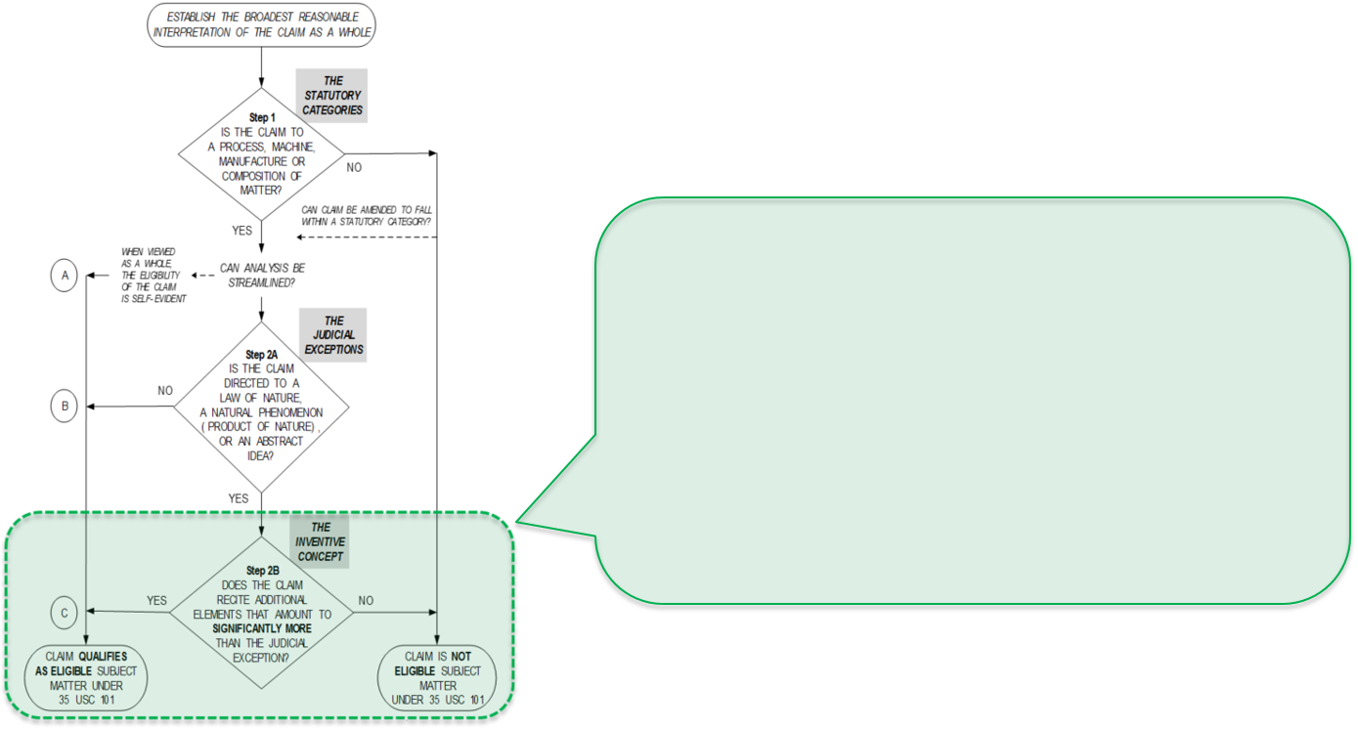
What remains the same: Step 2B
Still analyze inventive concept (aka “significantly more”) in 2B.
Even if claim ends up in Step 2B, it may still be eligible.
  E.g., claim recites an element or combination of elements that is unconventional.
Notes:
The 2019 PEG does not change the Step 2B analysis, which still requires an analysis of whether the claim provides an inventive concept (also called significantly more).
It also remains true that even if a claim is directed to a judicial exception and requires analysis under Step 2B, it may still be eligible, for example if it recites an additional element (or a combination of elements) that are unconventional.
These concepts are explained further in the next few slides.

Slide 24
Still analyze for inventive concept in Step 2B
In Step 2B, evaluate whether the claim recites additional elements that amount to an inventive concept (aka “significantly more”) than the recited judicial exception.
  If the claim as a whole amounts to significantly more than the exception itself (there is an inventive concept in the claim), the claim is eligible.
  If the claim as a whole does not amount to significantly more (there is no inventive concept in the claim), the claim is ineligible.
Same procedure as in prior guidance:
  Identifying whether there are any additional elements recited in the claim beyond the judicial exception(s), and
  Evaluating those additional elements individually and in combination to determine whether they amount to significantly more, using the considerations discussed on the following slides.
Notes:
The 2019 PEG does not change the Step 2B analysis, which still requires an evaluation of whether the claim recites additional elements that amount to an inventive concept (aka “significantly more”) than the recited judicial exception.
If the claim as a whole amounts to significantly more than the exception itself (there is an inventive concept in the claim), the claim is eligible.
If the claim as a whole does not amount to significantly more (there is no inventive concept in the claim), the claim is ineligible.
The procedure for evaluating Step 2B remains the same as in prior guidance:
First, the examiner identifies whether there are any additional elements recited in the claim beyond the judicial exception(s), and
Second, the examiner evaluates those additional elements individually and in combination to determine whether they amount to significantly more, using the considerations discussed on the following slides.

Slide 25
Eligibility at Step 2B
Revised Step 2A overlaps with Step 2B, and thus, many of the considerations need not be re-evaluated in Step 2B because the answer will be the same.
However, if an examiner had previously concluded under revised Step 2A that
an additional element was insignificant extra-solution activity, they should
re-evaluate that conclusion in Step 2B.
  If such reevaluation indicates that the element is unconventional or otherwise more than what is well-understood, routine, conventional activity in the field, this finding may indicate that an inventive concept is present and that the claim is thus eligible.
  For example, when evaluating a claim reciting an abstract idea such as a mathematical equation and a series of data gathering steps that collect a necessary input for the equation, an examiner might consider the data gathering steps to be insignificant extra-solution activity in revised Step 2A, and therefore find that the judicial exception is not integrated into a practical application. However, when the examiner reconsiders the data gathering steps in Step 2B, the examiner could determine that the combination of steps gather data in an unconventional way and, therefore, provide an “inventive concept,” rendering the claim eligible at Step 2B.
Notes:
Because revised Step 2A Prong Two overlaps with Step 2B, many of the considerations need not be re-evaluated in Step 2B because the answer will be the same. For example, if an additional element were considered to be a field of use in Step 2A, it will also be a field of use in Step 2B.
However, if an examiner had previously concluded under revised Step 2A that an additional element was insignificant extra-solution activity, they should re-evaluate that conclusion in Step 2B.
If such reevaluation indicates that the element is unconventional or otherwise more than what is well-understood, routine, conventional activity in the field, this finding may indicate that an inventive concept is present and that the claim is thus eligible.
For example, consider a claim reciting an abstract idea such as a mathematical equation and a series of data gathering steps that collect a necessary input for the equation.
When evaluating this claim in revised Step 2A, an examiner might consider the data gathering steps to be insignificant extra-solution activity, because they are merely collecting necessary input for the equation, and are required for all uses of the judicial exception. Thus, the examiner might find that the judicial exception is not integrated into a practical application.
However, when the examiner reconsiders the data gathering steps in Step 2B, the examiner could determine that the combination of steps gather data in an unconventional way and, therefore, provide an “inventive concept,” rendering the claim eligible at Step 2B.

Slide 26
Step 2B considerations overlap with Step 2A
Limitations that are indicative of an inventive concept (aka “significantly more”):
Improvements to the functioning of a computer, or to any other technology or technical field - see MPEP 2106.05(a);
Applying the judicial exception with, or by use of, a particular machine - see MPEP 2106.05(b);
Effecting a transformation or reduction of a particular article to a different state or thing - see MPEP 2106.05(c);
Applying or using the judicial exception in some other meaningful way beyond generally linking the use of the judicial exception to a particular technological environment, such that the claim as a whole is more than a drafting effort designed to monopolize the exception - see MPEP 2106.05(e) and Vanda Memo; and
Adding a specific limitation other than what is well-understood, routine, conventional activity in the field - see MPEP 2106.05(d).
Limitations that are not indicative of an inventive concept (aka “significantly more”):
Adding the words “apply it” (or an equivalent) with the judicial exception, or mere instructions to implement an abstract idea on a computer, or merely uses a computer as a tool to perform an abstract idea - see MPEP 2106.05(f);
Adding insignificant extra-solution activity to the judicial exception - see MPEP 2106.05(g);
Generally linking the use of the judicial exception to a particular technological environment or field of use – see MPEP 2106.05(h); and
Simply appending well-understood, routine, conventional activities previously known to the industry, specified at a high level of generality, to the judicial exception - see MPEP 2106.05(d) and Berkheimer Memo.
Notes:
As shown on this slide, Step 2B includes evaluation of the same considerations as revised Step 2A Prong Two, plus two additional considerations:
Adding a specific limitation other than what is well-understood, routine, conventional activity in the field, which is indicative that an inventive concept may be present, and
Simply appending well-understood, routine, conventional activities previously known to the industry, specified at a high level of generality, to the judicial exception, which is indicative that an inventive concept may not be present.
Both of these additional considerations are discussed in MPEP 2106.05(d) and the Berkheimer Memo issued on April 20, 2018.

Slide 27
Procedure for tentative abstract ideas
There may be rare circumstances in which an examiner believes a claim limitation should be treated as an abstract idea (“tentative abstract idea”) even though it does not fall within the enumerated groupings of abstract ideas.
In such circumstances, the examiner should evaluate the claim under the 2019 PEG:
  If the claim as a whole integrates the tentative abstract idea into a practical application, the claim is eligible. This concludes the eligibility analysis. Otherwise, proceed to Step 2B.
  In Step 2B, if the claim as a whole provides an inventive concept, the claim is eligible. This concludes the eligibility analysis. Otherwise, the examiner should bring the application to the attention of the Technology Center (TC) director.
  A rejection of a claim reciting a tentative abstract idea must be approved by the TC director (which approval will be indicated in the file record of the application) and must provide a justification for why such claim limitation is being treated as reciting an abstract idea.
Notes:
Although the 2019 PEG extracts and synthesizes key concepts identified by the courts as abstract to explain the groupings of abstract ideas, there may be rare circumstances in which an examiner believes a claim limitation should be treated as an abstract idea even though it does not fall within any of the enumerated groupings of abstract ideas. This type of claim limitation is referred to a “tentative abstract idea.”
In such circumstances, the examiner should evaluate the claim under the 2019 PEG:
If the claim as a whole integrates the tentative abstract idea into a practical application, the claim is eligible. This concludes the eligibility analysis. Otherwise, proceed to Step 2B.
In Step 2B, if the claim as a whole provides an inventive concept, the claim is eligible. This concludes the eligibility analysis. Otherwise, the examiner should bring the application to the attention of the Technology Center (TC) director.
A rejection of a claim reciting a tentative abstract idea must be approved by the TC director (which approval will be indicated in the file record of the application) and must provide a justification for why such claim limitation is being treated as reciting an abstract idea.
For example, an examiner may determine that a claim under examination does not appear to fall within at least one grouping of abstract ideas enumerated in the 2019 PEG. In reviewing a corresponding parent application, however, the examiner may find that a very similar claim was identified as an abstract idea by the PTAB or the U.S. Court of Appeals for the Federal Circuit. In this situation, the examiner should determine if the claim language identified as an abstract idea by the PTAB or the Federal Circuit in the parent application is similarly recited in the claim under examination. If such a rare circumstance occurs, the examiner should consider the claim to recite a tentative abstract idea and bring the application to the attention of the TC director to confirm that an eligibility rejection should be made.

Slide 28
Reminders & takeaways
Treat the claim as a whole – consider all of the recited limitations when determining eligibility.
No longer use the “Eligibility Quick Reference Sheet Identifying Abstract Ideas” when determining whether a claim recites an abstract idea.
Whether claim elements represent only well-understood, routine, conventional activity is considered at Step 2B and is not a consideration at Step 2A.
The key inquiry in revised Step 2A is whether a claim that recites a judicial exception is directed to the judicial exception itself, or is instead directed to a practical application of the judicial exception.
Practice compact prosecution – this includes addressing all statutory requirements (not just eligibility), and pointing applicants to eligible subject matter in the specification when possible.
Notes:
This slide presents a few reminders:
First, examiners are to no longer use the “Eligibility Quick Reference Sheet Identifying Abstract Ideas” when determining whether a claim recites an abstract idea.
In addition, the issue of whether claim elements represent only well-understood, routine, conventional activity is considered at Step 2B and is not a consideration at Step 2A.
This slide also presents a few takeaways from this training:
First, remember to treat the claim as a whole, and consider ALL of the recited limitations when determining eligibility.
The key inquiry in revised Step 2A is whether a claim that recites a judicial exception is directed to the judicial exception itself, or is instead directed to a practical application of the judicial exception.
Finally, practice compact prosecution. This means you should address all statutory requirements and not just eligibility when examining, and that you should point applicants to eligible subject matter in the specification when possible.

Slide 29
101-Related resources

Slide 30
Impact
The 2019 PEG supersedes:
  MPEP 2106.04(II) (Eligibility Step 2A: Whether a Claim Is Directed to a Judicial Exception).
  All versions of the “Eligibility Quick Reference Sheet Identifying Abstract Ideas”.
A chart of affected MPEP sections will be posted on the microsite.
Note: Any claim considered eligible under prior guidance should still be considered eligible under the 2019 PEG
Notes:
This 2019 PEG supersedes section 2106.04(II) (Eligibility Step 2A: Whether a Claim Is Directed to a Judicial Exception) of the MPEP, along with any other portion of the MPEP that conflicts with it. A chart of MPEP sections affected by the 2019 PEG will be posted on the microsite.
The 2019 PEG also supersedes all versions of the USPTO’s “Eligibility Quick Reference Sheet Identifying Abstract Ideas” (first issued in July 2015 and updated most recently in July 2018).
However, note that any claim considered patent eligible under prior guidance should be considered patent eligible under this guidance. Thus, eligible claims featured in training modules from 2015 through 2018, and eligible claims from the USPTO’s published examples from December 2014 onwards should still be considered eligible under the 2019 PEG.

Slide 31
Examples
The Office has issued numerous examples showing how to apply its eligibility guidance to analyze various fact patterns.
  New examples 37-42 present hypothetical claims that are analyzed under the 2019 PEG. These examples address abstract ideas, computer-related inventions, and software.
  Existing examples 1-36 were issued prior to the 2019 PEG, and some of them present analyses that may not be entirely consistent with the 2019 PEG. Thus, although all the claims indicated as eligible in prior examples 1-36 are still eligible today, you should use these examples with caution.
  NOTE: For more information on the new examples, and on how the 2019 PEG affected the existing examples, see the Advanced Module training slides and the example documents posted on the microsite.

Slide 32
New form paragraphs
The 2019 PEG affects some of the eligibility-related form paragraphs.
  Form paragraph 7.05.015 is superseded and replaced with new form paragraphs 7.05.016 and 7.05.017.
For “Step 2B” rejections (claim is directed to a judicial exception without providing an inventive concept/significantly more) use existing form paragraphs 7.04.01, 7.05 and the following new form paragraph(s):
  If the recited judicial exception is an abstract idea enumerated in the 2019 PEG, a law of nature, or a natural phenomenon, use new form paragraph 7.05.016.
  If the recited judicial exception is an abstract idea that is not enumerated in the 2019 PEG, use new form paragraph 7.05.016 and new form paragraph 7.05.017 because TC director approval is required.
Notes:
The 2019 PEG affects some of the eligibility-related form paragraphs. In particular, form paragraph 7.05.015 is superseded, and replaced with new form paragraphs 7.05.016 and 7.05.017. Other eligibility-related form paragraphs remain unchanged, but the examiner notes may have been updated to change the cross-references to other form paragraphs.
For “Step 2B” rejections (claim is directed to a judicial exception without providing an inventive concept/significantly more), use existing form paragraphs 7.04.01, 7.05 and the following new form paragraph(s):
If the recited judicial exception is an abstract idea enumerated in the 2019 PEG, a law of nature, or a natural phenomenon, use new form paragraph 7.05.016.
If the recited judicial exception is an abstract idea that is not enumerated in the 2019 PEG, use new form paragraph 7.05.016 and new form paragraph 7.05.017 because TC director approval is required.

Slide 33
Section 101 form paragraphs
Form paragraph | Status
7.04.01 Statement of Statutory Basis, 35 U.S.C. 101 | Unchanged (except for cross-references to other FP in the examiner notes)
7.05 Rejection, 35 U.S.C. 101, -Heading Only-
7.05.01 Rejection, 35 U.S.C. 101, Nonstatutory (Not One of the Four Statutory Categories)
7.05.015 Rejection, 35 U.S.C. 101, Nonstatutory (Directed to a Judicial Exception without Significantly More) | Deleted (use 7.05.016 instead)
7.05.016 Rejection, 35 U.S.C. 101, Nonstatutory (Directed to a Judicial Exception without an Inventive Concept/Significantly More) | New
7.05.017 Rejection, 35 U.S.C. 101, TC director Approval for Non-Enumerated Abstract Idea | New
Notes:
This slide presents the status of the primary Section 101 form paragraphs, in tabular form.
Form paragraphs 7.04.01, 7.05 and 7.05.01 are unchanged, except for the cross-references to other form paragraphs in the examiner notes. Those cross-references have been updated.
Form paragraph 7.05.015 has been deleted. Examiners should use new form paragraph 7.05.016 instead.
And as discussed on the preceding slide, form paragraphs 7.05.016 and 7.05.017 are new, and have been added to address rejections of claims that are directed to a judicial exception without providing an inventive concept/significantly more.

Slide 34
Applications in process
If applicant argues in response to an Office action that the claims are eligible:
  Examiners should re-evaluate the eligibility of each claim previously rejected under 35 U.S.C. 101 in accordance with the 2019 PEG.
  If the claim is now eligible, the rejection under 35 U.S.C. 101 should be withdrawn.
    If the claim is still ineligible, examiners should:
      update the form paragraph(s) used, and
      ensure that the explanation of the rejection under 35 U.S.C. 101 addresses why the claim recites a judicial exception, fails to integrate the judicial exception into a practical application, and fails to provide an inventive concept.
  Examiners should also consider the patentability of each claim under 35 U.S.C. 102 (novelty), 103 (nonobviousness), and 112 (enablement, written description, definiteness).
The Frequently-Asked-Questions document posted on the microsite provides additional guidance on how to handle applications in process, including when a rejection may be made final when updating or maintaining a rejection.
Notes:
If applicant argues, in response to an Office action, that the claims are eligible, the examiners should re-evaluate the eligibility of each claim previously rejected under 35 U.S.C. 101 in accordance with the 2019 PEG
If the claim is now eligible, the rejection under 35 U.S.C. 101 should be withdrawn. If, however, the claim is still ineligible, examiners should: update the form paragraph(s) used, and ensure that the explanation of the rejection addresses why the claim recites a judicial exception, fails to integrate the judicial exception into a practical application, and fails to provide an inventive concept. If appropriate, examiners should also ensure that the explanation of the rejection addresses the groupings of enumerated abstract ideas, if the recited exception is an abstract idea.
The Frequently-Asked-Questions document posted on the microsite provides additional guidance on how to handle applications in process, including when a rejection may be made final when updating or maintaining a rejection.

Slide 35
Resources
USPTO guidance on subject matter eligibility
  MPEP 2106 et seq. [except MPEP 2106.04(II), which has been superseded]
  Berkheimer Memo issued on April 20, 2018
  2019 PEG
Other materials
  New form paragraphs
  Chart of affected MPEP sections
  Sample rejection under the 2019 PEG
  Examples 37-42 demonstrating how to apply the 2019 PEG
  FAQ document
Notes:
This slide discusses examination resources related to Section 101.
First, as a reminder, the current USPTO guidance on subject matter eligibility includes:
MPEP 2106 et seq. except MPEP 2106.04(II)
The Berkheimer Memo issued on April 20, 2018, which requires a conclusion that an element is well-understood, routine, conventional activity to be supported with a factual determination, and
This 2019 PEG.
Additional resources are posted on the USPTO’s Subject Matter Eligibility microsite at the link shown on the slide. These include a document explaining the new form paragraphs, a chart of MPEP sections affected by the 2019 PEG, a sample rejection of a claim under the 2019 PEG, new examples 37-42 demonstrating how to apply the 2019 PEG, and a frequently asked questions document. Other resources such as training materials may be added to the microsite in the future.

