Slide 1
Examining Computer-Implemented Functional Claim Limitations for Compliance with 35 U.S.C. § 112 January 2019
Notes:
CBT NARRATION:
Accessibility note: Recorded materials in this CBT do not always exactly match the contents of the slides in this presentation.
This CBT addresses the examination of claims containing functional language for compliance with 35 U.S.C. § 112, and will focus on situations where functional language is used to claim computer-implemented inventions. Part one of this CBT addresses issues under 35 U.S.C. § 112 related to the examination of computer-implemented functional claims that are interpreted under 35 U.S.C. § 112(f). Part two of this CBT addresses issues under 35 U.S.C. § 112 related to the examination of computer-implemented functional claims that recite only the idea of a solution or outcome to a problem but fail to recite details of how the solution or outcome is accomplished.

Slide 2
Presentation navigation notes
Use menu at right to navigate to slides out of order using slide titles on the “Outline” tab.
Use bottom toolbar to control slides and voice recordings.
Notes:
CBT NARRATION:
Note that you can use the menu at right to navigate by slide titles using the Outline tab.
Also, take a moment to get familiar with the bottom toolbar, which has buttons to play and pause voice recordings, to move to the next or previous slide, to adjust the volume of the voice recordings, and to minimize and then re-open the bottom toolbar and the right-hand menu. To replay voice recordings, move the pointer on the slide progress bar back to the beginning.
Click the next button to continue.

Slide 3
Federal Register notice published January 7, 2019
Addresses issues under 35 U.S.C. § 112 related to the examination of computer-implemented functional claims.
Reinforces good practices in claim interpretation and evaluation of the § 112 requirements.
Emphasizes that problems with functional claiming can be effectively addressed using long-standing, well-understood principles under § 112.
Reinforces examination practice with respect to claim interpretation and does not alter any guidance provided in the MPEP.
Provides a refresher on these topics, in order to enhance the quality of examination.
Notes:
CBT NARRATION:
A Federal Register notice was published January 7, 2019 that addresses issues under 35 U.S.C. § 112 related to the examination of computer-implemented functional claims.
The notice reinforces good practices in claim interpretation and evaluation of the § 112 requirements.
The notice emphasizes that problems with functional claiming can be effectively addressed using long-standing, well-understood principles under § 112, reinforces examination practice with respect to claim interpretation and does not alter any guidance provided in the MPEP, and provides a refresher on these topics, in order to enhance the quality of examination.
In accordance with the notice, this CBT will assist in the examination of claims that contain functional language, particularly where functional language is used to claim computer-implemented inventions.

Slide 4
Training purpose
Ensure that computer-implemented functional claim limitations are properly treated under 35 U.S.C. § 112(f)
Additionally, ensure that functional claim limitations treated under 35 U.S.C. § 112(f) are sufficiently definite under 35 U.S.C. § 112(b) and meet the requirements of 35 U.S.C. § 112(a), as appropriate.
Ensure that computer-implemented functional claim limitations have proper written description and enablement support under 35 U.S.C. § 112(a) in the disclosure of the application.
Notes:
CBT NARRATION:
Functional claim limitations define an element in terms of the function it performs without reciting the structure, materials, or acts that perform the function. The patent examination process must ensure that functional claim limitations are properly treated as means plus function limitations under 35 U.S.C. § 112(f). Additionally, the patent examination process must ensure that functional claim limitations treated under 35 U.S.C. § 112 (f) are sufficiently definite under 35 U.S.C. § 112(b) and meet the requirements of 35 U.S.C. § 112(a), as appropriate. The patent examination process must also ensure that functional claim limitations have proper written description and enablement support under 35 U.S.C. § 112(a) in the disclosure of the application. These requirements are particularly relevant to computer-implemented functional claim limitations.

Slide 5
Background
The U.S. Court of Appeals for the Federal Circuit (“Federal Circuit”) has recognized a problem with broad functional claiming without adequate structural support in the specification in the context of 35 U.S.C. § 112(f).
The Federal Circuit has also criticized improper functional claiming in the context of 35 U.S.C. § 101.
Problems with functional claiming can be effectively addressed using long-standing, well-understood principles under 35 U.S.C. § 112.
Notes:
CBT NARRATION:
The U.S. Court of Appeals for the Federal Circuit (“Federal Circuit”) has recognized a problem with broad functional claiming without adequate structural support in the specification in the context of 35 U.S.C. § 112(f). In the context of another statutory requirement, 35 U.S.C. § 101, the Federal Circuit has also criticized improper functional claiming. Problems with functional claiming can be effectively addressed using long-standing, well-understood principles under 35 U.S.C § 112. Thus, the USPTO is providing further guidance on the application of 35 U.S.C. § 112 requirements during examination.

Slide 6
Part I: Review of issues under 35 U.S.C. § 112(f) and 35 U.S.C. § 112(b) related to examination of computer-implemented functional claim limitations
Notes:
CBT NARRATION:
Part one of this CBT will review issues under 35 U.S.C. § 112(f) and 35 U.S.C. § 112(b) related to the examination of computer-implemented functional claim limitations.

Slide 7
Claim construction
If a claim limitation recites a term and associated functional language, the examiner should determine whether the claim limitation invokes § 112(f).
Application of § 112(f) is driven by the claim language, not by applicant’s intent or mere statements to the contrary included in the specification or made during prosecution.
Apply § 112(f) to a claim limitation if it meets the 3-prong analysis set forth in MPEP § 2181(I).
Notes:
CBT NARRATION:
If a claim limitation recites a term and associated functional language, the examiner should determine whether the claim limitation invokes § 112(f). Application of § 112(f) is driven by the claim language, not by applicant’s intent or mere statements to the contrary included in the specification or made during prosecution. Apply § 112(f) to a claim limitation if it meets the 3-prong analysis set forth in MPEP § 2181, subsection I.
Section 112(f) is simply a style of claim drafting. It is not a requirement for patentability like other sections of 35 U.S.C. § 112 and thus does not form a basis for a rejection on its own. It is just a technique that can be used when drafting claims that influences how a claim will be interpreted.
Note that part one of this CBT focuses on means-plus-function limitations under § 112(f) and not step-plus-function limitations because step-plus-function limitations are rarely used.

Slide 8
3-Prong analysis for identifying § 112(f) claim limitations
(A) The claim limitation uses the term “means” or a term used as a substitute for “means” that is a generic placeholder (also called a nonce term or a non-structural term having no specific structural meaning) for performing the claimed function.
(B) The term “means” or the generic placeholder is modified by functional language, typically, but not always linked by the transition word “for” (e.g., “means for”) or another linking word or phrase, such as “configured to” or “so that.”
(C) The term “means” or the generic placeholder is not modified by sufficient structure, material, or acts for performing the claimed function.
See MPEP § 2181(I).
Notes:
CBT NARRATION:
Apply § 112(f) to a claim limitation if it meets the following 3-prong analysis set forth in MPEP § 2181, subsection I:
the claim limitation uses the term “means” or a term used as a substitute for “means” that is a generic placeholder (also called a nonce term or a non-structural term having no specific structural meaning) for performing the claimed function,
the term “means” or the generic placeholder is modified by functional language, typically, but not always linked by the transition word “for” (e.g., “means for”) or another linking word or phrase, such as “configured to” or “so that,” and
the term “means” or the generic placeholder is not modified by sufficient structure, material, or acts for performing the claimed function.

Slide 9
Presumption that § 112(f) applies
A claim limitation that explicitly uses the term “means” and includes functional language triggers the presumption that § 112(f) applies.
Presumption is overcome when the claim further includes the structure necessary to perform the recited function.
Notes:
CBT NARRATION:
A claim limitation is presumed to invoke § 112(f) when it explicitly uses the term “means” and includes functional language. The presumption that § 112(f) applies is overcome when the limitation further includes the structure necessary to perform the recited function.

Slide 10
Presumption that § 112(f) does not apply
A claim limitation that does not use the term “means” triggers the presumption that § 112(f) does not apply.
Presumption is overcome when “the claim term fails to ‘recite sufficiently definite structure’ or else recites ‘function without reciting sufficient structure for performing that function.’”
See MPEP § 2181(I) (quoting Williamson).
A substitute term can act as a generic placeholder for the term “means” where that term would not be recognized by one of ordinary skill in the art as being sufficiently definite structure for performing the claimed function.
Notes:
CBT NARRATION:
By contrast, a claim limitation that does not use the term “means” will trigger the presumption that § 112(f) does not apply.
The presumption that § 112(f) does not apply is overcome when the claim term fails to recite sufficiently definite structure or else recites function without reciting sufficient structure for performing that function. The USPTO’s examination practice regarding the presumption that § 112(f) does not apply to a claim limitation that does not use the term “means” is based on the Federal Circuit’s standard set forth in its decision in Williamson v. Citrix Online, LLC, 792 F.3d 1339, 1348 (Fed. Cir. 2015) (en banc).
Instead of using “means” in such cases, a substitute term can act as a generic placeholder for the term “means” where that term would not be recognized by one of ordinary skill in the art as being sufficiently definite structure for performing the claimed function.

Slide 11
Non-structural generic placeholders
There is no fixed list of generic placeholders that always result in § 112(f) interpretation.
Examples of non-structural generic placeholders that may invoke § 112(f) in some situations include: “mechanism for,” “module for,” “device for,” “unit for,” “component for,” “element for,” “member for,” “apparatus for,” “machine for,” or “system for.”
There is no fixed list of words that always avoid § 112(f) interpretation.
Every case will turn on its own unique set of facts.
Notes:
CBT NARRATION:
Note that there is no fixed list of generic placeholders that always result in § 112(f) interpretation. The following are examples of non-structural generic placeholders that may invoke § 112(f) in some situations: “mechanism for,” “module for,” “device for,” “unit for,” “component for,” “element for,” “member for,” “apparatus for,” “machine for,” or “system for.” This list is not exhaustive, and similar generic placeholders may invoke § 112(f).
Likewise there is no fixed list of words that always avoid § 112(f) interpretation. Every case will turn on its own unique set of facts.

Slide 12
Structural modifiers
A limitation will not invoke § 112(f) if a structural modifier further describes the term “means” or the generic placeholder.
To determine whether a word, term, or phrase coupled with a function denotes structure, check whether:
The specification provides a description sufficient to inform one of ordinary skill in the art that the term denotes structure.
General/subject matter specific dictionaries provide evidence that the term has achieved recognition as a noun denoting structure.
The prior art provides evidence that the term has an art-recognized structure to perform the claimed function.
Notes:
CBT NARRATION:
Even when a claim limitation uses the term “means” or a generic placeholder for the term “means,” a limitation will not invoke § 112(f) if there is a structural modifier that further describes the term “means” or the generic placeholder.
To determine whether a word, term, or phrase coupled with a function denotes structure, check whether:
the specification provides a description sufficient to inform one of ordinary skill in the art that the term denotes structure,
general and subject matter specific dictionaries provide evidence that the term has achieved recognition as a noun denoting structure, and
the prior art provides evidence that the term has an art-recognized structure to perform the claimed function.

Slide 13
Example 1: Application of § 112(f)
Claim 8: A system for conducting distributed learning among a plurality of computer systems coupled to a network, the system comprising:
a presenter computer system of the plurality of computer systems coupled to the network and comprising…;
an audience member computer system of the plurality of computer systems and coupled to the presenter computer system via the network, the audience member computer system comprising…; and
a distributed learning server remote from the presenter and audience member computer systems of the plurality of computer systems and coupled to the presenter computer system and the audience member computer system via the network and comprising: …
a distributed learning control module for receiving communications transmitted between the presenter and the audience member computer systems….
Using the 3-prong analysis, should the bolded limitation of claim 8 be interpreted under § 112(f)?
Notes:
CBT NARRATION:
The following example is drawn from Williamson v. Citrix Online, LLC, 792 F.3d 1339 (Fed. Cir. 2015) (en banc). Note that only an excerpt of claim 8 is shown for purposes of this example. Claim 8 is directed to a system for distributed learning that utilizes industry standard computer hardware and software linked by a network to provide a “virtual classroom” environment.
Using the 3-prong analysis for identifying § 112(f) claim limitations, should the bolded limitation of claim 8 be interpreted under § 112(f)?

Slide 14
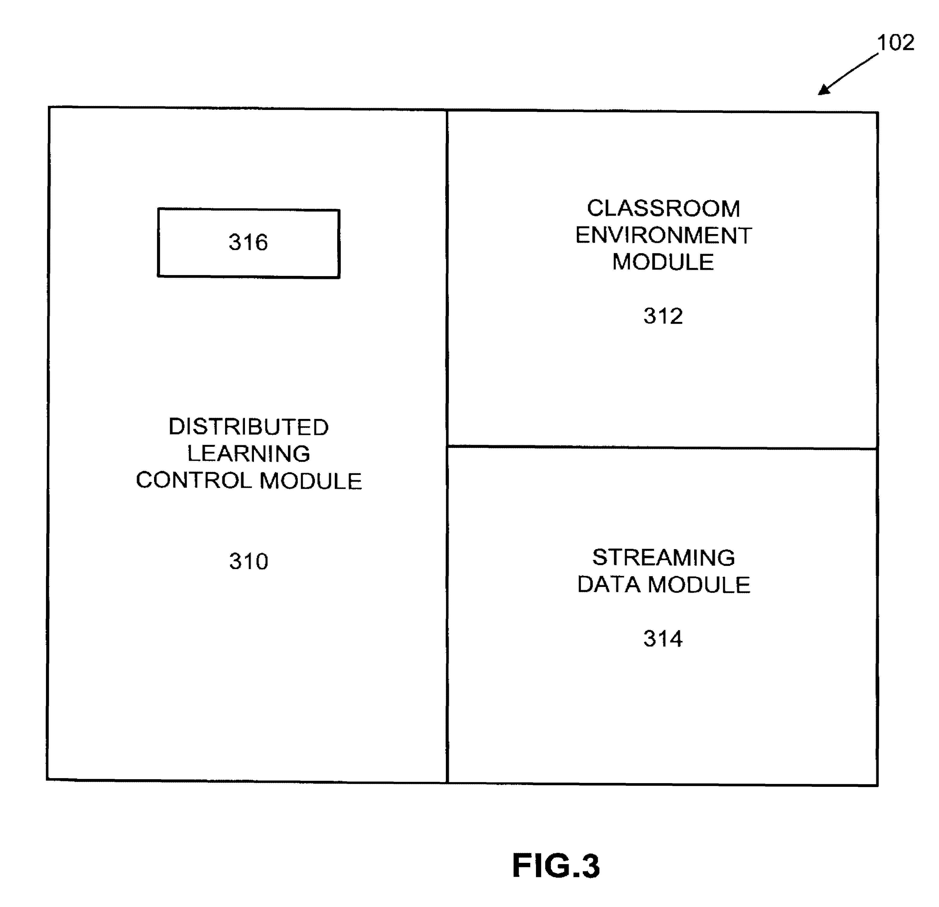
Example 1: Application of § 112(f) (cont.)
Excerpt from U.S. Patent No. 6,155,840
FIG. 3 is a block diagram illustrating the functional units of the DLS 102, including a distributed learning control module (DLCM) 310, a classroom environment module 312, and a streaming data module 314. The distributed learning control module (DLCM) 310 controls the communications among the various computer systems 106, 108 in the distributed learning system 100 and manages the other modules in the DLS 102. A preferred embodiment of the DLCM 310 executes an operating system like MICROSOFT WINDOWS NT® or SUN MICROSYSTEMNS SOLARIS® 2.x. and uses a hypertext transport protocol (HTTP)-based web server, like NETSCAPE ENTERPRISE SERVER 2.0 or the APACHE web server, to receive and respond to requests for data from the other computer systems 106, 108.
In addition, the DLCM 310 preferably includes software written in JAVASCRIPT and C++ providing auto-sensing capabilities for verifying that the participants' computer systems 106, 108 meet the hardware and software requirements for participating in the distributed learning session….
Notes:
CBT NARRATION:
Figure 3 from the patent at issue in the Williamson case illustrates the functional units of the Distributed Learning Servers, or “DLS,” including the distributed learning control module, or “DLCM,” which is recited in claim 8, a classroom environment module, and a streaming data module. While the following portion of the specification of the patent in the Williamson case describes the "distributed learning control module“ in a certain level of detail, the Federal Circuit found that the written description fails to impart any structural significance to the term.

Slide 15
Example 1: Application of § 112(f) (cont.)
“a distributed learning control module for receiving communications transmitted between the presenter and the audience member computer systems….”
The presumption is that § 112(f) does not apply because “means” is not used.
The presumption is overcome because the limitation fails to recite sufficiently definite structure.
The term “module” does not provide any indication of structure.
The modifier “distributed learning control” does not impart structure.
For the patent at issue in the Williamson case, the written description fails to impart any structural significance to the term.
Under the 3-prong analysis, the limitation should be interpreted under § 112(f).
The word “module” acts as a generic placeholder for the term “means.”
The generic placeholder “module” is modified by functional language “for receiving.”
The generic placeholder “module” is not modified by sufficient structure.
Notes:
CBT NARRATION:
At issue in the Williamson case was whether a “distributed learning control module” limitation in claims directed to a distributed learning system should be interpreted as a means-plus-function limitation. The Federal Circuit concluded that “the ‘distributed learning control module’ limitation fails to recite sufficiently definite structure and that the presumption against means-plus-function claiming is rebutted.”
In support of its finding, the Federal Circuit determined that:
“the word ‘module’ does not provide any indication of structure” and “sets forth the same black box recitation of structure ... as if the term ‘means’ had been used,”
“[t]he prefix ‘distributed learning control’ does not impart structure into the term ‘module,’” and
“the written description fails to impart any structural significance to the term.”
Under the 3-prong analysis, the bolded limitation should be interpreted under § 112(f) because:
the word “module” acts as a generic placeholder for the term “means,”
the generic placeholder “module” is modified by functional language “for receiving,” and
the generic placeholder “module” is not modified by sufficient structure.

Slide 16
Making the record clear
A determination that a claim limitation is being interpreted under § 112(f) should be expressly stated in the office action.
If applicant does not want to have the claim limitation interpreted under § 112(f), applicant may:
Present a sufficient showing to establish that the claim limitation recites sufficient structure to perform the claimed function so as to avoid interpretation under § 112(f), or
Amend the claim limitation in a way that avoids interpretation under § 112(f) (e.g., by reciting sufficient structure to perform the claimed function).
Notes:
CBT NARRATION:
A determination that a claim is being interpreted according to § 112(f) should be expressly stated in the office action. In response to the office action, if applicant does not want to have the claim limitation interpreted under § 112(f), applicant may:
present a sufficient showing to establish that the claim limitation recites sufficient structure to perform the claimed function so as to avoid interpretation under § 112(f), or
amend the claim limitation in a way that avoids interpretation under § 112(f), for example, by reciting sufficient structure to perform the claimed function.
The following form paragraphs are available for use in an office action when § 112(f) issues are present:
Form Paragraph 7.30.05 – Broadest Reasonable Interpretation under 35 U.S.C. § 112(f): Use of “Means” in Claim Drafting and Rebuttable Presumptions Raised,
Form Paragraph 7.30.06 – 35 U.S.C. § 112(f) Invoked Despite Absence of “Means,” and
Form Paragraph 7.30.07 – 35 U.S.C. § 112(f) Not Invoked Despite Presence of “Means.”

Slide 17
Broadest reasonable interpretation (BRI) of a § 112(f) claim limitation
The BRI of a claim limitation that is being interpreted under § 112(f) is the structure, material or act described in the specification as performing the entire claimed function and equivalents to the disclosed structure, material or act.
If a claim limitation is being interpreted under § 112(f), the specification must be consulted to determine the corresponding structure, material, or act for performing the claimed function.
Notes:
CBT NARRATION:
The broadest reasonable interpretation, or BRI, of a claim limitation that is subject to § 112(f) is the structure, material or act described in the specification as performing the entire claimed function and equivalents to the disclosed structure, material or act. Thus, if the claim limitation is being interpreted under § 112(f), the specification must be consulted to determine the corresponding structure, material, or act for performing the claimed function.

Slide 18
Computer-implemented § 112(f) claim limitations
For a computer-implemented § 112(f) claim limitation that performs a specific computer function, the specification must disclose an algorithm for performing the claimed specific computer function.
An algorithm is defined, e.g., as a finite sequence of steps for solving a logical or mathematical problem or performing a task. MPEP § 2181(II)(B).
Applicant may express that algorithm in any understandable terms including as a mathematical formula, in prose, or as a flow chart, or in any other manner that provides sufficient structure. MPEP § 2181(II)(B).
The corresponding structure is not simply a general purpose computer by itself but a computer specially programmed to perform the disclosed algorithm.
Notes:
CBT NARRATION:
For a computer-implemented 35 U.S.C. § 112(f) claim limitation that performs a specific computer function, the specification must disclose an algorithm for performing the claimed specific computer function (sometimes referred to as a specialized computer function). An algorithm is defined, for example, as a finite sequence of steps for solving a logical or mathematical problem or performing a task. Applicant may express that algorithm in any understandable terms including as a mathematical formula, in prose, or as a flow chart, or in any other manner that provides sufficient structure. See MPEP § 2181, subsection II(B).
The corresponding structure for a computer-implemented § 112(f) limitation that performs a specific computer function is not simply a general purpose computer by itself but a computer specially programmed to perform the disclosed algorithm.

Slide 19
Indefiniteness of computer-implemented § 112(f) claim limitations under § 112(b)
A computer-implemented § 112(f) claim limitation will be indefinite when the specification:
Fails to disclose any algorithm to perform the claimed function.
Discloses an algorithm but the algorithm is not sufficient to perform the entire claimed function(s).
The sufficiency of the algorithm is determined in view of what one of ordinary skill in the art would understand as sufficient to define the structure and make the boundaries of the claim understandable.
Disclosure of an algorithm cannot be avoided by arguing that one of ordinary skill in the art is capable of writing software to perform the claimed function.
Notes:
CBT NARRATION:
A computer-implemented § 112(f) claim limitation will be indefinite under § 112(b) when the specification fails to disclose an algorithm to perform the claimed function or when the specification discloses an algorithm but the algorithm is not sufficient to perform the entire claimed function or functions.
The sufficiency of the algorithm is determined in view of what one of ordinary skill in the art would understand as sufficient to define the structure and make the boundaries of the claim understandable. The requirement for the disclosure of an algorithm cannot be avoided by arguing that one of ordinary skill in the art is capable of writing software to perform the claimed function.

Slide 20
Example 2: Indefiniteness under § 112(b)
Claim 1. A method of preventing unauthorized recording of electronic media comprising:
activating a compliance mechanism in response to receiving media content by a client system, the compliance mechanism coupled to the client system, the client system having a media content presentation application operable thereon and coupled to the compliance mechanism;
controlling a data output pathway of the client system by diverting a commonly used data pathway of the media content presentation application to a controlled data pathway;
monitoring the controlled data pathway with the compliance mechanism to ensure there is no unauthorized recording of the media content; and
directing the media content to a custom media device coupled to the compliance mechanism via the data output pathway, for selectively restricting output of the media content.
Is the bolded limitation of claim 1 indefinite under § 112(b)?
Under the 3-prong analysis, “compliance mechanism” in this claim should be interpreted under § 112(f).
The “compliance mechanism” performs a computer-implemented function; i.e., monitoring the controlled data pathway to ensure there is no unauthorized recording of the media content.
Notes:
CBT NARRATION:
The following hypothetical example is drawn from Media Rights Technologies, Inc. v. Capital One Financial Corp., 800 F.3d 1366 (Fed. Cir. 2015). Note that claim 1 has been modified for purposes of this example. Claim 1 is directed to a method of preventing the unauthorized recording of electronic media. Among other steps, the method comprises activating a “compliance mechanism” in response to receiving media content by a client system.
Under the 3-prong analysis, “compliance mechanism” in this claim should be interpreted under § 112(f). In this example, the “compliance mechanism” performs the function of monitoring the controlled data pathway of the client system to ensure there is no unauthorized recording of the media content. This example will evaluate whether the bolded § 112(f) limitation of claim 1 is indefinite under § 112(b).

Slide 21
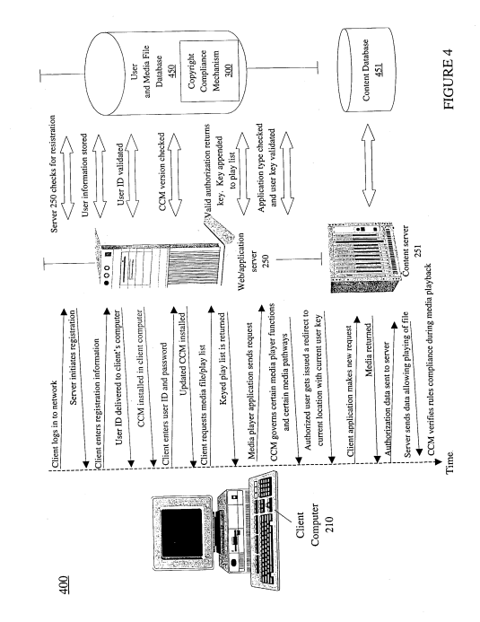
Example 2: Indefiniteness under § 112(b) (cont.)
Excerpt from U.S. Patent No. 7,316,033
Notes:
CBT NARRATION:
Figure 4 from the patent at issue in the Media Rights case illustrates a “Copyright Compliance Mechanism 300” (also referred to as “CCM”), which corresponds to the “compliance mechanism” limitation of claim 1. Also illustrated is a timeline showing the CCM performing a step of verifying rules compliance during media playback.

Slide 22
Example 2: Indefiniteness under § 112(b) (cont.)
Excerpt from U.S. Patent No. 7,316,033
If the rules, in accordance with CCM 300, are enforced, the codec/decoder 303 retrieves a subsequent portion of the media content that is stored locally in client computer system 210. The newly retrieved portion of the media file is then presented by the client’s media player application. While the newly retrieved portion is presented, CCM 300 then again checks that the rules are enforced, and retrieves an additional portion of the media file or suspends presentation of the media file if the rules are not being enforced, and these steps are performed repeatedly throughout the playback of the media file, in a loop environment, until the media file's contents have been presented in their entirety. Advantageously, by constant monitoring during playing of media files, CCM 300 can detect undesired activities and enforces those rules as defined by CCM 300.
Notes:
CBT NARRATION:
At issue in this example is whether the following portion of the specification of the patent in the Media Rights case discloses an algorithm for the “monitoring the controlled data pathway to ensure there is no unauthorized recording of the media content” function performed by the “compliance mechanism.” This portion of the specification explains that when a portion of the media file is being played, the CCM checks that rules are being enforced. The CCM retrieves an additional portion of the media file if the rules are being enforced or suspends the playing of the media file if the rules are not being enforced.

Slide 23
Example 2: Indefiniteness under § 112(b) (cont.)
The “compliance mechanism” limitation of claim 1 is indefinite under § 112(b) because the specification fails to adequately disclose structure to perform the claimed function.
For a computer-implemented § 112(f) claim limitation, the specification must disclose an algorithm(s) for performing the claimed specific computer function.
In this example, the specification states that there are rules, which the "copyright compliance mechanism" applies to monitor the data pathway to ensure there is no unauthorized recording of electronic media, but provides no detail about the rules themselves or how the "copyright compliance mechanism" determines whether the rules are being enforced.
Notes:
CBT NARRATION:
The “compliance mechanism” limitation of claim 1 is indefinite under § 112(b) because the specification fails to adequately disclose structure to perform the claimed function.
For a computer-implemented § 112(f) claim limitation, the specification must disclose an algorithm or algorithms for performing the claimed specific computer function.
In this example, the specification states that there are rules, which the "copyright compliance mechanism" enforces to monitor the data pathway to ensure there is no unauthorized recording of electronic media, but the specification provides no detail about the rules themselves or how the "copyright compliance mechanism" determines whether the rules are being enforced.

Slide 24
Related issues under § 112(a)
Written description
When a claim containing a computer-implemented § 112(f) claim limitation is found to be indefinite under § 112(b) for failure to disclose sufficient corresponding structure (e.g., the computer and the algorithm) in the specification that performs the entire claimed function(s), it will also lack written description under § 112(a).
Enablement
In such situations, further consider whether the disclosure contains sufficient information regarding the subject matter of the claims as to enable one skilled in the pertinent art to make and use the full scope of the claimed invention in compliance with the enablement requirement of § 112(a).
Notes:
CBT NARRATION:
When a claim containing a computer-implemented § 112(f) claim limitation is found to be indefinite under § 112(b) for failure to disclose sufficient corresponding structure, for example, the computer and the algorithm, in the specification that performs the entire claimed function or functions, it will also lack written description under § 112(a).
In such situations, further consider whether the disclosure contains sufficient information regarding the subject matter of the claims as to enable one skilled in the pertinent art to make and use the full scope of the claimed invention in compliance with the enablement requirement of § 112(a).

Slide 25
Part II: Review of issues under 35 U.S.C. § 112(a) related to examination of computer-implemented functional claim limitations
Notes:
CBT NARRATION:
Part two of this CBT will review issues under 35 U.S.C. § 112(a) related to the examination of computer-implemented functional claim limitations.

Slide 26
Written description and enablement support for claims not interpreted under § 112(f)
Even if a claim is not construed under § 112(f), computer-implemented functional claim language must still be evaluated for sufficient disclosure under the written description and enablement requirements of § 112(a).
The written description and enablement requirements of § 112(a) are separate and distinct.
Notes:
CBT NARRATION:
Even if a claim is not construed under § 112(f), computer-implemented functional claim language must still be evaluated for sufficient disclosure under the written description and enablement requirements of § 112(a). The written description and enablement requirements of § 112(a) are separate and distinct.

Slide 27
Written description requirement of § 112(a)
The specification must describe the claimed invention in sufficient detail such that one skilled in the art can reasonably conclude that the inventor had possession of the claimed invention at the time of filing.
The specification must provide a sufficient description of an invention, not an indication of a result that one might achieve.
The level of detail required varies depending on the nature and scope of the claims and on the complexity and predictability of the relevant technology. See MPEP § 2163(II)(A)(2).
Information that is well known in the art need not be described in detail in the specification.
However, sufficient information must be provided to show that the inventor had possession of the invention as claimed.
Notes:
CBT NARRATION:
In order to satisfy the written description requirement set forth in § 112(a), the specification must describe the claimed invention in sufficient detail such that one skilled in the art can reasonably conclude that the inventor had possession of the claimed invention at the time of filing. For instance, the specification must provide a sufficient description of an invention, not an indication of a result that one might achieve.
The level of detail required to satisfy the written description requirement varies depending on the nature and scope of the claims and on the complexity and predictability of the relevant technology. Information that is well known in the art need not be described in detail in the specification. However, sufficient information must be provided to show that the inventor had possession of the invention as claimed. See MPEP § 2163, subsection II(A)(2).

Slide 28
Scope of written description
Compare the scope of the claim with the scope of the description to determine whether applicant has demonstrated possession of the claimed invention.
There is no special rule for supporting a genus by the disclosure of a species.
Disclosure of the species must be sufficient to convey to one skilled in the art that the inventor possessed the subject matter of the genus.
Whether a genus is supported depends upon the state of the art and the nature and breadth of the genus.
Notes:
CBT NARRATION:
The analysis of whether the specification complies with the written description requirement calls for the examiner to compare the scope of the claim with the scope of the description to determine whether applicant or inventor has demonstrated possession of the claimed invention.
There is no special rule for supporting a genus by the disclosure of a species. Disclosure of the species must be sufficient to convey to one skilled in the art that the inventor possessed the subject matter of the genus. Whether a genus is supported depends upon the state of the art and the nature and breadth of the genus.

Slide 29
Example 3: Scope of written description
Background
The patent specification discloses use of a multiplexed bus.
In litigation, patentee asserted that the claimed “bus” covered both multiplexed and non-multiplexed buses.
During trial, expert testimony was presented that:
The invention would not be undermined by the use of a non-multiplexed bus;
Persons of ordinary skill in the art would understand that buses “come in all shapes and sizes;” and
The benefits of the features described in the patent could be achieved with non-multiplexed buses.
Notes:
CBT NARRATION:
The following example is drawn from Hynix Semiconductor Inc. v. Rambus Inc., 645 F.3d 1336 (Fed. Cir. 2011). The invention relates to an integrated circuit bus interface for computer and video systems which allows high speed transfer of blocks of data, particularly to and from memory devices, with reduced power consumption and increased system reliability.
The patent specification discloses use of a multiplexed bus. In litigation, patentee asserted that the claimed “bus” covered the use of both multiplexed and non-multiplexed buses. During trial, expert testimony was presented that the invention would not be undermined by the use of a non-multiplexed bus, persons of ordinary skill in the art would understand that buses “come in all shapes and sizes,” and that the benefits of the features described in the patent could be achieved with non-multiplexed buses.

Slide 30
Example 3: Scope of written description (cont.)
34. A synchronous memory device having at least one memory section which includes a plurality of memory cells, the memory device comprises:
internal clock generation circuitry to generate a first internal clock signal and a second internal clock signal, wherein the internal clock generation circuit generates the first and second internal clock signals using at least a first external clock;
an output driver, coupled to the internal clock generation circuitry, the output driver outputs data on a bus in response to the first and second internal clock signals and synchronously with respect to at least the first external clock signal; and
clock receiver circuitry to receive the first external clock and wherein the internal clock generation circuitry includes delay locked loop circuitry, coupled to the clock receiver circuitry, to generate the first internal clock signal and the second internal clock signal using at least the first external clock.
Does the disclosure reasonably convey to one skilled in the art that the inventor had possession of an invention using a generic bus?
Notes:
CBT NARRATION:
This example will evaluate in the context of claim 34 whether the disclosure reasonably conveys to one skilled in the art that the inventor had possession of an invention using a generic bus.
As recited in claim 34, a synchronous memory device includes an output driver, coupled to internal clock generation circuitry. The output driver outputs data on a bus in response to first and second internal clock signals and synchronously with respect to a first external clock signal. As claimed, the bus recited in claim 34 is not limited to being a multiplexed bus.

Slide 31
Example 3: Scope of written description (cont.)
Excerpt from U.S. Patent No. 5,915,105
The present invention is designed to provide a high speed, multiplexed bus for communication between processing devices and memory devices and to provide devices adapted for use in the bus system. … The bus consists of a relatively small number of lines connected in parallel to each device on the bus. The bus carries substantially all address, data and control information needed by devices for communication with other devices on the bus. In many systems using the present invention, the bus carries almost every signal between every device in the entire system. There is no need for separate device-select lines since device-select information for each device on the bus is carried over the bus. There is no need for separate address and data lines because address and data information can be sent over the same lines.
****
Another major advantage of this invention is that it drastically reduces the memory system power consumption. … The bus architecture of this invention makes possible an innovative 3-D packaging technology. By using a narrow, multiplexed (time-shared) bus, the pin count for an arbitrarily large memory device can be kept quite small-on the order of 20 pins.
Notes:
CBT NARRATION:
The specification of the patent at issue in the Hynix case describes a high speed, multiplexed bus for communication between processing devices and memory devices and devices adapted for use in the bus system. Rather than the combination of point-to-point and bus-based wiring used with conventional versions of these devices, the specification describes a wholly bus-based interface. In this system, there is no need for separate device-select lines since device-select information for each device on the bus is carried over the bus.
The specification also describes that the bus architecture of this invention makes possible an innovative 3-D packaging technology, and that by using a narrow, multiplexed (time-shared) bus, the pin count for an arbitrarily large memory device can be kept quite small-on the order of 20 pins.

Slide 32
Example 3: Scope of written description (cont.)
In this case, in view of the level of skill in the art, the disclosure of a species (the multiplexed bus) was sufficient to support the genus (the generic bus).
The court explained:
“Whether the genus is supported [or not] depends upon the state of the art and the nature and breadth of the genus.”
“[S]o long as disclosure of the species is sufficient to convey to one skilled in the art that the inventor possessed the subject matter of the genus, the genus will be supported by an adequate written description.”
Notes:
CBT NARRATION:
In this case, in view of the level of skill in the art, the disclosure of a species (the multiplexed bus) was sufficient to support the genus (the generic bus). Specifically, the court explained that “[w]hether the genus is supported [or not] depends upon the state of the art and the nature and breadth of the genus[,]” and that “so long as disclosure of the species is sufficient to convey to one skilled in the art that the inventor possessed the subject matter of the genus, the genus will be supported by an adequate written description.”

Slide 33
Example 3: Scope of written description (cont.)
Examination takeaway:
The specification must describe the claimed invention in sufficient detail such that one skilled in the art can reasonably conclude that the inventor had possession of the claimed invention at the time of filing.
During prosecution, a generic claim will be anticipated if the prior art discloses a species falling within the claimed genus. Accordingly, consider applicability of prior art under 35 U.S.C. §§ 102 and/or 103 as appropriate. See MPEP § 2131.02(I).
Notes:
CBT NARRATION:
In order to satisfy the written description requirement set forth in § 112(a), the specification must describe the claimed invention in sufficient detail such that one skilled in the art can reasonably conclude that the inventor had possession of the claimed invention at the time of filing.
During prosecution, a generic claim will be anticipated if the prior art discloses a species falling within the claimed genus. Accordingly, consider applicability of prior art under 35 U.S.C. §§ 102 and/or 103 as appropriate. See MPEP § 2131.02, subsection I.

Slide 34
Written description for result-oriented limitations
Determine whether the specification discloses the computer and the algorithm(s) that achieve the claimed function in sufficient detail that one of ordinary skill in the art can reasonably conclude that the inventor possessed the claimed subject matter at the time of filing.
Determine whether the specification describes how the claimed function is achieved.
It is not enough that one skilled in the art could theoretically write a program to achieve the claimed function, rather the specification itself must explain how the claimed function is achieved. See MPEP § 2161.01(I).
Notes:
CBT NARRATION:
For computer-implemented functional claims, the determination of the sufficiency of the disclosure will require an inquiry into the sufficiency of both the disclosed hardware and the disclosed software due to the interrelationship and interdependence of computer hardware and software.
When examining computer-implemented, software-related claims, determine whether the specification discloses the computer and the algorithm(s) that achieve the claimed function in sufficient detail that one of ordinary skill in the art can reasonably conclude that the inventor possessed the claimed subject matter at the time of filing.
Determine whether the specification describes how the claimed function is achieved. It is not enough that one skilled in the art could theoretically write a program to achieve the claimed function, rather the specification itself must explain how the claimed function is achieved. See MPEP § 2161.01, subsection I.

Slide 35
Example 4: Written description for result-oriented limitations
3. A method performed by a web browser operating on a user computer in a communications network for processing a translation order, the method comprising:
responsive to a single action user request, transmitting to a translation server an order to translate an original web page stored on a web server into a target language, wherein the original web page includes text and one or more original hypertext links that point to one or more hyperlinked web pages stored on the web server;
receiving from the translation server a translated web page including the text in the target language and the original hypertext links;
displaying the translated web page; and
providing translations of the hyperlinked web pages in the target language responsive to the user activating the original hypertext links in the translated web page.
Does the specification provide a description of how to achieve the result-oriented limitation (shown in bold text) in claim 3?
Notes:
CBT NARRATION:
The following hypothetical example is drawn from TransPerfect Global, Inc. v. Matal, 703 Fed. Appx. 953 (Fed. Cir. 2017) (unpublished). The invention relates to a method for ordering a translation via a communications network using a “one-click” ordering system for obtaining an “instant” translation of a web page. This example will evaluate whether hypothetical original claim 3 finds written description support under § 112(a), particularly the result-oriented limitation shown in bold text.
As recited in claim 3, an original web page includes text and one or more original hypertext links that point to one or more hyperlinked web pages. Responsive to a “single action” user request, the web browser transmits an order to a translation server to translate the original web page and receives from the translation server a translated web page that includes translated text and the original hypertext links.
The bolded limitation of claim 3 is interpreted as the web browser providing translated versions of the hyperlinked web pages in response to the user activating the original hypertext links in the translated web page. Claim 3 does not include features relating to how the web browser performs the “providing” step.

Slide 36
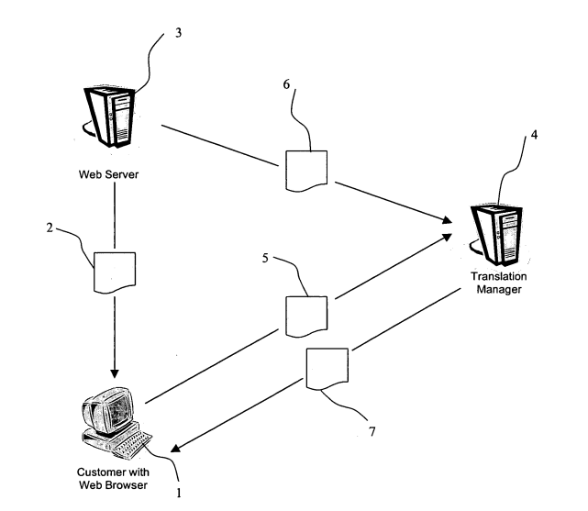
Example 4: Written description for result-oriented limitations (cont.)
Excerpt from U.S. Patent No. 6,857,022
Requested Web Page
Original Web Page
Order for Translation
Translated Web Page
FIG. 1
Notes:
CBT NARRATION:
Figure 1 of the patent at issue in the TransPerfect case shows a schematic of a translation ordering system. A customer requests translation of an original web page with a single “one-click” action, for example, using a web browser plug-in. The customer’s web browser transmits an order for translation via a communication network to a translation server, also referred to as the “translation manager.” The translation manager processes the order for translation by translating the text of the requested web page, for example, using translation programs stored in a memory. The translation manager transmits the translated web page to the customer, and the translated web page is displayed by the customer’s web browser.

Slide 37
Example 4: Written description for result-oriented limitations (cont.)
Excerpt from U.S. Patent No. 6,857,022
FIG. 1 shows a schematic of a translation ordering system. … The translation manager 4 retrieves the requested web page 6 from the web server 3. The translation manager 4 processes the order for translation 5 by translating the text (and possibly sound, video, graphics, etc.) of the requested web page 6 and optionally adding further information. The translation manager 4 obtains the translation using translation programs stored in a memory in communication with the translation manager 4 for effecting automatic translation of the requested web page 6. The translation manager 4 transmits the translated web page 7 to the customer 1, and the translated web page 7 is displayed by the customer’s web browser….
In one embodiment of the invention, the translation manager 4 replaces in the translated web page 7 all original hypertext links that point to other hyperlinked web pages stored on the web server with new hypertext links that point back to the translation manager 4. When translation of the original web page is requested by the single action, the other hyperlinked web pages are automatically translated in anticipation of the customer’s needs. Then, when the customer clicks on any of the new hypertext links in the translated web page 7, the translation manager 4 provides the translated hyperlinked web pages to the customer’s web browser for display. … This enables the customer to surf an entire web site, or indeed many web sites because often the hypertext links on a web page point to other web pages, without the need to separately request translation of each of the other hyperlinked web pages.
Notes:
CBT NARRATION:
The specification of the patent at issue in the TransPerfect case describes that, after requesting translation of an original web page that contains original hypertext links that point to other hyperlinked web pages, the customer can view translations of the other hyperlinked web pages without the need to separately request translation of each of them.
The specification describes an embodiment in which the translation manager replaces the original hypertext links in the translated web page with new hypertext links that point to the translation manager. The translation manager automatically translates the other hyperlinked web pages, using, for example, the translation programs stored in memory, when it receives the order to translate the original web page. The translation manager then provides the translations of the other hyperlinked web pages to the web browser responsive to the customer activating the new hypertext links in the translated web page.
The specification does not describe an embodiment in which the web browser provides translations of the other hyperlinked web pages responsive to the customer activating the original hypertext links in the translated web page.

Slide 38
Example 4: Written description for result-oriented limitations (cont.)
Claim 3 lacks written description under § 112(a)
For computer-implemented functional claims, the determination of the sufficiency of the disclosure under § 112(a) requires an inquiry into whether the specification provides a disclosure of the computer and algorithm that achieve the claimed function in sufficient detail that one of ordinary skill in the art can reasonably conclude that the inventor possessed the claimed subject matter at the time of filing. See MPEP § 2161.01(I).
The specification does not describe how the web browser performs the “providing” step of claim 3.
There is no discussion of how the web browser would provide translations of the other hyperlinked web pages responsive to a user activating original hypertext links in the translated web page because the specification only discusses providing translations in response to a user activating new hypertext links in the translated web page.
It is not enough that one skilled in the art could theoretically write a program to achieve the claimed function, rather the specification itself must explain how the claimed function is achieved.
Notes:
CBT NARRATION:
In this example, a rejection under § 112(a) for lack of written description would be appropriate for claim 3. For computer-implemented functional claims, the determination of the sufficiency of the disclosure under § 112(a) requires an inquiry into whether the specification provides a disclosure of the computer and algorithm that achieve the claimed function in sufficient detail that one of ordinary skill in the art can reasonably conclude that the inventor possessed the claimed subject matter at the time of filing. See MPEP 2161.01, subsection I.
The specification does not describe how the web browser performs the computer-implemented “providing” step of claim 3. There is no discussion of how the web browser would provide translations of the other hyperlinked web pages responsive to a user activating the original hypertext links in the translated web page because the specification only discusses providing translations in response to a user activating new hypertext links in the translated web page. It is not enough that one skilled in the art could theoretically write a program to achieve the claimed function, rather the specification itself must explain how the claimed function is achieved.
Because the specification provides no description of how the web browser performs the “providing” step, the specification does not reasonably convey to those skilled in the art that the inventor had possession of the “providing” limitation of claim 3.

Slide 39
Enablement requirement of § 112(a)
The specification must teach those skilled in the art how to make and use the full scope of the claimed invention without undue experimentation.
In determining whether experimentation is undue, Wands lists a number of factors to consider:
(1) The quantity of experimentation necessary
(2) The amount of direction or guidance presented
(3) The presence or absence of working examples
(4) The nature of the invention
(5) The state of the prior art
(6) The relative skill of those in the art
(7) The predictability or unpredictability of the art
(8) The breadth of the claims
Notes:
CBT NARRATION:
To satisfy the enablement requirement of § 112(a), the specification must teach those skilled in the art how to make and use the full scope of the claimed invention without undue experimentation.
In determining whether experimentation is undue, In re Wands, 858 F2d 731, 737 (Fed. Cir. 1988), lists a number of factors to consider: (1) the quantity of experimentation necessary, (2) the amount of direction or guidance presented, (3) the presence or absence of working examples, (4) the nature of the invention, (5) the state of the prior art, (6) the relative skill of those in the art, (7) the predictability or unpredictability of the art, and (8) the breadth of the claims.

Slide 40
Scope of enablement
With respect to the breadth of a claim, the relevant concern is whether the scope of enablement provided to one skilled in the art by the disclosure is commensurate with the scope of protection sought by the claims.
Consider how broad the claim is with respect to the disclosure, and
Whether one skilled in the art could make and use the entire scope of the claimed invention without undue experimentation.
Determine exactly what each claim recites and what subject matter is encompassed by the claim when the claim is considered as a whole, not when its parts are analyzed individually.
A rejection for lack of enablement must be made when the specification does not enable the full scope of the claim.
Notes:
CBT NARRATION:
With respect to the breadth of a claim, the relevant concern is whether the scope of enablement provided to one skilled in the art by the disclosure is commensurate with the scope of protection sought by the claims. Consider how broad the claim is with respect to the disclosure, and whether one skilled in the art could make and use the entire scope of the claimed invention without undue experimentation.
Determine exactly what each claim recites and what subject matter is encompassed by the claim when the claim is considered as a whole, not when its parts are analyzed individually.
A rejection for lack of enablement must be made when the specification does not enable the full scope of the claim.

Slide 41
Scope of enablement (cont.)
Not everything necessary to practice the invention need be disclosed.
A specification need not disclose what is well known in the art.
However, applicant cannot rely on the knowledge of one skilled in the art to supply information that is required to enable the novel aspect of the claimed invention when the enabling knowledge is in fact not known in the art.
This is of particular importance with respect to computer-implemented inventions due to the high level of skill in the art and the similarly high level of predictability in generating programs to achieve an intended result without undue experimentation.
Notes:
CBT NARRATION:
Not everything necessary to practice the invention need be disclosed. For instance, a specification need not disclose what is well known in the art. However, applicant cannot rely on the knowledge of one skilled in the art to supply information that is required to enable the novel aspect of the claimed invention when the enabling knowledge is in fact not known in the art.
This is of particular importance with respect to computer-implemented inventions due to the high level of skill in the art and the similarly high level of predictability in generating programs to achieve an intended result without undue experimentation.

Slide 42
Example 5: Enablement under § 112(a)
Claim 49. A method for integrating an image into a video output, the method comprising:
providing a user image;
providing as the video output a presentation output associated with a predefined image source wherein the video output is representative of a plurality of background images of which at least two of which are comprised of a common character function therewithin having a recognizable video presentation within respective ones of the background images;
selecting an image portion for the recognizable video presentation of the respective selected character functions as a selected portion for user image associative integration;
analyzing the signal for the presentation output associated with the selected portion;
integrating the user image in place of the selected image portion responsive to the analyzing; and
providing a modified presentation output wherein the user image is associated with and integrated into the selected image portion in the presentation output.
Is the full scope of the method of claim 49 enabled under § 112(a)?
The specification states that the invention can be used with movies or video games, then describes how to implement the invention with video games.
One skilled in the art would understand that movies and video games are technically different.
Notes:
CBT NARRATION:
The following example is drawn from Sitrick v. Dreamworks LLC, 516 F.3d 993 (Fed. Cir. 2008). The invention relates to a process for smooth integration of a user’s image into a pre-existing audiovisual presentation, such as a video game or movie. The specification states that the invention can be used with movies or video games, then describes how to implement the invention with video games. One skilled in the art would understand that movies and video games are technically different.
Claim 49 requires integration of a user image in place of a selected image portion of a video presentation. Under the broadest reasonable interpretation of claim 49, the method encompasses integration of user images into both video games and movies. This example will evaluate whether the full scope of the method of claim 49 is enabled under § 112(a).

Slide 43
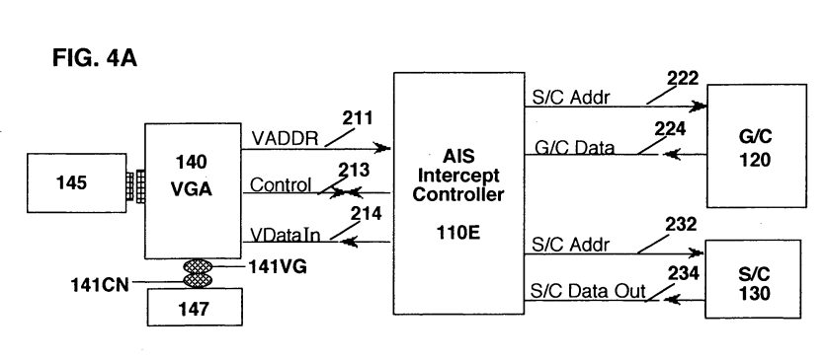
Example 5: Enablement under § 112(a) (cont.)
Excerpt from U.S. Patent No. 6,425,825
FIG. 4A illustrates the block diagram and data logic flow diagram of the Intercept Adapter Interface System…. An intercept controller embodiment of an adapter interface system 110E is coupled to a game cartridge 120 Storage Card (S/C) 130, and a video game apparatus 140. The video game apparatus is coupled to an external display monitor 145 and to user controls 147. The intercept controller adapter interface system 110E receives address signals 211 and control signals 213 from the video game apparatus 140 and selectively couples these signals to the game cartridge 120 and Storage Card 130 via respective Game Card address and control signals 222 and Storage Card address and control signals 232. The Game Cartridge 120 or Storage Card 130 responds to the respective address and control signals to provide either game card image data out 224 or Storage Card image data out 234 for coupling to the intercept controller adapter interface system 110E that provides a “video game data in” output 214 for coupling to the video game apparatus 140.
Notes:
CBT NARRATION:
The specification of the patent at issue in the Sitrick case describes an “Intercept Adapter Interface System” (or “IAIS”), shown in Figure 4A, that performs the integration or substitution of a user image in place of a predefined character image or a character function within an audiovisual presentation. The specification describes how the IAIS functions to intercept address signals coming from a video game apparatus and going to a game card or a storage card. If address signals correspond to the character functions that are to be replaced with a user image, the IAIS reconfigures the signals so that when the signal gets to the game card or the storage card, the user image is substituted for the predefined character image.

Slide 44
Example 5: Enablement under § 112(a) (cont.)
Excerpt from U.S. Patent No. 6,425,825
This invention relates to predefined video and audiovisual presentations such as movies and video games, and more particularly to an image development system and process for smooth integration of user-created images into a predefined video presentation, including, but not limited to, a video game player character image development system and methodology for smooth integration of user created video graphics into a predefined video, movie, or game system, and to an adapter interface system which provides for the utilization of a user visual image as a preselected character segment, such that the user visual image is incorporated into the audiovisual presentation of the movie or video game to which the adapter interface system is coupled.
*****
The analysis system 260, in conjunction with the remainder of the intercept controller adapter interface system 110E, provides for substitution of the user's image for the predefined game character image in a manner transparent to the original video game apparatus and the original game cartridge. … There are numerous ways to implement the analysis system 260. For example, address and/or control and/or data signal analysis, timing analysis, state analysis, signature analysis, or other transform or analysis techniques can be utilized to identify when particular predefined player graphic character segments are being accessed and transferred to the video game apparatus 140 read/write memory from the game card 120, and at the appropriate time, instead of accessing the Storage Card 130 and transferring data out 234 from the Storage Card via the intercept controller 110 for coupling via the video game data signals in 214 to the video game apparatus 140.
Notes:
CBT NARRATION:
While the specification of the patent at issue in the Sitrick case states that the invention is also applicable in non-video game embodiments, such as movies and animations, the specification does not explain how the “Intercept Adapter Interface System” would function outside of a video game.
For example, the specification describes an analysis system of the “Intercept Adapter Interface System” that analyzes the signals to determine when it is appropriate to make substitutions of user image data for predefined game character data. The analysis techniques discussed in the specification are described in the context of video games and not movies.

Slide 45
Example 5: Enablement under § 112(a) (cont.)
Claim 49 lacks enablement under § 112(a).
In this example, the specification indicates that the disclosed image substitution or integration is applicable to any audiovisual image source that provides an audiovisual presentation output, such as video, and yet does not provide any explanation of how it would function outside of a video game.
The court found that one skilled in the art could not take the disclosure with respect to substitution or integration of user images in video games and substitute a user image for a pre-existing character image in movies without undue experimentation.
To overcome a rejection for lack of enablement under § 112(a), applicant could amend claim 49 to limit the claimed method to video games.
Notes:
CBT NARRATION:
In Sitrick, the specification indicates that the disclosed image substitution or integration is applicable to any audiovisual image source that provides an audiovisual presentation output, such as video, and yet does not provide any explanation of how it would function outside of a video game. The court determined that the claims of the patent at issue in that case lacked enablement under § 112(a). Specifically, the court found that one skilled in the art could not take the disclosure with respect to substitution or integration of user images in video games and substitute a user image for a pre-existing character image in movies without undue experimentation.
To overcome a rejection for lack of enablement under § 112(a), applicant could amend claim 49 to limit the claimed method to video games.

Slide 46
Example 5: Enablement under § 112(a) (cont.)
Wands factors that support a finding of undue experimentation:
Amount of direction or guidance presented: The specification does not teach how to implement the Intercept Adapter Interface System in the context of movies given that movies do not have easily separable character functions, as video games do.
State of the prior art: One skilled in the art would not be able to take the teachings regarding video games and apply them to movies because movies and video games are technically different (i.e., the analysis techniques described in the specification for identifying character functions or intercepting character signals have no relevance to movies).
Breadth of the claim: Claim 49 is broad enough to cover both video games and movies.
Notes:
CBT NARRATION:
Wands factors that support a finding of undue experimentation based on the facts of this case include the following:
The amount of direction or guidance presented: The specification does not teach how to implement the Intercept Adapter Interface System in the context of movies, given that movies do not have easily separable character functions, as video games do.
The state of the prior art: One skilled in the art would not be able to take the teachings regarding video games and apply them to movies because movies and video games are technically different. The analysis techniques described in the specification for identifying character functions or intercepting character signals have no relevance to movies.
The breadth of the claim: Claim 49 is broad enough to cover both video games and movies.

Slide 47
Questions and follow-up
See your SPE or TC POC for questions.
Additional resources can be found on the “Examiner Training and Resource Materials” section of the USPTO’s internal webpage (ptoweb.uspto.gov/patents/exTrain/).
Notes:
CBT NARRATION:
Please see your SPE or TC POC with questions. Additional resources and training on issues under § 112 can be found on the “Examiner Training and Resource Materials” section of the USPTO’s internal webpage.

