Slide 1
Administrative Patent Trials Before The Patent Trial and Appeal Board
Thomas L. Giannetti
Administrative Patent Judge
USPTO
March 22, 2013

Slide 2
Administrative Trial Statistics (as of 2/14/13)
Administrative trials = 150 petitions
135 inter partes review (IPR)
15 covered business method (CBM)
16 trials instituted (10 IPR, 6 CBM)
75% electrical; 25% chemical/biotech/mechanical
Majority of challenged patents are currently or previously subject to district court litigation

Slide 3
Overview
Brief Review of AIA Trial Proceedings
Inter Partes Review (IPR)
Post-Grant Review (PGR)
Transitional Program for Covered Business Method Patents (CBM)
Practice Points

Slide 4
Trial Structure
Same basic structure for all the proceedings
Reduction of burdens on the parties via:
Streamlining and converging issues for decision;
Page limits and electronic filing (PRPS);
Conference calls
Institution of a trial on a claim-by-claim, ground-by-ground basis

Slide 5
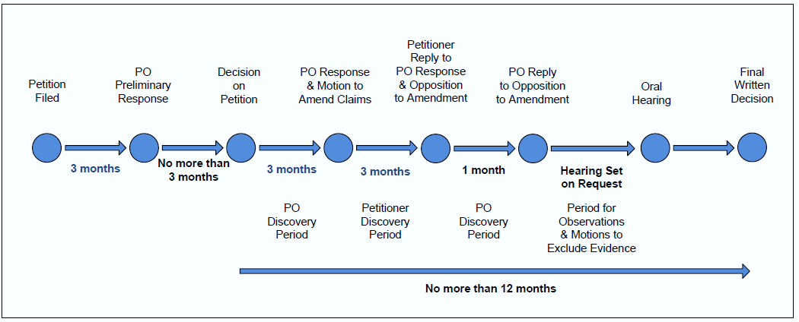
Trial Proceedings
PO = Patent Owner

Slide 6
Trial Rules
Umbrella Trial Rules
§§ 42.1 – 42.80
Inter Partes Review
§§ 42.100 – 42.123
Post-Grant Review
§§ 42.200 – 42.224
Covered Business Method Patent Review
§§ 42.300 – 42.304
Derivation Proceeding
Proposed §§ 42.400 – 42.412

Slide 7
Major Differences between IPR, PGR, and CBM
IPR
All patents are eligible
Petitioner has not filed an invalidity action and petition is filed no more than one year after service of infringement complaint for the patent
CBM
Both FTI & FITF patents are eligible, but must be a covered business method patent
Petitioner must be sued or charged w/ infringement
PGR
Only §§ 102 and 103 grounds based on patents or printed publication
Only FITF patents are eligible
Petitioner has not filed an invalidity action
Only §§ 101, 102, 103, and 112, except best mode
Only §§ 101, 102, 103, and 112, except best mode

Slide 8
Threshold Standards for Institution
IPR
Petition must demonstrate a reasonable likelihood that petitioner would prevail as to at least one of the claims challenged
PGR/CBM
Petition must demonstrate that it is more likely than not that at least one of the claims challenged is unpatentable
PGR/CBM: Greater than 50% chance
IPR: May encompass a 50/50 chance

Slide 9
Time Windows to File PR/PGR/CMB (After H.R. 6621 Was Signed)
First-to-Invent
Patents
CBM
After issuance
IPR
After issuance
First-Inventor-to-File
Patents
PGR
< 9 months from issue date
IPR or CBM
> 9 months from issue date

Slide 10
Time Windows to File PR/PGR/CMB (Before H.R. 6621 Was Signed)
First-to-Invent
Patents
CBM
After issuance
IPR
> 9 months from issue date
First-Inventor-to-File
Patents
PGR
< 9 months from issue date
IPR or CBM
> 9 months from issue date

Slide 11
Covered Business Methods: Eligible Patents
Both first-to-invent and first-inventor-to-file patents are eligible
Must be a covered business method patent
Generally defined in the AIA as a method or corresponding apparatus for performing data processing or other operations for a financial product or service
Definition excludes patents for “technological inventions”

Slide 12
Covered Business Methods: Technological Invention
Whether the claimed subject matter as a whole:
recites a technological feature that is novel and unobvious over the prior art; and
solves a technical problem using a technical solution
Based on what the patent claims, i.e., a patent having one or more claims directed to a covered business method is eligible for review

Slide 13
Covered Business Method Review Recent Decisions
CBM2012-00001(Jan. 9, 2013)
SAP v. Versata
Method for determining price of a product
CBM2012-00005 (Jan. 23, 2013)
CRS Adv. Tech. v. Frontline
Method for performing substitute fulfillment

Slide 14
Practice Points: Discovery
AIA authorizes the Office to set standards and procedures for the taking of discovery
Discovery rules allow parties to agree to discovery between themselves
Rules provide for:
mandatory initial disclosures
routine discovery; and
additional discovery

Slide 15
Practice Points: Routine Discovery
Routine discovery includes:
documents cited
cross-examination for submitted testimony
information inconsistent with positions advanced during the proceeding

Slide 16
Practice Points: Additional Discovery
Parties may agree to additional discovery between themselves or a party must request any discovery beyond routine discovery
Party seeking additional discovery:
in IPR: additional discovery is in the interests of justice
in PGR and CBM: subject to the lower good cause standard

Slide 17
Discovery Decisions
CBM2012-00001 (Order Nov. 15, 2012)
SAP v. Versata
IPR2012-00026 (Order Feb. 11, 2013)
Microsoft v. Proxyconn
IPR2012-00001 (Order Feb. 14, 2013)
Garmin International v. Cuozzo

Slide 18
Practice Points: Settlement
Terminates the proceeding with respect to the petitioner
Board may terminate the proceeding or issue a final written decision
Two settlements so far: IPR2013-00078 (pre-institution), IPR2012-00004 (post-institution)

Slide 19
Practice Points: Rehearing
Timing: 14 days of the entry of a non-final decision or a decision to institute a trial, or within 30 days of the entry of a final decision or a decision not to institute a trial
Standard: must specifically identify “all matters … misapprehended or overlooked”
Two examples: CBM2012-00005 (denied); IPR2012-00026 (denied)

Slide 20
Practice Points: Petitions
Avoid redundancy/cumulative references
Present complete analysis per claim per ground
Observe proper use of claim charts
Provide claim constructions
Properly mark and number your exhibits
Petitioner: 1000-1999
Patent owner: 2000-2999

Slide 21
Practice Points: Pro Hac Vice Motions
For guidance see IPR 2013-00010 October 15, 2012 (expanded PTAB panel)
File no sooner than 21 days after service of the petition; opposition due no later than one week after opening motion

Slide 22
Practice Points: Pro Hac Vice Motion Contents
Statement of facts showing there is good cause for admission
Affidavit or declaration of the individual seeking to appear attesting to:
Good standing membership of at least 1 state bar
No suspensions or disbarments
No application to appear before any court to administrative tribunal ever denied
No sanctions or contempt citations
Agreement to comply with the Patent Trial Practice Guide and Rules of Practice for Trials
Recognition of being subject to USPTO Code of Professional Conduct
Familiarity with subject matter of proceeding

Slide 23
Practice Points: CBM v. PGR
No 9-month “window” for CBM (FTI only)
More limited estoppel for CBM in DC/ITC
More favorable CBM stay provisions
Interlocutory appeal available
Four factor test including reduced burden of litigation

Slide 24
Practice Points: CBM vs. IPR
CBM is subject matter limited
CBM not limited to patents/printed publications
CBM estoppel limited in DC/ITC to grounds actually raised
CBM stay provisions more favorable
CBM requires infringement suit/charge

Slide 25
Practice Points: Representative Orders/Notices
Representative Orders and Decisions:
IPR2013-00010, Order Authorizing Motion for Pro Hac Vice Admission, Paper 6, Oct. 15, 2012
CBM2012-00003, Order (Redundant Grounds), Paper 7, Oct. 25, 2012
CBM2012-00003, Order (Denial of Grounds), Paper 8, Oct. 25, 2012
CBM2012-00001, Decision Denying Motion for Pro Hac Vice Admission, Paper 21, Nov. 6, 2012
CBM2013-00005, Decision Granting Motion for Pro Hac Vice Admission, Paper 13, Nov. 26, 2012
IPR2013-00033, Order to Stay Reexam, Paper 15, Nov. 6, 2012
IPR2013-00028, Decision on Motion to Take Jurisdiction, Paper 8, Nov. 27, 2012
Representative Notices:
CBM2012-00002, Notice of Filing Date Accorded, Paper 4, Sept. 21, 2012
IPR2013-00033, Notice of Filing Date Accorded, Paper 14, Oct. 26, 2012
IPR2012-00004, Notice of Defective Petition, Paper 6, Sept. 21, 2012
IPR2012-00022, Notice of Incomplete Petition, Paper 5, Sept. 27, 2012

Slide 26
Representative Notices/Orders (Continued)
IPR2012-00026 Decision on Request for Inter Partes Review, Paper No. 17, December 21, 2012 (First Trial Instituted)
IPR2012-00026 Scheduling Order, Paper No. 17, December 21, 2012 (First Scheduling Order)
CBM2012-00001 Decision on Institution, Paper No. 36, January 9, 2013 (First CBM Instituted)
IPR2012-00022 Decision, Paper No. 20, February 12, 2013 (Standing Challenge – Affirmative Defense of Invalidity)

Slide 27
Practice Points: AIA Help
1-855-HELP-AIA (1-855-435-7242)
HELPAIA@uspto.gov
www.uspto.gov/AmericaInventsAct
www.uspto.gov/ip/boards/bpai

Slide 28
Practice Points: Useful References
General Administrative Trial Final Rules, 77 Fed. Reg. 48612 (August 14, 2012)
Trial Practice Guide, 77 Fed. Reg. 48756 (August 14, 2012)
Inter Partes, Post Grant, and Covered Business Method Review Final Rules, 77 Fed. Reg. 48680 (August 14, 2012)
Covered Business Method and Technological Invention Definitions Final Rules, 77 Fed. Reg. 48734 (August 14, 2012)

