Slide 1
An Inside Look at the
Patent Trial and Appeal Board
Scott Boalick
Administrative Patent Judge
Patent Trial and Appeal Board

Slide 2
Board Hiring
Since October 2011
  Reviewed nearly 1,500 applicant records
  Interviewed nearly 240 candidates
  Selected 85 highly qualified candidates to become new Judges
  We stand at 168 Judges as of February 25, 2013.
Opportunities at Detroit/Denver/Dallas/Silicon Valley Satellite Offices
  Selecting candidates from previous postings now
  New advertisements have been posted
Goal for FY2013 - add 60 judges.

Slide 3
Board Hiring
Selectees have come from the following:
  USPTO Patent Examining Corps, Office of the General Counsel, and the PTAB
  International Trade Commission and Department of Justice
  Private Practice (solo to very large)
  All types of industries

Slide 4
Board Hiring
Administrative Patent Judge
(Biotechnology, Chemical, Mechanical, Communication, Computer, Electrical)
Announcement Number: PTAB-2013-0006
Questions about this job:
      Isis Thomas
      Phone: 571-272-4363
      Email: Isis.Thomas@uspto.gov
Announcement set to close on Friday, April 19, 2013.

Slide 5
Members of the Board
(as of 03/18/2013)

Slide 6
Board Backlog
Growth of the Backlog has been halted:
  Overall, for the last 4 months, more decisions issued than new appeals received
  Encouraging (for now)
Benefiting from numerous factors
  Successful hiring in FY2012 that needs to continue in FY2013
  Somewhat lower end-of-year intake for FY2012 and beginning of FY2013
  Extraordinary efforts by current Judges
Trend can still be reversed if ex parte appeal intake and AIA intake grow faster than new hires

Slide 7
Board Backlog

Slide 8
PTAB Receipts and Dispositions
Past Month
PTAB Receipts and Dispositions
Period: | 02/19/2013 | thru | 03/19/2013
Discipline | # Cases Received | # Cases Disposed | Difference (Disposed minus Received)
Biotech | 78 | 46 | -32
Business Methods | 85 | 96 | 11
Chemical | 157 | 197 | 40
Contested Cases | 22 | 25 | 3
Design | 3 | 0 | -3
Electrical | 418 | 470 | 52
Mechanical | 244 | 379 | 135
***Totals*** | 1007 | 1213 | 206

Slide 9
PTAB Receipts and Dispositions
Weekly: 01/09/2013 through 03/13/2013

Slide 10
Monthly Receipts and Dispositions – New Judge Comparison

Slide 11
Monthly Receipts and Dispositions – New Judge Comparison

Slide 12
Decisions by Type: FY2013

Slide 13
Decisions Adopting Persuasive Arguments Made in the Record
Allow the Board to issue decisions based on arguments presented by Examiners or Appellants
  Shorter decisions; disposed sooner; sometimes designated “Per Curiam”
Arguments of record must sufficiently explain the decision
Working with the offices of the Under-Secretary and Solicitor, the rules were finalized

Slide 14
“Per Curiam” Short Decisions as of 02/20/2013

Slide 15
Outcomes at the Federal Circuit
 | FY2012 | FY2013 (to date) | Total
Affirmances | 67 | 26 | 93
Reversals | 4 | 1 | 5
Remands | 10 | 4 | 14
Dismissals | 12 | 7 | 19
Total | 93 | 38 | 131

Slide 16
Technology Breakdowns of
AIA Petitions
As of April 1, 2013, the Office received a Total of 207 AIA Petitions: 17 CBMs and 190 IPRs
Technology | Number of Petitions | Percentage
Electrical/ Computer | 140 | 67.6%
Mechanical | 26 | 12.6%
Chemical | 29 | 14.0%
Bio/Pharma | 11 | 5.3%
Design | 1 | 0.5%
Institutions: 11 CBMs and 34 IPRs
Terminations (resulted from settlements): 4 IPRs

Slide 17
Post Grant Resources
General information concerning implementation of the Leahy-Smith America Invents Act, including post grant reviews, may be found at:
http://www.uspto.gov/aia_implementation/index.jsp
Information concerning the Board and specific trial procedures may be found at:
http://www.uspto.gov/ip/boards/bpai/index.jsp

Slide 18
Patent Corps Collaboration
Continuing to explore collaboration opportunities
Additional Examiner interviews during prosecution
Additional Examiner review of after-final amendments before coming to the Board
(on-going)

Slide 19
Published Opinions
Committee established to increase designation of precedential and informative decisions
Also will post informative orders from AIA proceedings
Looking at optimizing manner of posting on site

Slide 20
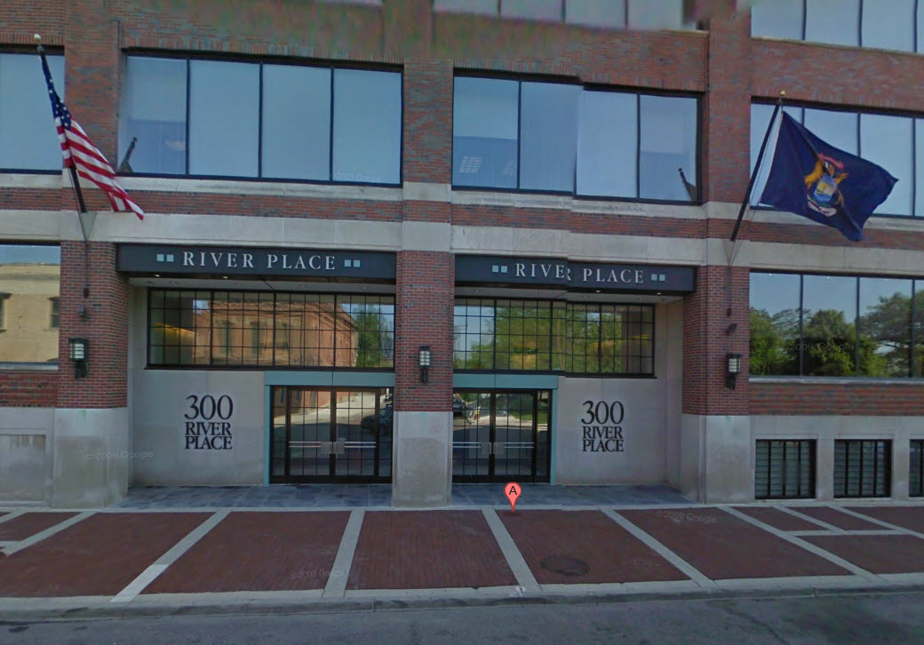
Detroit, Michigan
Elijah J. McCoy
United States Patent and Trademark Office
300 River Place South
Suit 2900
Detroit, Michigan 48207
Opened July 13, 2012
12 Administrative Patent Judges

Slide 21
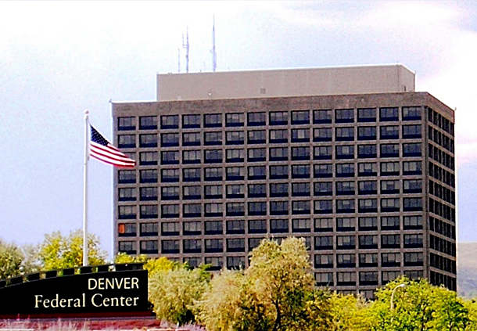
Denver, Colorado
Denver Federal Center
B20/D1000
W 6th Ave & Kipling Street Lakewood, Colorado 80225
Opened January 2, 2013
5 Administrative Patent Judges

Slide 22

Dallas, Texas
Santa Fe Building
1114 Commerce Street
Suite 705
Dallas, TX 75202
Opened March 18, 2013
4 Administrative Patent Judges

Slide 23

Menlo Park, California
????
345 Middlefield Road
Menlo Park, CA 94025
Opening April 15, 2013
6 Administrative Patent Judges
And Director Michelle K. Lee

