Slide 1
July 2015 Update to the Interim Eligibility Guidance: Abstract Idea Example Workshop II
Notes:
Instructor Note:
For this workshop the Examiner will be provided with:
Workshop Handout that includes:
Example 21 and Example 23,
A link to blank Worksheets, and
A link to the July 2015 Quick Reference Sheet (QRS);
PDF document of the Slides
The Instructor will have available completed Worksheets for each claim, including a sample rejection where appropriate.
Examiners are encouraged to fill out the worksheets for each claim as they progress through the training.
During Webex presentations the examiners should each open the slide set and follow the links to the necessary documents.
Prior to taking the workshop, examiners should be familiar with the July 2015 Update and the published examples, especially examples 21 and 23. As a prerequisite, training should have been completed on the 2014 Interim Guidance on Patent Subject Matter Eligibility, along with the first Abstract Idea Workshop. Refresher training is also available on 35 U.S.C. 101: Statutory Requirements and Four Categories of Invention (Step 1). All training is available at: http://www.uspto.gov/patent/laws-and-regulations/examination-policy/2014-interim-guidance-subject-matter-eligibility-0

Slide 2
Overview
This workshop training will demonstrate the application of several key aspects of the July 2015 Update including:
  Identifying abstract ideas
  Evaluating additional elements, particularly in combination
  How to write a rejection that satisfies your burden to make a prima facie case
The slides are designed to walk you through the analysis of several claims using the Subject Matter Eligibility Worksheets
Notes:
<Examiners should have the July 2015 Quick Reference Sheet (QRS) and blank copies of the Subject Matter Eligibility Worksheets at hand during this training session. Examiners are encouraged to fill out the worksheets for each claim as they progress through the training.>

Slide 3
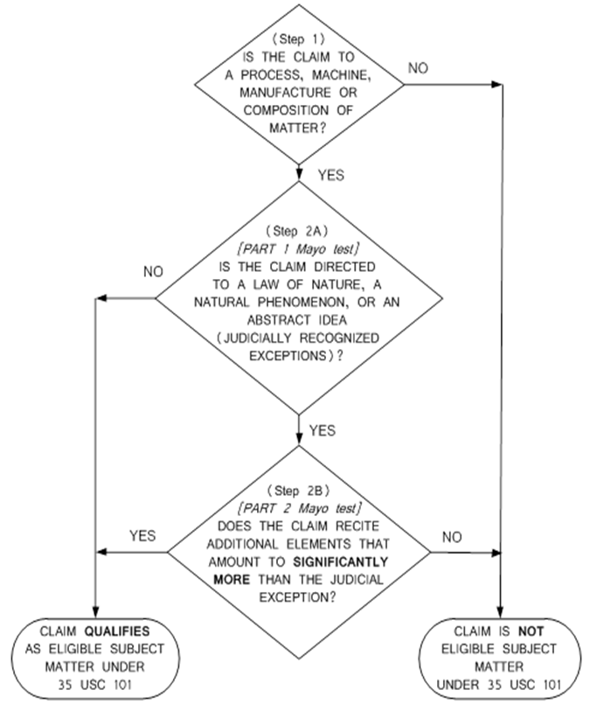
Evaluating Subject Matter Eligibility
Examiners are to:
Review the disclosure to identify what applicant considers as the invention.
Determine if the claim falls into a statutory category.
Identify the judicial exception recited in the claim (if any).
Determine if the claim as a whole recites significantly more than the judicial exception itself.
Notes:
On the right of slide is the USPTO flowchart for determining eligibility. Begin with a short explanation of the basic framework used for the eligibility inquiry.

Slide 4
July 2015 Update
Example 21, Claim 1 (original)
The following example should be analyzed under the 2014 Interim Guidance on Patent Subject Matter Eligibility (IEG).
As the example is intended to be illustrative only, it should be interpreted based on the fact pattern set forth below. Other fact patterns may have different eligibility outcomes.
Go to page 2 of the Workshop Handout for Example 21, sections I-III to evaluate claim 1
Notes:
Instructor Notes:
Here the examiners should open the Workshop Handout to Example 21.
Links are provided in the Handout to a blank worksheet and the QRS.
Proceed through slides 5-20, pausing on the question slides to get feedback from the examiners and then proceed to the answer slides.

Slide 5
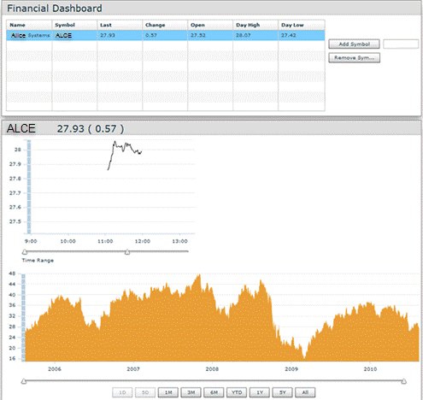
Example 21: Transmission of Stock Quote Data
The invention is directed to a stock quote alert subscription service where subscribers receive customizable stock quotes on their local computers from a remote data source.
Notes:
The next three slides provide an overview of the invention.
<Examiner should fill out Section I entitled “What did applicant invent?” of the blank worksheet.>

Slide 6
Example 21: Transmission of Stock Quote Data
Background
The invention addresses two issues: Existing services experienced challenges when attempting to notify a subscriber whose computer was offline (not connected to the Internet) at the time of the alert, since many stock quotes are time sensitive. Many previous subscription services simply transmitted all available stock quote information to the user at a given time, which required the subscriber to sort through large amounts of data to identify relevant stock quotes, and often sent information at an inconvenient time (e.g., after the stock exchanges are closed).

Slide 7




I: What did Applicant invent?
A process for generating customized stock quotes and alerting a remote subscriber that the quotes can be accessed from their computer. The stock quote alerts are generated by filtering received stock quotes, building stock quote alerts and formatting the alerts into data blocks based upon subscriber preference information. The data blocks are transmitted to the subscriber’s wireless device which, when connected to the computer, causes the computer to auto-launch a stock viewer application to display the alert and provide access to more detailed information about the stock quote.
Data Source
Data Source
Wireless
Network
Internet
Notes:
<Using the Worksheet, the examiner should fill out Section I entitled “What did applicant invent?” of the blank worksheet.>

Slide 8
Claim 1 (Original)
A method of distributing stock quotes over a network to a remote subscriber computer, the method comprising: receiving stock quotes at a transmission server sent from a data source over the Internet, the transmission server comprising a microprocessor and a memory that stores the remote subscriber’s preferences for information format, destination address, specified stock price values, and transmission schedule, wherein the microprocessor filters the received stock quotes by comparing the received stock quotes to the specified stock price values; generates a stock quote alert from the filtered stock quotes that contains a stock name, stock price and a universal resource locator (URL), which specifies the location of the data source; formats the stock quote alert into data blocks according to said information format; and transmits the formatted stock quote alert to a computer of the remote subscriber based upon the destination address and transmission schedule.

Slide 9
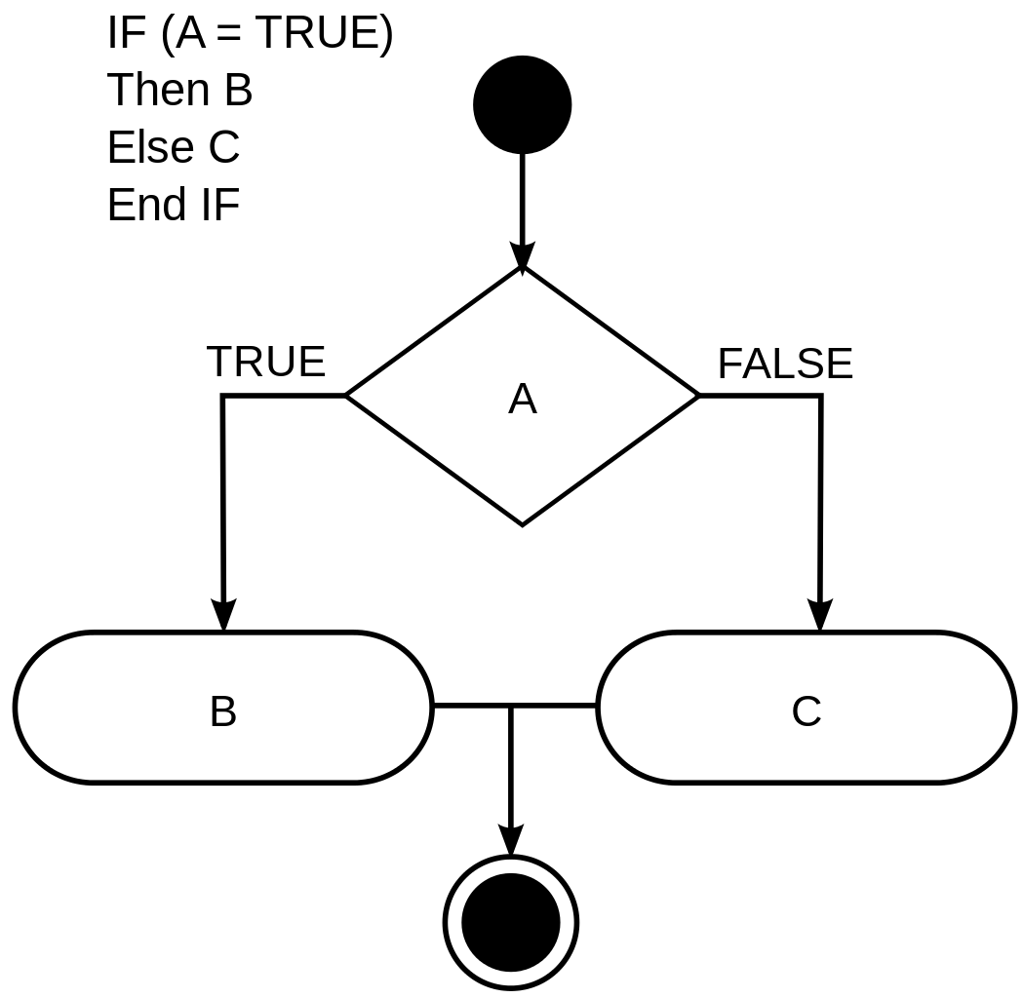



II: Does the claimed invention fall within a statutory category of invention (Step 1)?
Process Machine Manufacture Composition of
Matter
Notes:
<Pause for audience consideration and feedback, then advance slide>

Slide 10
II: Does the claimed invention fall within a statutory category of invention (Step 1)?
II: (A) Yes
The claim recites a series of acts for distributing stock quotes to selected remote devices. Thus, the claim is directed to a process, which is one of the statutory categories of invention.
Notes:
<Examiner should fill out Section II of the blank worksheet.>

Slide 11
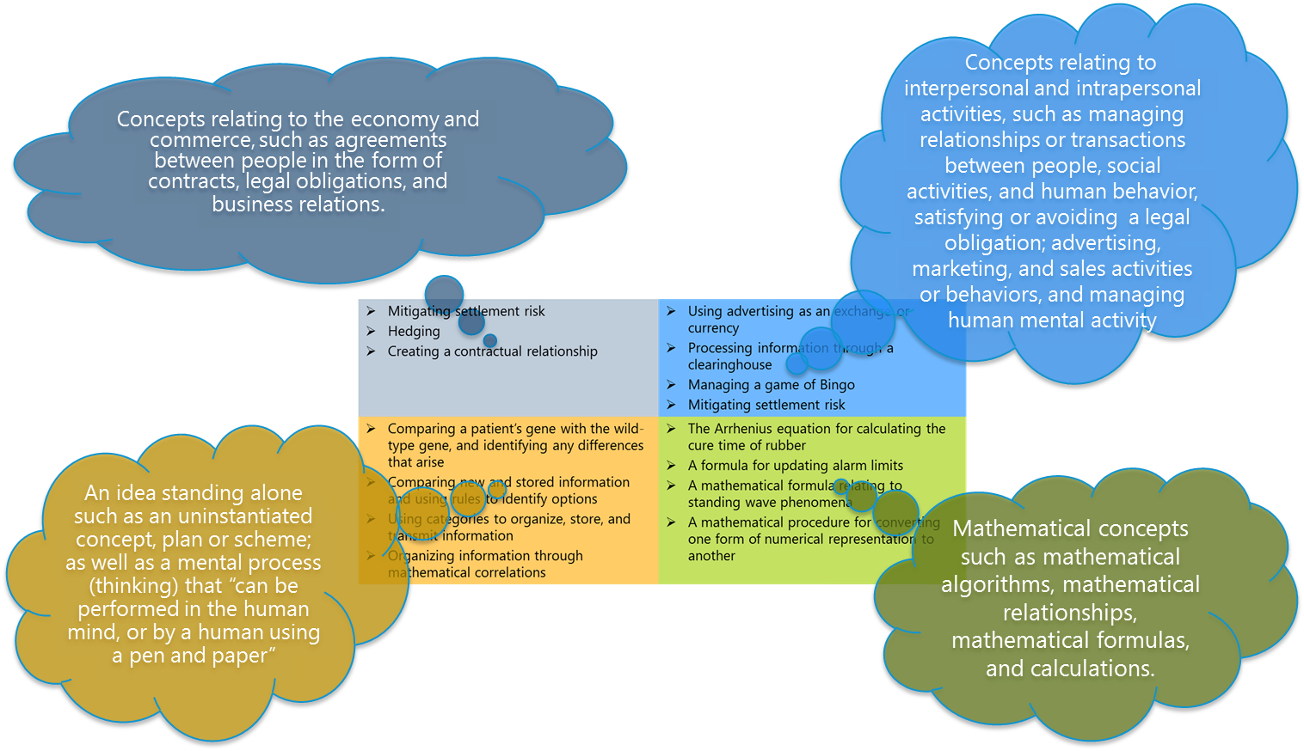
III: Is the claim directed to an abstract idea (Step 2A)?
  “Directed to” means that the claim recites (sets forth or describes) an abstract idea.
  An abstract idea can be identified by comparison to similar concepts found abstract by the courts.
  The July 2015 Update Quick Reference Sheet (page 2) contains a categorized list of some court-identified abstract ideas.
Notes:
<Pause for audience consideration and feedback, then advance slide>

Slide 12
III: Is the claim directed to an abstract idea (Step 2A)?
An idea standing alone such as a mental process (thinking) that can be performed in the human mind or by a human using pen and paper.
Claim 1 (Original)
A method of distributing stock quotes over a network to a remote subscriber computer, the method comprising: receiving stock quotes at a transmission server sent from a data source over the Internet, the transmission server comprising a microprocessor and a memory that stores the remote subscriber’s preferences for information format, destination address, specified stock price values, and transmission schedule, wherein the microprocessor filters the received stock quotes by comparing the received stock quotes to the specified stock price values; generates a stock quote alert from the filtered stock quotes that contains a stock name, stock price and a universal resource locator (URL), which specifies the location of the data source; formats the stock quote alert into data blocks according to said information format; and transmits the formatted stock quote alert to a computer of the remote subscriber based upon the destination address and transmission schedule.
Court Identified Abstract Ideas
Using categories to organize, store and transmit information (Cyberfone) Comparing new and stored information and using rules to identify options (SmartGene) Collecting and comparing known information (Classen) Obtaining and comparing intangible data (Cybersource)
Notes:
Determine if the claim is directed to an abstract idea. Starting with identifying the abstract idea focuses the 101 analysis on the central issue – is applicant claiming an abstract idea without significantly more?
Does the claim set forth or describe any idea similar to an idea previously identified by a court as an abstract idea?
The box on the left lists some concepts the courts have identified as abstract ideas. Other concepts not listed here can be found in the Update materials.
<Pause for audience consideration and feedback, then advance slide>

Slide 13
III: Is the claim directed to an abstract idea (Step 2A)?
III: (C) Yes. The limitations that set forth the abstract idea are receiving, filtering, generating, formatting, and transmitting the stock quote information (italics). In other words, the claim describes comparing and formatting information for transmission.
Reasons: These steps can be performed mentally, and are similar to the concepts identified as abstract ideas by the courts (e.g., using categories to organize and store information for transmission (Cyberfone) or comparing new and stored information and using rules to identify options in (SmartGene)).
Specifying the type of information being manipulated (i.e. stock quotes and user preferences) does not render the idea any less abstract.
Claim 1 (Original)
A method of distributing stock quotes over a network to a remote subscriber computer, the method comprising: receiving stock quotes at a transmission server sent from a data source over the Internet, the transmission server comprising a microprocessor and a memory that stores the remote subscriber’s preferences for information format, destination address, specified stock price values, and transmission schedule, wherein the microprocessor filters the received stock quotes by comparing the received stock quotes to the specified stock price values; generates a stock quote alert from the filtered stock quotes that contains a stock name, stock price and a universal resource locator (URL), which specifies the location of the data source; formats the stock quote alert into data blocks according to said information format; and transmits the formatted stock quote alert to a computer of the remote subscriber based upon the destination address and transmission schedule.
Notes:
<Examiner should fill out Section III entitled “Is the claim directed to an abstract idea?” of the blank worksheet.>
It is noted that the receiving and transmitting steps are included as part of the abstract idea in this example. Some courts have found that a broad recitation of receiving and transmitting information is part of the abstract idea. However, other cases have treated similar claim elements as additional limitations to the abstract idea. In those cases, these steps were found to not amount to significantly more because they are insignificant extra-solution activity. In either scenario, the result is the same, broad recitations of receiving and transmitting data, alone, do not make an otherwise ineligible claim eligible.

Slide 14
IV: Does the claim as a whole amount to significantly more than the abstract idea (Step 2B)?
  A. Are there any additional elements (features/limitations/steps) recited in the claim beyond the abstract idea?
Notes:
<Pause for audience consideration and feedback, then advance slide>

Slide 15
IV(A): Are there any additional elements recited in the claim beyond the abstract idea?
IV (A) (2) Yes. The claim elements in addition to the abstract idea are: a transmission server with a memory that stores subscriber preferences, a microprocessor that performs the steps of comparing, formatting, and transmitting information to a computer of the remote subscriber, and the step of receiving and transmitting the information over the Internet.
Claim 1 (Original)
A method of distributing stock quotes over a network to a remote subscriber computer, the method comprising: receiving stock quotes at a transmission server sent from a data source over the Internet, the transmission server comprising a microprocessor and a memory that stores the remote subscriber’s preferences for information format, destination address, specified stock price values, and transmission schedule, wherein the microprocessor filters the received stock quotes by comparing the received stock quotes to the specified stock price values; generates a stock quote alert from the filtered stock quotes that contains a stock name, stock price and a universal resource locator (URL), which specifies the location of the data source; formats the stock quote alert into data blocks according to said information format; and transmits the formatted stock quote alert to a computer of the remote subscriber based upon the destination address and transmission schedule.
Notes:
<Examiner should fill out Section IV.A entitled “Are there any additional elements recited in the claim beyond the abstract idea identified above?” of the blank worksheet.>
<Pause for audience consideration and feedback, then advance slide>

Slide 16
IV: Does the claim as a whole amount to significantly more than the abstract idea (Step 2B)?
  B: Evaluate the significance of the additional elements. Consider all the additional elements individually and in combination.
Notes:
<Pause for audience consideration and feedback, then advance slide>

Slide 17
IV (B): Do the additional elements, considered individually or in combination, provide an “inventive concept”?
IV (B) (2) No. The transmission server is recited at a high level of generality, and comprises only a microprocessor and memory to simply perform the generic computer functions of receiving, manipulating and transmitting information to a computer of the remote subscriber. Generic computers performing generic computer functions, alone, do not amount to significantly more than the abstract idea.
The Internet limitation is simply a field of use and does not add a meaningful limit on the abstract idea.
Viewing the elements as a combination does not add anything further than the individual elements.
Claim 1 (Original)
A method of distributing stock quotes over a network to a remote subscriber computer, the method comprising: receiving stock quotes at a transmission server sent from a data source over the Internet, the transmission server comprising a microprocessor and a memory that stores the remote subscriber’s preferences for information format, destination address, specified stock price values, and transmission schedule, wherein the microprocessor filters the received stock quotes by comparing the received stock quotes to the specified stock price values; generates a stock quote alert from the filtered stock quotes that contains a stock name, stock price and a universal resource locator (URL), which specifies the location of the data source; formats the stock quote alert into data blocks according to said information format; and transmits the formatted stock quote alert to a computer of the remote subscriber based upon the destination address and transmission schedule.
Step 2B: No.
The claim is not patent eligible.
Notes:
The transmission server is recited at a high level of generality and its broadest reasonable interpretation comprises only a microprocessor, memory and transmitter to simply perform the generic computer functions of receiving, processing and transmitting information to a computer of a remote subscriber. Generic computers performing generic computer functions, alone, do not amount to significantly more than the abstract idea.
Finally, the Internet limitations are simply a field of use that is an attempt to limit the abstract idea to a particular technological environment and, so do not add a meaningful limit on the abstract idea.
Viewing the limitations as a combination does not add anything further than the individual elements.
<Examiner should fill out Section IV.B entitled “Evaluate the significance of the additional elements” of the blank worksheet>

Slide 18
What should be included in the rejection to make a prima facie case of ineligible subject matter?
Notes:
<Pause for audience consideration and feedback, then advance slide>

Slide 19
Making a Prima Facie Case
A rejection of claim 1 should identify the exception by pointing to the receiving, filtering, generating and formatting steps and explain that the comparing and formatting of information is a mental process that is similar to the concepts that courts have previously found abstract. The rejection should also identify the additional elements and explain why those elements comprise only a generic computer performing generic computer functions that do not impose meaningful limits on the claimed method.
Notes:
<Examiner should fill out the sample rejection portion of the blank worksheet>

Slide 20
Are there elements in the disclosure that could be added to the claim that may provide an inventive concept and make it eligible?
Notes:
<Pause for audience consideration and feedback, then advance slide>
Note: This is for discussion purposes only. While the amended claim in the next slide is eligible, there may be other amendments that may make the claim patent eligible.
Recall that limitations that may be enough to qualify as “significantly more” when recited in a claim with a judicial exception include:
Improvements to another technology or technical field
Improvements to the functioning of the computer itself
Applying the judicial exception with, or by use of, a particular machine
Effecting a transformation or reduction of a particular article to a different state or thing
Adding a specific limitation other than what is well-understood, routine and conventional in the field, or adding unconventional steps that confine the claim to a particular useful application
Other meaningful limitations beyond generally linking the use of the judicial exception to a particular technological environment

Slide 21
July 2015 Update
Example 21, Claim 2, shown here as amended Claim 1
Assume that the applicant has amended claim 1 in response to the rejection under § 101.
  Note that for purposes of simplicity published claim 2 is shown here in amended form as amended claim 1.
Go to page 4 of the Workshop Handout for Example 21, sections IV-V to evaluate amended claim 1
Notes:
Instructor Notes:
Note claim 1 (amended) is the same as claim 2 in Example 21.
Here the examiners should open the Workshop Handout to Example 21.
Links are provided in the Handout to a blank worksheet and the QRS.
Proceed through slides 22-28, pausing on the question slides to get feedback from the examiners and then proceed to the answer slides.

Slide 22
Claim 1 (amended)
A method of distributing stock quotes over a network to a remote subscriber computer, the method comprising: providing a stock viewer application to a subscriber for installation on the remote subscriber computer; receiving stock quotes at a transmission server sent from a data source over the Internet, the transmission server comprising a microprocessor and a memory that stores the remote subscriber’s preferences for information format, destination address, specified stock price values, and transmission schedule, wherein the microprocessor filters the received stock quotes by comparing the received stock quotes to the specified stock price values; generates a stock quote alert from the filtered stock quotes that contains a stock name, stock price and a universal resource locator (URL), which specifies the location of the data source; formats the stock quote alert into data blocks according to said information format; and transmits the formatted stock quote alert over a wireless communication channel to a wireless device associated with a subscriber to a computer of the remote subscriber based upon the destination address and transmission schedule, wherein the alert activates the stock viewer application to cause the stock quote alert to display on the remote subscriber computer and to enable connection via the URL to the data source over the Internet when the wireless device is locally connected to the remote subscriber computer and the remote subscriber computer comes online.
Notes:
<Examiners should review claim 1, as amended. >
<Examiners are encouraged to fill out a new worksheet for amended claim 1 as they progress through the training. Part I of the worksheet for amended claim 1 will be the same as Part I of the worksheet for original claim 1>

Slide 23
II: Does the claimed invention fall within a statutory category of invention (Step 1)?
II: (A) Yes
The claim recites a series of acts for distributing stock quotes to selected remote devices. Thus, the claim is directed to a process, which is one of the statutory categories of invention.
Notes:
< Consider whether the claim falls within a statutory category of invention. Examiner should fill out Section II of the blank worksheet.>

Slide 24
III: Is the claim directed to an abstract idea (Step 2A)?
Claim 1 (amended)
A method of distributing stock quotes over a network to a remote subscriber computer, the method comprising: providing a stock viewer application to a subscriber for installation on the remote subscriber computer; receiving stock quotes at a transmission server sent from a data source over the Internet, the transmission server comprising a microprocessor and a memory that stores the remote subscriber’s preferences for information format, destination address, specified stock price values, and transmission schedule, wherein the microprocessor filters the received stock quotes by comparing the received stock quotes to the specified stock price values; generates a stock quote alert from the filtered stock quotes that contains a stock name, stock price and a universal resource locator (URL), which specifies the location of the data source; formats the stock quote alert into data blocks according to said information format; and transmits the formatted stock quote alert over a wireless communication channel to a wireless device associated with a subscriber based upon the destination address and transmission schedule, wherein the alert activates the stock viewer application to cause the stock quote alert to display on the remote subscriber computer and to enable connection via the URL to the data source over the Internet when the wireless device is locally connected to the remote subscriber computer and the remote subscriber computer comes online.
III: (C) Yes. The amended claim recites the same concept of receiving, filtering, generating, formatting, and transmitting stock quote information as the original claim (italics).
As discussed previously, this concept is similar to the concepts the courts have identified as abstract ideas.
Notes:
The claim recites the steps of filtering and formatting stock quote information for transmission.
In other words, the claim recites comparing and formatting information for transmission which can be performed mentally and is an idea of itself.
It is similar to other concepts that have been identified as abstract by the courts, such as using categories to organize, store and transmit information in Cyberfone, or comparing new and stored information and using rules to identify options in SmartGene.
It is noted that the receiving and transmitting steps are included as part of the abstract idea in this example. Some courts have found that a broad recitation of receiving and transmitting information is part of the abstract idea. However, other cases have treated similar claim elements as additional limitations to the abstract idea. In those cases, these steps were found to not amount to significantly more because they are insignificant extra-solution activity. In either scenario, the result is the same, broad recitations of receiving and transmitting data, alone, do not make an otherwise ineligible claim eligible.
A finding that a claim is directed to an abstract idea must be explained, but does not require a showing of factual evidence.
<Examiner should fill out Section III entitled “Is the claim directed to an abstract idea?” of the blank worksheet.>

Slide 25
IV: Does the claim as a whole amount to significantly more than the abstract idea?
  A: Are there any additional elements (features/limitations/steps) recited in the claim beyond the abstract idea?
Notes:
<Pause for audience consideration and feedback, then advance slide>

Slide 26
IV (A)
Are there any additional elements recited in the claim beyond the abstract idea?
Claim 1 (Amended)
A method of distributing stock quotes over a network to a remote subscriber computer, the method comprising: providing a stock viewer application to a subscriber for installation on the remote subscriber computer; receiving stock quotes at a transmission server sent from a data source over the Internet, the transmission server comprising a microprocessor and a memory that stores the remote subscriber’s preferences for information format, destination address, specified stock price values, and transmission schedule, wherein the microprocessor filters the received stock quotes by comparing the received stock quotes to the specified stock price values; generates a stock quote alert from the filtered stock quotes that contains a stock name, stock price and a universal resource locator (URL), which specifies the location of the data source; formats the stock quote alert into data blocks according to said information format; and transmits the formatted stock quote alert over a wireless communication channel to a wireless device associated with a subscriber based upon the destination address and transmission schedule, wherein the alert activates the stock viewer application to cause the stock quote alert to display on the remote subscriber computer and to enable connection via the URL to the data source over the Internet when the wireless device is locally connected to the remote subscriber computer and the remote subscriber computer comes online.
IV (A) (2) Yes. The claim elements in addition to the abstract idea are: a transmission server with a memory that stores subscriber preferences, a transmitter that transmits information over a data channel, and a microprocessor that performs the generic functions of comparing and formatting information; using a wireless device to receive information over a data channel and locally transmit that information to a subscriber computer; and a stock quote viewer application that causes the stock quote alert to display on the subscriber computer and enables a connection from the subscriber computer to the data source over the Internet when the subscriber computer comes online.
Notes:
<Pause for audience consideration and feedback, then advance slide>
<Examiner should fill out Section IV.A entitled “Are there any additional elements (features/limitations/steps) recited in the claim beyond the abstract idea identified above?” of the blank worksheet.>

Slide 27
IV: Does the claim as a whole amount to significantly more than the abstract idea (Step 2B)?
  B: Evaluate the significance of the additional elements. Consider all the additional elements individually and in combination.
Notes:
<Pause for audience consideration and feedback, then advance slide>

Slide 28
IV (B): Do the additional elements, considered individually or in combination, provide an “inventive concept”?
Claim 1 (amended)
A method of distributing stock quotes over a network to a remote subscriber computer, the method comprising: providing a stock viewer application to a subscriber for installation on the remote subscriber computer; receiving stock quotes at a transmission server sent from a data source over the Internet, the transmission server comprising a microprocessor and a memory that stores the remote subscriber’s preferences for information format, destination address, specified stock price values, and transmission schedule, wherein the microprocessor filters the received stock quotes by comparing the received stock quotes to the specified stock price values; generates a stock quote alert from the filtered stock quotes that contains a stock name, stock price and a universal resource locator (URL), which specifies the location of the data source; formats the stock quote alert into data blocks according to said information format; and transmits the formatted stock quote alert over a wireless communication channel to a wireless device associated with a subscriber based upon the destination address and transmission schedule, wherein the alert activates the stock viewer application to cause the stock quote alert to display on the remote subscriber computer and to enable connection via the URL to the data source over the Internet when the wireless device is locally connected to the remote subscriber computer and the remote subscriber computer comes online.
IV (B) (1) Yes. The additional elements, as a combination, address the Internet- centric challenge of alerting a subscriber when their computer is offline with a claimed solution necessarily rooted in computer technology.
These are meaningful limitations beyond simply applying the abstract idea on the Internet.
Step 2B: Yes – the claim is patent eligible
Notes:
<Examiner should fill out Section IV.B entitled “Evaluate the significance of the additional elements” of the blank worksheet>
It is noted that, as discussed above, some of the limitations when viewed individually do not amount to significantly more than the abstract idea (such as storing subscriber preferences or transmitting an alert). However, when looking at the additional limitations as a combination, the invention as a whole amounts to significantly more than simply organizing and comparing data. The claimed invention addresses the Internet‐centric challenge of alerting a subscriber with time sensitive information when the subscriber’s computer is offline. This is addressed by transmitting the alert over a wireless communication channel to activate the stock viewer application, which causes the alert to display and enables the connection of the remote subscriber computer to the data source over the Internet when the remote subscriber computer comes online. These are meaningful limitations that add more than generally linking the use of the abstract idea (the general concept of organizing and comparing data) to the Internet, because they solve an Internet‐centric problem with a claimed solution that is necessarily rooted in computer technology, similar to the additional elements in DDR Holdings. These limitations, when taken as a combination, provide unconventional steps that confine the abstract idea to a particular useful application. Therefore, the claim recites patent eligible subject matter (Step 2B: YES).

Slide 29
Summary of Example 21
For more information about the eligibility analysis of these claims, consult:
  The analysis in Example 21 in Appendix 1 to the July 2015 Update for claim 1 and claim 2
    http://www.uspto.gov/sites/default/files/documents/ieg-july-2015-app1.pdf
A sample rejection of claim 1 is presented in the worksheet answer key.

Slide 30
July 2015 Update
Example 23, Claim 3
The following example should be analyzed under the 2014 Interim Guidance on Patent Subject Matter Eligibility (IEG).
As the example is intended to be illustrative only, it should be interpreted based on the fact pattern set forth below. Other fact patterns may have different eligibility outcomes.
Go to page 5 of the Workshop Handout for Example 23, sections I-III to evaluate claim 3
Notes:
Instructor Notes:
Here the examiners should open the Workshop Handout to example 23.
Links are provided in the Handout to a blank worksheet and the QRS.
Proceed through slides 31-44, pausing on the question slides to get feedback from the examiners and then proceed to the answer slides.

Slide 31
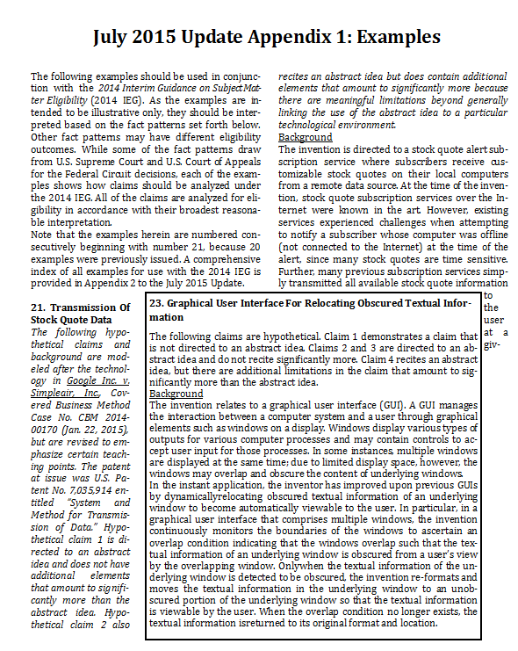
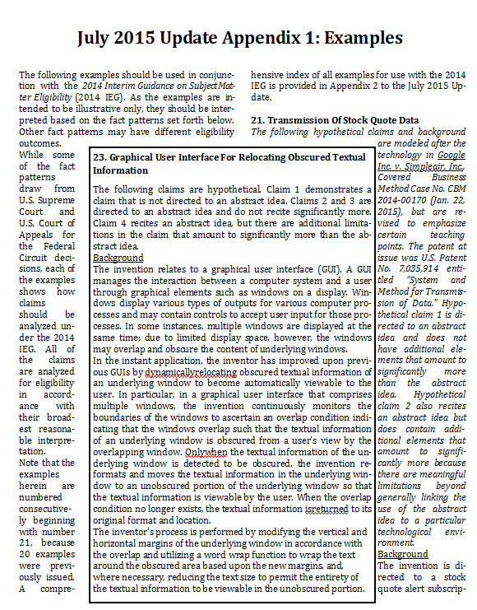
Example 23: Graphical User Interface For Relocating Obscured Textual Information
I. What did Applicant invent?
A graphical user interface for dynamically relocating/rescaling obscured textual information of an underlying window to become automatically viewable to the user. By permitting textual information to be dynamically relocated based on an overlap condition, the computer’s ability to display information is improved.
Notes:
<Examiners are encouraged to fill out a new worksheet for claim 3 as they progress through the training. Examiner should fill out Section I entitled “What did applicant invent?” of the blank worksheet.>
In a graphical user interface that comprises multiple windows, the invention continuously determines whether the windows overlap such that the displayed text of an underlying window is obscured by an overlapping window.
Whenever the text in the underlying window is obscured, the invention relocates and rescales the text to an unobscured portion of the underlying window.
When the overlap condition no longer exists, the underlying window’s text is returned to its original format and location.
This is Example 23, claims 3 and 4.

Slide 32
Claim 3: Calculating a Text Scaling Factor
3. A computer‐implemented method of resizing textual information within a window displayed in a graphical user interface, the method comprising: generating first data for describing the area of a first graphical element; generating second data for describing the area of a second graphical element containing textual information; and calculating, by the computer, a scaling factor for the textual information which is proportional to the difference between the first data and second data.
Notes:
The claimed invention is a computerized method of calculating a text scaling factor. The claimed method generates data representing a first area and a second area, and uses the area data to calculate a scaling factor. This is Example 23, claim 3.

Slide 33
II: Does the claimed invention fall within a statutory category of invention (Step 1)?
Process Machine Manufacture Composition of
Matter
Notes:
Examiners should consider whether the claim falls within a statutory category of invention.
<Pause for audience consideration and feedback, then advance slide>

Slide 34
II. Does the claimed invention fall within a statutory category of invention (Step 1)?
Worksheet II: (A) Yes
Claim 3 recites a series of steps for calculating a scaling factor. Thus, the claim is directed to a process, which is one of the statutory categories of invention. (Step 1: YES)
Notes:
<Examiner should fill out Section II of the blank worksheet.>

Slide 35
III. Is the claim directed to an abstract idea (Step 2A)?
  “Directed to” means that the claim recites (sets forth or describes) an abstract idea.
  An abstract idea can be identified by comparison to similar concepts found abstract by the courts.
  The July 2015 Update Quick Reference Sheet (page 2) contains a categorized list of some court-identified abstract ideas.
Notes:
<Pause for audience consideration and feedback, then advance slide>

Slide 36
III. Is the claim directed to an abstract idea (Step 2A)?
Mathematical concepts such as mathematical algorithms, mathematical relationships, mathematical formulas, and calculations
Claimed Invention
3. A computer‐implemented method of resizing textual information within a window displayed in a graphical user interface, the method comprising: generating first data for describing the area of a first graphical element; generating second data for describing the area of a second graphical element containing textual information; and calculating, by the computer, a scaling factor for the textual information which is proportional to the difference between the first data and second data.
Court Identified Abstract Ideas
An algorithm for converting binary coded decimal to pure binary A formula for computing an alarm limit A mathematical formula for hedging Computing a price for the sale of a fixed income asset and generating a financial analysis output Calculating the difference between local and average data values
Notes:
Determine if the claim is directed to an abstract idea. Starting with identifying the abstract idea focuses the 101 analysis on the central issue – is applicant claiming an abstract idea without significantly more?
Does the claim set forth or describe (i.e., the claim is directed to) any idea similar to an idea previously identified by a court as an abstract idea?
The box on the right lists some concepts the courts have identified as abstract ideas. Other concepts not listed here can be found in the Update materials.
<Pause for audience consideration and feedback, then advance slide>

Slide 37
III. C. Is the claim directed to an abstract idea?
Claimed Invention
3. A computer‐implemented method of resizing textual information within a window displayed in a graphical user interface, the method comprising: generating first data for describing the area of a first graphical element; generating second data for describing the area of a second graphical element containing textual information; and calculating, by the computer, a scaling factor for the textual information which is proportional to the difference between the first data and second data.
III C. Yes., the claim recites the steps of generating first and second data, and calculating a scaling factor proportional to the difference between the first and second data (italics).
Reasons: These three steps recite and describe mathematical relationships and algorithms, which has been found by the courts (e.g., Benson, Flook, Diehr, Grams) to be an abstract idea.
Step 2A: Yes
Notes:
Yes, the claim recites a mathematical calculation of a scaling factor from two datasets.
A mathematical calculation as claimed is similar to the types of concepts found by the courts to be abstract ideas.
The presence of the computer in the claim is not relevant to the determination that the claim recites a mathematical calculation – the computer limitation will be addressed in Step 2B.
A finding that a claim is directed to an abstract idea must be explained, but does not require a showing of factual evidence that an idea is abstract.
<Examiner should fill out Section III entitled “Is the claim directed to an abstract idea?” of the blank worksheet.>

Slide 38
IV: Does the claim as a whole amount to significantly more than the abstract idea?
  A: Are there any additional elements (features/limitations/steps) recited in the claim beyond the abstract idea?
Notes:
<Pause for audience consideration and feedback, then advance slide>

Slide 39
IV (A): Are there any additional elements recited in the claim beyond the abstract idea?
Claimed Invention
3. A computer‐implemented method of resizing textual information within a window displayed in a graphical user interface, the method comprising: generating first data for describing the area of a first graphical element; generating second data for describing the area of a second graphical element containing textual information; and calculating, by the computer, a scaling factor for the textual information which is proportional to the difference between the first data and second data.
IV. A.2. Yes. The claim elements in addition to the abstract idea are: the recitations of “computer‐implemented”, “within a window displayed in a graphical user interface” and “by the computer”.
Notes:
Now we evaluate the significance of the additional elements. We start by looking at each limitation individually.
The additional elements beyond the abstract idea are highlighted here for convenience.
<Examiner should fill out Section IV.A entitled “Are there any additional elements (features/limitations/steps) recited in the claim beyond the abstract idea identified above?” of the blank worksheet.>

Slide 40
IV: Does the claim as a whole amount to significantly more than the abstract idea (Step 2B)?
  B: Evaluate the significance of the additional elements. Consider all the additional elements individually and in combination.
Notes:
<Pause for audience consideration and feedback, then advance slide>

Slide 41
IV B. Evaluate the significance of the additional elements
IV. B.2. No. Considered individually, “computer-implemented” and “by the computer” are merely using a computer for calculating numbers, i.e. “apply it”; and “in a graphical user interface” merely limits the abstract idea to a particular technological environment (GUI).
Considered in combination, the additional elements do not show any inventive concept in applying the mathematical operations, e.g., an improvement to computer or other technology. Steps describe nothing more than computer’s basic function of numerical calculation, and do not meaningfully limit the performance of the calculation.
Claimed Invention
3. A computer‐implemented method of resizing textual information within a window displayed in a graphical user interface, the method comprising: generating first data for describing the area of a first graphical element; generating second data for describing the area of a second graphical element containing textual information; and calculating, by the computer, a scaling factor for the textual information which is proportional to the difference between the first data and second data.
  Step 2B: No - Claim 3 as a whole is not significantly more than the abstract idea itself, and is ineligible.
Notes:
Regarding the graphical user interface limitation, the courts have found that simply limiting the use of the abstract idea to a particular technological environment is not significantly more. However, the mere recitation of “computer‐implemented” and “by the computer” are akin to adding the words “apply it” in conjunction with the abstract idea. Such a limitation is not enough to qualify as significantly more.
Taking all limitations together, the claim recites a mathematical calculation being performed on a generically recited computer.
Even though the disclosed invention may improve computer technology, the claimed invention merely uses the computer for its numerical calculation abilities – a basic computer function.
Furthermore, calculating on the generically claimed computer, rather than manually or otherwise, does not meaningfully limit the performance of the calculation.
Simply because the calculation of the scaling factor is limited to a GUI context, the recited calculations are not meaningfully limited by that context in this claim.
None of the considerations for Step 2B are met.
<Examiner should fill out Section IV.B entitled “Evaluate the significance of the additional elements” of the blank worksheet>

Slide 42
What should be included in the rejection to make a prima facie case of ineligible subject matter?
Notes:
<Pause for audience consideration and feedback, then advance slide>

Slide 43
Making a Prima Facie Case
A rejection of claim 3 should identify the exception by pointing to the generating and scaling steps and explain that these steps are a mathematical algorithm similar to those found by the courts to be abstract. The rejection should also identify the additional elements including the computer-implementation and graphical user interface and explain why those elements merely require the abstract idea to be performed by a generic computer and in a particular technological environment.
Notes:
<Examiner should fill out the sample rejection portion of the blank worksheet>

Slide 44
Are there elements in the disclosure that could be added to the claim that may provide an inventive concept and make it eligible?
Notes:
<Pause for audience consideration and feedback, then advance slide>
Note: This is for discussion purposes only. While the amended claim in the next slide is eligible, there may be other amendments that may make the claim patent eligible.
Recall that limitations that may be enough to qualify as “significantly more” when recited in a claim with a judicial exception include:
Improvements to another technology or technical field
Improvements to the functioning of the computer itself
Applying the judicial exception with, or by use of, a particular machine
Effecting a transformation or reduction of a particular article to a different state or thing
Adding a specific limitation other than what is well-understood, routine and conventional in the field, or adding unconventional steps that confine the claim to a particular useful application
Other meaningful limitations beyond generally linking the use of the judicial exception to a particular technological environment

Slide 45
July 2015 Update
Appendix 1: Example 23, Claim 4
Assume that applicant has canceled claim 3 and presented a new claim 4 in response the rejection under § 101.
Go to page 7 of the Workshop Handout for Example 23, sections IV-V to evaluate claim 4
Worksheet answers are provided in the following slides.
Notes:
Instructor Notes:
Here the examiners should open the Workshop Handout to Example 23.
Give time for the examiners to fill out a blank worksheet for claim 4.
Links are provided in the Handout to a blank worksheet and the QRS.
Then proceed through slides 46-54, pausing to get feedback from the examiners and then walk through the worksheet answers.

Slide 46
II. Does the claimed invention fall within a statutory category of invention (Step 1)?
Claim 4
4. A computer‐implemented method for dynamically relocating textual information within an underlying window displayed in a graphical user interface, the method comprising: displaying a first window containing textual information in a first format within a graphical user interface on a computer screen; displaying a second window within the graphical user interface; constantly monitoring the boundaries of the first window and the second window to detect an overlap condition where the second window overlaps the first window such that the textual information in the first window is obscured from a user’s view; determining the textual information would not be completely viewable if relocated to an unobstructed portion of the first window; calculating a first measure of the area of the first window and a second measure of the area of the unobstructed portion of the first window; calculating a scaling factor which is proportional to the difference between the first measure and the second measure; scaling the textual information based upon the scaling factor; automatically relocating the scaled textual information, by a processor, to the unobscured portion of the first window in a second format during an overlap condition so that the entire scaled textual information is viewable on the computer screen by the user; and automatically returning the relocated scaled textual information, by the processor, to the first format within the first window when the overlap condition no longer exists.
Notes:
Examiners should review claim 4.
<Examiners are encouraged to fill out a new worksheet for claim 4 as they progress through the training. Part I of the worksheet for claim 4 will be the same as Part I of the worksheet for claim 3>
Examiners should consider whether the claim falls within a statutory category of invention.
<Pause for consideration of the question.>

Slide 47
II. Does the claimed invention fall within a statutory category of invention (Step 1)?
II: (A) Yes
The claim recites a series of acts for relocating obscured textual data. Thus, the claim is directed to a process, which is one of the statutory categories of invention. Step 1: YES
Notes:
<Examiner should fill out Section II of the blank worksheet.>

Slide 48
III. Is the claim directed to an abstract idea (Step 2A)?
Mathematical concepts such as mathematical algorithms, mathematical relationships, mathematical formulas, and calculations
Claimed Invention
4. A computer‐implemented method for dynamically relocating textual information within an underlying window displayed in a graphical user interface, the method comprising: displaying a first window containing textual information in a first format within a graphical user interface on a computer screen; displaying a second window within the graphical user interface; constantly monitoring the boundaries of the first window and the second window to detect an overlap condition where the second window overlaps the first window such that the textual information in the first window is obscured from a user’s view; determining the textual information would not be completely viewable if relocated to an unobstructed portion of the first window; calculating a first measure of the area of the first window and a second measure of the area of the unobstructed portion of the first window; calculating a scaling factor which is proportional to the difference between the first measure and the second measure; scaling the textual information based upon the scaling factor; automatically relocating the scaled textual information, by a processor, to the unobscured portion of the first window in a second format during an overlap condition so that the entire scaled textual information is viewable on the computer screen by the user; and automatically returning the relocated scaled textual information, by the processor, to the first format within the first window when the overlap condition no longer exists.
Notes:
Determine if the claim is directed to an abstract idea. Starting with identifying the abstract idea focuses the 101 analysis on the central issue – is applicant claiming an abstract idea without significantly more?
Does the claim set forth or describe any idea similar to an idea previously identified by a court as an abstract idea?

Slide 49
III. Is the claim directed to an abstract idea (Step 2A)?
Claimed Invention
4. A computer‐implemented method for dynamically relocating textual information within an underlying window displayed in a graphical user interface, the method comprising: displaying a first window containing textual information in a first format within a graphical user interface on a computer screen; displaying a second window within the graphical user interface; constantly monitoring the boundaries of the first window and the second window to detect an overlap condition where the second window overlaps the first window such that the textual information in the first window is obscured from a user’s view; determining the textual information would not be completely viewable if relocated to an unobstructed portion of the first window; calculating a first measure of the area of the first window and a second measure of the area of the unobstructed portion of the first window; calculating a scaling factor which is proportional to the difference between the first measure and the second measure; scaling the textual information based upon the scaling factor; automatically relocating the scaled textual information, by a processor, to the unobscured portion of the first window in a second format during an overlap condition so that the entire scaled textual information is viewable on the computer screen by the user; and automatically returning the relocated scaled textual information, by the processor, to the first format within the first window when the overlap condition no longer exists.
III C. Yes. Similar to claim 3, claim 4 recites a mathematical calculation of a scaling factor from two data sets (italics).
Reasons: As in claim 3, these limitations are mathematical relationships and algorithms and thus similar to the concepts found abstract previously by the courts (e.g., Benson, Flook, Diehr, Grams).
Step 2A: Yes
Notes:
Does the claim set forth or describe (i.e., the claim is directed to) any idea similar to an idea previously identified by a court as an abstract idea?
As in claim 3, claim 4 recites numerical calculation of a scaling factor from data sets.
<Examiner should fill out Section III entitled “Is the claim directed to an abstract idea?” of the blank worksheet.>

Slide 50
IV: Does the claim as a whole amount to significantly more than the abstract idea?
  A: Are there any additional elements (features/limitations/steps) recited in the claim beyond the abstract idea?
Notes:
<Pause for audience consideration and feedback, then advance slide>

Slide 51
Claimed Invention
4. A computer‐implemented method for dynamically relocating textual information within an underlying window displayed in a graphical user interface, the method comprising: displaying a first window containing textual information in a first format within a graphical user interface on a computer screen; displaying a second window within the graphical user interface; constantly monitoring the boundaries of the first window and the second window to detect an overlap condition where the second window overlaps the first window such that the textual information in the first window is obscured from a user’s view; determining the textual information would not be completely viewable if relocated to an unobstructed portion of the first window; calculating a first measure of the area of the first window and a second measure of the area of the unobstructed portion of the first window; calculating a scaling factor which is proportional to the difference between the first measure and the second measure; scaling the textual information based upon the scaling factor; automatically relocating the scaled textual information, by a processor, to the unobscured portion of the first window in a second format during an overlap condition so that the entire scaled textual information is viewable on the computer screen by the user; and automatically returning the relocated scaled textual information, by the processor, to the first format within the first window when the overlap condition no longer exists.
IV A. Are there any additional elements recited in the claim beyond the abstract idea?
IV. A.2. Yes. The claim elements in addition to the abstract idea are highlighted in claim 4.
Notes:
<Pause for audience consideration and feedback, then advance slide>
<Examiner should fill out Section IV.A entitled “Are there any additional elements (features/limitations/steps) recited in the claim beyond the abstract idea identified above?” of the blank worksheet.>

Slide 52
IV: Does the claim as a whole amount to significantly more than the abstract idea (Step 2B)?
  B: Evaluate the significance of the additional elements. Consider all the additional elements individually and in combination.
Notes:
<Pause for audience consideration and feedback, then advance slide>

Slide 53
IV (B): Evaluate the significance of the additional elements.
Claimed Invention
4. A computer‐implemented method for dynamically relocating textual information within an underlying window displayed in a graphical user interface, the method comprising: displaying a first window containing textual information in a first format within a graphical user interface on a computer screen; displaying a second window within the graphical user interface; constantly monitoring the boundaries of the first window and the second window to detect an overlap condition where the second window overlaps the first window such that the textual information in the first window is obscured from a user’s view; determining the textual information would not be completely viewable if relocated to an unobstructed portion of the first window; calculating a first measure of the area of the first window and a second measure of the area of the unobstructed portion of the first window; calculating a scaling factor which is proportional to the difference between the first measure and the second measure; scaling the textual information based upon the scaling factor; automatically relocating the scaled textual information, by a processor, to the unobscured portion of the first window in a second format during an overlap condition so that the entire scaled textual information is viewable on the computer screen by the user; and automatically returning the relocated scaled textual information, by the processor, to the first format within the first window when the overlap condition no longer exists.
Claim 4 recites a computer screen and processor.
Considered individually, these additional elements:
Limit abstract idea solely by generic computer components performing generic computer functions.
Are not significantly more than the abstract idea.
Notes:
Next, we look to the limitations individually to see if any cause the claimed invention to be significantly more than the abstract idea itself.
Consider, for example, that the claim recites a computer screen and a processor. Calculating and displaying on the generically claimed screen and processor, rather than manually or otherwise, does not meaningfully limit the performance of the calculation and recordation of its result. Without more, this claim would be ineligible for the same reasons as for claim 3.

Slide 54
IV (B): Evaluate the significance of the additional elements.
Claimed Invention
4. A computer‐implemented method for dynamically relocating textual information within an underlying window displayed in a graphical user interface, the method comprising: displaying a first window containing textual information in a first format within a graphical user interface on a computer screen; displaying a second window within the graphical user interface; constantly monitoring the boundaries of the first window and the second window to detect an overlap condition where the second window overlaps the first window such that the textual information in the first window is obscured from a user’s view; determining the textual information would not be completely viewable if relocated to an unobstructed portion of the first window; calculating a first measure of the area of the first window and a second measure of the area of the unobstructed portion of the first window; calculating a scaling factor which is proportional to the difference between the first measure and the second measure; scaling the textual information based upon the scaling factor; automatically relocating the scaled textual information, by a processor, to the unobscured portion of the first window in a second format during an overlap condition so that the entire scaled textual information is viewable on the computer screen by the user; and automatically returning the relocated scaled textual information, by the processor, to the first format within the first window when the overlap condition no longer exists.
IV. B.1. Yes Claim 4 further recites window overlap detection and automatic text relocation limitations. Considered as a combination, the elements improve the basic display function of the computer.
Step 2B: Yes – the claim as a whole is significantly more than the mathematical calculation of a scaling factor, and is eligible.
Notes:
The claim further requires additional steps that improve the ability of the computer to display information and interact with the user. Thus, the combination of all limitations in the claim amounts to significantly more than the mathematical calculation of a scaling factor.
<Examiner should fill out Section IV.B entitled “Evaluate the significance of the additional elements” of the blank worksheet>

Slide 55
Summary of Example 23
For more information about the eligibility analysis of these claims, consult:
  The analysis in Example 23 in Appendix 1 to the July 2015 Update for claim 3 and claim 4
    http://www.uspto.gov/sites/default/files/documents/ieg-july-2015-app1.pdf
A sample rejection of claim 3 is presented in the worksheet answer key.

Slide 56
Questions and Comments?
Please see your SPE for questions or comments. Your SPE can direct you to TC subject matter eligibility points of contact (POCs) if needed.
Training Time Code: ATRAIN-0000-090101

