Slide 1
Operations update
Dan Vavonese
Deputy Commissioner for Trademark Operations

Slide 2
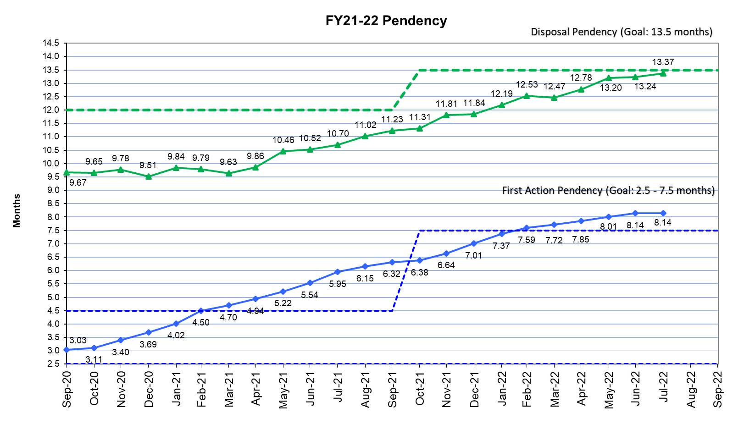
FY21-22 Pendency

Slide 3
Unexamined application inventory

Slide 4
Trademarks performance: Quality
Trademarks performance measures | FY 2022 targets | FY 2022 YTD Results
First action compliance In-process review evaluation of the statutory bases for which the USPTO raises issues and/or refuses marks for registration based on the first office action | 95.5% | 96.0%
Final action compliance In-process review evaluation of the statutory bases for which the USPTO raises issues and/or refuses marks for registration based on the examining attorney’s approval or denial of the application | 97.0% | 98.4%
Exceptional office action Measure indicating the comprehensive quality of the first office action search, evidence, writing, and decision making | 50.0% | 60.6%
Notes:
Includes FY22 YTD quality results through February
Slide updated 03/17/2022, Trademark Analytics

Slide 5
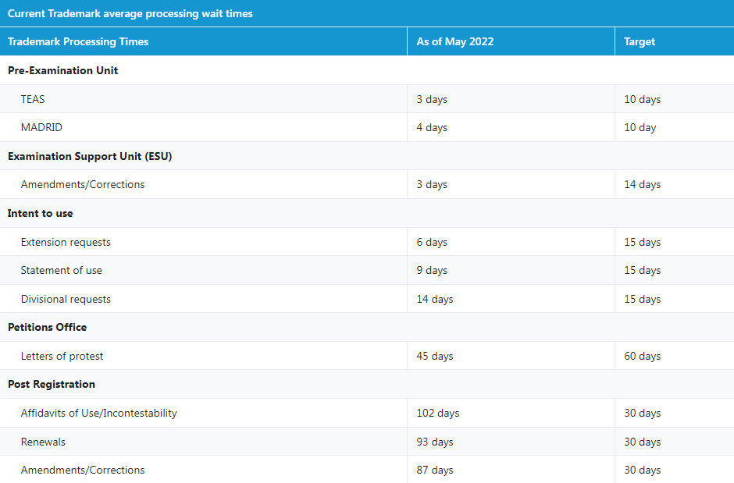
Current processing timelines
First actions: 8.1 months; Disposal: 13.3 months
Post Registration: Maintenance filings processed in 100+ days
Current processing times viewable on uspto.gov
  Updated monthly
  TM Dashboard provides yearly and quarterly statistics
https://www.uspto.gov

Slide 6
Staffing and process
Examining attorney hiring
  FY22: 91 examining attorneys hired
  FY23: Currently interviewing for two classes in FY23
  TM Academy
Post registration specialist hiring
  4 specialists hired; will be onboarding soon
TM Flex conducting bad faith investigations
3rd party continuing to assess the entire examination process
TMA flexible response periods effective December 1, 2022
  3 months to respond to office actions in applications

Slide 7
Thank you!
Dan Vavonese
Deputy Commissioner for Trademark Operations
Dan.Vavonese@USPTO.GOV
(571) 272-8901

