Slide 2
Antibody Decisions and Their Compliance with the Written Description Requirement
Workgroup 1640 2015

Slide 3
Overview
Introduction
Centocor
3. AbbVie

Slide 4
The Written Description Guidelines
MPEP 2163: W.D. guidelines for complying with the written description requirement of 35 U.S.C. 112(a) that the “specification shall contain a written description of the invention. … “.
This requirement is separate and distinct from the enablement requirement (Ariad Pharm., Inc. v. Eli Lilly & Co., 598 F.3d 1336, 1355 (Fed. Cir. 2010)).

Slide 5
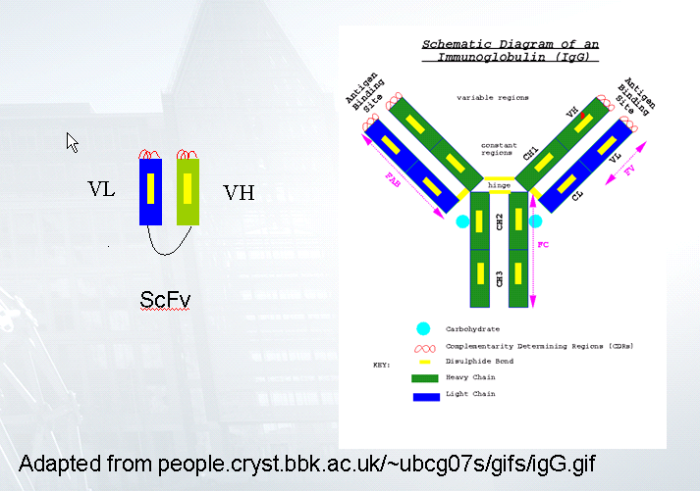
Antibody Structure

Slide 6
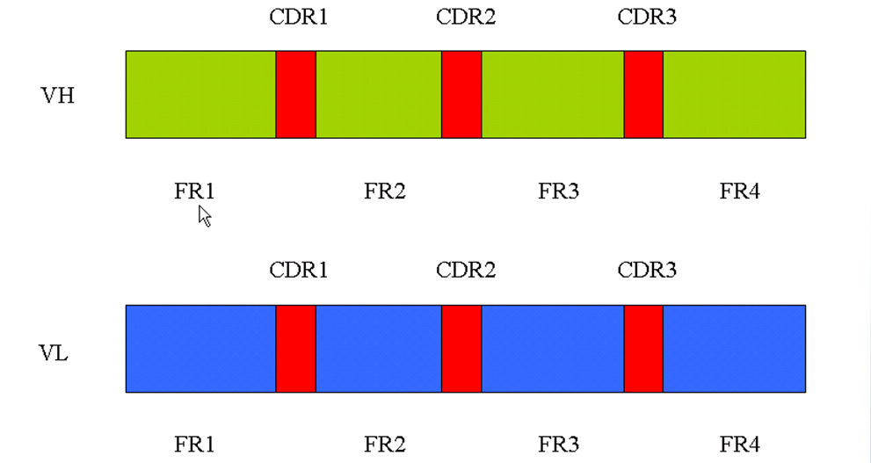
Antibody Variable Domains

Slide 7
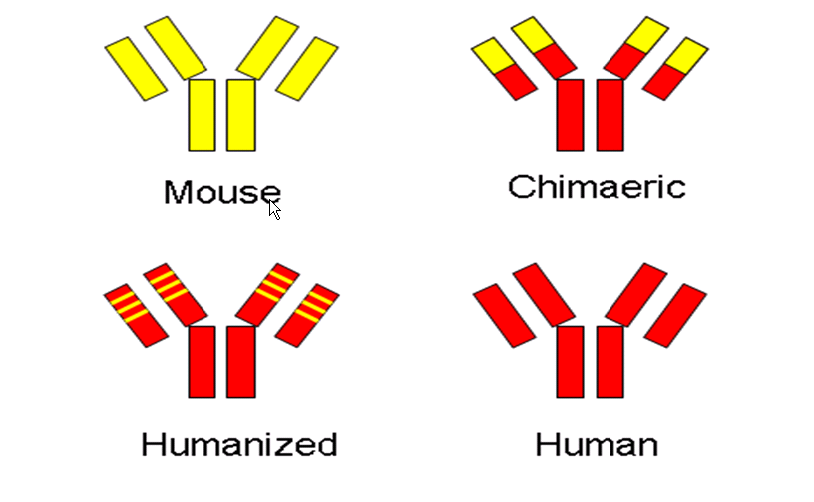
Humanization of Antibodies
Mouse
Chimeric
Humanized
Human

Slide 8
W.D. for claimed genus may be satisfied through sufficient description of a representative number of species
inverse function of the skill and knowledge in the art
depends on whether one of skill in the art would recognize necessary common
attributes or features possessed by the members of the genus.
generally, in an unpredictable art, adequate written description of a genus
which embraces widely variant species cannot be achieved by disclosing only
one species within the genus
See Enzo Biochem, Inc. v. Gen-Probe Inc., 323 F.3d 956 (Fed. Cir. 2002); Noelle v. Lederman,
355 F.3d 1343 (Fed. Cir. 2004); Regents of the University of California v. Eli Lilly Co.,
119 F.3d 1559 (Fed. Cir. 1997)

Slide 9
W.D. is also satisfied when relevant identifying characteristics are disclosed
[D]etermine whether the specification discloses other relevant identifying
characteristics sufficient to describe the claimed invention in such full, clear,
concise, and exact terms that a skilled artisan would recognize applicant was in
possession of the claimed invention. For example, if the art has established a
strong correlation between structure and function, one skilled in the art would
be able to predict with a reasonable degree of confidence the structure of the
claimed invention from a recitation of its function. Thus, the written description
requirement may be satisfied through disclosure of function and minimal
structure when there is a well-established correlation between structure and
function.
MPEP 2163 (emphasis added)

Slide 10
Claiming by function does not necessarily satisfy written description
[A] generic statement such as "vertebrate insulin cDNA" or "mammalian insulin cDNA," without more, is not an adequate written description of the genus because it does not distinguish the claimed genus from others, except by function. It does not specifically define any of the genes that fall within its definition. It does not define any structural features commonly possessed by members of the genus that distinguish them from others.
A definition by function, as we have previously indicated, does not suffice to define the genus because it is only an indication of what the gene does, rather than what it is. See Fiers v. Revel, 984 F.2d 1164 (Fed. Cir. 1993); (discussing Amgen, Inc. v. Chugai Pharmaceutical Co., 927 F.2d 1200 (Fed. Cir. 1991). It is only a definition of a useful result rather than a definition of what achieves that result.
Regents of the University of California v. Eli Lilly Co., 119 F.3d 1559 (Fed. Cir. 1997)

Slide 11
Centocor Orth Biotech, Inc. v. Abbott Labs., 636 F.3d 1341 (Fed. Cir. 2011)

Slide 12
Centocor’s 7,070,775 (‘775 patent) (2006)
An isolated recombinant anti-TNF-α antibody or antigen-binding fragment
thereof, said antibody or antigen-binding fragment comprising a human
constant region, wherein said antibody or antigen binding fragment (i)
competitively inhibits binding of A2 (ATCC Accession No. PTA-7045) to
human TNF-α, and (ii) binds to a neutralizing epitope of human TNF-α
in vivo with an affinity of at least 1x10⁸ liter/mole, measured as an
association constant (Ka), as determined by Scatchard analysis.
2. The antibody or antigen-binding fragment of claim 1, wherein the
antibody or antigen binding fragment comprises a human constant region
and a human variable region.
(emphasis added)

Slide 13


Human anti-human TNF-α antibody
Centocor sues for infringement, indicating that Abbott’s TNF-α (Humira®)
antibody is encompassed by Centocor’s claim 2.
Centocor’s ‘775 patent filed July 18, 2002, claims CON/DIV priority to 08/570,674, filed
12/11/1995, which is a CIP of 08/324,799, filed 10/18/1994. It sought priority (effective filing
date) to this 1994 application, which would pre-date Abbott’s earliest filing date for Humira® (1995).
Centocor’s ‘775 patent claims priority to a 1991 application that discloses an antibody that was
obtained by identifying a mouse antibody to human TNF-α that had high affinity
and neutralizing activity (“A2 mouse antibody”) and substituting the mouse
constant region with a human constant region. The result was a chimeric antibody.
Abbott’s antibody (first filed 1995) was obtained from a phage display library that contained a
large number of human variable regions. After identifying variable regions that
bound to human TNF-α, “guided selection” was used to identify variable regions
that had neutralizing activity (U.S. Patent 6,090,382).
Chimeric
Human

Slide 14

Human anti-human TNF-α antibody (cont.)
Centocor files CIP applications (1993) that are rejected under enablement
because they are drawn to “less than an entire mouse variable region.” The spec
only teaches fully-mouse variable regions.
Centocor files CIP applications (1993-1994) drawn to “less than an entire mouse
variable region.” This comprises new matter that Centocor relies on as evidence to
support the asserted claims of 7,070,775. While these additions were made, no
claims were drawn to human variable regions.
Following the Abbott patent of Humira® in 2000 and its regulatory approval in
2002, Centocor files claims to fully-human antibodies. Upon withdrawal of
the enablement rejection, Centocor’s claims are patented in 2006 (U.S. Patent 7,070,775).

Slide 15
Written Description support is raised
Question raised in Centocor CAFC decision:
Does Centocor have written description support for human antibodies against TNF-α?
Abbott’s position
To have the 1994 priority, Centocor’s 1994 CIP must provide written description for a human antibody with 1) a human constant region, 2) a human variable region, 3) high affinity for human TFN-α, 4) neutralizing activity, and 5) the ability to bind TNF-α in the same place as Centocor’s A2 mouse antibody.
Abbott points out that making human antibodies against human proteins is difficult (e.g. autoimmune issues) and thus an artisan would need to engineer a human antibody.

Slide 16
Written Description support is raised (cont.)
Conclusions
The courts found that all Centocor really has support for is the A2 mouse antibody
and the single chimeric antibody. This mouse sequence does not serve as a
stepping stone for the human variable region. Further, it was shown that the sequence
of the mouse variable region was different from that of the human. As such, Centocor
lacked written description for the genus of human anti-TNF-α antibodies.
Thus, while the patent broadly claims a class of antibodies that contain human
variable regions, the specification does not describe a single antibody that satisfies the
claim limitations. It does not disclose any relevant identifying characteristics for such
fully-human antibodies or even a single human variable region. Nor does it disclose
any relationship between the human TNF-α protein, the known mouse variable
region that satisfies the critical claim limitations, and potential human variable
regions that will satisfy the claim limitations (Centocor, 636 F.3d at 1349, citing Regents
of the Univ. of Cal. v. Eli Lilly, 119 F.3d (1997))(emphasis added).

Slide 17
Written Description support is raised (cont.)
A “mere wish or plan” for obtaining the claimed invention is not sufficient. (Centocor v. Abbott, 1348, citing Regents of the University of California v. Eli Lilly Co., 119 F.3d 1559 (Fed. Cir. 1997))
While our precedent suggests that written description for certain antibody claims can be satisfied by disclosing a well-characterized antigen, that reasoning applies to disclosure of newly characterized antigens where creation of the claimed antibodies is routine. [O]btaining a high affinity, neutralizing, A2 specific antibody with a human variable region was not possible in 1994 using “conventional,” “routine,” “well developed and mature” technology. (Centocor, 636 F.3d at 1349 citing USPTO, Written Description Training Materials Revision 1 March 25, 2008 at 46 (emphasis added).

Slide 18
AbbVie Deutschland GmbH v. Janssen Biotechnology, Ltd.,
759 F.3d 1285 (Fed. Cir. 2014)

Slide 19
Abbvie v. Janssen (2014)
Human antibody against human IL-12
AbbVie patents US 7,504,485 and US 6,914,128, shared specification with
claims directed to fully human anti-IL-12 antibodies
Centocor produced Stelara® (ustekinumab) indicated for the treatment of
adults with moderate-to-severe plaque psoriasis
From AbbVie ‘128, claim 29:
A neutralizing isolated human antibody, or antigen-binding portion thereof that
binds to human IL-12 and disassociates from human IL-12 with a K_{off} rate
constant of 1x10⁻² s⁻¹ or less, as determined by surface plasmon resonance.

Slide 20
Written Description support is raised
AbbVie’s ‘128 and ‘485 taught ~300 fully human antibodies that bind and
neutralize IL-12
All disclosed AbbVie antibodies were derived from 1st Gen antibody “Joe-9.”
Joe-09 CDR3 (VH/VL) mutated to increase affinity & neutralizing activities
All disclosed AbbVie antibodies have:
VH3 heavy chains
Lambda light chains
At least 90% similarity with Joe-9 in variable regions
More than 200 of the abs differ from the 2nd gen ab (Y61) at a single amino
acid residue (99.5% similarity in variable regions)

Slide 21
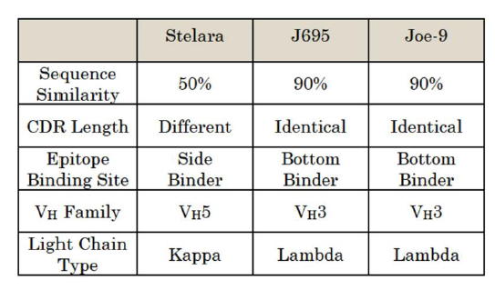
Written Description support is raised (cont.)
Stelara® met the functional claim limitations:
Fully human
Anti-IL-12
Neutralize activity of IL-12
But is structurally distinct from Joe and Joe-derived abs.
®

Slide 22
Stelera® is not encompassed by Joe-9 and its derivatives
Anti-IL12 human antibodies
Stelara®
Joe-9 and derivatives

Slide 23
Written Description support is raised (cont.)
Representative Number and/or Common Structural Features
“When a patent claims a genus using functional language to define a desired
result, the specification must demonstrate that the applicant has made a
generic invention that achieves the claimed result and do so by showing
that the applicant has invented species sufficient to support a claim to
the functionally-defined genus" (Capon v. Eshhar, 418 F.3d 1349 (Fed. Cir. 2005))
(emphasis added).
“[A] sufficient description of a genus . . . requires the disclosure of
either a representative number* of species falling within the scope of the
genus or structural features common to the members of the genus so that
one of skill in the art can 'visualize or recognize' the members of the genus”
(AbbVie, 759 F.3d at 1297, reiterating Eli Lilly, 119 F.3d at 1568-69)(emphasis
added).
*author’s comment: representative number of examples that vary greatly from each other

Slide 24
Written Description support is raised (cont.)
Functional limitations are not strictly prohibited.
“It is true that functionally defined claims can meet the written description
requirement if a reasonable structure-function correlation is established, whether
by the inventor as described in the specification or known in the art at the time of
the filing date” (AbbVie, 759 F.3d at 1298, reiterating Enzo Biochem, Inc., 323 F.3d at
964)(emphasis added).
But, genus claims need core structure or representative examples
“The asserted claims attempt to claim every fully human IL-12 antibody that
would achieve a desired result, i.e., high binding affinity and neutralizing activity,
and cover an antibody as different as Stelara®, whereas the patents do not describe
representative examples to support the full scope of the claims.” Jury’s decision of
invalidly for lack of adequate written description for the claimed genus affirmed
(AbbVie, 759 F.3d at 1298)(emphasis added).
Genus-Species guidance in MPEP 2163. MPEP includes citations of Noelle v. Lederman, 355 F.3d
1343 (Fed. Cir. 2004), Enzo Biochem, Inc. v. Gen-Probe Inc., 323 F.3d 956 (Fed. Cir. 2002), and
Regents of the University of California v. Eli Lilly Co. 119 F.3d 1559 (Fed. Cir. 1997)

Slide 25
The Difference between Written Description and Enablement
Written description requires description while enablement is satisfied with disclosure
of how to make and use.
MPEP 2163 (written description): “A biomolecule sequence described only by a
functional characteristic, without any known or disclosed correlation between
that function and the structure of the sequence, normally is not a sufficient
identifying characteristic for written description purposes, even when accompanied
by a method of obtaining the claimed sequence” (emphasis added).
MPEP 2164 (enablement): The “predictability or lack thereof” in the art refers to the
ability of one skilled in the art to extrapolate the disclosed or known results to the claimed
invention. If one skilled in the art can readily anticipate the effect of a change within the
subject matter to which the claimed invention pertains, then there is predictability in the
art.

Slide 26
Which Rejection Addresses the Issue at Hand?
The peptide having 95% identity to SEQ ID NO. 1, wherein the peptide
activates protein X.
Written description
What structure, or 95% of the sequence, needs to be preserved to maintain the peptide’s function?
Enablement
Can an artisan predict which 95% of the sequence needs to be intact to maintain the peptide’s function?
Applicant’s response: make amino acid mutants and screen for the ones that activates
protein X (i.e., an argument on how to make).
Enablement rejection drops, written description maintained.

