Slide 1
USPTO Update on the Implementation of the America Invents Act: Lessons Learned in the First Six Months of the Post-Patent Reform World
March 5, 2013
Janet Gongola
Patent Reform Coordinator
Janet.Gongola@uspto.gov
Direct dial: 571-272-8734
Notes:
Good afternoon, everyone! On behalf of all of us at the United States Patent and Trademark Office, let me welcome you here to our campus. We are happy to be the host of the 8th Annual Advanced Patent Law Institute, sponsored by two great law schools, George Mason University and the University of Texas. I always love it when major events like this are held here in our very own Madison auditorium. It certainly makes my commute easier!
You have already heard today from my dear friend James Smith, the Chief Judge of our newly renamed Patent Trial and Appeal Board, or PTAB, as well as other judges and USPTO officials. I know more are scheduled to speak today and tomorrow. So I thought what I would do during our time together today is just go over some of the major stories we have to tell here at the USPTO.
As you know, we have been very busy here, and we will continue to be after Dave’s Departure, when the hardest working man in IP, David Kappos, returns to private life. It has been an honor to work with him during this time of historic change at the USPTO.
What Director Kappos likes to point out—and it is a point with which I fully agree--is that the real strength of this agency is found in its hard-working employees. Our senior management remains in place. We continue to press forward on all of our initiatives, thanks to the inspiring leadership of the USPTO senior team and all of our employees. And we will continue to engage with smart folks like you, our stakeholders, to keep learning from you and keep serving you.

Slide 2
Obama Memorandum: Transparency and Open Government
“Government should be transparent”
“Government should be participatory”
“Government should be collaborative”

Slide 3
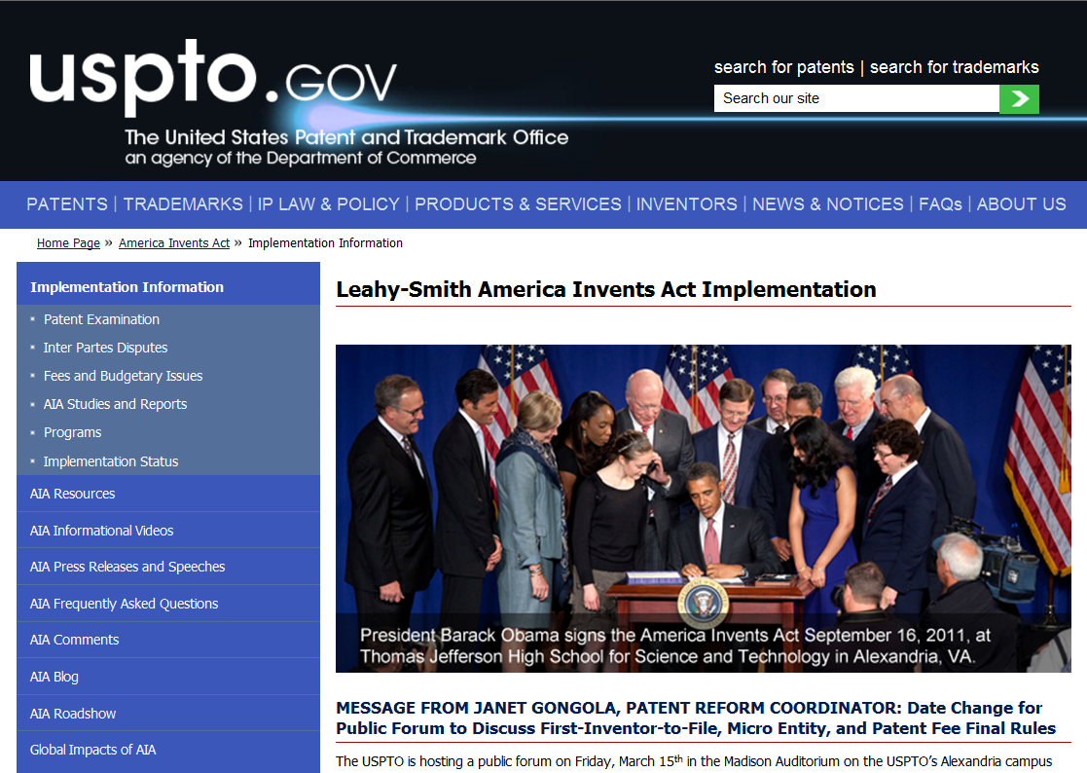
Pillars of AIA Implementation
Transparency
AIA micro-site: www.uspto.gov/AmericaInventsAct
AIA subscription center
>500 AIA presentations
Public participation
16 roadshows
>500 AIA presentations
Collaboration
>750 public comments

Slide 4
AIA Enactment Timeline
Day of Enactment
Sept 16, 2011
10 Days
Sept 26, 2011
Oct 1, 2011
60 Days
Nov 15, 2011
12 Months
Sept 16, 2012
18 Months
Mar 2013
Reexamination transition for threshold
Tax strategies are deemed within prior art
Best mode
Human organism prohibition
OED statute of limitations
Prioritized Examination
15% transition Surcharge
Reserve Fund
Electronic filing incentive
Inventor’s oath/declaration
Preissuance submission
Supplemental examination
Citation of prior art in a patent file
Inter partes review
Post-grant review
Transitional post-grant review program for covered business method patents
First-inventor-to-file
Derivation proceedings
Repeal of statutory invention registration
New patent fees
Micro entity discount
Provisions are enacted

Slide 5
First Inventor to File (FITF) (Effective March 16, 2013)
Pre-AIA 35 U.S.C. 102 A person shall be entitled to a patent unless— | AIA 35 U.S.C. 102 Concordance
(a) the invention was known or used by others in this country, or patented or described in a printed publication in this or a foreign country, before the invention thereof by the applicant for patent, or | 102(a)(1)
(b) The invention was patented or described in a printed publication in this or a foreign country or in public use or on sale in this country, more than one year prior to the date of the application for patent in the United States, or
(c) He has abandoned the invention, or | No corresponding provision
(d) The invention was first patented or caused to be patented, or was the subject of an inventor’s certificate, by the applicant or his legal representatives or assigns in a foreign country prior to the date of the application for patent in this country on an application for patent or inventor’s certificate filed more than twelve months before the filing date of the application in the United States, or
(e) The invention was described in An application for patent, published under section 122(b), by another filed in the United States before the invention by the applicant for patent or A patent granted on an application for patent by another filed in the United States before the invention by the applicant for patent, except than an international application filed under the treaty defined in section 351(a) shall have the effects for the purposes of this subsection of an application filed in the United States only if the international application designated the United States and was published under Article 21(2) of such treaty in the English language, or | 102(a)(2)
(f) He did not himself invent the subject matter sought to be patented, or | 101 and 115
(g) during the course of an interference conduced under section 135 or section 291, another inventor involved therein establishes, to the extent permitted in section 104, that before such person’s invention thereof the invention was made by such other inventor and not abandoned, suppressed, or concealed, or Before such person’s invention thereof, the invention was made in this country by another inventor who had not abandoned, suppressed, or concealed it. | No corresponding provision
Look to
Look to
Abandonment of invention
Premature foreign patenting
Look to
Derivation
Prior invention by another

Slide 6
FITF Statutory Framework
Prior Art 35 U.S.C. 102(a) (Basis for Rejection) | Exceptions 35 U.S.C. 102(b) (Not Basis for Rejection)
102(a)(1) Disclosure with Prior Public Availability Date | 102(b)(1) | (A) Grace Period Disclosure by Inventor or Obtained from Inventor
 |  | (B) Grace Period Intervening Disclosure by Third Party
102(a)(2) U.S. Patent, U.S. Patent Application, and PCT Application with Prior Filing Date | 102(b)(2) | (A) Disclosure Obtained from Inventor
 |  | (B) Intervening Disclosure by Third Party
 |  | (C) Commonly Owned Disclosure

Slide 7
Applicability of FITF
Filed before March 16, 2013;
Priority/Benefit claim before March 16, 2013
Filed after March 16, 2013; Priority/Benefit claim before March 16, 2013
Filed after March 16, 2013; Priority/Benefit claim after March 16, 2013
pre-AIA application
Transitional application
AIA application

Slide 8
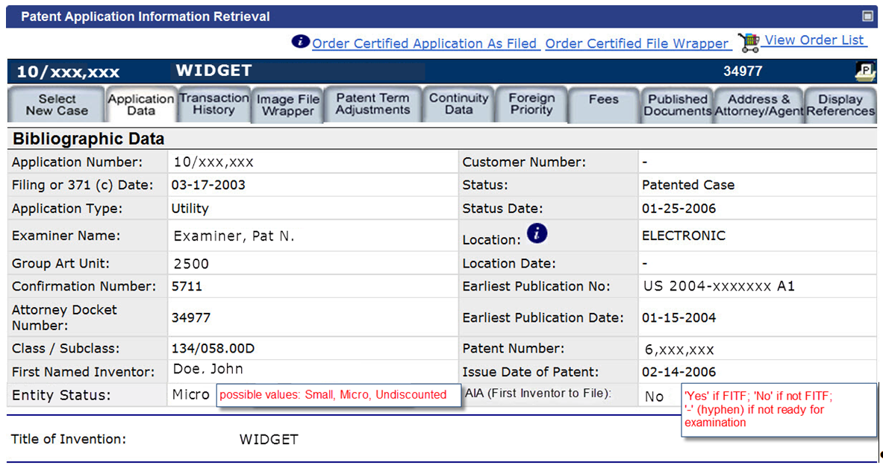
AIA Indicator: PAIR

Slide 9
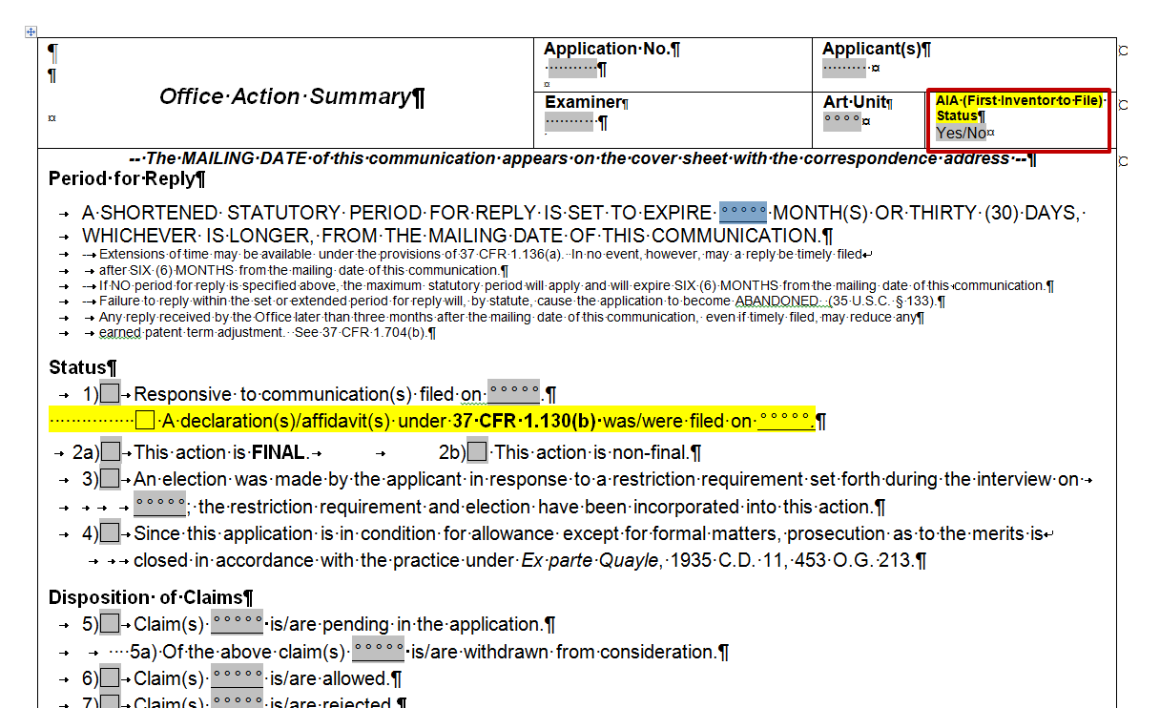
AIA Indicator: Office Action Summary

Slide 10
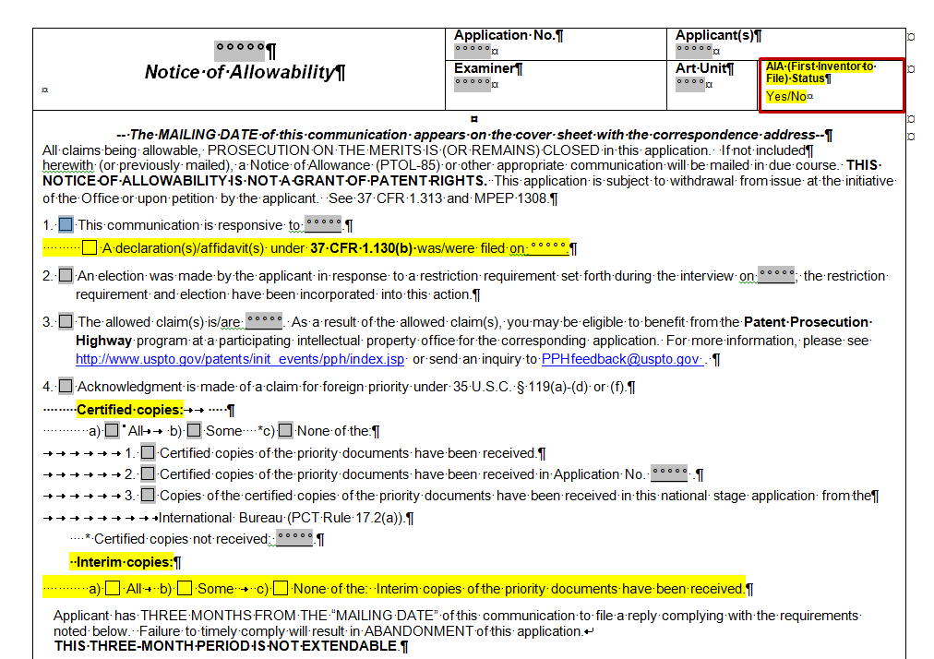
AIA Indicator: Notice of Allowability

Slide 11
FITF Examiner Training
Overview Training: Identifying if your application is subject to the new AIA FITF provisions and introducing the FITF statutory framework (mid-March 2013)
Introductory Video: Provides background for Overview Training
Live Training: >25 training sessions
Follow-up Video: Statutory review and additional illustrations
Comprehensive training (June/July 2013)
Just-in-time training: available as needed (March through July 2013)
Notes:
Training for the first-inventor-to-file provisions will occur in 3 phases over the next several months.
The overview training, divided into three parts, gives you a first introduction to the first-inventor-to-file provisions.
In the summer, we will provide much more comprehensive training, filling in many details on how to apply the first-inventor-to-file provisions of the AIA during examination.
Between now and the summer, we will offer just-in-time training for those of you who have an application subject to the AIA on your docket.
This situation is likely to be rare, but could occur, for example, in design applications or in an application undergoing prioritized examination.
If you find yourself in this situation, go to the Points of Contact in your Technology Center who will assist in providing just in time training with you. Those Points of Contact are provided at the end of these slides.
The agency is using a 3-phase training approach for the first-inventor-to-file provisions because the majority of you will not have a case on your docket to examine under the AIA until this coming fall. Additionally, we believe that an iterative approach will be helpful since the first-inventor-to-file statutory framework is much different from the first-to-invent statutory framework and hearing the information more than once will help solidify it for you.

Slide 12
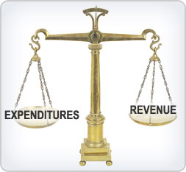
Fee Setting (Effective March 19, 2013)
Ensure patent fee schedule generates sufficient aggregate revenue to recover aggregate costs of USPTO operations
Individual fees set using agency discretion
http://www.uspto.gov/web/offices/ac/qs/ope/fee031913.htm
Goals:
Optimize patent timeliness and quality;
Implement a sustainable funding model for operations;
Encourage innovation;
Facilitate administration of patent system; and
Offer prosecution options to applicants

Slide 13
Comparison of Current to Final Fees: Filing through Issue
$4,144
$3,330
80% of Cost
Note: In each of the following summary pages, from the Current to the Final Rule fee structures, the fees paid could also increase by (a) $170 for each independent claim in excess of 3; (b) $18 for total claims in excess of 20; and (c) $320 for each multiple dependent claim.

Slide 14
Comparison of Current to Final Fees: Filing through 3rd Stage Maintenance
$12,190
366% of Cost
366% of Cost
294% of Cost
$4,147

Slide 15
Comparison of Current to Final Fees: Other
Fee | Current | Final | Change
Request for Continued Exam | $930 | $1,200 (first) $1,900 (second and subsequent)
Prioritized Exam | $4,800 | $4,000
Ex Parte Reexam | $17,750 | $12,000
Supplemental Exam | $21,260 | $16,500
Inter Partes Review | $27,200 | $23,000
Post Grant Review | $35,800 | $30,000
Notes:
Note that this is truly a good story, and will get even better in March, when a 75 percent micro-entity discount goes into effect.

Slide 16
Comparison of Current to Final Fees: Other
Fee | Current | Final | Change
Notice of Appeal | $630 | $800
Filing Appeal Brief | $630 | N/A
Appeal Forwarding | N/A | $2,000
TOTAL | $1,260 | $2,8000
Notes:
Note that this is truly a good story, and will get even better in March, when a 75 percent micro-entity discount goes into effect.

Slide 17
Micro Entity Discount (Effective March 19, 2013)
Entitled to a 75% discount on fees for “filing, searching, examining, issuing, appealing, and maintaining” patent applications/patents
2 ways to be eligible:
Limited income and limited number of patent filings; or
Employment or assignment to institution of higher education
Must certify micro entity eligibility before paying a fee in the micro entity amount

Slide 18
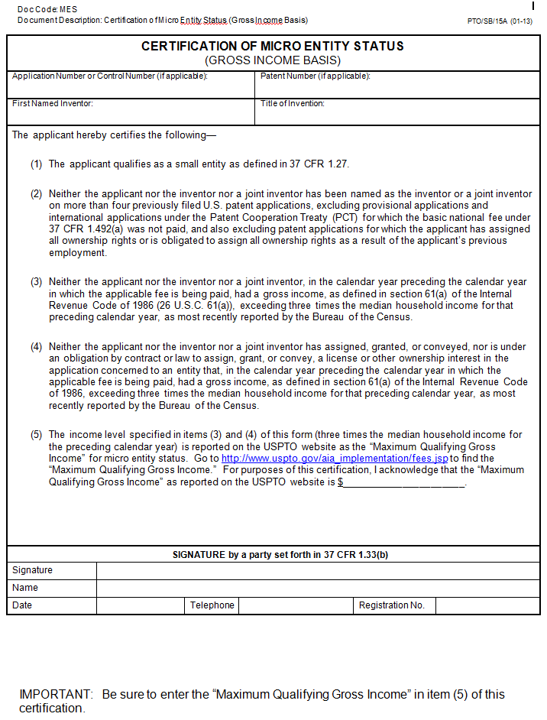
Micro Entity Certification Forms: Gross Income Basis

Slide 19
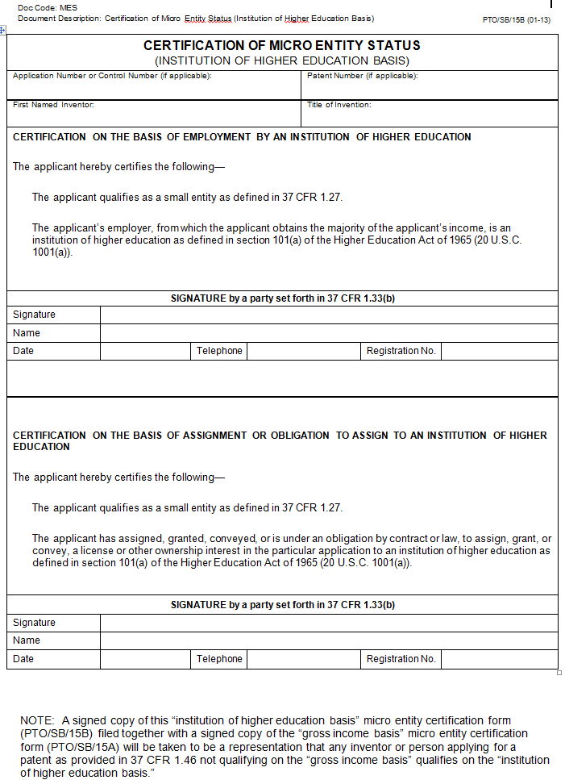
Micro Entity Certification Form: Institution of Higher Education Basis

Slide 20
Public Forum on FITF, Patent Fees, and Micro Entity Discount
March 15, 2013 from 1 to 4 pm EDT
USPTO Auditorium at Alexandria Headquarters
Webcast:
Event number: 996 254 133
Event password: 123456
Event address for attendees: https://uspto-events.webex.com/uspto-events/onstage/g.php?d=996254133&t=a

Slide 21
Prioritized Exam Statistics
(Data from Sept 26, 2011 to Feb19, 2013)
Petitions Filed | % of Decided Petitions Granted | Days from Petition grant to first Office action | Average Days to Final Disposition
8,554 | 94% | 55 | 168
First Action on Merits Mailed | Final Dispositions Mailed | Allowances Mailed | Percent of Petitions From Small Entities
5,503 | 3,667 | 1,828 | 43%
Notes:
Note that this is truly a good story, and will get even better in March, when a 75 percent micro-entity discount goes into effect.

Slide 22
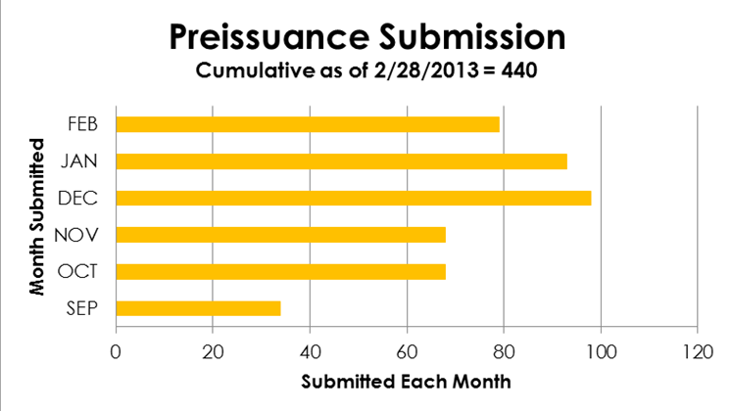
Preissuance Submissions (Data from Sept 16, 2012 to Feb 28, 2013)

Slide 23
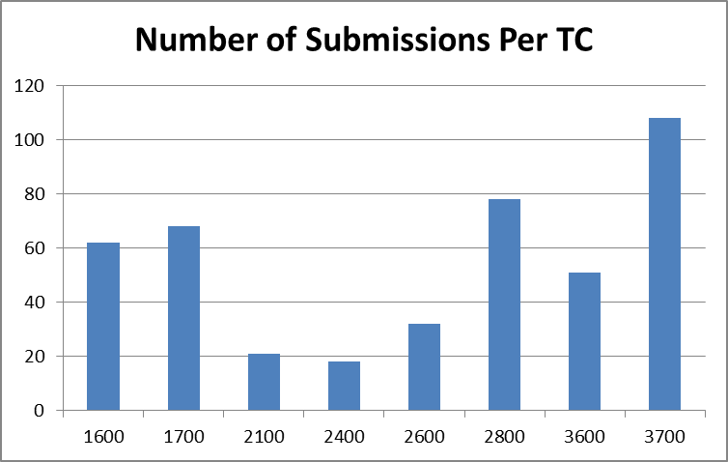
Preissuance Submission
(Data from Sept 16, 2012 to Feb 15, 2013)
Notes:
Note that we are delighted to see submissions across the Technology Centers. Several of those TCs involve technologies that contain software components.

Slide 24
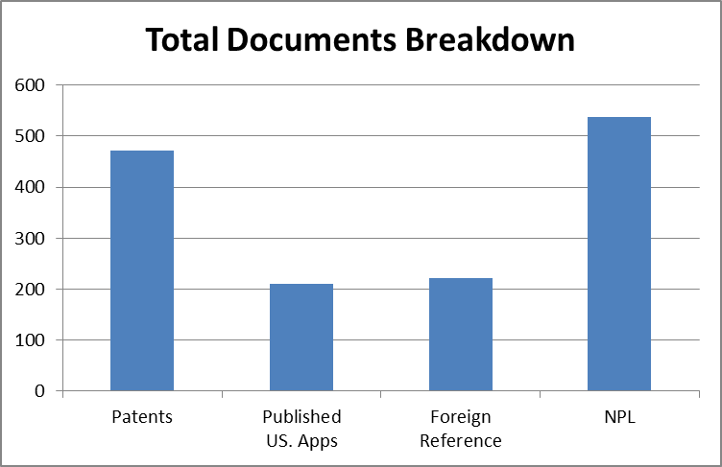
Preissuance Submission
(Data from Sept 16, 2012 to Feb 15, 2013)
Total Documents
Patents | 472
Published US Apps | 211
Foreign Reference | 221
Non-Patent Literature (NPL) | 537
Total Documents | 1441
Notes:
Note that we are pleased with the overall number of submissions to date, but we anticipate our partnership with the crowdsourcing network Ask Patents by Stack Exchange will help generate even more third-party submissions.

Slide 25
Preissuance Submission: Concise Description of Relevance
Statement of facts explaining how the document is of potential relevance to the examination of the application
Third party should not use the concise description to:
propose rejections; or
raise arguments related to an Office action or an applicant’s response

Slide 26
Preissuance Submission: Example of Concise Description of Relevance
Compliant | Non-compliant
Publication X and Publication Y both disclose machines that perform the same function as the machine recited in claim 1. In the first embodiment depicted in Figure 2 and discussed on page 5, the machine of publication X expressly includes element A of claim 1. See lines 7-14 on page 5 of publication X. Publication Y teaches a machine having element B of claim 1. See lines 1-3 on page 6 of publication Y. | Same with the following concluding sentence: Accordingly, claim 1 is obvious in view of the combination of Publication X and Publication Y.

Slide 27
Preissuance Submission Services
Patent Stack Exchange
Uses crowd sourcing to collect potential printed publications
http://patents.stackexchange.com/
Commercial vendors
IP.com
Patronus
http://gary-gerttula.squarespace.com/pre-issuance-tracking-and-submissions/

Slide 28
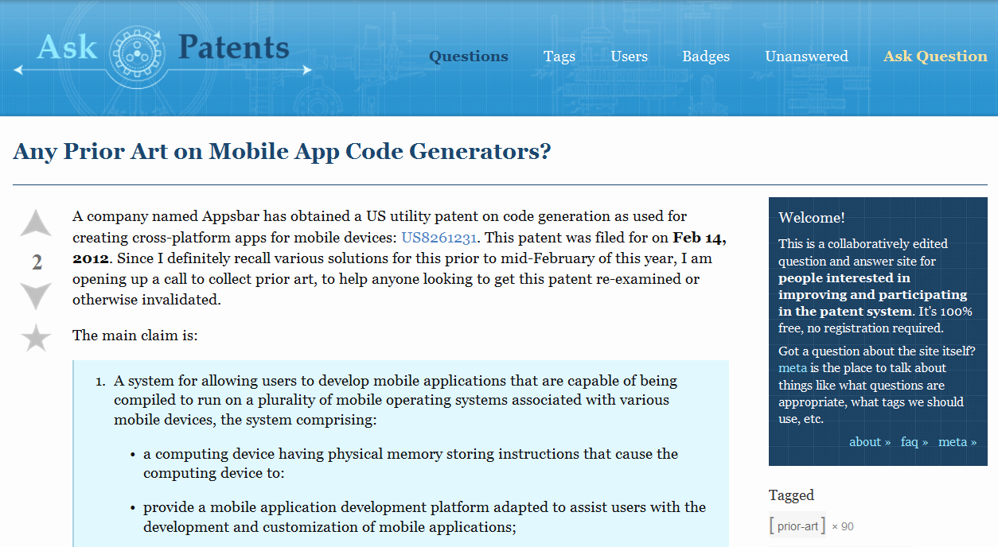
Patent Stack Exchange: Example

Slide 29
Patent Stack Exchange: Example

Slide 30
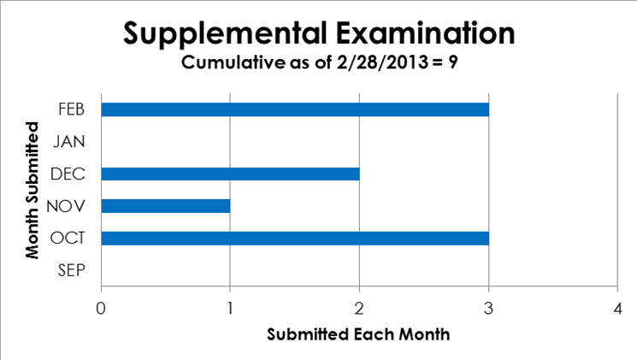
Supplemental Examination (Data from Sept 16, 2012 to Feb 28, 2013)

Slide 31
Supplemental Examination
(Data from Sept 16, 2012 to Feb 28, 2013)
Supplemental Examination Completed: 2
Reexamination Ordered: 1
Reexamination Not Ordered: 1
Supplemental Examination in Progress: 7

Slide 32
Supplemental Examination: Detailed Description of Relevance
Statement of facts explaining how each item of information is applicable to each claim
General statement not tied to any particular claim limitation is not sufficient
Statement should not state what the item of information does not teach
Statement not satisfied by incorporating a paper in another proceeding

Slide 33
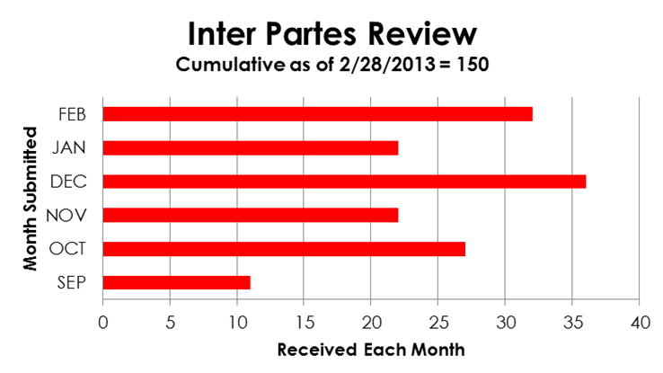
Inter Partes Review (Data from Sept 16, 2012 to Feb 28, 2013)

Slide 34
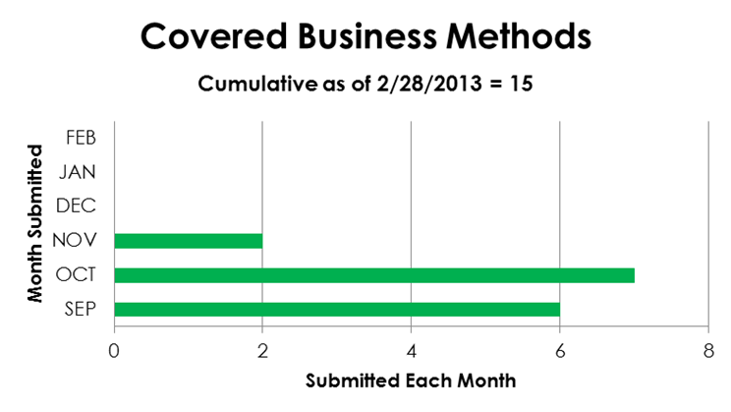
Covered Business Method Review (Data from Sept 16, 2012 to Feb 28, 2103)

Slide 35
Administrative Trial Petitions (Data from Sept 16, 2012 to Feb 20, 2013)
Technology | Number of Petitions | Percentage
Electrical/ Computer | 112 | 72.3%
Mechanical | 8 | 5.2%
Chemical | 23 | 14.8%
Bio/Pharma | 11 | 7.1%
Design | 1 | 0.6%
Notes:
Note that this breakdown is about what we would have expected. Director Kappos in his November 20th Center for American Progress speech highlighted these proceedings as an avenue the high-tech sector would embrace.

Slide 36
Administrative Trial Petitions (Data from Sept 16, 2012 to Feb 20, 2013)
Instituted:
10 IPR
6 CBM
Terminated due to settlement: 2

Slide 37
Administrative Trials: Page Limits and Requests for Waiver
Petition and response
60 pages for IPR; 80 pages for PGR/CBM
Petition includes statement of material facts, but response does not
Motion and response
15 pages
Waiver of page limits
Identify how the particular case facts demonstrate a need for waiver, and how that need is in the interest of justice
Waiver will not be commonly granted for generic reasons (e.g., additional pages used on the primary target claims because the patent is challenged on multiple grounds and thus it is in the interest of justice to respond or explain all grounds)

Slide 38
Administrative Trials: Written Arguments in Petitions
Avoid redundancy
Representative Order: CBM2012-00003, Order (Redundant Grounds), Paper 7, Oct. 25, 2012, available at http://www.uspto.gov/ip/boards/bpai/representative_order_cbm2012-00003_order_(redundant_grounds)_paper_7_(10-25-12).pdf
Present complete analysis per claim per ground to show how requisite standard is met
Provide support from evidentiary record

Slide 39
Satellite Office Program
Terminal Annex Federal Building
Temporary Space opening soon
Byron G. Rogers Building
Temporary space in Lakewood
Opened in July
62 patent examiners
11 patent law judges
Michelle Lee new director
Zeroing in on appropriate location
Notes:
Key details are in text on the slide. Note that while we are under a Congressional mandate to open two of the three offices by the summer of 2014, we’re already putting judges to work locally without permanent space yet occupied.
Temporary space in Dallas is the Santa Fe Federal Building – Occupancy March 2013
Temporary Space in Denver is open - the Denver Federal Center – currently occupied by PTAB judges
Temporary Space in Silicon Valley should be coming soon, April 2013; will house Michelle Lee and PTAB judges

Slide 40
AIA Help Center
1-855-HELP-AIA (1-855-435-7242)
HELPAIA@uspto.gov
>1,3900 calls/emails per month

Slide 41
Thank You
Janet Gongola
Patent Reform Coordinator
Janet.Gongola@uspto.gov
Direct dial: 571-272-8734

