Slide 1
USPTO Implementation of the America Invents Act
15th Annual Richard C. Sughrue Symposium on
Intellectual Property Law and Policy
March 4, 2013
Teresa Stanek Rea
Acting Under Secretary of Commerce for Intellectual Property and Acting Director of the U.S. Patent and Trademark Office

Slide 2
Purpose of the AIA
“This long-overdue reform is vital to our ongoing efforts to modernize America’s patent laws and reduce the backlog of 700,000 patent applications – which won’t just increase transparency and certainty for inventors, entrepreneurs and businesses, but help grow our economy and create good jobs.”
-President Barack Obama

Slide 3
Intellectual Property and the Economy: Industries in Focus (Data for 2010)
Entire U.S. economy relies on some form of IP
40 million jobs tied to IP-intensive industries
$5.06 trillion, or 34.8% of U.S. gross domestic product, attributable to IP-intensive industries
42% higher wages in IP-intensive industries
60.7% of all exports, or $775 billion, from IP-intensive industries

Slide 4
AIA Enactment Timeline
Day of enactment
Sept 16, 2011
10 Days
Sept 26, 2011
Oct 1, 2011
60 Days
Nov 15, 2011
12 Months
Sept 16, 2012
18 Months
Mar 16, 2013
Reexamination transition for threshold
Tax strategies are deemed within prior art
Best mode
Human organism prohibition
Virtual and false marking
Venue change from DDC to EDVA for suits brought under 35 U.S.C. §§ 32, 145, 146, 154 (b)(4)(A), and 293
OED Statute of Limitations
Fee Setting Authority
Establishment of micro-entity
Prioritized Examination
15% transition Surcharge
Reserve Fund
Electronic Filing Incentive
Inventor’s oath/declaration
Third party submission of prior art for patent application
Supplemental examination
Citation of prior art in a patent file
Priority examination for important technologies
Inter partes review
Post-grant review
Transitional post-grant review program for covered business method patents
First-to-File
Derivation proceedings
Repeal of Statutory Invention Registration
Provisions are enacted

Slide 5
Track One Statistics
(through February 19, 2013)
Petitions Filed | % of Decided Petitions Granted | Days from Petition grant to first Office action | Average Days to Final Disposition
8,554 | 94% | 55 | 168
First Action on Merits Mailed | Final Dispositions Mailed | Allowances Mailed | Percent of Petitions From Small Entities
5,503 | 3,667 | 1,828 | 43%

Slide 6
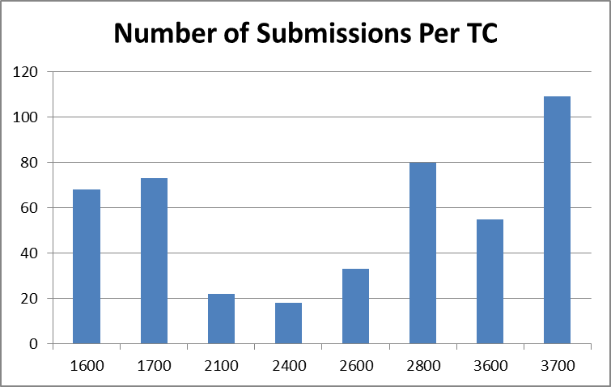
Third Party Submission
(Sept 16, 2012- Feb 22, 2013)
Total 3rd Party Submissions | 466

Slide 7
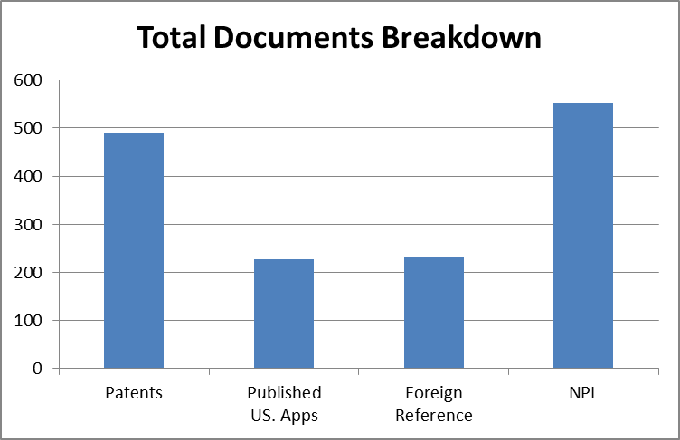
Third Party Submission
(Sept 16, 2012- Feb 22, 2013)
Total Documents
Patents | 490
Published US Apps | 228
Foreign Reference | 230
Non-Patent Literature (NPL) | 552
Total Documents | 1500

Slide 8
Supplemental Examination
(Sept 16, 2012- Feb 15, 2013)
7 supplemental examination requests have received filing dates
Supplemental Examination Completed: 2
Reexamination Ordered: 1
Reexamination Not Ordered: 1
Supplemental Examination in Progress: 5

Slide 9
Reexamination Practice
Inter partes reexamination was modified and eventually phased out on 09/16/12 by AIA
Inter Partes Review replaces inter partes reexamination, but there will be overlap
Increased filings of Inter Partes Reexamination filings and Ex Parte Reexamination Filings were received in August and September 2012 (> 600)

Slide 10
Trial Rules
Umbrella Trial Rules
§§ 42.1 – 42.80
Inter Partes Review
§§ 42.100 – 42.123
Post-Grant Review
§§ 42.200 – 42.224
Covered Business Method (CBM) Patent Review
§§ 42.300 – 42.304
Derivation Proceeding
Proposed §§ 42.400 – 42.412

Slide 11
PTAB Inter Partes and CBM Filings (Sept 17, 2012-Feb 20, 2013)
140
155

Slide 12
Technology Breakdowns of AIA Petitions as of Feb 20, 2013
Technology | Number of Petitions | Percentage
Electrical/ Computer | 112 | 72.3%
Mechanical | 8 | 5.2%
Chemical | 23 | 14.8%
Bio/Pharma | 11 | 7.1%
Design | 1 | 0.6%

Slide 13
Members of the Board as of Feb 20, 2013
Currently 168 members

Slide 14
Satellite Office Program
Terminal Annex Federal Building
Temporary Space opening soon
Byron G. Rogers Building
Temporary space in Lakewood
Opened in July
62 patent examiners
11 patent law judges
Michelle Lee new director
Zeroing in on appropriate location

Slide 15
First Inventor to File (FITF)
Effective Date: March 16, 2013
Publication of final rules and Guidance on February 14, 2013:
Changes to Implement the First Inventor to File Provisions of the Leahy-Smith America Invents Act, 78 Fed. Reg. 11024
Examination Guidelines for Implementing the First-Inventor-to-File Provisions of the Leahy-Smith America Invents Act , 78 Fed. Reg. 11059
USPTO Hosting Public Forum on March 15, 2013 on the Alexandria Campus to discuss final rules and guidance

Slide 16
Fee Setting
Effective March 19, 2013
Final rule published January 18, 2013:
Setting and Adjusting Patent Fees, 78 Fed. Reg. 4212
Ensure the patent fee schedule generates sufficient aggregate revenue to recover the aggregate cost of USPTO operations to achieve two significant USPTO Goals:
Optimize patent timeliness and quality; and
Implement a sustainable funding model for operations

Slide 17
Fee Setting
Set individual fees to further key policy considerations:
Encourage innovation and ease of access to patent system;
Facilitate effective administration of the patent system and help reduce pendency; and
Increase patent patent prosecution options to applicants

Slide 18
Micro Entity Status for Paying Patent Fees
Effective March 19, 2013
Publication of final rules December 19, 2012:
Changes to Implement Micro Entity Status for Paying Patent Fees, 77 Fed. Reg. 75019
Entitled to a 75% discount on fees for “filing, searching, examining, issuing, appealing, and maintaining” patent applications/patents

Slide 19
AIA Help
1-855-HELP-AIA (1-855-435-7242)
HELPAIA@uspto.gov
www.uspto.gov/AmericaInventsAct

Slide 20
Unexamined Patent Application Backlog FY 2009 – FY 2013
595,167 Unexamined Applications as of February 19, 2013.
End of Fiscal Year 2012 backlog was 608,283.
20
Notes:
20

Slide 21
First Action Pendency and Total Pendency FY 2009 – FY 2013
Total Pendency as of January 31, 2013: 31.4 months.
First Action Pendency as of January 31, 2013: 19.2 months.
FY 2013 Targets:
Average First Action Pendency: 18.0 months.
Average Total Pendency: 30.1 Months.

Slide 22
Total Serialized and Request for Continued Examination (RCE) Filings FY 2002 – FY 2013
203,936 as of February 19, 2013.

Slide 23
RCE Backlog FY 2010 – FY 2013
111,435 as of February 19, 2013.
End of Fiscal Year RCE backlog was 95,200.
Notes:
23

Slide 24
Request for Stakeholder Input
Request for Comments on Request for Continued Examination (RCE) Practice
Soliciting feedback to better understand factors that impact the decision to file an RCE
Call for comments in response to questions
Deadline for written comments extended to March 11, 2013
Feedback
Submission of written comments
IdeaScale® web-based collaboration tool
Roundtables
http://www.uspto.gov/patents/init_events/rce_outreach.jsp

Slide 25
Request for Stakeholder Input
Request for Comments on Matters Related to the Harmonization of Substantive Patent Law
Seeking input on certain matters relating to international harmonization of substantive patent law, including:
The grace period
Publication of applications
The treatment of conflicting applications
Prior User Rights
USPTO Hosting Public Hearing on March 21, 2013 on the Alexandria Campus
Requests to present oral testimony and written comments were due February 28, 2013

Slide 26
Request for Stakeholder Input
Request for Comments on Preparation of Patent Applications
Seeking input on practices that may be employed by applicants while preparing and drafting applications
Written comments due March 15, 2013
Request for Comments and Notice of Roundtable Events for Partnership for Enhancement of Quality of Software-Related Patents
Forming a partnership with and engaging the software community to enhance quality in software-related inventions
Two Roundtable Events Held: Silicon Valley (2/12/13) and New York City (2/27/13)
Written comments due March 15, 2013

Slide 27
Thank You

