Slide 1
Software Partnership Meeting: Functional Claiming and Clarity of the Record
July 22, 2014 in Alexandria, VA

Slide 2
Welcome
Janet Gongola
Senior Advisor and Moderator

Slide 3
Agenda
Time | Topic
1:05 PM | Opening Remarks, Deputy Director Michelle Lee
1:20 PM | Presentation on Clarity, Judge Paul R. Michel
1:35 PM | Functional Claiming Training, Drew Hirshfeld, Deputy Commissioner for Patent Examination Policy; Greg Vidovich, TC Director 3600; and Derris Banks, TC Director 2600
2:40 PM | BREAK
3:00 PM | Stakeholder Presentations
3:50 PM | Open Discussion, Wendy Garber, TC Director 2100, and Dave Wiley, TC Director 2600
4:30 PM | Alice Corp. Preliminary Examination Instructions, Drew Hirshfeld
4:55 PM | Closing

Slide 4
Materials
Available at:
http://www.uspto.gov/patents/init_events/software_partnership.jsp

Slide 5
Opening Remarks
Michelle Lee
Deputy Under Secretary of Commerce and Deputy Director of the USPTO

Slide 6
Presentation on Clarity
Judge Paul R. Michel

Slide 7
Training on Functional Claiming
Drew Hirshfeld, Deputy Commissioner for Patent Examination Policy
Derris Banks, Director, Technology Center 2600
Greg Vidovich, Director, Technology Center 3600

Slide 8
Importance of Claim Clarity
Key component to enhancing the quality of patents and raising confidence in the patent system
The Office’s efforts include focus on:
  Ensuring that the boundaries of the claim are easily understood; and
  Providing a clear record of prosecution

Slide 9
Supplemental 112 Examination Guidelines
Comprehensive Guidelines were issued in January 2011:
  Examination of claims for compliance with
  § 112, 2nd paragraph (now § 112(b))
  Examination of claims that contain functional language under § 112,
  6th paragraph (now § 112(f))
Notes:
In 2011, the Office issued Supplemental Guidelines on 112 to emphasize the importance of clarity and to remind examiners that 112 is a powerful tool during prosecution to ensure that claims have clearly defined boundaries before they issue.

Slide 10
Previous Partnership Meetings
February 2013: (Silicon Valley and New York City)
  Public offered input on enhancing the quality of software-related patents
  Public expressed desire for more training on § 112 issues, including functional claim language

Slide 11
Previous Partnership Meetings
October 2013 (Berkeley, CA)
  Tightening functional claiming and improving claim clarity by exploring feasibility of using glossaries in patent applications
December 2013 (Alexandria, VA)
  Prior art resources used by examiners and received input on additional prior art resources and search techniques
April 2014 (Alexandria, VA)
  Use of crowdsourcing to uncover prior art

Slide 12
Executive Action 2:
Claim Clarity (June 4, 2013)
Executive Action 2 relates to developing strategies to improve claim clarity
  Use of glossaries in patent applications
  Targeted examiner training on scrutiny of functional claiming

Slide 13
Targeted Training on Functional Claiming
USPTO has developed an extensive,
multi-phased training program for all examiners focused on evaluating functional claims and improving examination consistency and the clarity of the examination record

Slide 14
Recently Completed Examiner Training
Four, 1-hour examiner training modules:
  Module 1: Identifying § 112(f) limitations
    Recognizing § 112(f) limitations that do not use classic “means for” phrasing
    Interpreting “generic placeholders” that serve as substitutes for means (e.g., unit, mechanism)
  Module 2: Clarifying the record to place remarks in the file regarding when § 112(f) is, or is not, invoked
    Establishing presumptions based on use of “means”
    Providing explanatory remarks when presumptions are rebutted
Notes:
The first two training modules that were delivered last year are:
Identifying § 112(f) limitations, which corresponds to the first theme of cases I discussed earlier. This training was directed to recognizing § 112(f) limitations that do not use classic “means for” phrasing and how to interpret “generic placeholders” that serve as substitutes for means (e.g., unit, mechanism).
The second module is directed to clarifying the record by placing remarks in the file regarding when § 112(f) is, or is not, invoked. This includes establishing the presumptions on the record based on use of “means” and providing explanatory remarks when the presumptions are rebutted.
Example of the presumptions form paragraph:
¶ 7.30.04 Use of “Means” (or “Step for”) in Claim Drafting and Rebuttable Presumptions Raised
Use of the word “means” (or “step for”) in a claim with functional language creates a rebuttable presumption that the claim element is to be treated in accordance with 35 U.S.C. § 112(f) (pre-AIA 35 U.S.C. 112, sixth paragraph). The presumption that § 112(f) (pre-AIA § 112, sixth paragraph) is invoked is rebutted when the function is recited with sufficient structure, material, or acts within the claim itself to entirely perform the recited function.
Absence of the word “means” (or “step for”) in a claim creates a rebuttable presumption that the claim element is not to be treated in accordance with 35 U.S.C. § 112(f) (pre-AIA 35 U.S.C. 112, sixth paragraph). The presumption that § 112(f) (pre-AIA § 112, sixth paragraph) is not invoked is rebutted when the claim element recites function but fails to recite sufficiently definite structure, material or acts to perform that function.
Claim elements in this application that use the word “means” (or “step for”) are presumed to invoke § 112(f) except as otherwise indicated in an Office action. Similarly, claim elements that do not use the word “means” (or “step for”) are presumed not to invoke § 112(f) except as otherwise indicated in an Office action.

Slide 15
Recently Completed Examiner Training
Module 3: Interpretation and definiteness of 35 U.S.C. § 112(f) limitations
  How to interpret § 112(f) limitations under the broadest reasonable interpretation (BRI) standard
  Evaluating equivalents
  Determining whether a § 112(f) limitation is definite under
  § 112(b)
Module 4: Computer-implemented (software)
§ 112(f) limitations
  Determining whether a sufficient algorithm is provided to support a software function
Notes:
The next module focused on § 112(f) and addresses how to interpret § 112(f) limitations under the broadest reasonable interpretation (BRI) standard, evaluating equivalents, and determining whether a § 112(f) limitation is definite under § 112(b).
The final 112(f) module focused on computer-implemented (or software) § 112(f) limitations. It deals specifically with determining whether a sufficient algorithm is provided to support a software function.

Slide 16
Module 1: Identifying Limitations that Invoke § 112(f)
Overview of § 112(f) for means-type claims
  Intended to reinforce the 2011 § 112 Supplemental Guidelines and training, especially with respect to boundaries for functional claim language
  Motivated by public concerns over claim clarity
  Critical for examination under the Broadest Reasonable Interpretation (BRI) standard
Notes:
Next I am going to do a tasting menu of the training modules to give you a flavor of what the examiners received. These are selected slides, in some cases slightly revised to make sense in this context, of the modules available on our website. Please review the original slides and CBTs for the full effect. I have not included the review slides or the specific examples that are discussed in the modules.
The first module is directed to identifying limitations that invoke 112(f). This module is an overview of 112(f) for Means-type Claims. It is intended to reinforce the 2011 § 112 Supplemental Guidelines and training, especially with respect to boundaries for functional claim language. This training is motivated by public concerns over claim clarity and is critical for examination under the Broadest Reasonable Interpretation (BRI) standard.

Slide 17
Module 1: Identifying Limitations that Invoke § 112(f)
3-prong analysis for means-type claim limitation as set forth in MPEP 2181(I):
The claim limitation uses the phrase “means” or a term used as a substitute for “means” that is a generic placeholder;
The phrase “means” or the substitute term is modified by functional language, typically linked by the transition word “for” (e.g., “means for”) or another linking word; and
The phrase “means” or the substitute term is not modified by sufficient structure or material for performing the claimed function
Notes:
In this module, the 3 prong analysis for identifying means-type claims is reviewed from MPEP 2181(I).
A claim limitation should be interpreted according to 112(f) if it meets the following 3-Prong analysis:
the claim limitation uses the phrase “means” or a term used as a substitute for “means” that is a generic placeholder;
the phrase “means” or the substitute term is modified by functional language, typically linked by the transition word “for” or another linking word; and
the phrase “means” or the substitute term is not modified by sufficient structure or material for performing the claimed function.
For a term to be considered a substitute for “means”, and lack sufficient structure for performing the function, it must be a generic placeholder and not limit the scope of the claim to any specific manner/structure for performing the claimed function. It is important to remember that there are no absolutes in the determination of terms used as a substitute for “means” that serve as generic placeholders. The examiner must carefully consider the term in light of the specification and the commonly accepted meaning in the technology. Every application will turn on its own facts.
Failure to meet the 3-prong analysis simply means that the claim limitation will not be interpreted under 112(f) as a means-plus-function limitation.

Slide 18
Module 1: Identifying Limitations that Invoke § 112(f)
112(f) presumptions:
  The term “means” with functional language raises a rebuttable presumption that the claim element is to be treated under § 112(f)
    Rebutted when the function is recited with sufficient structure or material within the claim itself to entirely perform the recited function
  Absence of the term “means” with functional language raises a rebuttable presumption that the claim element is not to be treated under § 112(f)
    Rebutted when claim element (1) recites a generic placeholder for structure or material; (2) recites a function; and (3) does not recite sufficient structure or material to perform the function
Notes:
This module also explains the rebuttable presumptions associated with 112(f).
There are two rebuttable presumptions under section 112(f). The first rebuttable presumption is raised when a claim element uses the term “means” with functional language. The presumption is that the claim element is to be treated under section 112(f). The presumption is rebutted when the function is recited along with sufficient structure or material within the claim itself to entirely perform the recited function. In that case, section 112(f) is not invoked due to the presence of structure that performs that function in the claim element.
The second presumption arises when there is functional language and “means” is not used, and the presumption is that the claim language is not to be treated under section 112(f). The presumption is rebutted when the claim element (1) recites a generic placeholder for structure or material; (2) recites a function; and (3) does not recite sufficient structure or material to perform the function. Saying it another way, section 112(f) is invoked when a word that serves as a generic placeholder is substituted for means in a claim element.
It is important to remember that section 112(f) is a claiming technique for functional limitations. It is evaluated on an element-by-element basis. When invoked, a structure, material or act can be recited as a purely functional claim element. The structure, material or act corresponding to the function is provided in the specification instead. Accordingly, it is only suitable to use 112(f) when the claim element is drawn to structure, material or an act. So, when “means” is not used, a generic term that overcomes the presumption that 112(f) is not invoked must be a placeholder for structure or material. Terms that represent only non-structural elements that are directed to things such as information, data, instructions, and software per se cannot serve as a substitute for “means” and would not be suitable for use with 112(f). In cases where it is unclear whether 112(f) is invoked, it would be appropriate to reject the claim under 112(b) as being indefinite.
For handling purely functional limitations that neither recite structure nor invoke section 112(f), see MPEP 2173.05(g), 2111.05, 2114 and 2161.01. Purely functional limitations often raise issues of clear boundaries under section 112(b) and adequacy of the written description and scope of enablement under section 112(a).
Terms that represent only non-structural elements such as information, data, instructions, and software per se would not serve as substitutes for “means”, because the terms do not serve as placeholders for structure or material.

Slide 19
Module 2: Making the Record Clear
Benefits of a clear prosecution record
  Clarifies the record with regard to the broadest reasonable interpretation for the claim limitations
  Places the Applicant on notice with regard to the Office’s position, thus enabling a more effective Applicant response
  Assists in the evaluation of any afforded patent protection throughout the life of the patent
Notes:
The next training module is directed to making the record clear. It outlines the benefits of a clear prosecution record, which are:
Clarifies the record with regard to the broadest reasonable interpretation for the claim limitations
Places the Applicant on notice with regard to the Office’s position enabling a more effective Applicant response
Assists in the evaluation of any afforded patent protection throughout the life of the patent

Slide 20
Module 2: Making the Record Clear
When an application contains claim limitations in the form of a term modified by functional language, note the 112(f) presumptions by use of FP 7.30.04
FP 7.30.04 recites in part:
  “…Claim elements that use the word “means” are presumed to invoke 112(f) except as otherwise indicated in the Office Action. Similarly, claim elements that do not use the word “means” are presumed not to invoke 112(f) except as otherwise indicated in an Office Action.”
Notes:
This module provides the examiner with a tool in the form of a form paragraph to easily establish the presumptions on the record.
Use of the term “means” in a claim raises a rebuttable presumption that 112(f) is invoked, while lack of the term “means” in a claim raises a rebuttable presumption that 112(f) is not invoked. These presumptions should be noted when a claim limitation is expressed in the form of a term modified by functional language. In order to alleviate the need for the examiner to individually note in the Office Action every occurrence of a term modified by functional language present in the claims, the 112(f) presumptions should be placed in the record using FP 7.30.04.
FP 7.30.04 recites in part: “…Claim elements that use the word “means” are presumed to invoke 112(f) except as otherwise indicated in the Office Action. Similarly, claim elements that do not use the word “means” are presumed not to invoke 112(f) except as otherwise indicated in an Office Action.”
The examiner is still required to complete the 3-prong Analysis for each occurrence of a term modified by functional language and determine if 112(f) is invoked. However, the examiner will only be required to explain those instances in which the presumptions are overcome. As such, FP 7.30.04 should be followed by a discussion of any specific instances that overcome the noted presumptions when necessary.

Slide 21
Module 2: Making the Record Clear
In addition to the use of FP 7.30.04, the prosecution record should be clarified when the presumptions are overcome, such as when:
  a claim uses the word “means” and 112(f) is not invoked
    Not modified by functional language
    Includes sufficient structure or material for achieving the specified function
  a claim uses a generic placeholder instead of the word “means” and 112(f) is invoked
Notes:
In addition to the use of FP 7.30.04, the prosecution record should be clarified when the presumptions are overcome, such as when a claim uses the word “means” and 112(f) is not invoked. Those may be instances when “means” is not modified by functional language, or when the phrase includes sufficient structure or material for achieving the specified function. Clarification should also be made when a claim uses a generic placeholder instead of the word “means” and 112(f) is invoked. For example, “unit for” performing a function.

Slide 22
Module 2: Making the Record Clear
After completing the 3-prong analysis for all recitations of a term modified by functional language, make your determinations clear in the record:
  Use FP 7.30.04, once during prosecution, whenever a term modified by functional language is present in the claims to note 112(f) presumptions in the record
  Specifically identify claim language that uses the word “means” and 112(f) is not invoked with explanation
    Not modified by functional language
    Includes sufficient structure to perform the associated function
  Specifically identify claim language that uses a generic placeholder for the word “means” and 112(f) is invoked
Notes:
After completing the 3-prong analysis for all recitations of a term modified by functional language, make your determinations clear in the record. Use FP 7.30.04, once during prosecution, when a term and associated function language is present in the claims or is introduced into the claims to note the presumptions in the record. Then, when appropriate, specifically identify claim language that uses the word “means” and 112(f) is not invoked with an explanation, such as the term is not modified by functional language and/or the limitation includes sufficient structure or material to perform the associated function. Additionally, when appropriate, specifically identify any claim language that uses a generic placeholder as a substitute for the word “means” and 112(f) is invoked.

Slide 23
Module 3: BRI and Definiteness of
§ 112(f) Limitations
  Ensuring that a claim limitation that invokes
  35 U.S.C. § 112(f) is properly interpreted
    Statutorily authorized claiming technique
    (“means-(or step-)plus-function” limitations)
      Invoking § 112(f) permits an applicant to claim an element using purely functional language, but the interpretation is limited to the description in the specification and equivalents
  Ensuring that a § 112(f) limitation is definite and making a § 112(b) rejection when appropriate
Notes:
The third module is directed to interpreting 112(f) limitations under the broadest reasonable interpretation standard (BRI).
The goal of this training module is to assist examiners in ensuring that functional claim limitations that invoke section 112(f) are properly interpreted.
These limitations are often called “means-(or step-)plus-function” limitations. 35 U.S.C. § 112 lists requirements for the specification of a patent application, including that the specification shall conclude with one or more claims. Section 112(f), also known as the sixth paragraph pre-AIA, is directed to the use of functional language for elements in a claim to a combination. It is invoked on an element-by-element basis.
It is a statutorily authorized claiming technique that permits an applicant to recite a claim limitation in purely functional language provided that certain conditions are met. Those conditions require that the structure, material, or act that performs the function be described in the specification. When a claim recites a limitation in accordance with section 112(f), there are special considerations that control the broadest reasonable interpretation of that limitation. In particular, the interpretation is limited to what is described in the specification and equivalents.
Another goal of this training is to ensure that a section 112(f) limitation is definite and that the boundaries of the limitation are clear. The training will address how to evaluate whether the boundaries are clear and how to make an indefiniteness rejection when appropriate.

Slide 24
Module 3: BRI and Definiteness of
§ 112(f) Limitations
  Typically, under the BRI, the claim language is construed in accordance with its plain meaning in light of the specification as it would be understood by one of ordinary skill in the art
    The specification is used to interpret the meaning of the claim terms - not to implicitly add limitations that do not have express basis in the claim
    A claim would not be limited to the preferred embodiment unless those limitations are positively recited in the claim
Notes:
All claims under examination are given the Broadest Reasonable Interpretation (called the BRI for short).
The reason claims are given the BRI is that applicant has the opportunity to clarify and refine the claims during prosecution so reading the claims broadly during examination will ensure that the issued claims cover the appropriate scope. Using the BRI during examination when claims can be amended will reduce the possibility that the claim, once issued, will be interpreted more broadly than is justified in view of the prior art.
It is helpful for examiners to provide explanation of their BRI on the record and how the prior art reads on the BRI of the claim. This will assist the applicant in making an effective response to a rejection. Such explanation may also be used later to inform the public as to the scope of the claim and to assist in post-grant and court proceedings. In fact, courts regularly review the prosecution record to determine the proper interpretation of the claim. In the case of section 112(f) limitations, the court will look to the record to determine if the presumptions relating to invocation of section 112(f) have been rebutted.
It is especially important to state whether a claim limitation is being interpreted under section 112(f) because the BRI will be limited to the structure described in the specification and its equivalents, and a decision on the allowability of the claim will be made in view of that limited range of prior art. If there is no indication by the examiner that the claim was examined based on a narrow interpretation, the applicant may believe that the claim is entitled to a much broader scope of coverage than the examiner believed. The subsequent patent owner may then assert the patent claim more broadly than is justified in view of the prior art. By clarifying the record, the examiner and the applicant, and later the patent owner, can have a meeting of the minds.
For claims that do not include section 112(f) limitations, typically under the BRI, the claim language is construed in accordance with its plain meaning in light of the specification as it would be understood by one of ordinary skill in the art. The specification is used only to interpret the meaning of the claim terms in the same manner as they would be interpreted by one of ordinary skill in the art. The specification is not used to implicitly add limitations that do not have express basis in the claim. For example, a claim would not be limited to the preferred embodiment unless the limitations of the preferred embodiment are positively recited in the claim.

Slide 25
Module 3: BRI and Definiteness of
§ 112(f) Limitations
  35 U.S.C. 112(f) imposes limits on the BRI
    BRI under § 112(f) is restricted to the corresponding structure, material, or acts described in the specification and equivalents thereof
      § 112(f) is a claiming technique that allows applicants to use purely functional terms in their claims in exchange for relying on the structure, material or act that performs the function described in the supporting specification
Notes:
In contrast, for claims that use section 112(f) limitations, 35 U.S.C. 112(f) imposes limits on the BRI. The BRI is restricted to the corresponding structure, material, or acts described in the specification and equivalents thereof. So, means-plus-function limitations are required to be interpreted more narrowly.
The reason for this narrow interpretation is that section 112(f) is a claiming technique that allows applicants to recite limitations using purely functional terms. In exchange for the ability to use purely functional terms in the claim, the specification must recite the structure, material or act that performs the function. By this, the functional limitation is provided with clear boundaries – those boundaries are imposed by what is described in the specification.

Slide 26
Module 3: BRI and Definiteness of
§ 112(f) Limitations
  What qualifies as “corresponding” structure or material?
    The structure or material that is described in the specification as performing the recited function
      The statute identifies the “specification” – this is interpreted to mean the written description, including the drawings.
      This is also called the corresponding “disclosure,” meaning the description in the specification
    Adequate disclosure in the specification is required for the claim to be definite under § 112(b) because the specification forms part of the § 112(f) claim limitation
Notes:
What qualifies as “corresponding” structure or material? It is the structure or material for “means-type” limitations that is described in the specification as performing the recited function. The statute identifies the specification as providing the corresponding disclosure. This is interpreted to mean the written description, including the drawings. So the corresponding structure could be appropriately described in a figure or in the written description.
The corresponding structure must be disclosed in a way that one skilled in the art will understand what specific structure or material the inventor has identified to perform the recited function.
Adequate disclosure in the specification is required for the claim to be definite because the specification actually forms part of the claim under section 112(f).

Slide 27
Module 3: BRI and Definiteness of
§ 112(f) Limitations
  Result of an inadequate corresponding disclosure for § 112(f) limitation:
    The claim limitation becomes an unbounded purely functional limitation
      No limits imposed by structure, material or acts
      Covers all ways of performing a function, both known and unknown
  Indefinite under 35 U.S.C. 112(b) (second paragraph, pre-AIA) because claim boundaries are unknown
Notes:
If it determined that the corresponding disclosure is inadequate, the claim is indefinite and should be rejected under 35 U.S.C. section 112(b) or second paragraph, pre-AIA.
The reason that the claim is indefinite is that without a limiting specification, which is required by statute, the claim limitation becomes an unbounded purely functional limitation. When there are no boundaries or limits imposed by structure, material or acts, the claim will cover all ways of performing a function, known and unknown.
Therefore, such an unbounded limitation renders the claim indefinite, and the claim should be rejected under 35 U.S.C. section 112(b) or second paragraph (pre-AIA).

Slide 28
Module 3: BRI and Definiteness of
§ 112(f) Limitations
A claim including a means-plus-function element must be rejected as indefinite under § 112(b) when:
§ 112(f) has been invoked, and there is no disclosure of corresponding structure that performs the claimed function;
§ 112(f) has been invoked, and the corresponding structure is insufficient to perform the claimed function;

Slide 29
Module 3: BRI and Definiteness of
§ 112(f) Limitations
A claim including a means-plus-function element must be rejected as indefinite under § 112(b) when:
§ 112(f) has been invoked, and there is no clear linkage disclosed between the corresponding structure and the claimed function; or
It is unclear whether § 112(f) is being invoked.

Slide 30
Module 3: BRI and Definiteness of
§ 112(f) Limitations
Provide reasons to support an indefiniteness rejection
    Make the written record clear as to the specific deficiencies, based on reasons A, B, C, or D (prior slides)
    Will provide the applicant an opportunity to directly address the issues
Provide an explanation on the record regarding claim construction when needed to assist in clarifying position
    Identify on the record the corresponding structure for a § 112(f) limitation
Notes:
Examiners are instructed to provide reasons to support the indefiniteness rejection. Reasons will make the written record clear as to the specific deficiencies and provide the applicant an opportunity to directly address the issues. It is also recommended to provide an explanation regarding claim construction on the record when needed to assist in clarifying position. For example, the corresponding structure for a § 112(f) limitation should be identified when there is any ambiguity.

Slide 31
Module 3: BRI and Definiteness of
§ 112(f) Limitations
  A showing by applicant that one of ordinary skill in the art could find a way to perform the function of a § 112(f) limitation does not satisfy the § 112(b) requirement for disclosure of corresponding structure
    The purpose of § 112(f) is to ensure that the supporting disclosure imposes boundaries on the purely functional language used in a means-plus-function claim limitation
    An appropriate response to a rejection under § 112(b) would be to:
      Identify the structure described in the specification that performs the claimed function, or
      Amend the claim to recite the structure that performs the function if possible, thus not invoking § 112(f)
Notes:
The training also addresses the applicant’s response.
Because section 112(f) requires that the structure, material or act be described in the corresponding disclosure, merely showing or arguing that one of ordinary skill in the art could find a way to perform the function of a section 112(f) limitation does not satisfy section 112(b). This is because without explicit identification in the specification of the corresponding structure, the boundaries of the section 112(f) functional limitation are undefined. Thus, the claim must be found indefinite under section 112(b). This is the quid pro quo of section 112(f) in which applicants are permitted to use claim limitations written in purely functional language in exchange for disclosure of the structure that performs the function in the specification.
In response to a rejection under § 112(b), an applicant may identify the structure described in the specification that performs the claimed function, or amend the claim to recite the structure that performs the function if possible, thus not invoking § 112(f), or otherwise amend the claim to avoid invoking section 112(f).

Slide 32
Module 3: BRI and Definiteness of
§ 112(f) Limitations
  Equivalents - An equivalent must perform the identical function specified in the claim
  Applicant is not required to explain the full range of equivalents
    However, if applicant chooses to specify equivalents, the BRI will be limited to those specified
  Equivalence is determined based on what one of ordinary skill in the art would consider a functional equivalent to the structure(s) described in the specification as performing the claimed function

Slide 33
Module 3: BRI and Definiteness of
§ 112(f) Limitations
  If equivalents are not defined, the range of functional equivalents in the prior art can be identified using any one of these factors:
    The prior art element performs the identical function specified in the claim in substantially the same way, and produces substantially the same results as the corresponding element disclosed in the specification;
    A person of ordinary skill in the art would have recognized the interchangeability of the element shown in the prior art for the corresponding element disclosed in the specification; or
    There are insubstantial differences between the prior art element and the corresponding element disclosed in the specification

Slide 34
Module 4: Evaluating § 112(f) Limitations in Software-Related Claims for Definiteness
  Goal: Ensuring that software-implemented
  § 112(f) functional claim limitations (means-plus-function) have definite boundaries under § 112(b)
  Topics:
    Review of invocation of § 112(f) and evaluating definiteness of a § 112(f) limitation
    Handling common types of software-related claims, including programmed computer functions
    Clarifying the record, including identifying whether § 112(f) computer-related limitations have clear boundaries
Notes:
The last module is focused on software type limitations that invoke 112(f).
The topics cover:
Review of invocation of § 112(f) and evaluating definiteness of a § 112(f) limitation
Handling common types of software-related claims, including programmed computer functions
Clarifying the record, including identifying whether § 112(f) computer-related limitations have clear boundaries

Slide 35
Module 4: Evaluating § 112(f) Limitations in Software-Related Claims for Definiteness
Programmed computer functions require a computer programmed with an “algorithm” to perform the function
  An algorithm is a step-by-step procedure for accomplishing a given result
  Can be expressed in various ways “in any understandable terms including as a mathematical formula, in prose or as a flow chart, or in any other manner that provides sufficient structure” (Finisar)
  Amount of disclosure of an algorithm is analyzed on a case-by-case basis
Notes:
Programmed computer functions require a computer programmed with an “algorithm” to perform the function. In the context of programmed functions, an algorithm is a step-by-step procedure for accomplishing a given result. An algorithm may be expressed in various ways, provided the description sets forth a sufficient step-by-step procedure for accomplishing the result.
The adequacy and amount of disclosure required of the algorithm should be evaluated on a case-by-case basis. The amount of detail required depends on the subject matter in view of the existing knowledge in the field. The specification can express the algorithm in any understandable terms including mathematical formulas, prose or as flow charts, for example. [Finisar Corp. v. DirecTV Group Inc., 86 USPQ2d 1609, 1623, (Fed. Cir. 2008)] Any manner of disclosure that provides a sufficient explanation of how the function is accomplished is acceptable “structure.”
It is important to remember that the disclosure must identify the way the inventor performs the function, whether or not a skilled artisan might otherwise be able to glean another way from other sources or his or her own understanding. The reason that disclosure of the specific algorithm is required is precisely because various ways might exist to perform the function. The quid pro quo of 112f is that the applicant is permitted to recite claim limitations using purely functional terms provided that the supporting specification specifically identifies the structure (including an algorithm for specialized functions) that performs the claimed function. When using section 112(f) claiming, the public is entitled to know which way of performing the function is covered by the patent claims.
If it is determined that the algorithm is missing or insufficient, reasons should be placed on the record as to the specific deficiency. For example, the Office action can state “the specialized function of x requires disclosure of an algorithm, but the specification does not describe any procedure for performing function x.”

Slide 36
Module 4: Evaluating § 112(f) Limitations in Software-Related Claims for Definiteness
Two types of computer-implemented functions:
  Specialized functions: functions other than those commonly known in the art, often described by courts as requiring “special programming” for a general purpose computer or computer component to perform the function
    Ex. means for matching incoming orders with inventory on a pro rata basis
  Non-specialized functions: functions known by those of ordinary skill in the art as being commonly performed by a general purpose computer or computer component
    Ex. means for storing data
Notes:
Computer-implemented functions fall into two general types: The first type are specialized functions. These are functions other than those commonly known in the art. Courts often describe these functions as requiring “special programming” in order for a general purpose computer or computer component to perform the function. An example of a specialized function is a “means for matching incoming orders with inventory on a pro rata basis.” Special programming is typically described as the algorithm by which the computer operates. [Example derived from Chicago Board Options Exchange v. Int. Securities Exchange (Fed. Cir. 2014)]
The second type are non-specialized functions. Those are functions known by those of ordinary skill in the art as being commonly performed by a general purpose computer or computer component. An example of a non-specialized function is a “means for storing data.”
It is critical to focus on the entire claimed function when evaluating whether the function is specialized or non-specialized. More detailed functions are usually specialized.
Next we will look at what level of disclosure of supporting structure is required for each type of function.

Slide 37
Module 4: Evaluating § 112(f) Limitations in Software-Related Claims for Definiteness
The corresponding structure in the specification that supports a § 112(f) limitation that recites a specialized function is:
A general purpose computer or computer component along with the algorithm that the computer uses to perform the claimed specialized function
  The disclosure requirement under § 112(f) is not satisfied by stating that one of ordinary skill in the art could devise an algorithm to perform the specialized programmed function
Notes:
The corresponding structure in the specification that supports a § 112(f) limitation that recites a specialized function is a general purpose computer or computer component along with the algorithm that the computer uses to perform the claimed specialized function. Looking back to the example of the specialized function, sufficient supporting structure for a “means for matching incoming orders with inventory on a pro rata basis” would be a processor and the algorithm by which the processor performed the matching function. A bare disclosure of a general purpose computer would not be sufficient because such a basic processing device would require special programming in order to accomplish the matching function.
It is important to note that the disclosure requirement under § 112(f) is not satisfied by a statement by applicant that one of ordinary skill in the art could devise an algorithm to perform the specialized programmed function.

Slide 38
Module 4: Evaluating § 112(f) Limitations in Software-Related Claims for Definiteness
A specialized function must be supported in the specification by the computer or computer component and the algorithm that the computer uses to perform the claimed specialized function
  The default rule for § 112(f) programmed computer claim limitations is to require disclosure of an algorithm when special programming is needed to perform the claimed function
  Disclosure of the step by step procedure for specialized functions establishes clear, definite boundaries and notifies the public of the claim scope
  “Claiming a processor to perform a specialized function without disclosing the internal structure of the processor in the form of an algorithm, results in claims that exhibit the ‘overbreadth inherent in open-ended functional claims’” (Halliburton Energy Services (emphasis added))
Notes:
A specialized function must be supported in the specification by the computer and the algorithm that the computer uses to perform the claimed specialized function. The default rule for § 112(f) programmed computer claim limitations is to require disclosure of an algorithm when special programming is needed to perform the claimed function. The reason that this is the default rule is that disclosure of the step by step procedure for specialized functions establishes clear, definite boundaries and notifies the public of the claim scope. “Claiming a processor to perform a specialized function without disclosing the internal structure of the processor in the form of an algorithm, results in claims that exhibit the ‘overbreadth inherent in open-ended functional claims’” Halliburton Energy Services v. M-I LLC, 514 F.3d 1244, 1256 n.7 (Fed. Cir. 2008). Disclosing the algorithm for a specialized function is the quid pro quo for the ability to claim an element in purely functional terms.

Slide 39
Module 4: Evaluating § 112(f) Limitations in Software-Related Claims for Definiteness
A non-specialized computer function can be adequately supported in the specification by a general purpose computer or a known computer component only
  Applies to functions that can be accomplished by any general purpose computer without special programming
  It is only in rare circumstances that an algorithm need not be disclosed
  In those situations, make the record clear, if necessary, that the function is a non-specialized function and therefore no disclosure of an algorithm is required
  Note that a known prior art device (any general purpose computer) that performs the claimed function would anticipate the limitation
Notes:
A non-specialized computer function can be adequately supported in the specification by a general purpose computer only. This applies to functions that can be accomplished by any general purpose computer without special programming. It is only in rare circumstances that an algorithm need not be disclosed. In those situations, the Office action should make the record clear, if necessary, that the function is a non-specialized function and therefore no disclosure of an algorithm is required. In those situations, known prior art devices (any general purpose computer) that perform the claimed function would anticipate the limitation.
There is no bright line rule for identifying a non-specialized function. As always, the claim must be interpreted in light of the specification as it would be interpreted by one of ordinary skill in the art at the time of the invention. Thus, if the examiner has any doubt as to whether a general purpose computer without any special programming can perform the function, an algorithm should be required. If the applicant persuasively responds with evidence that the function is a non-specialized function, the algorithm requirement can be withdrawn and a general purpose computer can be applied to meet the limitation.

Slide 40
Module 4: Evaluating § 112(f) Limitations in Software-Related Claims for Definiteness
The corresponding structure in the specification that supports a § 112(f) limitation that recites a
non-specialized function is:
A general purpose computer or a known computer component that is recognized by those of ordinary skill in the art as typically including structure and basic programming, if needed, to perform the claimed function
No disclosure of a specific algorithm is required
  Sufficient supporting structure for a “means for storing data” could be a known memory device, such as a RAM, recognized by those skilled in the art as sufficient structure for storing data
Notes:
The corresponding structure in the specification that supports a § 112(f) limitation that recites a non-specialized function is a general purpose computer or a known computer component that is recognized by those of ordinary skill in the art as typically including structure and basic programming, if needed, to perform the claimed function. For non-specialized functions, no disclosure of a specific algorithm is required.
As an example, for a “means for storing data,” sufficient supporting structure for this limitation could be a known memory device, such as a RAM, that would be recognized by those skilled in the art as sufficient structure for storing data. Another example of a non-specialized function would be “means for inputting data” with a specification that states that data is input by a keyboard. Those of ordinary skill in the computer art would recognize a keyboard, that is typically installed with standard operating software, as sufficient structure for inputting data. Thus, disclosure of the keyboard would be sufficient. It can be beneficial to add a statement on the record that the identified general purpose computer or component is sufficient to perform the claimed non-specialized function.
Of course, interpreting a claim, including determining whether a claim recites a non-specialized or specialized function, always requires analyzing the terms from the perspective of one of ordinary skill in the art in the context of the inventor’s specification. If the invention is directed to a new type of memory device, then a means for storing will likely require more support than simply a RAM, especially if the novelty rests in a new type of storage hardware or software.
Every claim limitation will be interpreted differently based on its own unique set of facts.

Slide 41
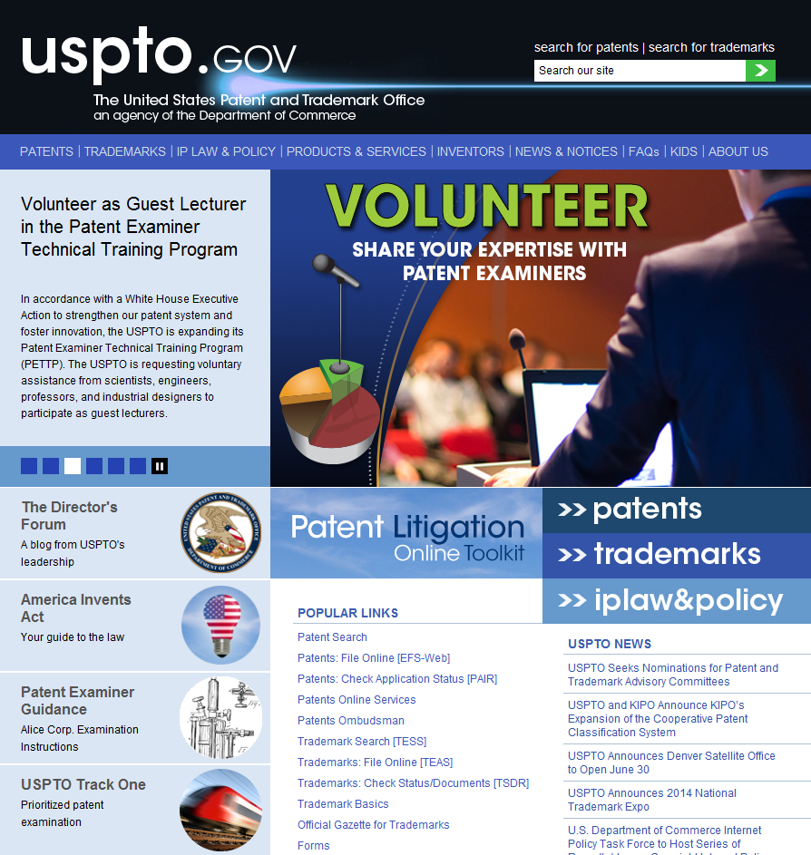
Examiner Guidance and Training Materials: How to Access
Notes:
All of these training modules are on our website. You can get there from the main page using the radio button on the left side of the screen that is labeled Patent Examiner Guidance. It will also reflect the latest posting.

Slide 42
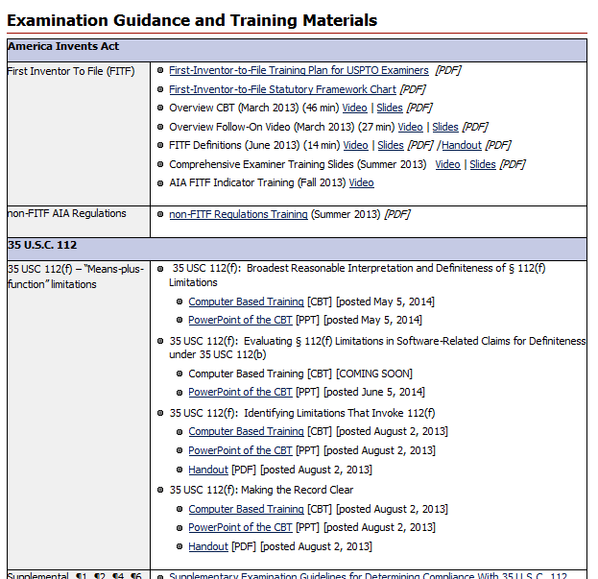
Examination Guidance and Training Materials: How to Access
Notes:
Clicking the radio button gets you to this page that lists all of the current guidance available to examiners. Of course, the MPEP is also available and will include guidance materials as appropriate when ever it is updated. For example, the 2011 guidelines have been incorporated as have the principles from this training in the last edition.

Slide 43
Next Steps
Next series of training modules focused on:
  Claim interpretation: plain and ordinary meaning;
  Definite boundaries under 112(b) for functional claim limitations that do not invoke 112(f); and
  Written description and enablement

Slide 44
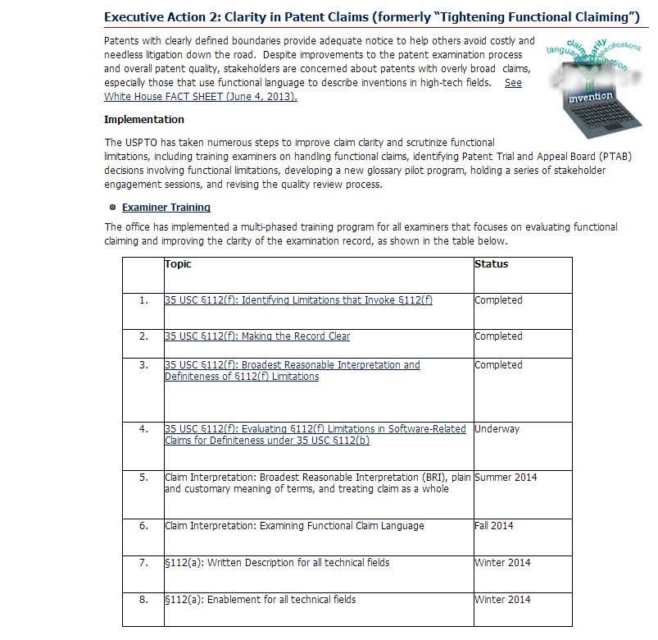
USPTO Executive Actions Webpage

Slide 45

Additional Information
USPTO-led Executive Actions on High Tech Patent Issues
  http://www.uspto.gov/executiveactions
Software Partnership
  http://www.uspto.gov/patents/init_events/software_partnership.jsp
Examiner Guidance and Training http://www.uspto.gov/patents/law/exam/examguide.jsp
USPTO.gov main page radio button
Feedback: TrainingComments112f@uspto.gov
Notes:
All of the initiatives I talked about today are explained in more detail on our website. We also have a training feedback mailbox where the public can submit comments.

Slide 46
Thank You

Slide 47
Break

Slide 48
Stakeholder Presentations

Slide 49
Chris Bullard
Oblon Spivak on behalf of the American Bar Association, IP Section

Slide 50
John Vandenberg
Klarquist Sparkman

Slide 51
David Jones
Microsoft

Slide 52
Eric Sutton
Oracle

Slide 53

Filtering the Unclear or Abstract
Eric Sutton (eric.sutton@oracle.com)
July 22, 2014

Slide 54
Disclaimer
Examples provided herein are intended to be general in nature and are not directed to any particular patent owned by Oracle or any third party. Patent determinations are often fact-specific and often depend on the contents of the claims and the specification. These slides are intended to promote a discussion of the issues regarding unclear or abstract claims and not for any other purpose.

Slide 55
Hypothetical Scenario
An unclear or abstract software claim is asserted.
  What products could be relevant to the claim?
    Significantly more engineering time and attorney time is spent answering this question for unclear or abstract patents.
  Is there a risk of infringement by those products?
    It may depend on certain interpretations of the claim, necessitating an invalidity analysis for alternative interpretations of the claim.
  Is the claim valid?
    It may depend on certain other interpretations of the claim, necessitating integration with a non-infringement analysis.
  What is the certainty of the risk or lack thereof?
    Significantly lower certainty for unclear or abstract claims, making business decisions much more difficult.
  RESULT: BIG WASTE OF EVERYONE’S TIME

Slide 56
What is usually unclear?
At or near the point of novelty, ambiguous antecedent leads to multiple possible divergent meanings, and the intended meaning is not otherwise apparent on the record.
  “generating an X;
  generating an X;
  sending the X;”
At or near the point of novelty, ambiguous term or phrase has divergent meanings, and the intended meaning is not otherwise apparent on the record.
  “causing an event”
  specification examples:
  event is caused by sending an email message to a user
  event is caused by storing observed information

Slide 57
What is usually clear?
Using the English language as intended
“generating a message;
wherein the generated message comprises . . .”
Typographical errors
  “A method comprising:
  generating the a message . . .”
Basic software tools not near the point of novelty
  “. . . causing display of the result”
  “using a randomly generated number to . . .”
  Should we be explaining these in every application, or do they generally provide sufficient structure in and of themselves?

Slide 58
What is usually abstract?
Claims that are not clearly machine-implemented or are not otherwise clearly machine-specific
  Just mentally possible steps, such as “determining X”
  How would one know whether or not these claims are infringed or valid?
What is usually not abstract?
Claims that are clearly machine-implemented or are otherwise clearly machine-specific
  “determining, by a computing device, X”
  “transmitting a message according to X protocol”

Slide 59
What can you do about it? (1)
Call the applicant (prior to search)
(+) | (-)
May lead to more compact prosecution due to better search if reachable | Takes away from search time and leads to less compact prosecution if unreachable
Efficient docket management by resolving issues as they arise | Negative effect on docket management statistics if unreachable
May lead to preliminary amendment or examiner’s amendment if reachable | Stuck with claims as-is if unreachable
Receive normal count if reachable and clarifying information makes accurate examination possible | Lost time and no count if unreachable and accurate examination not possible
May receive a detailed explanation of the technology and other clarifying information if reachable | The detailed explanation and other clarifying information might not make it onto the record

Slide 60
What can you do about it? (2)
Issue an action based on a search that makes assumptions, preferably stating the assumptions
(+) | (-)
May lead to more compact prosecution if applicant fixes or addresses issues in reply or if assumptions are correct | Search may not be useful if assumptions are incorrect, and the count system does not allow as much time for subsequent searches and actions
Efficient docket management if assumptions are correct | Negative effect on docket management statistics if assumptions are incorrect and subsequent non-final actions are needed
May lead to amendment if assumptions are correct | May not be sufficient to cause an amendment if assumptions are incorrect
Receive normal count up front | May require subsequent non-final actions without a count if assumptions are incorrect
Applicant may provide clarifying information on the record if assumptions are correct | Risk of making no progress and/or having no clarifying information on record if assumptions are incorrect

Slide 61
Nautilus (2014)
“a patent must be precise enough to afford clear notice of what is claimed, thereby “‘appris[ing] the public of what is still open to them.’ Otherwise there would be “[a] zone of uncertainty which enterprise and experimentation may enter only at the risk of infringement claims. And absent a meaningful definiteness check, we are told, patent applicants face powerful incentives to inject ambiguity into their claims. Eliminating that temptation is in order, and “the patent drafter is in the best position to resolve the ambiguity in . . . patent claims.”
“. . . we read §112, ¶2 to require that a patent’s claims, viewed in light of the specification and prosecution history, inform those skilled in the art about the scope of the invention with reasonable certainty. The definiteness requirement, so understood, mandates clarity, while recognizing that absolute precision is unattainable.”

Slide 62
MPEP 702.01
3rd ed. 1961
“A reasonable search should be made of the invention so far as it can be understood from the disclosure, objects of invention and claims and any apparently pertinent art cited. In the rare case in which the disclosure is so incomprehensible as to preclude a reasonable search, the Office action should clearly inform applicant that no search was made”
4th ed. 1979

Slide 63
Rule 105 and MPEP 704.11(a)
“37 CFR 1.105(a)(1)(i)-(viii) list specific examples of information that may be reasonably required. Other examples, not meant to be exhaustive, of information that may be reasonably required for examination of an application include:
. . . (S) Interrogatories or Stipulations.
. . . (3) Of precisely which portion(s) of the disclosure provide the written description and enablement support for specific claim element(s),
(4) Of the meaning of claim limitations or terms used in the claims, such as what teachings in the prior art would be covered by particular limitations or terms in a claim and which dictionary definitions would define a particular claim term, particularly where those terms are not used per se in the specification, . . .”
NOTE: Other 105 requests may be very burdensome to software companies and even discriminate against practicing entities

Slide 64
What can you do about it? (3)
Issue an action under 702.01 using 112/101 and/or with a Rule 105 requirement (prior to search)
(+) | (-)
May lead to more compact prosecution due to better search if clarifying information provided in reply | Less compact prosecution due to wasted time if examination could have been done efficiently despite 112/101 issues
Positive effect on docket management statistics by prompting clarifying information within 2 months | Negative effect on docket management statistics if clarifying information does not make examination any easier
May lead to clarifying amendment | May lead to appeal before reaching art
Able to efficiently shift attention to other cases that are ready for examination | No count for informal actions
May receive a detailed explanation of the technology and other clarifying information on the record | Added burden on applicants if prosecution could have advanced efficiently without any added information

Slide 65
Questions
Please feel free to contact me at eric.sutton@oracle.com if you have any follow-up questions later on.

Slide 66
Laura Sheridan
Google

Slide 67
Open Discussion
Wendy Garber, Director, Technology Center 2100
Dave Wiley, Director, Technology Center 2600

Slide 68
Alice Corp. v. CLS Bank
USPTO Preliminary Examination Instructions 2014
Drew Hirshfeld, Deputy Commissioner for Patent Examination Policy

Slide 69
Preliminary Examination Instructions for Analyzing Claims with Abstract Ideas
Supreme Court issued unanimous decision on June 19, 2014
USPTO issued Preliminary Examination Instructions on June 25, 2014
Further guidance will be developed based on:
  The decision considered in the context of existing precedent
  Public feedback

Slide 70
Preliminary Examination Instructions for Analyzing Claims with Abstract Ideas
In Alice Corp., the Supreme Court applied the framework set forth in Mayo Collaborative Services v. Prometheus Laboratories, Inc., 566 U.S. __ (2012) (Mayo)
  This framework is applicable to all claims directed to laws of nature, natural phenomena, and abstract ideas for subject matter eligibility under 35 U.S.C. § 101
Alice Corp. does not:
  create a per se excluded category of subject matter, such as software or business methods, or
  impose any special requirements for eligibility of software or business methods

Slide 71
Preliminary Examination Instructions – Changes from Prior Guidance
Changes from prior guidance:
Under Alice Corp., the same analysis is used for:
  all types of judicial exceptions
    Prior USPTO guidance applied a different analysis to claims with abstract ideas than to claims with laws of nature
  all categories of claims
    Prior USPTO guidance applied a different analysis to product claims involving abstract ideas than to process claims

Slide 72
Analyzing Claims with Abstract Ideas: Basic Inquiries
The basic inquiries to determine subject matter eligibility remain the same:
Does the claim fall within one of the four statutory categories of invention, i.e., process, machine, manufacture, or composition of matter?
  If not, the claim must be rejected as being directed to non-statutory subject matter
Is the claim directed to an ineligible abstract idea?
  Examiners are provided a two part analysis following the framework set forth in Mayo and relied upon in Alice Corp. This analysis determines whether the claim is directed to a patent-eligible application of an abstract idea or to the (ineligible) abstract idea itself

Slide 73
Preliminary Examination Instructions for Analyzing Claims with Abstract Ideas
Two-part Analysis for Abstract Ideas
Part 1: Determine whether the claim is directed to an abstract idea
Part 2: If so, determine whether any element, or combination of elements, in the claim is sufficient to ensure that the claim amounts to significantly more than the abstract idea itself
  The claim is analyzed as a whole by considering all claim elements, both individually and in combination

Slide 74
Preliminary Examination Instructions −
Part 1
Part 1: Abstract Ideas
At some level, all inventions embody, use, reflect, rest upon, or apply abstract ideas and the other exceptions
However, an invention is not rendered ineligible simply because it involves an abstract concept - inventions that apply the abstract idea in a meaningful way are eligible

Slide 75
Preliminary Examination Instructions −
Part 1
Part 1: Abstract Ideas
Examples of abstract ideas referenced in Alice Corp. include:
  Fundamental economic practices;
  Certain methods of organizing human activities;
  “[A]n idea of itself”; and,
  Mathematical relationships/formulas
For claims that include abstract ideas, the examiner proceeds to Part 2 to determine whether the abstract idea has been applied in an eligible manner

Slide 76
Preliminary Examination Instructions −
Part 2
  Part 2: Significantly More?
  For Part 2, examiners determine whether any element, or combination of elements, in the claim is sufficient to ensure that the claim amounts to significantly more than the abstract idea itself
  In other words, are there other limitations in the claim that show a patent-eligible application of the abstract idea, e.g., more than a mere instruction to apply the abstract idea?

Slide 77
Preliminary Examination Instructions −
Part 2
  Part 2: Significantly More?
Limitations referenced in Alice Corp. that may be enough to qualify as “significantly more” when recited in a claim with an abstract idea:
  Improvements to another technology or technical field
  Improvements to the functioning of the computer itself
  Meaningful limitations beyond generally linking the use of an abstract idea to a particular technological environment

Slide 78
Preliminary Examination Instructions −
Part 2
  Part 2: Significantly More?
Limitations referenced in Alice Corp. that are not enough to qualify as “significantly more” when recited in a claim with an abstract idea:
  Adding the words “apply it” (or an equivalent) with an abstract idea
  Mere instructions to implement an abstract idea on a computer
  Requiring no more than a generic computer to perform generic computer functions that are well-understood, routine and conventional activities previously known to the industry

Slide 79
Preliminary Examination Instructions −
Part 2
  If the claim does not qualify as “significantly more” than an abstract idea, the claim will be rejected under 35 U.S.C. § 101 as being directed to
  non-statutory subject matter
  After the § 101 analysis is complete, examination then proceeds in accordance with the other requirements of 35 U.S.C. § 101 (utility and double patenting), non-statutory double patenting, and §§112, 102, and 103

Slide 80
Preliminary Examination Instructions −
Further Guidance
  The public is invited to contribute written comments
    Written comments received by July 31, 2014, will be taken into consideration when formulating further guidance
    Comments may be emailed to: alice_2014@uspto.gov

Slide 81
Thank You

Slide 82
Closing

Slide 83
Materials
Available at:
http://www.uspto.gov/patents/init_events/software_partnership.jsp

Slide 84
Upcoming Meetings
Fall 2014: Crowdsourcing
Winter 2015: Patent Litigation Research from the Edison Scholars

Slide 85
Thank You

