Slide 1
Software Patents, Pseudo Code and UML
On how including UML in a patent application can be done right to increase efficiency and patent quality.

Slide 2

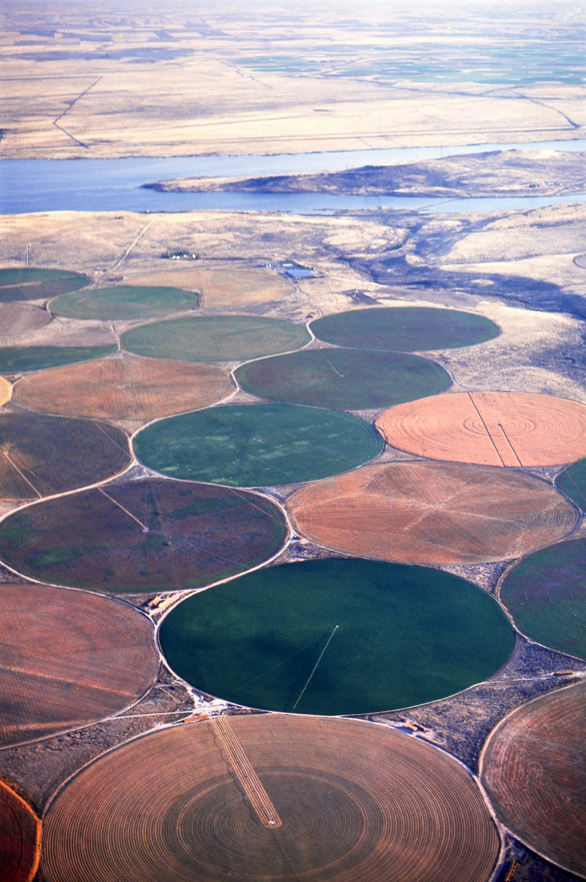
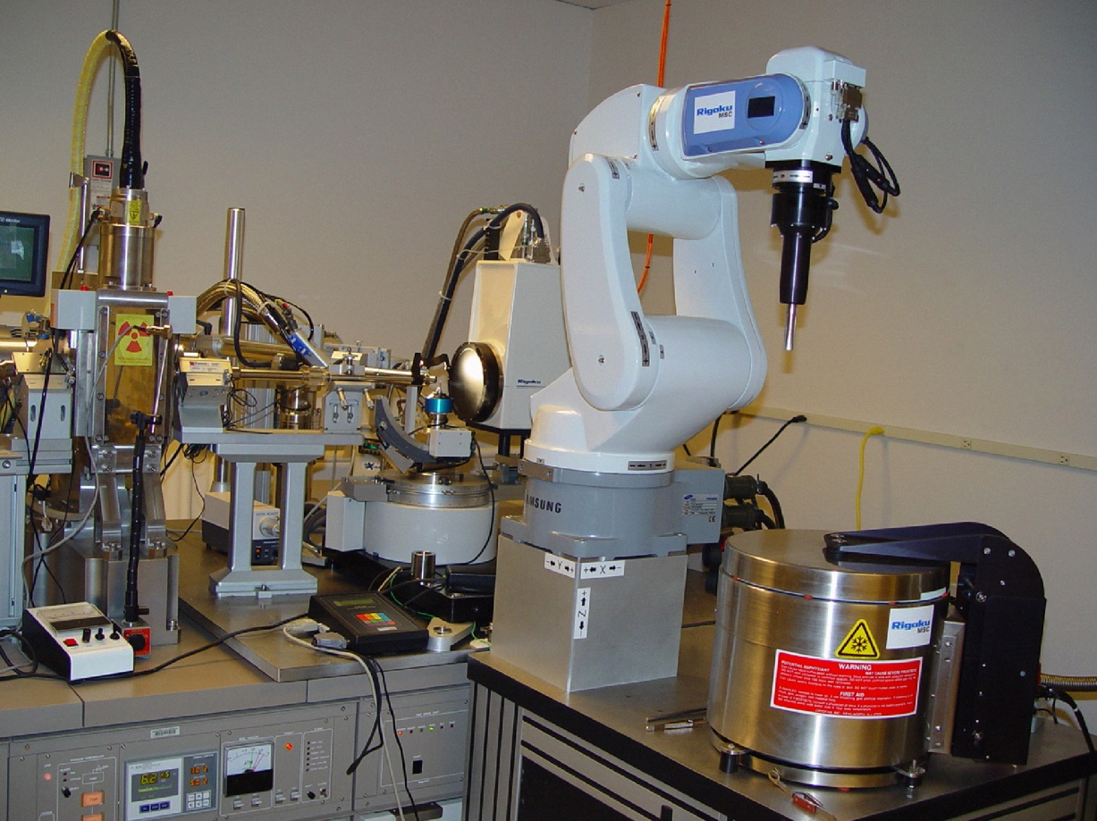

Education
Agriculture
Medicine
Industry

Slide 3
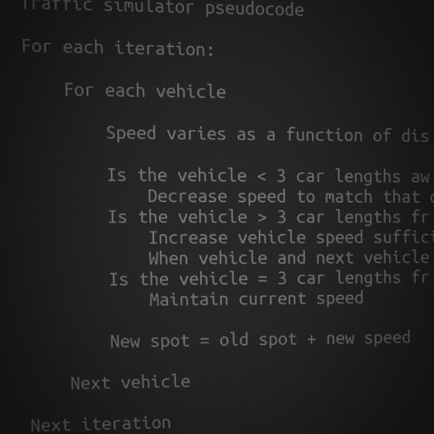
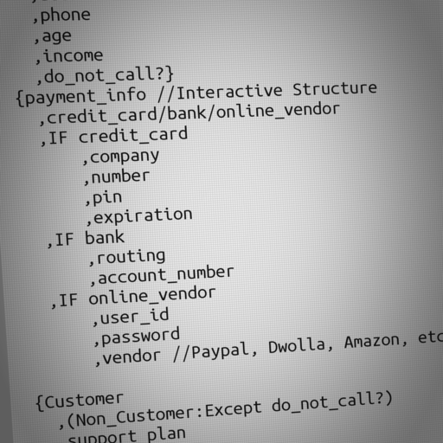
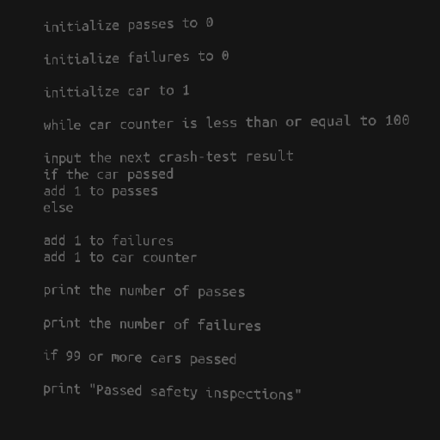
Pseu.do-n’t
Pseudo code is a developers tool
Teams tend to develop their own flavors
Lack of standardization makes training harder

Slide 4
Create vs Consume Ratio
It is relatively easy to see what a UML diagram is doing.
It’s harder to learn how to make one properly.
Moves a burden of work from the examiners onto the patent applicants.

Slide 5
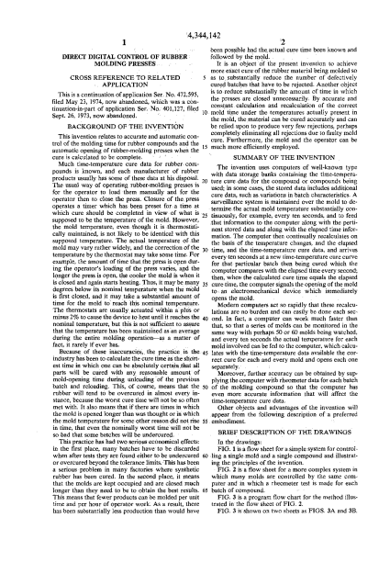
Normal Patent Application (eg. Diamond Deihr)
Abstract
Drawings
Detailed Description
Claims

Slide 6
Initial Node
Timer Node
Action Node
1 Second
Decision Node
Note
Send Signal Action
Merge Node
Edge Node

Slide 7
Edge Node
Patent number labels to match with the “Detailed Description of Drawings” portion of a patent application.
Final Node

Slide 8
Free UML Learning
www.tutorialspoint.com/uml/index.htm
www.sparxsystems.com/uml-tutorial.html
http://edn.embarcadero.com/article/31863
To name a few.
http://www.omg.org/spec/UML/2.4.1/ – For the, detailed, spec sheets.

Slide 9
Free UML diagram creators
UMLet @ www.umlet.com – (My favorite)
StarUML @ staruml.sourceforge.net
Less feature-full open source and free creators are available.
Commercial alternatives are plentiful

Slide 10
Special Thanks
http://www.omg.org (for UML)
All the free UML diagram creators and teachers.
instacod.es (those hip pseudo-code pictures)
flickr.com/photos/jamesclay/3509154015 For the classroom photo
US Gov sites that had the other images under public domain

