Slide 1
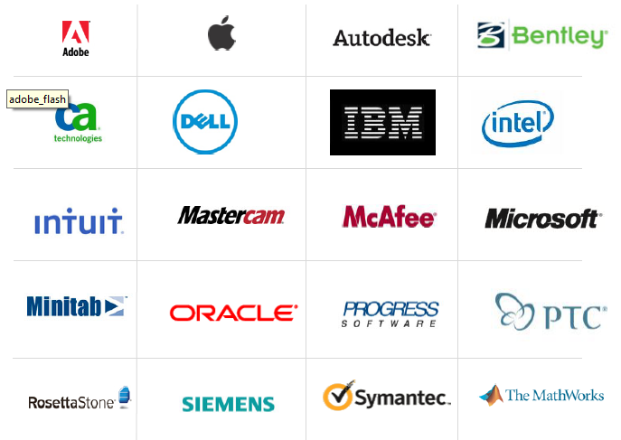
BSA’s member companies include:

