Slide 1
Notice of Proposed Rulemaking
United States Patent and Trademark Office Rules of Professional Conduct
Changes to Representation of Others Before the United States Patent and Trademark Office
William R. Covey
Deputy General Counsel for Enrollment and Discipline and Director of the Office of Enrollment and Discipline

Slide 2
Changes to Representation of Others Before the United States Patent and Trademark Office
Overview
History of USPTO Regulation of Practitioners
Considerations for Update to USPTO Ethics Rules
Proposed USPTO Rules of Professional Conduct: Highlights
Next Steps – Public Outreach

Slide 3
History of USPTO Regulation of Practitioners
1861 – Congressional support for specific power for USPTO to regulate practitioners. (See Sperry v. State of Florida, 373 U.S. 379, 388 (1963))
1899 – USPTO required practitioner registration.
1922 – Commissioner expressly authorized to prescribe regulations for the recognition of agents and attorneys. (42 Stat. 390 (1922))
1952 – Patent Act of 1952 included provisions relating to recognition and conduct of agents and attorneys. Rules in 1959 focus on national standards.
1963 – U.S. Supreme Court in Sperry v. State of Florida confirmed that federal preemption prohibited states from preventing non-lawyer patent agents from practicing in federal patent matters. (373 U.S. 379 (1963))

Slide 4
History of USPTO Regulation of Practitioners
1971 - USPTO adopted rule incorporating by reference rules linking practitioner conduct to the standards set forth in the ABA Code of Professional Responsibility as amended February 24, 1970. (36 FR 12617)
1985 - USPTO adopted detailed rules which expressly incorporated many 1980 updates to the older 1970 model ABA Code. (50 FR 5158)
2003 - USPTO published an NPRM which proposed to replace the USPTO Code of Professional Responsibility with new rules based on the modern ABA Model Rules of Professional Conduct. (68 FR 69442)
2004 - Final rules were adopted which did not include a majority of the 2003 proposed revisions based upon the ABA Model Rules of Professional Conduct. (69 FR 35428)
Final Rules largely dealt with computerized exam

Slide 5
History of USPTO Regulation of Practitioners
2008 - Final Rules adopted relating to disciplinary investigations and proceedings and conduct of individuals registered to practice before the Office in patent cases. (73 FR 47650)
2008 - Final Rules implementing practitioner maintenance fee. (73 FR 67750)
2012 - USPTO adopted final rules related to the time periods for commencing Office disciplinary proceedings in accord with Leahy-Smith America Invents Act. (77 FR 45247)

Slide 6
Notice of Proposed Rulemaking
Published October 18, 2012
77 Federal Register 64190
60 day comment period – ends December 17, 2012
Comments submitted
By Email: ethicsrules.comments@uspto.gov
By Web: www.regulations.gov
By Mail: Mail Stop OED – Ethics Rules United States Patent and Trademark Office P.O. Box 1450 Alexandria, Virginia 22313-1450 Attention: William R. Covey, Deputy General Counsel for Enrollment and Discipline and Director of the Office of Enrollment and Discipline

Slide 7
Proposed USPTO Rules of Professional Conduct
Based on ABA Model Rules of Professional Conduct, which have been adopted in some form by 49 states and the District of Columbia.
California: moving toward Model Rules: Board of Governors approved; awaiting Supreme Court action
Provides attorneys with consistent, updated professional conduct standards throughout the nation.
Provides practitioners with similar ethical obligations when practicing before the Office.
Proposed new rules are not a significant deviation from rules of professional conduct required by the Office

Slide 8
Proposed USPTO Rules of Professional Conduct
Codifies many obligations that already apply to the practice of law under professional and fiduciary duties owed to clients.
Provides practitioners with non-binding but helpful case law and opinions written by disciplinary authorities that have adopted the ABA Model Rules of Professional Conduct.
“Comment” and “Annotation” sections of ABA Model Rules may also be used for guidance as to how to interpret the equivalent USPTO Rules of Professional Conduct.

Slide 9
ABA and USPTO Proposed Rule Comparison Chart
A side-by-side comparison of the ABA Model Rules of Professional Conduct and the proposed USPTO Rules of Professional Conduct is on the USPTO’s website:
www.uspto.gov/ip/boards/oed/ethics.jsp

Slide 10
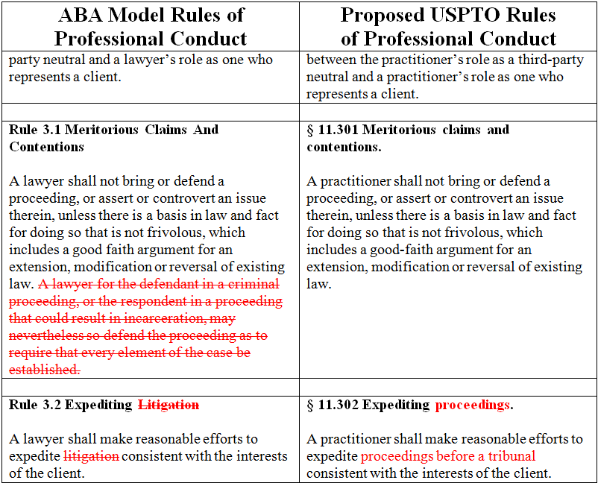
ABA and USPTO Proposed Rule Comparison Chart
Deletions
Modifications
10

Slide 11
Highlights of the Proposed USPTO Rules:
Removes Annual Practitioner Maintenance Fee (§ 11.8(d))
No Continuing Legal Education Reporting Requirement

Slide 12
Highlights of the Proposed USPTO Rules:
Definitions (§ 11.1)
“Practitioner”
“Fraud or Fraudulent”
Confidentiality of information (§ 11.106)
Modifies ABA Model Rule to accommodate duty of disclosure.
§ 11.106(a): prohibition on revealing client information.
§ 11.106(b): permissive disclosure of client information.
§ 11.106(c): practitioner shall comply with the duty of disclosure.
Candor toward tribunal (§ 11.303)
Modified ABA Model Rule to include ex parte proceedings.
Inadvertently transmitted materials (§ 11.404(b))

Slide 13
Highlights of the Proposed USPTO Rules:
Safekeeping property (e.g., § 11.115 )
Adds provision relating to practitioners situated in foreign countries.
Integrates provisions from ABA Model Rules for Client Trust Account Records into the Safekeeping Property Rule.
Includes added “safe harbor” provision for those complying with recordkeeping requirements of their state bar.
Includes provision encompassing patent agents and those with limited recognition who are employed by a law firm.

Slide 14
Highlights of the Proposed USPTO Rules:
Advertising/Communication Regarding Services (§§ 11.701-11.705)
Prohibition on false or misleading communications regarding services (§ 11.701)
No payments for referrals, with exceptions (§11.702)
Rules regarding direct contact with prospective clients (§ 11.703)
Fields of Practice and Specialization (§ 11.704)
Firm Names and Letterheads (§ 11.705)

Slide 15
Highlights of the Proposed USPTO Rules:
Conflicts of interest and duties to clients (e.g., §§ 11.107-11.110)
§ 11.107: Conflict of interest: Current clients
§ 11.108: Conflict of interest: Current clients: Specific rules
§ 11.109: Duties to former clients
§ 11.110: Imputation of conflicts of interest: General rule
Proposed USPTO Rules include numerous provisions specifying that notice, consent, or other terms with clients be in writing: e.g., §§ 11.105, 11.107 - 11.110, 11.112, 11.117 - 11.118.

Slide 16
Highlights of the Proposed USPTO Rules:
Former or current Federal Government employees (e.g., § 11.111)
References applicable Federal ethics laws of the lawyer’s current or former employer.
Unauthorized practice of law (e.g., § 11.505)
Misconduct (e.g., § 11.804)
Proposed USPTO Rules adopt ABA definitions of misconduct.
Carryover provisions from current USPTO Code.

Slide 17
Next Steps - Public Outreach
Press release
Director Kappos’ blog
Public Speaking Engagements
OED website
Twitter, Facebook
Q & A’s

Slide 18
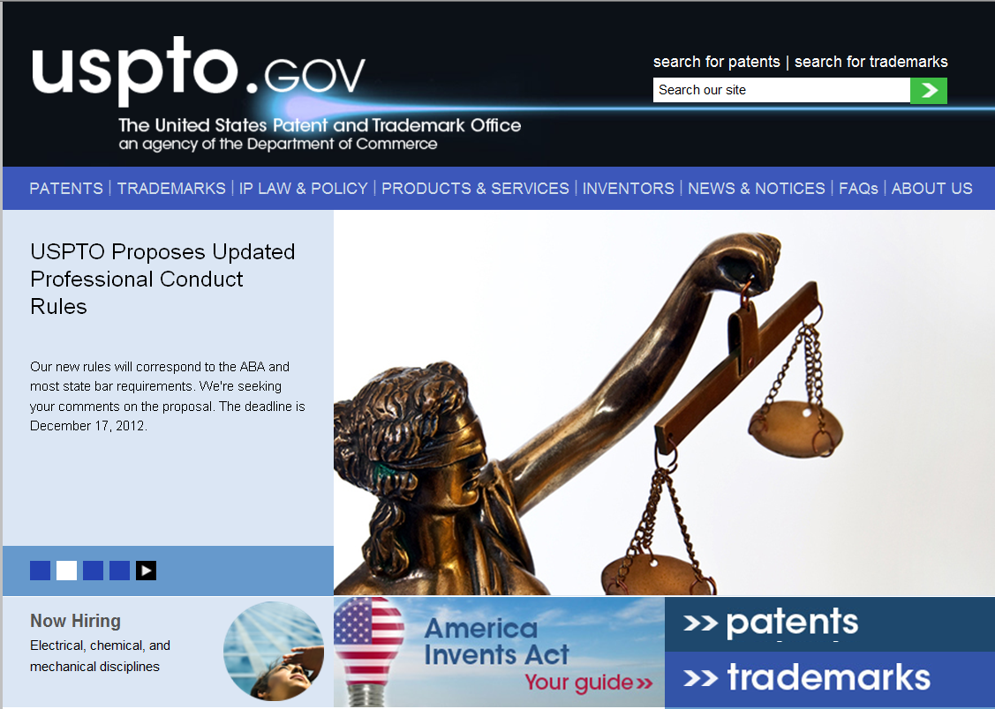
www.uspto.gov
18

Slide 19
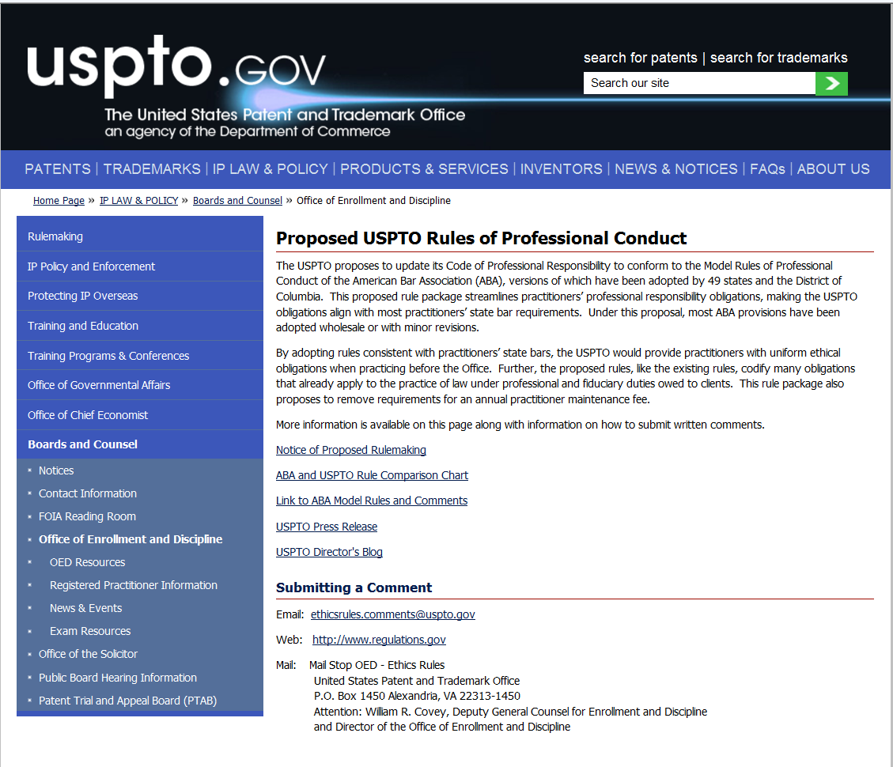
www.uspto.gov/ip/boards/oed/ethics.jsp
19

Slide 20
Notice of Proposed Rulemaking
Published October 18, 2012
77 Federal Register 64190
60 day comment period – ends December 17, 2012
Comments submitted
By Email: ethicsrules.comments@uspto.gov
By Web: www.regulations.gov
By Mail: Mail Stop OED – Ethics Rules United States Patent and Trademark Office P.O. Box 1450 Alexandria, Virginia 22313-1450 Attention: William R. Covey, Deputy General Counsel for Enrollment and Discipline and Director of the Office of Enrollment and Discipline

