Slide 1
The America Invents Act: Eighteen Months Post-Enactment
Janet Gongola
Patent Reform Coordinator
March 27, 2013

Slide 2
Overview
First Inventor to File
Patent Fee Schedule
Micro Entity Discount

Slide 3
First Inventor to File Final Rules and Guidelines Effective March 16, 2013

Slide 4
Guidelines
Examination Guidelines for Implementing the First Inventor to File Provisions of the Leahy-Smith America Invents Act , 78 Fed. Reg. 11059 (February 14, 2013)

Slide 5
Critical Date for Claimed Invention
Pre-AIA: date of invention
AIA: effective filing date

Slide 6
35 U.S.C. 100(i)(1): New Definition for Effective Filing Date
Effective filing date of a claimed invention under examination is the earlier of:
the actual filing date of the patent or application containing a claim to the invention;
or
the filing date of the earliest application for which the patent or application is entitled to a right of foreign priority or domestic benefit as to such claimed invention

Slide 7
AIA Impact on pre-AIA 35 U.S.C. 102
Pre-AIA 35 U.S.C. 102 A person shall be entitled to a patent unless— | AIA 35 U.S.C. 102 Concordance
(a) the invention was known or used by others in this country, or patented or described in a printed publication in this or a foreign country, before the invention thereof by the applicant for patent, or | 102(a)(1)
(b) The invention was patented or described in a printed publication in this or a foreign country or in public use or on sale in this country, more than one year prior to the date of the application for patent in the United States, or
(c) He has abandoned the invention, or | No corresponding provision
(d) The invention was first patented or caused to be patented, or was the subject of an inventor’s certificate, by the applicant or his legal representatives or assigns in a foreign country prior to the date of the application for patent in this country on an application for patent or inventor’s certificate filed more than twelve months before the filing date of the application in the United States, or
(e) The invention was described in An application for patent, published under section 122(b), by another filed in the United States before the invention by the applicant for patent or A patent granted on an application for patent by another filed in the United States before the invention by the applicant for patent, except than an international application filed under the treaty defined in section 351(a) shall have the effects for the purposes of this subsection of an application filed in the United States only if the international application designated the United States and was published under Article 21(2) of such treaty in the English language, or | 102(a)(2)
(f) He did not himself invent the subject matter sought to be patented, or | 101 and 115
(g) during the course of an interference conduced under section 135 or section 291, another inventor involved therein establishes, to the extent permitted in section 104, that before such person’s invention thereof the invention was made by such other inventor and not abandoned, suppressed, or concealed, or Before such person’s invention thereof, the invention was made in this country by another inventor who had not abandoned, suppressed, or concealed it. | No corresponding provision
Abandonment of invention
Premature foreign patenting
Derivation
Prior invention by another

Slide 8
AIA Statutory Framework
Prior Art 35 U.S.C. 102(a) (Basis for Rejection) | Exceptions 35 U.S.C. 102(b) (Not Basis for Rejection)
102(a)(1) Disclosure with Prior Public Availability Date | 102(b)(1) | (A) Grace Period Disclosure by Inventor or Obtained from Inventor
 |  | (B) Grace Period Intervening Disclosure by Third Party
102(a)(2) U.S. Patent, U.S. Patent Application, and PCT Application with Prior Filing Date | 102(b)(2) | (A) Disclosure Obtained from Inventor
 |  | (B) Intervening Disclosure by Third Party
 |  | (C) Commonly Owned Disclosure

Slide 9
35 U.S.C. 102(a)(1): Prior Public Disclosures as Prior Art
35 U.S.C. 102(a)(1) precludes a patent if a claimed invention was, before the effective filing date of the claimed invention:
patented;
described in a printed publication;
in public use;
on sale; or
otherwise available to the public

Slide 10
In Public Use or On Sale
Does not include pre-AIA geographic limitation
Use or sale may occur anywhere in the world
Does not include pre-AIA treatment of secret sale as prior art
Sale activity must have been available to the public

Slide 11
“Otherwise Available to the Public”
Introduced by the AIA; no corresponding language in pre-AIA 35 U.S.C. 102
Catch-all to account for other means of making an invention publicly available

Slide 12
35 U.S.C. 102(b)(1)(A) Exception: Grace Period Disclosure of Inventor’s Work
First exception: A disclosure made one year or less before the effective filing date of the claimed invention shall not be prior art under 35 U.S.C. 102(a)(1) if:
the disclosure was made by:
the inventor or joint inventor; or
another who obtained the subject matter directly or indirectly from the inventor or joint inventor

Slide 13
Example 1: Exception in 102(b)(1)(A)
July 1, 2013
July 1, 2014
Taylor publishes X
Taylor files patent application claiming X
Inventor Taylor’s Grace Period
Taylor’s publication is not available as prior art against Taylor’s application because of the exception under 102(b)(1)(A) for a grace period disclosure by an inventor.

Slide 14
Example 2: Exception in 102(b)(1)(A)
Smith publishes X
July 1, 2013
July 1, 2014
Taylor files patent application claiming X
Inventor Taylor’s Grace Period
Smith’s publication would be prior art to Taylor under 102(a)(1) if it does not fall within any exception in 102(b)(1).
However, if Smith obtained subject matter X from Taylor, then it falls into the 102(b)(1)(A) exception as a grace period disclosure obtained from the inventor, and is not prior art to Taylor.

Slide 15
35 U.S.C. 102(b)(1)(B) Exception: Grace Period Intervening Disclosure by Third Party
Second exception: A disclosure made one year or less before the effective filing date of the claimed invention shall not be prior art under 35 U.S.C. 102(a)(1) if:
the subject matter disclosed was, before such disclosure, publicly disclosed by:
the inventor or joint inventor; or
another who obtained the subject matter directly or indirectly from the inventor or joint inventor

Slide 16
“The Subject Matter”
For the 35 U.S.C. 102(b)(1)(B) exception to apply:
the subject matter in the prior disclosure must be the same as that which is later publicly disclosed
the mode of prior disclosure by the inventor need not be the same as the mode of later disclosure by another
verbatim disclosures are not required

Slide 17
Example 3: Exception in 102(b)(1)(B)
Smith publishes X
July 1, 2013
July 1, 2014
Taylor publishes X
Taylor files patent application claiming X
Inventor Taylor’s Grace Period
Smith’s publication is not prior art because of the exception under 102(b)(1)(B) for a grace period intervening disclosure by a third party.
Taylor’s publication is not prior art because of the exception under 102(b)(1)(A) for a grace period disclosure by the inventor.
If Taylor’s disclosure had been before the grace period, it would be prior art against his own application. However, it would still render Smith inapplicable as prior art.

Slide 18
AIA Statutory Framework
Prior Art 35 U.S.C. 102(a) (Basis for Rejection) | Exceptions 35 U.S.C. 102(b) (Not Basis for Rejection)
102(a)(1) Disclosure with Prior Public Availability Date | 102(b)(1) | (A) Grace Period Disclosure by Inventor or Obtained from Inventor
 |  | (B) Grace Period Intervening Disclosure by Third Party
102(a)(2) U.S. Patent, U.S. Patent Application, and PCT Application with Prior Filing Date | 102(b)(2) | (A) Disclosure Obtained from Inventor
 |  | (B) Intervening Disclosure by Third Party
 |  | (C) Commonly Owned Disclosure

Slide 19
35 U.S.C. 102(a)(2): U.S. and PCT Patent Documents Are Prior Art as of the Date They Are “Effectively Filed”
35 U.S.C. 102(a)(2) precludes a patent if a claimed invention was described in a:
U.S. Patent;
U.S. Patent Application Publication; or
PCT Application Publication designating the U.S.
that names another inventor and was effectively filed before the effective filing date of the claimed invention

Slide 20
35 U.S.C. 102(d): Determining the Date that a U.S. or PCT Patent Document Is “Effectively Filed”
Date that a U.S. or PCT patent document being applied as a reference is effectively filed is the earlier of:
the actual filing date of the U.S. patent or published application;
or
the filing date of the earliest application to which the U.S. patent or published application is entitled to claim a right of foreign priority or domestic benefit which describes the subject matter
Date that a patent document used as a reference is effectively filed may be different depending on whether the application under examination is subject to AIA or pre-AIA law

Slide 21
35 U.S.C. 102(b)(2)(A) Exception: Disclosure Obtained from Inventor
First exception: A disclosure in an application or patent shall not be prior art under 35 U.S.C. 102(a)(2) if:
the disclosure was made by another who obtained the subject matter directly or indirectly from the inventor or joint inventor

Slide 22
Example 4: Exception in 102(b)(2)(A)
Smith files patent application disclosing X
Smith’s application publishes
April 1, 2014
October 1, 2015
July 1, 2014
Taylor files patent application claiming X
Smith’s patent application publication is not prior art if Smith obtained X from Inventor Taylor because of the exception under 102(b)(2)(A) for a disclosure obtained from the inventor
Notes:
In this illustration, an exception under AIA section 102(b)(2)(A) is shown.
Inventor Taylor filed a patent application claiming subject matter X on July 1, 2014 which is in the middle of the timeline. This is the application under examination.
We are considering using Smith as a reference.
Three months earlier, Smith filed a patent application disclosing subject matter X. Smith’s patent application published on October 1, 2015, well after Inventor Taylor’s patent application filing.
Smith’s patent application publication was “effectively filed” on April 1, 2014—the filing date of Smith’s application.
Because Smith’s patent application publication was “effectively filed” before the effective filing date of Taylor’s application, Smith’s patent application publication is available as prior art under AIA section 102(a)(2), the yellow box.
An exception applies under AIA section 102(b)(2)(A) when evidence is in the record that Smith obtained subject matter X from Inventor Taylor, then Smith’s publication would not be available as prior art because of the exception under AIA section 102(b)(2)(A), the first orange box on your chart. Normally, this evidence will be provided in response to the examiner making the rejection.

Slide 23
35 U.S.C. 102(b)(2)(B) Exception: Intervening Disclosure by Third Party
Second exception: A disclosure in an application or patent shall not be prior art under 35 U.S.C. 102(a)(2) if:
the subject matter disclosed was, before such subject matter was effectively filed, publicly disclosed by:
the inventor or joint inventor; or
another who obtained the subject matter directly or indirectly from the inventor or joint inventor

Slide 24
Example 5: Exception in 102(b)(2)(B)
Smith files patent application disclosing X
Smith’s application publishes
April 1, 2014
October 1, 2015
March 1, 2014
July 1, 2014
Taylor publishes subject matter X
Taylor files patent application claiming X
Smith’s patent application publication is not prior art against Taylor’s application because of the exception under 102(b)(2)(B) for an intervening disclosure by a third party.

Slide 25
35 U.S.C. 102(b)(2)(C) Exception: Commonly Owned Disclosure
Third exception: A disclosure made in an application or patent shall not be prior art under 35 U.S.C. 102(a)(2) if:
the subject matter and the claimed invention were commonly owned or subject to an obligation of assignment to the same person not later than the effective filing date of the claimed invention
Resembles pre-AIA 35 U.S.C. 103(c), but applies to both novelty and obviousness, whereas pre-AIA disqualified art only for obviousness

Slide 26
Commonly Owned or Subject to Obligation of Assignment
Applicant can establish common ownership or obligation of assignment by making a clear and conspicuous statement
Corroborating evidence is not required

Slide 27
Example 6: Exception in 102(b)(2)(C)
Smith files patent application disclosing X
Smith invents X and assigns to Company Z
March 1, 2014
April 1, 2014
February 1, 2014
July 1, 2014
Taylor invents X and assigns to Company Z
Taylor files patent
application claiming X
Smith’s patent application publication is not prior art because of the exception under 102(b)(2)(C) for a commonly owned disclosure.
There is no requirement that Smith’s and Taylor’s subject matter be the same in order for the common ownership exception to apply.

Slide 28
Rules
Changes to Implement the First Inventor to File Provisions of the Leahy-Smith America Invents Act, 78 Fed. Reg. 11024 (February 14, 2013)

Slide 29
Rule 1.130 Affidavits or Declarations
Revised rule 1.130 provides a mechanism for an applicant or patent owner to provide information relevant to certain prior art exceptions:
affidavit or declaration of attribution under 1.130(a), to invoke the 102(b)(1)(A) or 102(b)(2)(A) exception
affidavit or declaration of prior public disclosure under 1.130(b), to invoke the 102(b)(1)(B) or 102(b)(2)(B) exception

Slide 30
Rule 1.130(a): Affidavit or Declaration of Attribution
In response to a rejection based on a disclosure, applicant or patent owner may submit an affidavit or declaration of attribution attesting that the disclosure was made
by the inventor or joint inventor;
or
by another who obtained the subject matter disclosed directly or indirectly from the inventor or joint inventor
Declaration or affidavit may be used to overcome a rejection based on 102(a)(1) or 102(a)(2) prior art by invoking the 102(b)(1)(A) or 102(b)(2)(A) exception, respectively

Slide 31
Rule 1.130(b): Affidavit or Declaration of Prior Public Disclosure
In response to a rejection based on a disclosure, applicant or patent owner may submit an affidavit or declaration of prior public disclosure attesting that a prior public disclosure of the subject matter was made
by the inventor or joint inventor
or
by another who obtained the subject matter disclosed directly or indirectly from the inventor or joint inventor
Declaration or affidavit may be used to overcome a rejection based on 102(a)(1) or 102(a)(2) prior art by invoking the 102(b)(1)(B) or 102(b)(2)(B) exception, respectively

Slide 32
Rule 1.130(c): Affidavit or Declaration Not Available
An affidavit or declaration is not available to overcome a rejection if:
the rejection is based on a disclosure made more than one year before effective filing date of claimed invention
An affidavit or declaration under rule 1.130 may not available to overcome a rejection if:
the affidavit or declaration contends that the inventor named in prior art U.S. patent or U.S. patent application publication derived the claimed invention

Slide 33
Applicability of AIA
Filed before March 16, 2013;
Priority/Benefit claim before March 16, 2013
Filed on or after March 16, 2013; Priority/Benefit claim before March 16, 2013
Filed after March 16, 2013; Priority/Benefit claim after March 16, 2013
pre-AIA application
Transitional application
AIA application

Slide 34
Rule 1.55(j), 1.78(a)(6), or 1.78(c)(6): Statements in Transitional Applications
Nonprovisional applications that are:
filed on or after March 16, 2013;
and
claim foreign priority or domestic benefit of an application filed before March 16, 2013,
are called transitional applications
If a transitional application has ever included a claim to an invention having an effective filing date on or after March 16, 2013, applicant must provide a statement to that effect

Slide 35
Rule 1.55(j), 1.78(a)(6), or 1.78(c)(6): Timing of Statements for Transitional Applications
Statements must be filed within the later of:
4 months from the actual filing date of the later-filed application;
4 months from the date of entry into the national stage;
16 months from the filing date of the prior-filed application from which benefit or priority is sought;
or
the date that a first claim having an effective filing date on or after March 16, 2013, is presented in the later-filed application.

Slide 36
Rule 1.55(j), 1.78(a)(6), or 1.78(c)(6): Statements in Transitional Applications
Applicant is not required to identify how many or which claims have an effective filing date on or after March 16, 2013
A statement is not required if applicant reasonably believes that the application does not, and did not at any time, contain a claim that has an effective filing date on or after March 16, 2013
A statement is not required for transitional applications that add unclaimed subject matter, which if claimed would have an effective filing date on or after March 16, 2013

Slide 37
AIA Indicators
Applicants can view PAIR to find out whether an application is being examined under the AIA or under pre-AIA law
Certain USPTO forms received with Office actions also will include an AIA indictor
Examiners will have indicators in our internal IT systems (i.e., eDAN and PALM) to show whether an application has been identified as subject to the AIA or to pre-AIA law

Slide 38
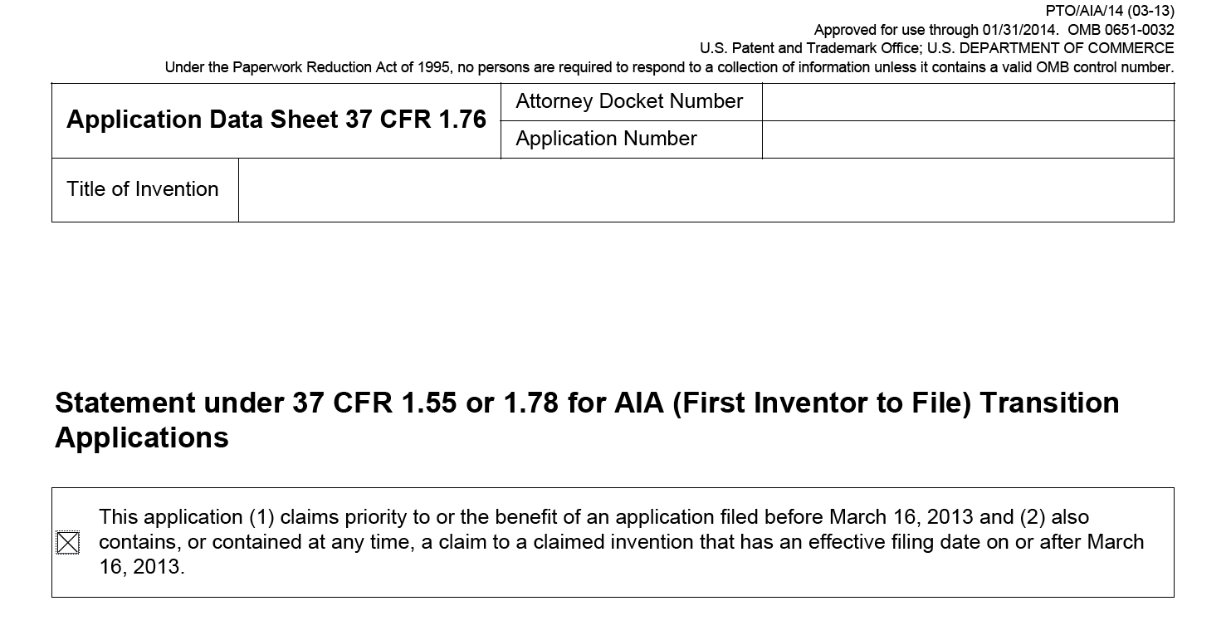
Application Data Sheet with AIA Statement

Slide 39
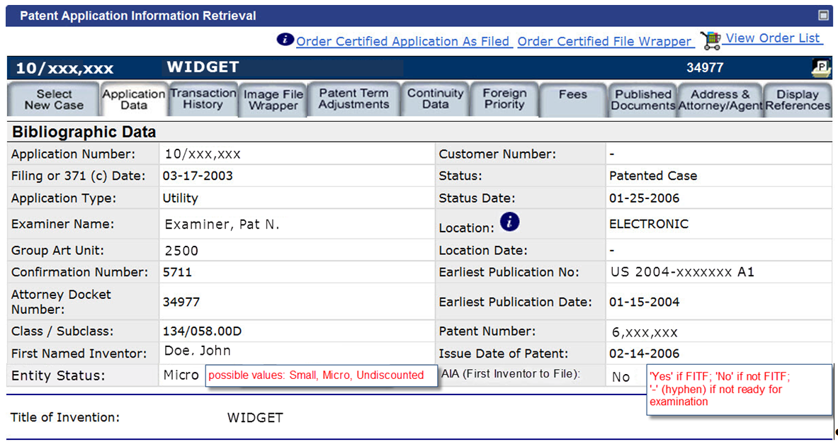
AIA Indicator: PAIR

Slide 40
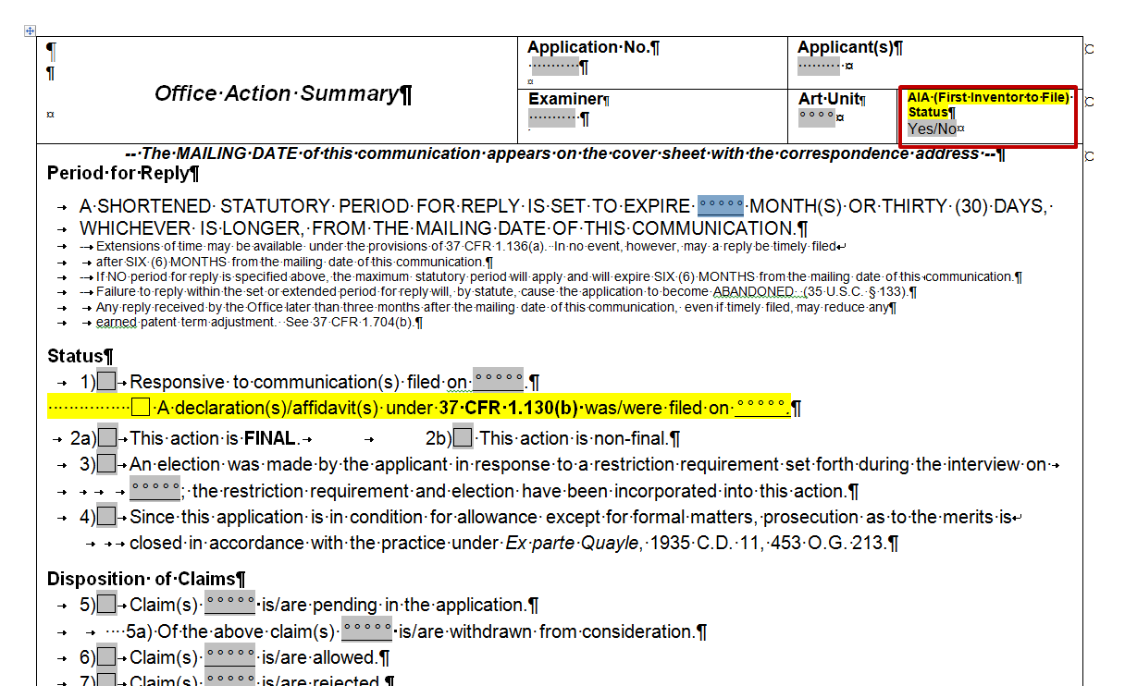
AIA Indicator: Office Action Summary

Slide 41
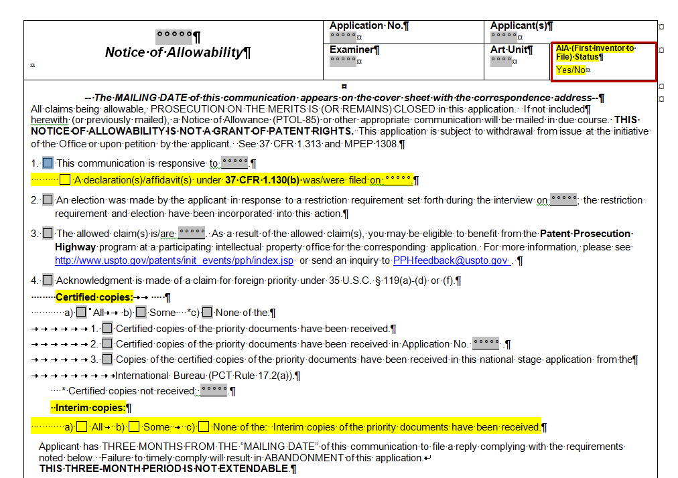
AIA Indicator: Notice of Allowability

Slide 42
Rule 1.55(a), (b), (d), and (e): Foreign Priority in a 35 U.S.C. 111(a) Application
To take advantage of the new definition of “effective filing date” which includes a foreign filing date, applicant must:
claim foreign priority within the later of:
4 months from the actual filing date of the application; or
16 months from the filing date of the foreign priority application
and
include the foreign priority in an application data sheet (ADS)
Foreign priority claimed is waived if omitted from the ADS
Unintentionally delayed claim may be accepted by petition

Slide 43
Rule 1.55(f): Certified Copy of Foreign Priority Document
Certified copy of any foreign priority application must be filed within the later of:
4 months from the actual filing date; or
16 months from the filing date of the prior foreign application
unless an exception applies
Certified copy is needed since U.S. patents and U.S. patent application publications have prior art effect as of the date that they are effectively filed, which might be the foreign priority date

Slide 44
Rule 1.55(f)-(i): Three Ways to Satisfy the Time Limit Requirement to File the Certified Copy
Applicant files a certified copy of the foreign priority document with the Office within the 4/16 time period
Applicant authorizes Office to retrieve a copy of the foreign priority application through the Office’s Priority Document Exchange Program (PDX)
Applicant files interim copy of the foreign priority within the 4/16 time period
In order to perfect foreign priority, the certified copy of the foreign priority document or a copy retrieved via PDX, must be received by the Office no later than patent grant

Slide 45
FITF Examiner Training
Three-part overview training (March-April 2013)
Introductory Video: background for overview training
Live Training: >20 training sessions
Follow-up Video: statutory review and illustrations
Comprehensive training (June-July 2013)
Just-in-time training as needed (March-July 2013)

Slide 46
Resources
Statutory Framework Chart: http://www.uspto.gov/aia_implementation/FITF_card.pdf
FAQs: http://www.uspto.gov/aia_implementation/faqs_first_inventor.jsp
Examiner Introductory Video: http://helix-1.uspto.gov/asxgen/AIA Close Cpt.wmv
Examiner Overview Training Slides: (available on AIA micro-site soon)
Examiner Follow-up Video: (available on AIA micro-site soon)

Slide 47
Patent Fee Schedule and Micro Entity Discount

Slide 48
Fee Setting (Effective March 19, 2013)
Ensure patent fee schedule generates sufficient aggregate revenue to recover aggregate costs of USPTO operations
Individual fees set using agency discretion
http://www.uspto.gov/web/offices/ac/qs/ope/fee031913.htm

Slide 49
Fee Setting Goals
Optimize patent timeliness and quality;
Implement a sustainable funding model for operations;
Encourage innovation;
Facilitate administration of patent system; and
Offer prosecution options to applicants

Slide 50
Comparison of Current to Final Fees: Filing through Issue
$4,144
$3,330
80% of Cost
Note: In each of the following summary pages, from the Current to the Final Rule fee structures, the fees paid could also increase by (a) $170 for each independent claim in excess of 3; (b) $18 for total claims in excess of 20; and (c) $320 for each multiple dependent claim.

Slide 51
Comparison of Current to Final Fees: Filing through 3rd Stage Maintenance
$12,190
366% of Cost
366% of Cost
294% of Cost
$4,147

Slide 52
Micro Entity Discount (Effective March 19, 2013)
Entitled to a 75% discount on fees for “filing, searching, examining, issuing, appealing, and maintaining” patent applications/patents
2 ways to be eligible:
Limited income and limited number of patent filings; or
Employment or assignment to institution of higher education
Must certify micro entity eligibility before paying a fee in the micro entity amount

Slide 53
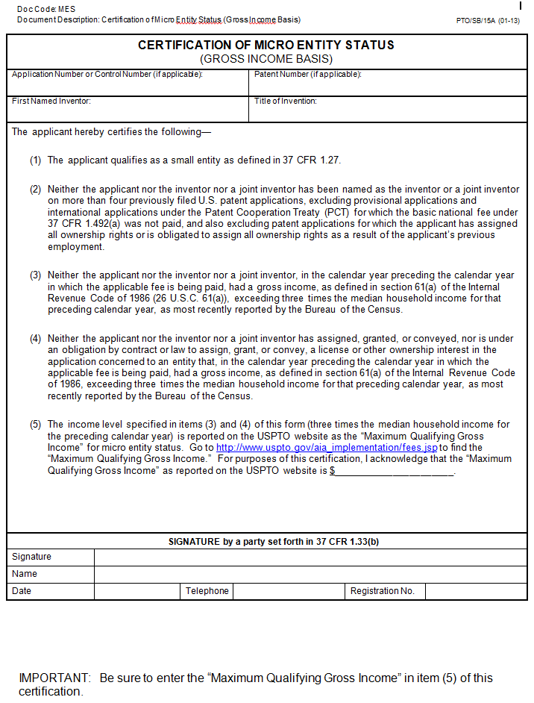
Micro Entity Certification Forms: Gross Income Basis

Slide 54
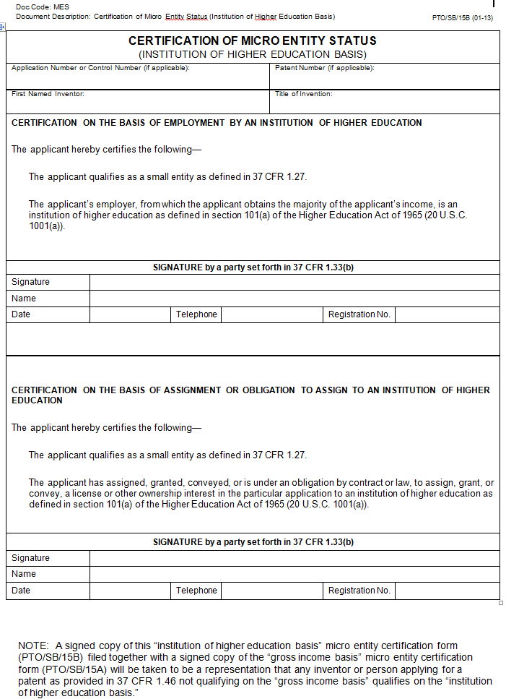
Micro Entity Certification Form: Institution of Higher Education Basis

Slide 55
AIA Help Center
1-855-HELP-AIA (1-855-435-7242)
HELPAIA@uspto.gov

Slide 56
Thank You

