Slide 1
Trademark Trial and Appeal Board (TTAB) update
Gerard Rogers
Chief Administrative Trademark Judge

Slide 2
Moderating filings in FY20
Ex parte appeals (3,487) +4.6%
Extensions to oppose (18,893) -7.8%
Oppositions (6,712) -3.5%
Petitions to cancel (2,501) +3.1%

Slide 3
Continued moderation in FY21
Ex parte appeals (3,531) +1.3%
Extensions to oppose (17,200) -9%
Oppositions (6,669) -.6%
Petitions to cancel (2,400) -4%

Slide 4
FY22 returns (through Q3)
Ex parte appeals (2,393) -9.6%
Extensions to oppose (12,554) -2.7%
Oppositions (4,951) -1%
Petitions to cancel (1,736) -3.6%

Slide 5
Filings by quarter –Q1FY20 through Q3FY22

Slide 6
Pending cases by type – Q1FY20 through Q3FY 22

Slide 7
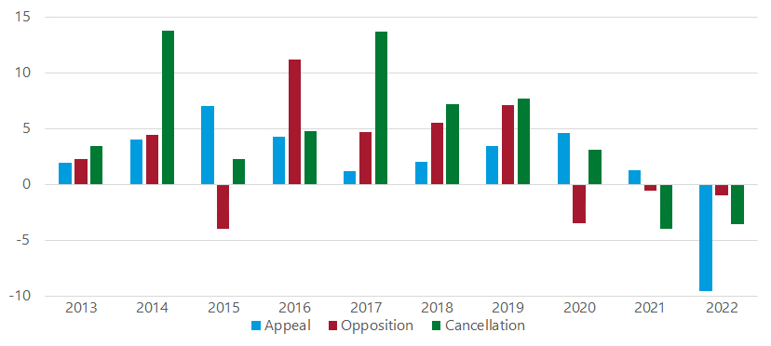
Increase/decrease by % - annual new filings

Slide 8
Pendency goals met in FY21
Motion decision pendency at 9.9 weeks
Appeal decision pendency at 7.7 weeks
Trial decision pendency at 9.8 weeks
186 cases left with pending motions
93 cases left as ready for merits decision

Slide 9
Pendency goals met YTD in FY22
Motion decision pendency at 10.5 weeks
Appeal decision pendency at 8.6 weeks
Trial decision pendency at 10.6 weeks
Trademark filing surge, Trademark Modernization Act (TMA) appeals may cause pendency measures to increase

Slide 10
“End to End” processing in FY22
Average pendency, appeals – 38.7 weeks
Median pendency, appeals – 36 weeks
Average pendency, trials – 136 weeks
Median pendency, trials – 121 weeks
Average pendency, accelerated case resolution (ACR) trials – 93.5 weeks

Slide 11
Oral arguments

Slide 12
TTAB resuming in person hearings
Beginning August 8, 2022
Parties can still choose virtual option
Parties must agree on in person option
Many panels will still have a judge appear virtually

Slide 13
Final pretrial conference pilot

Slide 14
Pretrial conference pilot
TTAB attorneys (IAs) and judges (ATJs) all contributed on goals, processes
Board has begun soliciting customer input
Would focus on cases with indications they are likely to create large and redundant, or unfocused or unwieldy records

Slide 15
Benefits
Goals are to save time and resources of parties and the TTAB, and foster effective presentation of case
Parties would be strongly encouraged to enter into stipulations on exhibits, agreed-upon facts, presentation of evidence; subject to Board approval
Winnow down the case with stipulations, and dispense with extraneous claims/defenses/objections

Slide 16
Recommendations
Focus on cases wherein (A) the number of claims/defenses unwarranted; (B) parties or counsel unfamiliar with TTAB practice; (C) proceedings too contentious, too many motions
Large majorities of TTAB attorneys and judges said all three somewhat or very important signs, with (C) the most important

Slide 17
Recommendations
Parties would submit a proposed Final Pretrial Conference Order (FPCO) (complete with a trial plan and pretrial disclosures); Board will provide template for parties’ use
Parties come to the FPC with possible amendments to their claims and defenses in their draft FPCO
Once the claims and defenses are reflected in the FPCO approved by the Board, that limits what parties will pursue at trial

Slide 18
Recommendations
Known objections to evidence should be raised and discussed in conference, particularly for documentary evidence (to encourage stipulations)
Encourage parties to focus objections on issues they are likely to win and that are outcome determinative
Discourage parties from asserting a whole litany of objections

Slide 19
Recommendations
Proceed with pilot, experiment, adjust over time
An ATJ and IA should oversee each FPC
ATJ who sits on FPC should not be on panel deciding case
The FPC should be held sometime after close of discovery but before pre-trial disclosures are due

Slide 20
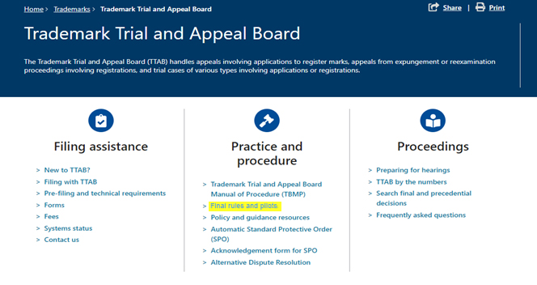
Input needed
Provide feedback via TTABFeedback@uspto.gov

Slide 21
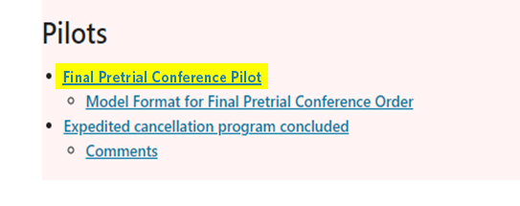
Input needed
Provide feedback via TTABFeedback@uspto.gov

Slide 22
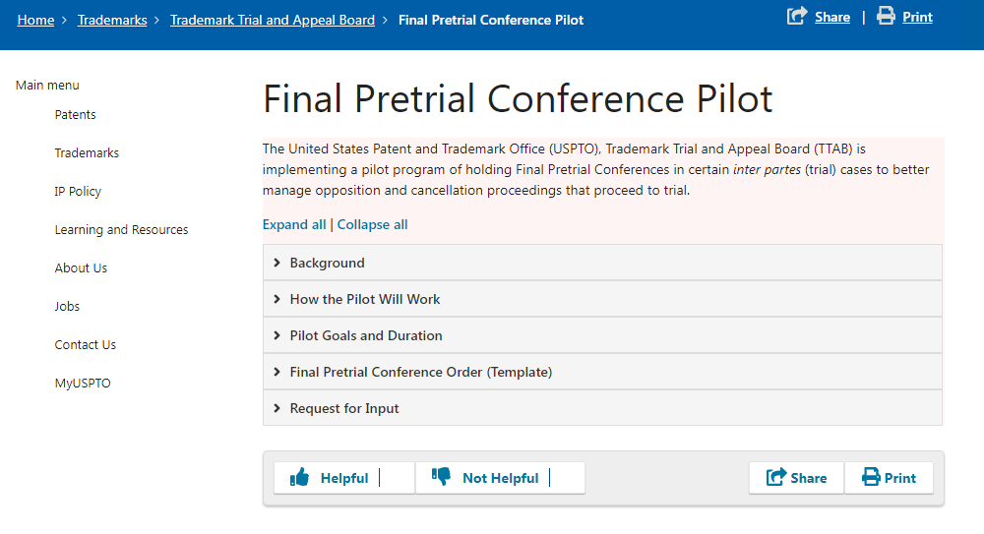
Input needed
Provide feedback via TTABFeedback@uspto.gov

Slide 23
Thank you!
Gerard Rogers
Chief Administrative Trademark Judge
gerard.rogers@uspto.gov
(571) 272-9300

