Slide 1
Trademark examination policy update
Amy Cotton
Deputy Commissioner for Trademark Examination Policy

Slide 2
USPTO.gov trademark customer account identity verification

Slide 3
Register protection
USPTO.gov account access controls
2019
Phase 1
USPTO.gov account required to access all electronic trademark forms
2022
Phase 2
Require identity verification and user roles to access electronic forms
2023
Phase 3
Role-based access controls, i.e., limit submissions on applications or registrations to authorized parties

Slide 4
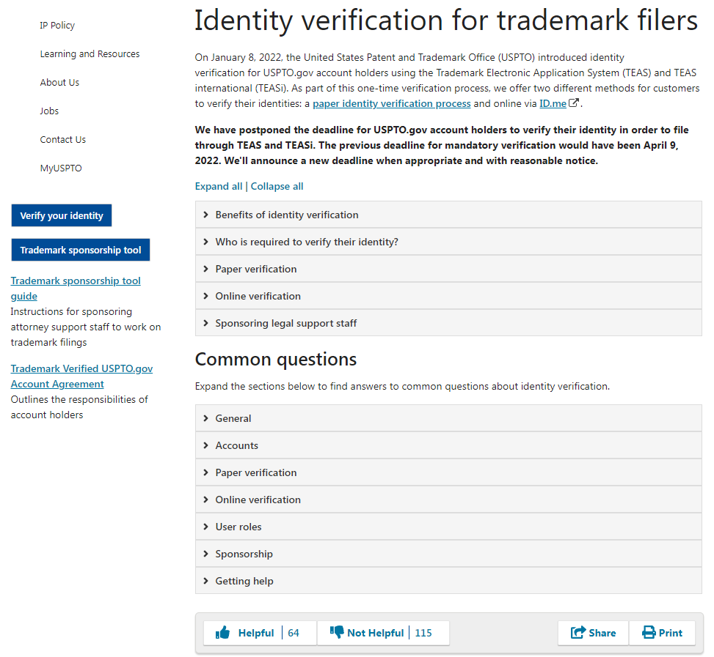
USPTO.gov ID verification
Mandatory date
Mandatory date: August 6, 2022
USPTO.gov accounts must be ID verified in order to continue filing trademark submissions
For information about the program:
https://www.uspto.gov/trademarks/apply/identity-verification
For the terms of use of the trademark customer account:
https://www.uspto.gov/sites/default/files/documents/TM-verified-account-agreement.pdf
Notes:
“

Slide 5
USPTO.gov ID verification
Summary of verification options
Paper process
Attorneys and owners only may mail in a notarized paper form for self identification
Attorney support staff process
Attorneys must verify the identities of their sponsored support staff with the Trademark Sponsorship tool
Online verification process
● Self-service
● Video chat option
● only for attorneys and owners
Patent proofed customers
● Identity-proofed patent practitioners and independent inventors are already verified for trademarks
● May have to choose a trademark user role
Notes:
“

Slide 6
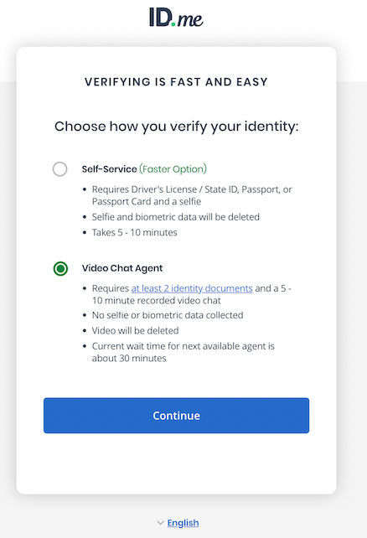
USPTO.gov ID verification
Online verification changes: options compared
Self-service
● Requires drivers license, passport, or passport card
● Uses AI to check selfie match
◦ Data deleted (24 hours)
● Credit profile check required
● Takes 5-10 minutes
● If unsuccessful, directed to next available video chat agent
Direct-to-video chat agent
● Requires at least 2 identity documents from a wider list
● No AI, just live video chat
◦ Chat recorded, deleted after 30 days
● Credit profile check optional
● May be a wait for agent, session takes 5-10 minutes
◦Estimated wait time displayed
Notes:
“

Slide 7
Phase 2
Must select one of four user roles
USPTO.gov account holders choose a role prior to verifying their identity
Attorneys and owners verify their identity with one of the ID verification options
Attorney support staff are verified by their sponsoring attorney
Trademark roles
● Trademark owner
● U.S.-licensed attorney
● Canadian attorney or agent
● Attorney support staff
Notes:
USPTO is limiting trademark verified USPTO.gov accounts to those who are authorized to make submissions in trademark matters.
Only owners and attorneys are authorized to make submissions under USPTO rules.
All of the suspicious filings we investigate feature submissions from unauthorized representatives.
Applications featuring rule violations are vulnerable to invalidation.
They also harm the integrity of the trademark register and damage the profession.

Slide 8
Phase 2
USPTO.gov account doesn’t mean you are authorized to take an action
Application or filing preparer
Who may prepare the filing under 37 CFR §11.5?
Authorized signatory
Who has the authority to sign a submission under 37 CFR §2.193?
Validate, certify, and transmit
Who can “validate” the submission by transmitting and making the necessary certifications under 37 CFR §11.18(b)?
Representation
Who may represent the applicant or registrant under 37 CFR §11.5?

Slide 9
Phase 2
Representation and filing preparation rules regulate the practice of law before the Office in trademark matters
Practice before the Office includes…[any] law-related service that comprehends any matter connected with the presentation to the Office … relating to a client's rights, privileges, duties, or responsibilities … for the… registration of a trademark…
such presentations include:
consulting with or giving advice to a client in contemplation of filing a trademark application or other document with the Office
preparing or prosecuting an application for trademark registration
preparing or prosecuting a document for maintaining, correcting, amending, canceling, surrendering, or otherwise affecting a registration…
preparing an amendment that may require written argument to establish the registrability of the mark
Notes:
37 CFR 11.5(b)

Slide 10
Phase 2
Representation and filing preparation rules exclude non-attorney entities
Non-attorney entities are those that do not have an attorney directly supervising the staff’s interactions with clients or the USPTO.
Non-attorneys may provide only “law-related services” to clients, such as:
acting as a mere scrivener when assisting in the preparation of trademark documents
offering trademark information, not advice
conducting trademark searches but not offering opinions on the registrability of a mark

Slide 11
Phase 2
Representation and filing preparation rules regulate practice; violations are subject to sanctions
If non-attorney entities provide legal advice, prepare trademark applications, or file submissions on behalf of others…
are subject to investigation and possible administrative sanctions
they likely are engaging in unauthorized practice and representation of others before the USPTO
These sanctions may affect the validity of submissions made by that entity

Slide 12
Phase 2
US counsel rule circumvention
Non-attorney filing entities contracting with US counsel
Yiheng Lou
NY-licensed attorney contracted with Dingji IP Co. (5/12/2021)
Devasena Reddy
CA-licensed attorney contracted with Indian entities, KA Partners, KAnalysis, KA Filing (9/9/2021)
Bennett David
Patent attorney/MA-licensed attorney contracted with Chinese IP firm (9/24/2021)
Di Li
CA-licensed attorney contracted with Chinese entity, Sellergrowth (10/7/2021)
Tony Hom
NY-licensed attorney contracted with several different Chinese firms (12/17/2021)
Elizabeth Yang
CA-licensed attorney contracted with Chinese entity, Sellergrowth (12/17/2021)
Yi Wan
NY-licensed attorney contracted with several Chinese entities, including Shenmahui IP and Huanyee IP (4/14/2022)
Jonathan Morton
NY licensed patent attorney contracted with Chinese firms (4/20/22)
Kathy Hao
CA licensed attorney contracted with Chinese entities, Sellergrowth, Shenmate, and Xingyue (4/27/2022)
Weibo Zhang
NY licensed attorney contracted with Chinese entities, Sellergrowth, Xinyi International IP, etc. (7/11/22)

Slide 13
Phase 2
Authorized signatories
Persons with legal authority to bind
When a document must be signed by a person with "legal authority to bind a juristic entity," the signatory must be someone who has the authority to bind that entity to any obligation and/or agreement whatsoever, and not solely with regard to trademark matters.
Submissions must be personally signed
TMEP § 611.01(c) (“Signature of Documents Filed Electronically”)
Signatures are non-delegable
Authorizing someone who is not the signatory to sign a trademark submission jeopardizes the validity of the submission and may affect the validity of the entire application or registration
Authorized signatories don’t need an account in order to sign a submission
Verifications of fact
● a person with legal authority to bind the applicant
● a qualified attorney representing the applicant or
● a person with firsthand knowledge of the facts and actual or implied authority to act on behalf of the applicant
Responses, amendments, requests, and petitions
● Must be signed by attorney, if one is appointed
● Otherwise, must be signed by individual applicant(s) or by someone with legal authority to bind the applicant/registrant (if a juristic entity)
● For joint applicants/registrants, all must sign
Notes:
Two types of signatures may be required when filing documents with the USPTO: (1) a verification signature and/or (2) a submission signature. Tmep 611.02

Slide 14
Phase 2
Validation, certification, and transmittal rules
TEAS and TEASi forms require validation before submitting:
“By clicking the validate button, you acknowledge that certifications are being made to the USPTO as set forth in 37 C.F.R § 11.18(b)”
37 CFR § 11.18(c): violations of (b) subject to sanctions
37 CFR § 11.18(b) certifications
● All statements are true
● Knowing and willful false statements are subject to 18 USC § 1001 and may jeopardize submission
● Paper not presented for improper purpose
● Allegations have evidentiary support

Slide 15
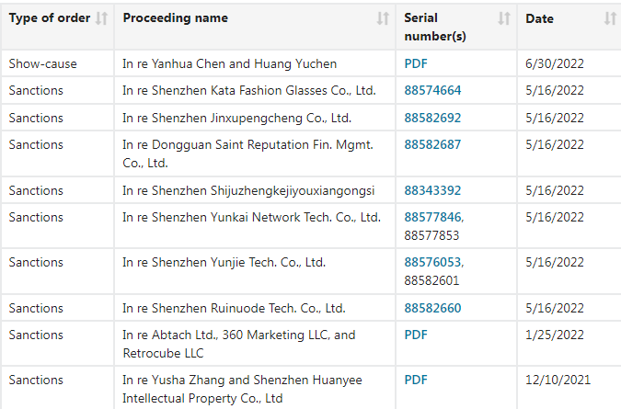
Phase 2
Sanction orders for violations of USPTO rules
Possible sanctions:
Terminating applications
Blocking USPTO.gov account
Precluding from appearing before the USPTO
Notes:
The graphic is a screen shot of the sanctions orders.

Slide 16
Phase 2
User roles defined
Owner
A person who is an individual and the owner of the mark
A person who can legally bind the owner to any obligation and/or agreement whatsoever, e.g., a corporate officer
A person who is directly employed by a juristic entity owner
US-licensed attorney
An active member in good standing of the bar of the highest court of any U.S. state, Commonwealth or territory, or the District of Columbia
Canadian attorney or agent
A practitioner reciprocally recognized by the USPTO’s Office of Enrollment and Discipline (OED) to represent persons located in Canada before the USPTO in trademark matters
Attorney support staff
U.S.-licensed attorneys and Canadian attorneys/agents may sponsor individuals with USPTO.gov accounts in a support staff role

Slide 17
Phase 2
Use of non-attorney assistants
Owner
● For a non-individual owner, the “owner” is someone who can bind the owner in all types of matters (e.g., corporate officer, partner, etc.).
● A corporate officer/partner can act as the owner and prepare the forms, but that person is not “representing” the owner before the USPTO and is not practicing law.
● Because the officer cannot legally “represent” the owner under USPTO rules, the officer cannot have non-attorney assistants provide legal advice and otherwise prepare the applications.
Attorneys
Attorneys/practitioners representing the applicant are allowed to have support staff to assist with the practice of law before the Office as long as they are directly supervised by the practitioner. 37 CFR § 11.5(b)

Slide 18
Petitions office
Filing trends

Slide 19
Petition to Director & Letter of Protest filing trends

Slide 20
Letters of Protest

Slide 21
Benefits of Letters of Protest (LOPs)
Helps customers
Third parties can bring evidence to the USPTO’s attention that is relevant to examination without having to file an opposition at the TTAB
Helps examining attorneys
Third parties can provide evidence that increases the quality of examination

Slide 22
LOP filings over time
Notes:
2019
Increases in new application filings directly correlate to increases in LOPs
Application filings increased in 2019
2020
Trademark Modernization Act increased visibility of LOPs
2021
Fee increase for oppositions made LOPs more attractive

Slide 23
LOP Terminology
Pre-publication
Standard for consideration: LOP evidence is relevant to a ground of refusal
Post-publication
Standard for consideration: LOP evidence establishes a prima facie case for refusal
LOPs are “considered” instead of “accepted” or “granted”
LOPs are “not considered” instead of “denied” or “dismissed”

Slide 24
Pre-publication Petitions office actions taken on LOPs

Slide 25
Post-publication Petitions office actions taken on LOPs
Considered
Not Considered

Slide 26
Pre-publication Law office actions taken on considered LOPs
Refusal Issued
Awaiting Assignment to Examining Attorney

Slide 27
Post-publication Law office actions taken on considered LOPs
Notes:
*For post publication LOPs, the examining attorney is required to issue the refusal. For the few on here in orange noted as “declined”, the EA issued an Examiner’s Amendment that overcame the refusal instead of a formal refusal in an Office action.

Slide 28
Petitions to the Director

Slide 29
Petition filings over time
U.S. Counsel Rule, Duplicate Reg Certs

Slide 30
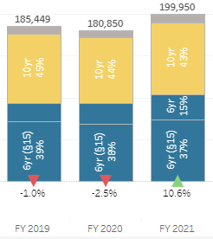
Driver for increased petition filings: 2021 Filing surge
2021
Increases in new application filings are directly correlated with examination-related petition filings
10% increase in post-registration filings in 2021 corresponds to increase in petitions
30% of Petitions workload is post-registration matters

Slide 31
Post registration petitions
Post Reg Audit Program
Notes:
Rule/practice changes since 2019 that created more petition categories:
Duplicate registration certificates (2019)
Will be reduced with eReg certs starting May 2022
Domicile Address Waiver Petitions (2019)
TEAS Outages & Petitions to accept Paper (2020)
COVID-19 related petitions (2020)
CARES Act expired on March 27, 2022
Prioritized Examination Program will phase out when Patents program ends
Administrative sanctions program (2022)
Will increase
Expungement/Reexamination petitions seeking reinstatement
Will be filed once proceedings start terminating for no response to Office action

Slide 32
Main petition types FY 2020 - FY 2022

Slide 33
Thank you!
Amy Cotton
Deputy Commissioner for Trademark Examination Policy
Amy.Cotton@USPTO.GOV
(571) 272-8901

